Slide 1
Signed Partial Products in Tree Multiplier
Lecture 06 (Part D)
Chap. 11

Slide 2
Recap: basic concepts of multiplication

Slide 3
Basic multiply scheme
1 0 1 1
*)
0 1 0 1
1 0 1 1
0 0 0 0
1 0 1 1
+)
0 0 0 0

Slide 4
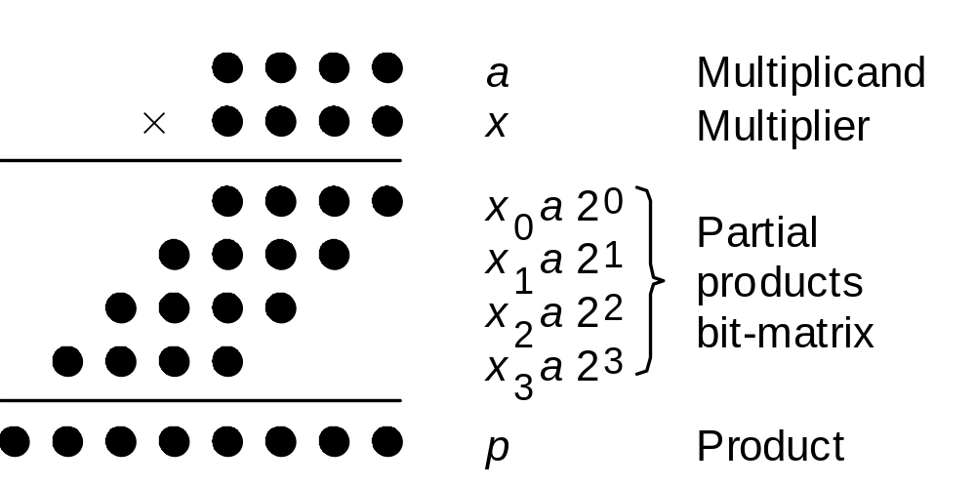
The dot-diagram
Notation for our discussion of multiplication algorithms:
a Multiplicand a_{k–1}a_{k–2} . . . a₁a₀
x Multiplier x_{k–1}x_{k–2} . . . x₁x₀
p Product (a × x) p_{2k–1}p_{2k–2} . . . p₃p₂p₁p₀
Initially, we assume unsigned operands
Fig. 9.1 Multiplication of two 4-bit unsigned binary numbers in dot notation.

Slide 5
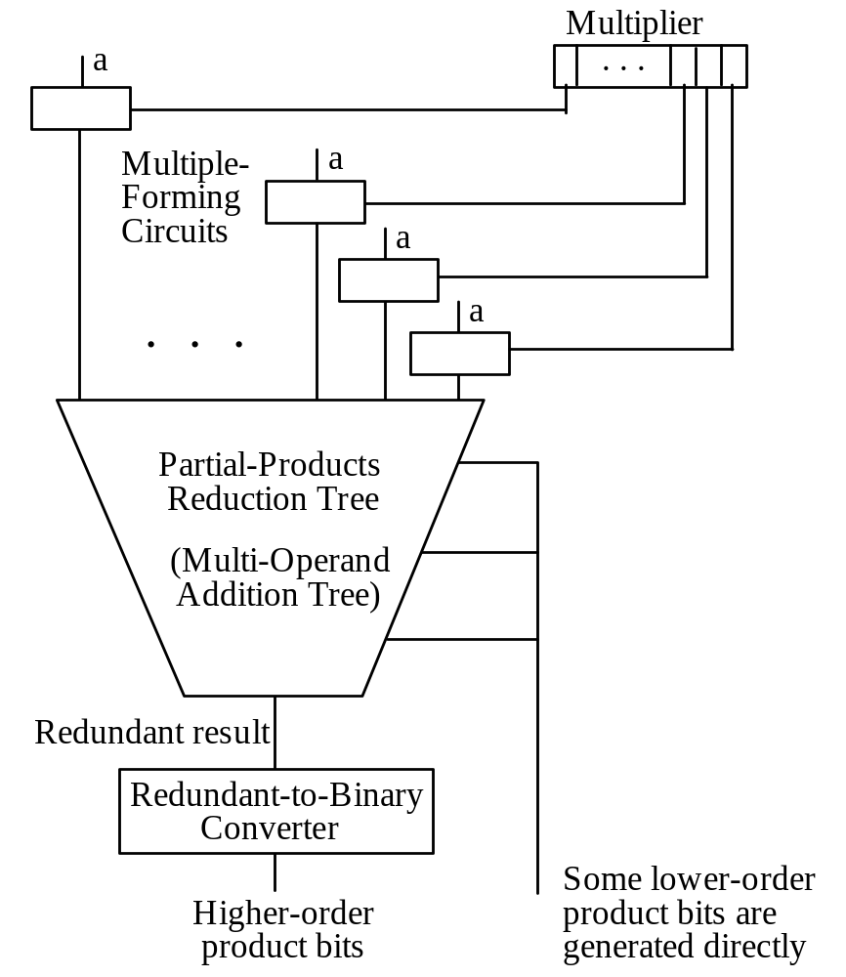
General structure of the multiplier
1 0 1 1
*)
0 1 0 1
1 0 1 1
0 0 0 0
1 0 1 1
+)
0 0 0 0
Fig. 11.1 General structure of a full-tree multiplier.

Slide 6
General structure of the multiplier
Partial product generation
1 0 1 1
*)
0 1 0 1
1 0 1 1
0 0 0 0
1 0 1 1
+)
0 0 0 0
Fig. 11.1 General structure of a full-tree multiplier.

Slide 7
General structure of the multiplier
1 0 1 1
*)
0 1 0 1
1 0 1 1
0 0 0 0
1 0 1 1
+)
0 0 0 0
fast summation of partial products
Fig. 11.1 General structure of a full-tree multiplier.

Slide 8
Issues to realize the general structure
partial product generation
  reduce height of partial products
  reduce width of a partial products
fast summation: CSA trees
CSA
CSA
CSA
*)
height
CSA
+)
width

Slide 9
Now we start
the Baugh-Wooley encoding

Slide 10
Core Problem
Consider: designing a tree multiplier for signed numbers
Q: to generate short partial products?

Slide 11
Core Problem
Consider: designing a tree multiplier for signed numbers
Q: to generate short partial products?
The straight scheme: sign extension
*)
+)

Slide 12
Core Problem
Consider: designing a tree multiplier for signed numbers
Q: to generate short partial products?
The straight scheme: sign extension
Sign extension
*)
+)

Slide 13
Core Problem
Consider: designing a tree multiplier for signed numbers
Q: to generate short partial products?
Goal: we don’t want the sign extensions!
Sign extension
*)
+)

Slide 14
Modified Baugh-Wooley encoding
preview on the final answer

Slide 15
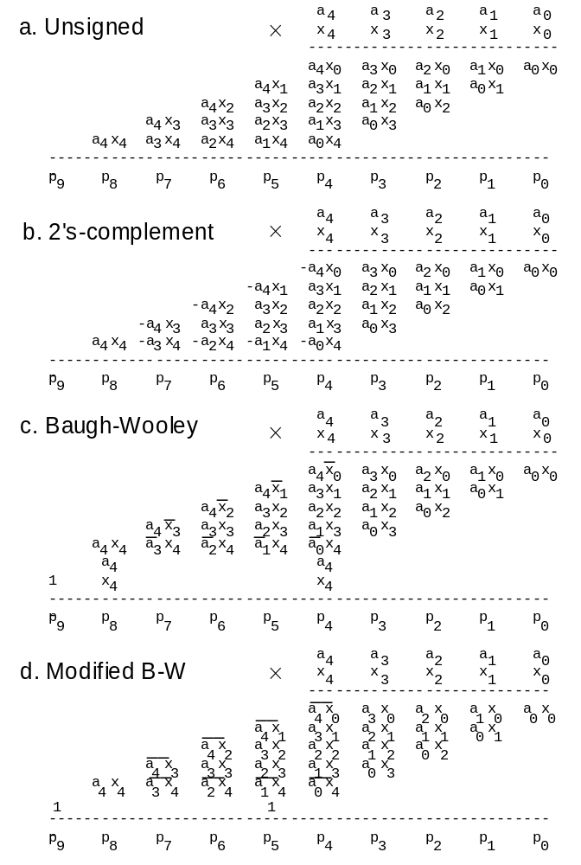
Modified Baugh-Wooley encoding
The final result
Figure 11.8

Slide 16
Modified Baugh-Wooley encoding
complement

Slide 17
Modified Baugh-Wooley encoding
complement

Slide 18
Modified Baugh-Wooley encoding
compensation

Slide 19
In-Class Exercise: Verify the encoding
Consider: 4x4 -> 8 signed multiplier
verify with these cases:
  5*6
  (-5)*6
  5*(-6)
  (-5)*(-6)

Slide 20
Derivation of the Baugh-Wooley encoding

Slide 21
Key Idea of the derivation
representing partial products in radix-2 number system with range [-1,1]

Slide 22
Radix-2 number system with range [-1,1]

Slide 23
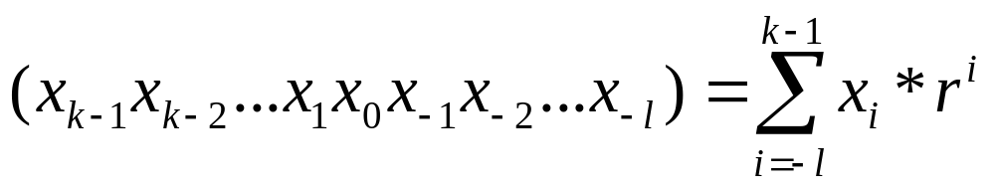
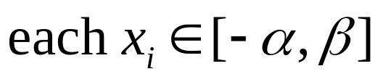
Recap:
General formula: radix-r number system
the number represented by a vector:

Slide 24
Radix-2 with range [-1,1]
Example:
  (-1, 1, 0, 1, 1, 0) representing

Slide 25
Addition with the vector representation
just the vector addition
-5
(-1, 0, 1, 1)
+)
3
+)
(0, 0, 1, 1)
(-1, 0, 2, 2)
(-1, 0, 3, 0)
(-1, 1, 1, 0)

Slide 26
Addition with the vector representation
just the vector addition
-5
(-1, 0, 1, 1)
+)
7
+)
(0, 1, 1, 1)
(-1, 1, 2, 2)
(-1, 1, 3, 0)
(-1, 2, 1, 0)
(0, 0, 1, 0)

Slide 27
Derivation of the Baugh-Wooley encoding
now we can derive it with the number system

Slide 28
Partial products representation
-a₃
a₂
a₁
a₀
*)
-x₃
x₂
x₁
x₀
-a₃x₀
a₂x₀
a₁x₀
a₀x₀
-a₃x₁
a₂x₁
a₁x₁
a₀x₁
-a₃x₂
a₂x₂
a₁x₂
a₀x₂
+)
a₃x₃
-a₂x₃
-a₁x₃
-a₀x₃

Slide 29
Rewriting a partial product
-a₃x₀
a₂x₀
a₁x₀
a₀x₀
a₃x₀
a₂x₀
a₁x₀
a₀x₀
+)
-1
1
Note:

Slide 30
Rewriting the final partial product
a₃x₃
-a₂x₃
-a₁x₃
-a₀x₃
a₃x₃
a₂x₃
a₁x₃
a₀x₃
-1
1
-1
1
+)
-1
1
a₃x₃
a₂x₃
a₁x₃
a₀x₃
-1
1

Slide 31
The final result
by putting all partial products together and cancel (-1) and 1 on the same column
-a₃
a₂
a₁
a₀
*)
-x₃
x₂
x₁
x₀
a₃x₀
a₂x₀
a₁x₀
a₀x₀
a₃x₁
a₂x₁
a₁x₁
a₀x₁
a₃x₂
a₂x₂
a₁x₂
a₀x₂
a₃x₃
a₂x₃
a₁x₃
a₀x₃
+)
-1
1

Slide 32
In-Class Exercise
Verify the vector model result with the result in previous page
  5*6
  (-5)*6
  5*(-6)
  (-5)*(-6)

Slide 33
The final question on implementation
How to deal with the leading (-1)?
-a₃
a₂
a₁
a₀
*)
-x₃
x₂
x₁
x₀
a₃x₀
a₂x₀
a₁x₀
a₀x₀
a₃x₁
a₂x₁
a₁x₁
a₀x₁
a₃x₂
a₂x₂
a₁x₂
a₀x₂
a₃x₃
a₂x₃
a₁x₃
a₀x₃
+)
-1
1

