Slide 1
Booth Encoding Revisited
Lecture 06 (Part E)
short encoding of signed partial products

Slide 2
Basic idea of Booth encoding

Slide 3
Question
generate only two partial products for this multiplication
MD
*)
0
0
1
1
1
1
0
0
MR

Slide 4
In Class-Exercise (The Answer)
generate only two partial products for this multiplication
MD
*)
0
0
1
1
1
1
0
0
MR
-MD
+)
+MD

Slide 5
In Class-Exercise (The Answer)
Q: the mathematical foundation?
MD
*)
0
0
1
1
1
1
0
0
MR
-MD
+)
+MD

Slide 6
Key idea of Booth encoding
generate two partial products for each consecutive sequence of 1’s in MR
MD
*)
0
0
0
1
1
1
0
0
0
0
1
1
1
1
0
0
MR
-MD
+MD
-MD
+)
+MD

Slide 7
Key idea of Booth encoding
generate two partial products for each consecutive sequence of 1’s in MR
MD
*)
0
0
0
1
1
1
0
0
0
0
1
1
1
1
0
0
MR
-MD
+MD
+)
-MD
+MD

Slide 8
Booth-2 encoding table
the correct scheme

Slide 9
Examining MR to generate partial product
generate a partial product per 2-bit of MR
but examine 3 consecutive bits in MR
*)
+)

Slide 10
Examining MR to generate partial product
generate a partial product per 2-bit of MR
but examine 3 consecutive bits in MR
*)
0
+)

Slide 11
Examining MR to generate partial product
generate a partial product per 2-bit of MR
but examine 3 consecutive bits in MR
*)
+)

Slide 12
Examining MR to generate partial product
generate a partial product per 2-bit of MR
but examine 3 consecutive bits in MR
*)
+)

Slide 13
Examining MR to generate partial product
generate a partial product per 2-bit of MR
but examine 3 consecutive bits in MR
*)
+)

Slide 14
Examining MR to generate partial product
Note: additional partial product required
*)
00
+)

Slide 15
The Booth-2 encoding table
MR[i+1:i-1]
Partial Product
0
0
0
0
0
0
1
MD
0
1
0
MD
0
1
1
2*MD
1
0
0
-2*MD
1
0
1
-MD
1
1
0
-MD
1
1
1
0

Slide 16
Deriving the encoding table
MR[i+1:i-1]
Partial Product
ending a series of consecutive ones
0
0
0
0
*)
0
1
1
0
0
1
MD
0
1
0
MD
0
1
1
2*MD
+2MD
1
0
0
-2*MD
+)
1
0
1
-MD
1
1
0
-MD
1
1
1
0

Slide 17
Deriving the encoding table
MR[i+1:i-1]
Partial Product
beginning a series of consecutive ones
0
0
0
0
*)
1
1
0
0
0
1
MD
0
1
0
MD
0
1
1
2*MD
-MD
1
0
0
-2*MD
+)
1
0
1
-MD
1
1
0
-MD
1
1
1
0

Slide 18
Now we begin

Slide 19
Question
How to do Booth encoding without sign extension for negative partial products?
MR[i+1:i-1]
Partial Product
0
0
0
0
*)
0
0
1
MD
Sign extension
0
1
0
MD
0
1
1
2*MD
1
0
0
-2*MD
+)
1
0
1
-MD
1
1
0
-MD
1
1
1
0

Slide 20
The encoding scheme
Flynn & Oberman, Advanced Computer Arithmetic Design
  Chap. 3

Slide 21
Encoding Rules
for unsigned 16-bit inputs

Slide 22
Overview and the notation
MD
*)
MR
PP0
PP1
PP2
…
2 bits
PP8
+)
PP9

Slide 23
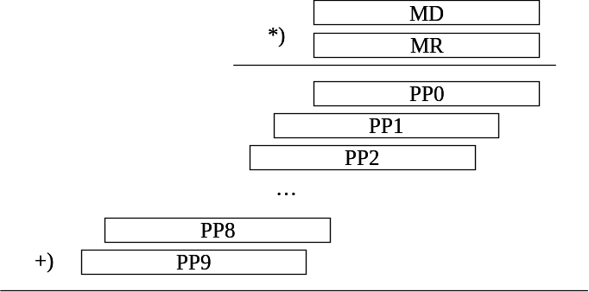



Encode the first partial product
17 bits
S
S
P
S
MR[i+1:i-1]
Partial Product
P
S
0
0
0
0
000…0
0
0
0
1
MD
MD
0
1
0
MD
MD
0
1
1
2*MD
MD<<1
1
0
0
-2*MD
1
1
0
1
-MD
1
1
0
-MD
1
1
1
0
111…1

Slide 24
Encode a partial product in the middle
17 bits
1
P
S
MR[i+1:i-1]
Partial Product
P
S
0
0
0
0
000…0
0
0
0
1
MD
MD
0
1
0
MD
MD
0
1
1
2*MD
MD<<1
1
0
0
-2*MD
1
1
0
1
-MD
1
1
0
-MD
1
1
1
0
111…1

Slide 25
Encode partial product PP8
17 bits
P
S
MR[i+1:i-1]
Partial Product
P
S
0
0
0
0
000…0
0
0
0
1
MD
MD
0
1
0
MD
MD
0
1
1
2*MD
MD<<1
1
0
0
-2*MD
1
1
0
1
-MD
1
1
0
-MD
1
1
1
0
111…1

Slide 26
Encode the last partial product
16 bits
P
MR[i+1:i-1]
Partial Product
P
S
0
0
0
0
000…0
0
0
0
1
MD
MD
0
1
0
MD
MD
0
1
1
2*MD
MD<<1
1
0
0
-2*MD
1
1
0
1
-MD
1
1
0
-MD
1
1
1
0
111…1

Slide 27
In-Class Exercise
check the encoding rule with the example:
  63669*40119

Slide 28
Deriving the encoding rule

Slide 29
Q: How this case derived?
17 bits
1
P
S
MR[i+1:i-1]
Partial Product
P
S
0
0
0
0
000…0
0
0
0
1
MD
MD
0
1
0
MD
MD
0
1
1
2*MD
MD<<1
1
0
0
-2*MD
1
1
0
1
-MD
1
1
0
-MD
1
1
1
0
111…1

Slide 30
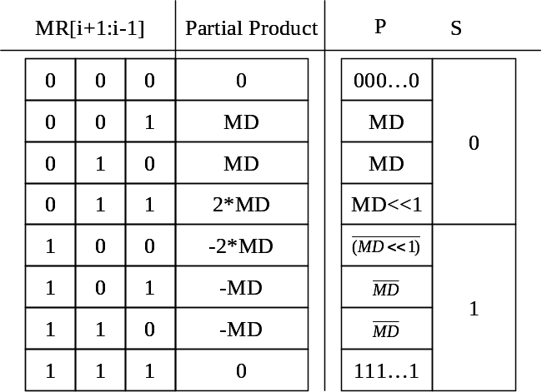
Two’s complement encoding of a partial product
but in vector form
17 bits
-MD
-S
P
S

Slide 31

Two’s complement encoding of a partial product
but in vector form
17 bits
-MD
-S
P
S
17 bits
P
-1
1
1
S

Slide 32
Two’s complement encoding of a partial product
put consecutive partial products together
P
-1
1
1
S
P
1
P
-1
1
1
S
S
P
-1
1
1
S

Slide 33
In-Class Exercise
derive the encoding rules for
  the 1st partial product
  the last two partial products

Slide 34
Coming Up
the dividor design
Recall: recurrence relation you learned in discrete math

