Slide 1
Advanced Multiplier Design
Lecture 06 (Part F)
Chap. 11

Slide 2
Today’s Content
High-radix Booth multiplier
Array multiplier design
your Lab for multiplier design

Slide 3
High-radix Booth multiplier
Part 1

Slide 4
Core Problem
How to reduce the amount of partial products even more
  n/3 partial products,
  n/4 partial products

Slide 5
Examining MR to generate partial product
generate a partial product per 3-bit of MR
but examine 4 consecutive bits in MR
*)
+)

Slide 6
Examining MR to generate partial product
generate a partial product per 3-bit of MR
but examine 4 consecutive bits in MR
*)
0
+)

Slide 7
Examining MR to generate partial product
generate a partial product per 3-bit of MR
but examine 4 consecutive bits in MR
*)
+)

Slide 8
Examining MR to generate partial product
generate a partial product per 3-bit of MR
but examine 4 consecutive bits in MR
*)
00
+)

Slide 9
In-Class Exercise
Derive the Booth-3 encoding table

Slide 10
Q: How to generate the partial product 3*MD
Method 1: additional stage to pre-compute
Method 2: use two partial products instead
  (2/3)*n partial products
0
MD
0
2MD

Slide 11
Q: How to generate partial product 3*MD?
Method 3: partial redundant form
0
MD
+)
0
2MD
4
4
4
4
4
4
4
4
4-bit
adder
4-bit
adder
4-bit
adder
4-bit
adder
4
4
4
4
Carry
Sum
Carry
Sum
Carry
Sum
Carry
Sum
partial
product

Slide 12
Study by yourself
Derive Booth-4/Booth-5, etc. multiplier
What’s the optimum radix for Booth multiplier?

Slide 13
Array Multiplier
Part 2

Slide 14
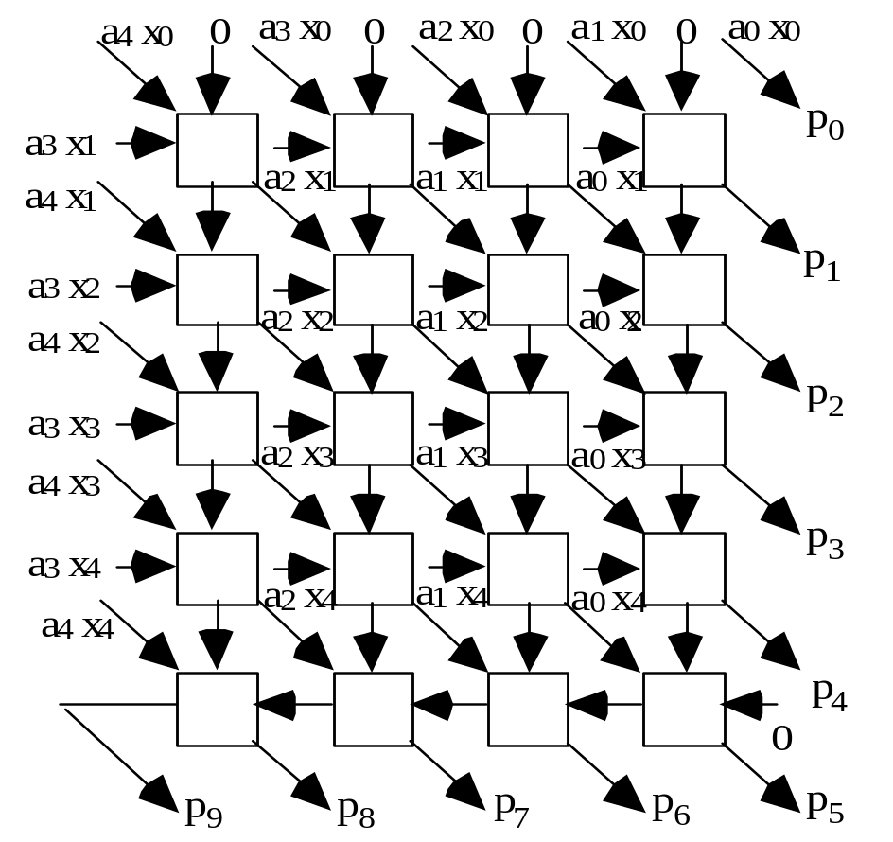
Objective
Design: a regular FA array
  easy to layout on 2-D space
Fig. 11.11 Details of a 5 × 5 array multiplier using FA blocks.

Slide 15
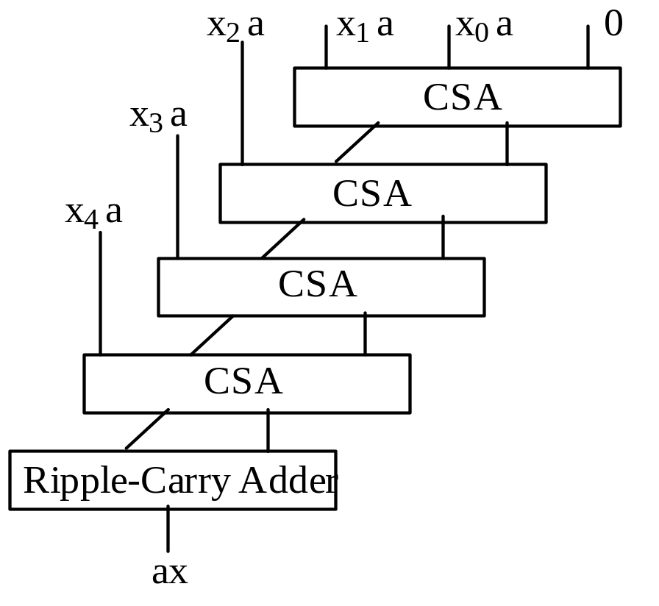
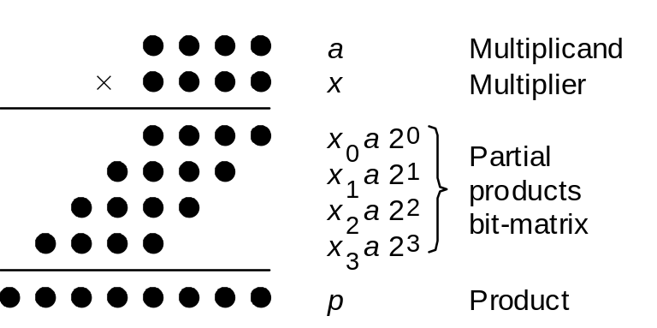
How to derive the design
Fig. 11.10 A basic array multiplier uses a one-sided CSA tree and a ripple-carry adder.

Slide 16
Put it all together

Slide 17
Put it all together
a block is a full-adder
sum
carry

Slide 18
Put it all together

Slide 19
Put it all together

Slide 20
Put it all together

Slide 21
Put it all together

Slide 22
Put it all together

Slide 23
Finishing the part of multiplier

