Slide 1
Overview on Adder Design
Lecture 04 (Part A)
things you learned and not learned on digital circuit course

Slide 2
Basic adder design
the adder you learned in digital circuit course

Slide 3
How a computer performs binary addition
0 1 1 0
A
for each bit i=0 to N-1 do {
{C[i+1], S[i]} = A[i]+B[i]+C[i]
}
+)
0 0 1 1
B
S

Slide 4
How a computer performs binary addition
Step 1: addition for bit 0
0 1 1 0
A
for each bit i=0 to N-1 do {
{C[i+1], S[i]} = A[i]+B[i]+C[i]
}
+)
0 0 1 1
B
S

Slide 5
How a computer performs binary addition
Step 1: addition for bit 0
Carry C[1]
0
0 1 1 0
A
for each bit i=0 to N-1 do {
{C[i+1], S[i]} = A[i]+B[i]+C[i]
}
+)
0 0 1 1
B
1
S
Sum S[0]

Slide 6
How a computer performs binary addition
Step 2: addition for bit 1 with carry
0
0 1 1 0
A
for each bit i=0 to N-1 do {
{C[i+1], S[i]} = A[i]+B[i]+C[i]
}
+)
0 0 1 1
B
1
S

Slide 7
How a computer performs binary addition
Step 2: addition for bit 1 with carry
1
0
0 1 1 0
A
for each bit i=0 to N-1 do {
{C[i+1], S[i]} = A[i]+B[i]+C[i]
}
+)
0 0 1 1
B
0
1
S

Slide 8
How a computer performs binary addition
Step 2: addition for bit 1 with carry
Carry C[2]
1
0
0
0 1 1 0
A
for each bit i=0 to N-1 do {
{C[i+1], S[i]} = A[i]+B[i]+C[i]
}
+)
0 0 1 1
B
0
1
S
Sum S[1]

Slide 9
How a computer performs binary addition
repeat the procedure and we get the result
0 1 1 0
A
for each bit i=0 to N-1 do {
{C[i+1], S[i]} = A[i]+B[i]+C[i]
}
+)
0 0 1 1
B
1 0 0 1
S
So, what’s the basic cell for the addition?

Slide 10
Full Adder: the basic component for an adder
a combinational circuit doing the following truth table
to perform addition for a bit i
Y
X
X
Y
Cin
Cout
S
1
0
0
0
0
0
0
0 1 1 0
A
Cin
0
0
1
0
1
+)
0 0 1 1
B
FA
0
1
0
0
1
0
1
1
1
0
0
1
S
1
0
0
0
1
1
0
1
1
0
S
1
1
0
1
0
Cout
1
1
1
1
1

Slide 11
Ripple-Carry Adder
B
A
n
n
always @(*)
{Cout, S} = A+B+Cin;
Cout
Adder
Cin
n
S
B[n-1]
A[n-1]
B[n-2]
A[n-2]
B[2]
A[2]
B[1]
A[1]
B[0]
A[0]
0 1 1 0
A
+)
0 0 1 1
B
Cin
FA
FA
FA
FA
FA
1 0 0 1
S
…
Cout
S[n-1]
S[n-2]
S[2]
S[1]
S[0]

Slide 12
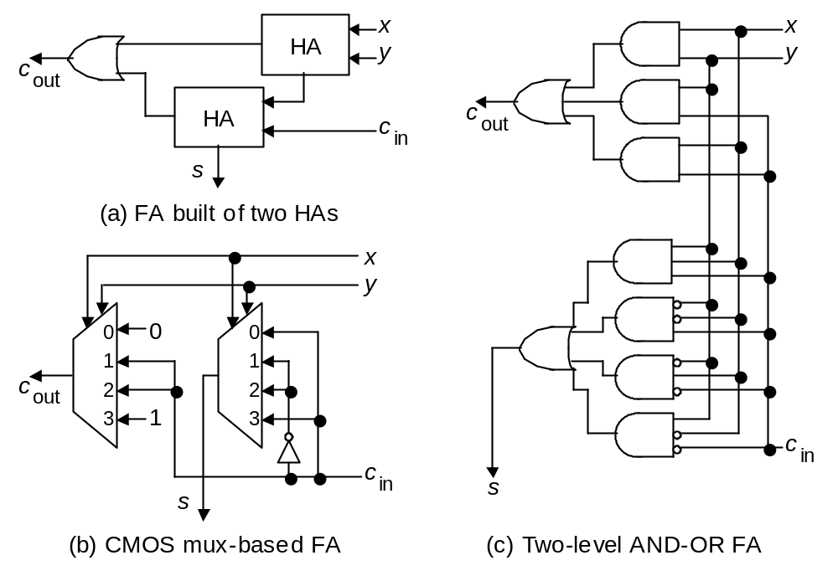
Full-adder implementation
Fig. 5.2 (alternate version) Possible designs for a full-adder in terms of half-adders, logic gates, and CMOS transmission gates.

Slide 13
How to generate flags for signed number addition
things you learned in digital circuit course by may be unfamiliar

Slide 14
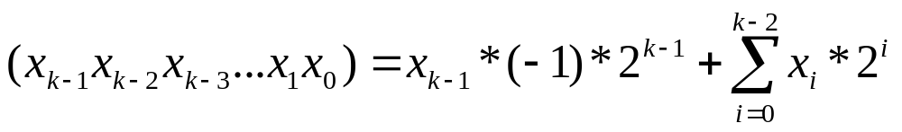
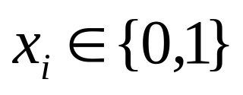
Representing a signed number
the 2’s complement representation
Examples:
  (0101)=5
  (1011)=-5
    ~(0101)+1

Slide 15


Flags for signed number addition
carry-out
overflow OF:
negative N:
zero Z:

Slide 16
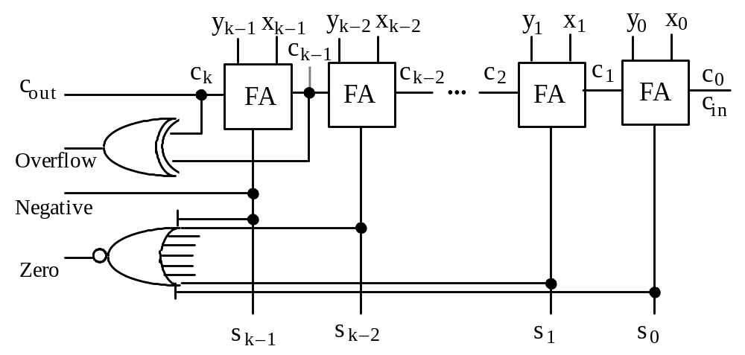
Signed adder with flag generation
Fig. 5.7 Two’s-complement adder with provisions for detecting conditions and exceptions.

Slide 17
Signed adder with flag generation
Carry-out
Fig. 5.7 Two’s-complement adder with provisions for detecting conditions and exceptions.

Slide 18
Signed adder with flag generation
Check the most significant bit for the sign of the result

Slide 19
Signed adder with flag generation
The result is 0 if every bit is 0

Slide 20
Signed adder with flag generation
I believe you have difficulty to derive this!

Slide 21
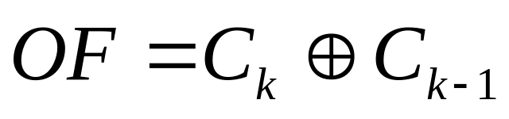
In-Class Exercise
Derive the rule:
Hint: start from the vector representation of a signed number
  The case that the highest element is outside the range {-1,0}

Slide 22
So that’s what you learned before about the adder
is it really so simple?

Slide 23
Core Problems
design an extremely small adder
  use as few chip area as possible
design an extremely fast adder
  path-delay as short as possible
design an extremely low-power adder
  will not mentioned in this course

Slide 24
How to do these optimized designs
check what you can do through the VLSI implementation stack
ESL design
(Electronic System Level)
RTL design
(Register Transfer Level)
gate-level design
circuit-level design
(transistor-level)
physical layout

Slide 25
How to build a small adder
an overview

Slide 26
How to do a small adder
a bit-serial adder
  Figure 5.3(a) at page 78
ESL design
(Electronic System Level)
RTL design
(Register Transfer Level)
gate-level design
circuit-level design
(transistor-level)
physical layout

Slide 27
How to do a small adder
direct design of a full adder
  not composed from half-adder
ESL design
(Electronic System Level)
RTL design
(Register Transfer Level)
gate-level design
circuit-level design
(transistor-level)
physical layout

Slide 28
How to do a small adder
take a full-adder as a cell
and optimize
ESL design
(Electronic System Level)
RTL design
(Register Transfer Level)
gate-level design
circuit-level design
(transistor-level)
physical layout

Slide 29
Full-adder as a cell
implement this as a cell

Slide 30
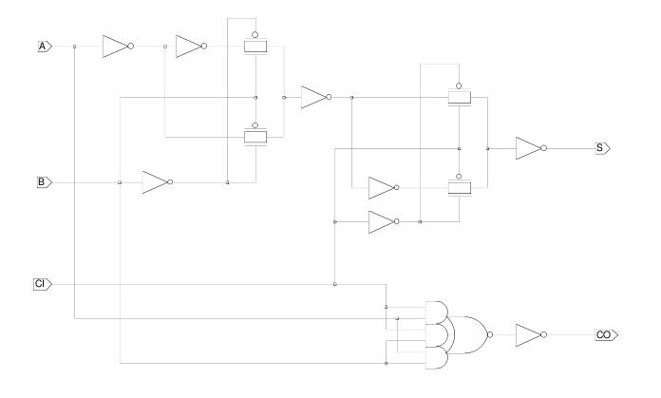
Let’s see the FA-cell provided by UMC

Slide 31
Check the reference
Uyemura, Introduction to VLSI Circuits and Systems
  Chap. 2: logic design with MOSFET
    Sec. 2.5: Transmission gate circuits

Slide 32
How to design a fast adder

Slide 33
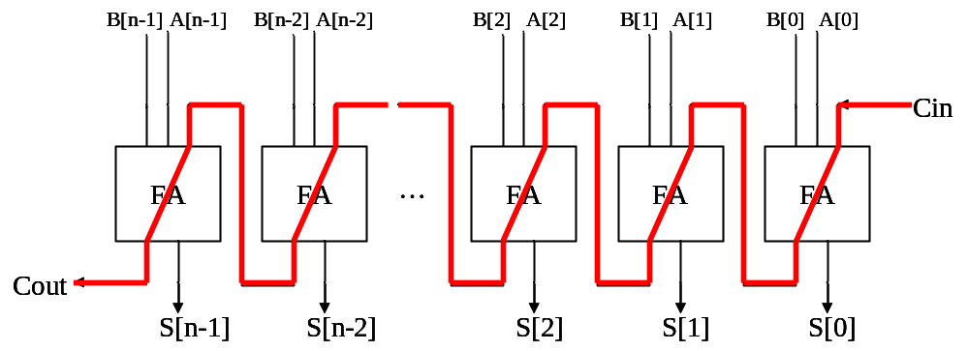
How to design a fast adder
various architectures to reduce the carry-chain
ESL design
(Electronic System Level)
RTL design
(Register Transfer Level)
gate-level design
circuit-level design
(transistor-level)
physical layout

Slide 34
How to design a fast adder
various architectures to reduce the carry-chain
  Carry-lookahead adders
    hierarchical
    prefix computation
  Alternative adders
    carry-skip adders
    carry-select adders
ESL design
(Electronic System Level)
RTL design
(Register Transfer Level)
gate-level design
circuit-level design
(transistor-level)
physical layout

Slide 35
How to design a fast adder
asynchronous circuit design
ESL design
(Electronic System Level)
RTL design
(Register Transfer Level)
gate-level design
circuit-level design
(transistor-level)
physical layout

Slide 36
How to design a fast adder
Manchester carry-chain
dual-rail logic network
dynamic circuit
ESL design
(Electronic System Level)
RTL design
(Register Transfer Level)
gate-level design
circuit-level design
(transistor-level)
physical layout

Slide 37
Reference: a fast full-adder with circuit-level optimization
Uyemura, Introduction to VLSI Circuits and Systems
  Sec. 12.1: full-adder with dual-rail logic network

