Slide 1
Circuit-Level Design of the Full Adder
Lecture 04 (Part C)
with chip area as small as possible

Slide 2
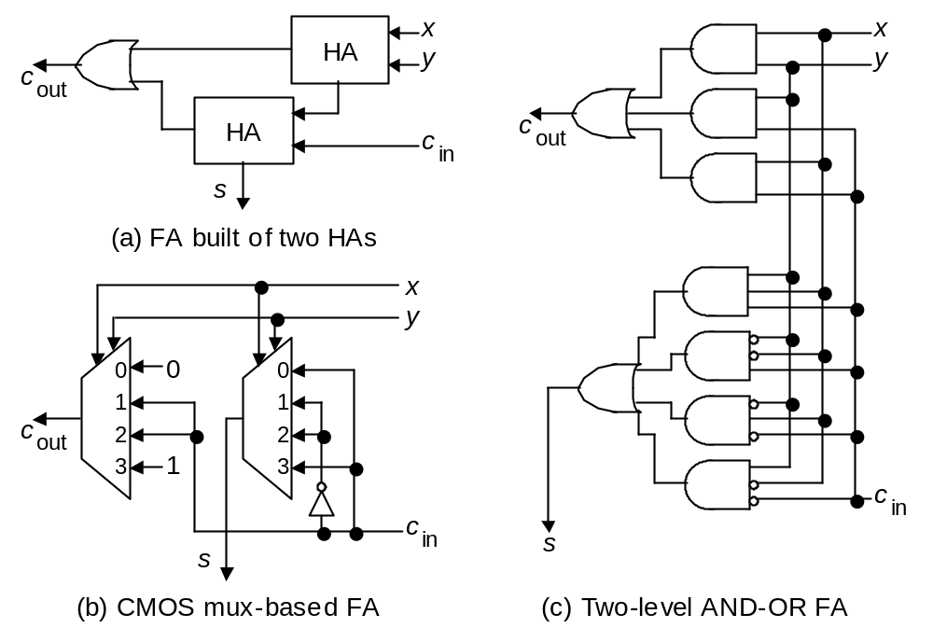
Full-adder implementation
Fig. 5.2 (alternate version) Possible designs for a full-adder in terms of half-adders, logic gates, and CMOS transmission gates.

Slide 3
Full-adder implementation
the design to be derived today
Fig. 5.2 (alternate version) Possible designs for a full-adder in terms of half-adders, logic gates, and CMOS transmission gates.

Slide 4
The road to small full-adder design
Recap on electronics
  MOS as switching logic
  pass characteristic of MOSFET
  CMOS circuit
transmission gate
your exercise: design the full adder with transmission gate

Slide 5
Recap: the electronics (1)
switching logic of MOSFET

Slide 6
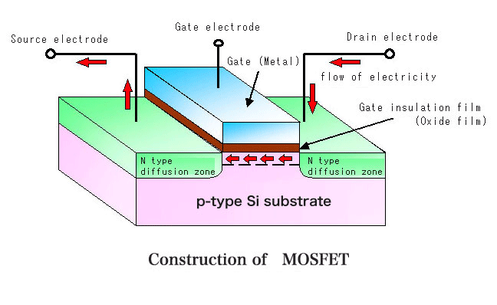
The basic device to build a chip:
MOS transistor
D
G
X
X=0
X=1
S

Slide 7
The nFET
the n-channel FET (field effect transistor)
use negatively charged electrons for current flow
Gate
source
drain

Slide 8
The nFET
conducted when we apply high voltage (logic 1) on the Gate terminal
Logic 1
Gate
ON
source
drain

Slide 9
The nFET
not conducted when we apply logic 0 on the Gate terminal
Logic 0
Gate
OFF
source
drain

Slide 10
The pFET
the p-channel FET (field effect transistor)
use positive charges current flow
Gate
drain
source

Slide 11
The pFET
apply logic 0 (low voltage) on the gate terminal makes the switch ON
Logic 0
Gate
ON
drain
source

Slide 12
The pFET
apply logic 0 (low voltage) on the gate terminal makes the switch ON
Logic 1
Gate
OFF
drain
source

Slide 13
Recap: electronics (2)
gates from switching logic

Slide 14
NOT gate
Vdd
A
X
A
X
A

Slide 15
NOT gate: when A=1
Vdd
A
X
1
A
OFF
X
1
A
ON

Slide 16
NOT gate: when A=1
Vdd
A
X
1
A
OFF
X=0
X
1
A
ON

Slide 17
NOT gate: when A=0
Vdd
A
X
0
A
ON
X
0
A
OFF

Slide 18
NOT gate: when A=0
Vdd
A
X
0
A
ON
X=1
X
0
A
OFF

Slide 19
NAND gate
Vdd
A
A
B
X
B
X
A
B
X
A
0
0
1
0
1
1
1
0
1
B
1
1
0

Slide 20
NAND gate: check the truth table
Vdd
ON
OFF
0
1
A
A
B
X
B
X
A
B
X
0
A
OFF
0
0
1
0
1
1
1
0
1
1
B
ON
1
1
0

Slide 21
NAND gate: check the truth table
Vdd
ON
OFF
0
1
A
A
B
X
B
X=1
X
A
B
X
0
A
OFF
0
0
1
0
1
1
1
0
1
1
B
ON
1
1
0

Slide 22
NAND gate: check the truth table
Vdd
OFF
OFF
1
1
A
A
B
X
B
X
A
B
X
1
A
ON
0
0
1
0
1
1
1
0
1
1
B
ON
1
1
0

Slide 23
NAND gate: check the truth table
Vdd
OFF
OFF
1
1
A
A
B
X
B
X=0
X
A
B
X
1
A
ON
0
0
1
0
1
1
1
0
1
1
B
ON
1
1
0

Slide 24
AND gate?
Vdd
A
X
B
A
A
B
X
B
0
0
0
What’s wrong?
X
0
1
0
1
0
0
A
B
1
1
1

Slide 25
Schematic of AND gate from UMC cell-library spec
why additional transistors?
A
X
B

Slide 26
Recap: electronics (3)
the pass characteristics

Slide 27
Threshold voltage of nFET
conducted when V_{A}=V_{GSn} >= V_{Tn}
  V_{Tn}: the threshold voltage
  V_{GSn}: gate-source voltage for nFET
to Vdd
V_{A}
drain
Vdd
Gate
V_{A}
+
transistor ON
-
V_{Tn}
source
transistor OFF
0
to ground

Slide 28
Threshold voltage of pFET
conducted when V_{A}>= Vdd-|V_{Tp}|
  V_{Tp}: the threshold voltage
  V_{SGp}: source-gate voltage for pFET
to Vdd
V_{A}
source
+
Vdd
Gate
transistor OFF
V_{A}
Vdd-| V_{Tp} |
-
drain
transistor ON
to ground
0

Slide 29


Pass characteristic of nFET
Logic 0 transfer
  a strong 0
Vdd
in
out

Slide 30


Pass characteristic of nFET
Logic 1 transfer
  a weak 1
Vdd
+
V_{Tn}
-
in
out

Slide 31

Pass characteristic of pFET
Logic 1 transfer
  a strong 1
0
in
out

Slide 32


Pass characteristic of pFET
Logic 0 transfer
  a weak 0
0
-
+
in
out

Slide 33
Recap: electronics (4)
CMOS circuit design

Slide 34
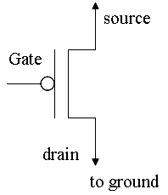
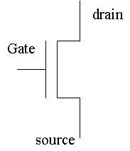
General scheme of CMOS
CMOS: complementary MOS
Vdd
inputs
circuit composed of
pFET
output
circuit composed of
nFET
inputs

Slide 35
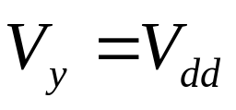
General scheme of CMOS
to ensure “strong 1” transfer when output=1
Vdd
inputs
circuit composed of
pFET
output
circuit composed of
nFET
inputs

Slide 36
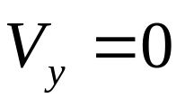
General scheme of CMOS
to ensure “strong 0” transfer when output=0
Vdd
inputs
circuit composed of
pFET
output
circuit composed of
nFET
inputs

Slide 37
NOT gate
Vdd
A
X
A
X
A

Slide 38
NAND gate
Vdd
A
A
B
X
B
X
A
B
X
A
0
0
1
0
1
1
1
0
1
B
1
1
0

Slide 39
AND gate?
Vdd
A
X
B
A
A
B
X
B
0
0
0
What’s wrong?
X
0
1
0
1
0
0
A
B
1
1
1

Slide 40
Schematic of AND gate from UMC cell-library spec
why additional transistors?
A
X
B

Slide 41
Transmission gate technology

Slide 42
Goal
design a multiplexor with transistors as few as possible
A
MUX
Y
B
S

Slide 43




Transmission Gate
Y=X if S=1

Slide 44


2-to-1 MUX with transmission gate
A
MUX
Y
B
S

Slide 45
On-Class Exercise
Design a 4-to-1 MUX with as few transistors as possible

Slide 46
Full-adder with transmission gate

Slide 47
Full Adder: the basic component for an adder
a combinational circuit doing the following truth table
to perform addition for a bit i
Y
X
X
Y
Cin
Cout
S
1
0
0
0
0
0
0
0 1 1 0
A
Cin
0
0
1
0
1
+)
0 0 1 1
B
FA
0
1
0
0
1
0
1
1
1
0
0
1
S
1
0
0
0
1
1
0
1
1
0
S
1
1
0
1
0
Cout
1
1
1
1
1

Slide 48
Full-adder implementation
Fig. 5.2 (alternate version) Possible designs for a full-adder in terms of half-adders, logic gates, and CMOS transmission gates.

Slide 49
Full-adder implementation
direct implementation of the true table
Fig. 5.2 (alternate version) Possible designs for a full-adder in terms of half-adders, logic gates, and CMOS transmission gates.

Slide 50
On-Class exercise
realize with transmission-gate logic
and calculate the transistor count

