Slide 1
Hierarchical Lookahead Carry Generation
Lecture 05 (Part B)

Slide 2
Recap: carry lookahead adder

Slide 3
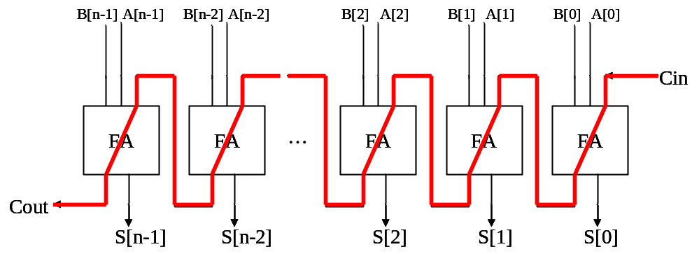
The core problem
Q: How to design a fast n-bit adder?
  attach the O(n) carry-chain delay

Slide 4





























Framework of CLA
CLA: carry-lookahead adder for X+Y
pg
pg
pg
pg
pg
lookahead carry generator
FA
FA
FA
FA
FA
…

Slide 5






Framework of CLA
CLA: carry-lookahead adder for X+Y
pg
pg
pg
pg
pg
0
0
0
0
0
0
1
0
1
lookahead carry generator
1
0
0
1
1
1
1
1
0
FA
FA
FA
FA
FA
…

Slide 6
Framework of CLA
CLA: carry-lookahead adder for X+Y
to implement Boolean equations
pg
pg
pg
pg
pg
lookahead carry generator
FA
FA
FA
FA
FA
…

Slide 7
Framework of CLA
CLA: carry-lookahead adder for X+Y
pg
pg
pg
pg
pg
lookahead carry generator
FA
FA
FA
FA
FA
…
full adders to get the sum without O(n) carry chain

Slide 8
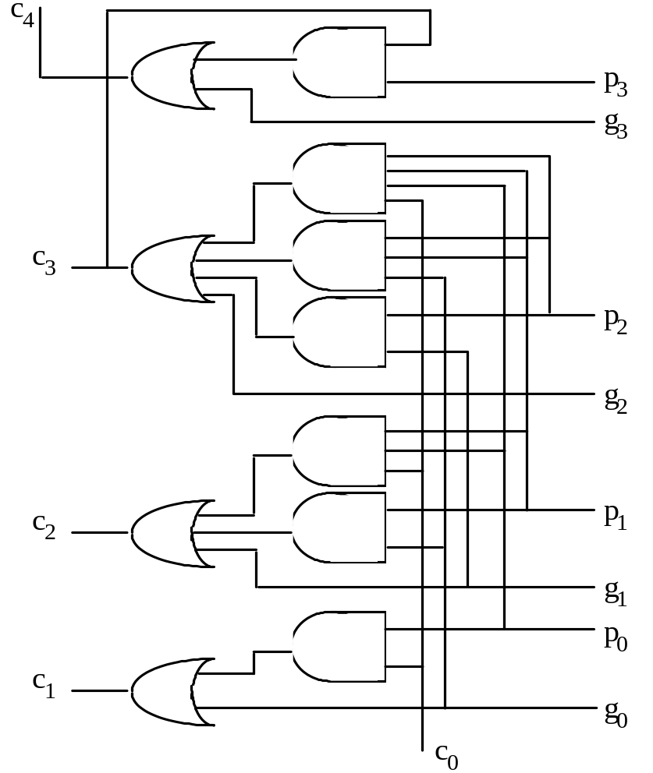
4-bit look-ahead carry generation
Fig. 6.1 Four-bit carry network with full lookahead.
Full carry lookahead is quite practical for a 4-bit adder
c₁ = g₀ ∨ c₀ p₀
c₂ = g₁ ∨ g₀ p₁ ∨ c₀ p₀ p₁
c₃ = g₂ ∨ g₁ p₂ ∨ g₀ p₁ p₂ ∨ c₀ p₀ p₁ p₂
c₄ = g₃ ∨ g₂ p₃ ∨ g₁ p₂ p₃ ∨ g₀ p₁ p₂ p₃
∨ c₀ p₀ p₁ p₂ p₃

Slide 9
Question
Q: How to design a general n-bit adder?
  brute-force Boolean equation expansion?
  the large fan-in problem
Schemes for n-bit lookahead carry generation
  Sec 6.2: hierarchical construction of lookahead carry generator
  Sec 6.3: parallel prefix computation

Slide 10
General n-bit carry lookahead
Consider a 32-bit adder
c₁ = g₀ ∨ c₀ p₀
c₂ = g₁ ∨ g₀ p₁ ∨ c₀ p₀ p₁
c₃ = g₂ ∨ g₁ p₂ ∨ g₀ p₁ p₂ ∨ c₀ p₀ p₁ p₂
.
.
.
c₃₁ = g₃₀ ∨ g₂₉ p₃₀ ∨ g₂₈ p₂₉ p₃₀ ∨ g₂₇ p₂₈ p₂₉ p₃₀ ∨ . . . ∨ c₀ p₀ p₁ p₂ p₃ ... p₂₉ p₃₀
32-input AND
. . .
High fan-ins necessitate tree-structured circuits
32-input OR

Slide 11
Today’s Goal
a hierarchical design for n-bit carry lookahead
with critical path length O(log n)

Slide 12
Observation: How to do radix-r carry generation

Slide 13
Carry generation for hex addition
Q: will there be a carry to digit i?
a 3 b 5 c 8 9
a 3 b 5 c 8 9
+)
b 6 7 a 3 a 9
+)
b 6 7 a 3 a 9

Slide 14
Carry generation for hex addition
Q: will there be a carry to digit i?
Seems the same method applies
carry propagation
C_{i}=1
C_{i}=1
a 3 b 5 c 8 9
a 3 b 5 c 8 9
+)
b 6 7 a 3 a 9
+)
b 6 7 a 3 a 9
carry generation
carry generation

Slide 15
Scheme for fast carry generation
Base signals:
  g_{i+3,i} =1 if carry is generated by x[i+3:i]+y[i+3:i]
  p_{i+3,i} =1 if carry is propagated through bit i to i+3
p_{15,12}=1
C_{j}=1
C_{j}=1
a 3 b 5 c 8 9
a 3 b 5 c 8 9
+)
b 6 7 a 3 a 9
+)
b 6 7 a 3 a 9
g_{19,16}=1
carry generation

Slide 16
Scheme for fast carry generation
Base signals:
  g_{i+3,i} =1 if carry is generated by x[i+3:i]+y[i+3:i]
  p_{i+3,i} =1 if carry is propagated through bit i to i+3
p_{15,12}=1
Looks like you have seen this Boolean equation before?
C₁₆=1
a 3 b 5 c 8 9
+)
b 6 7 a 3 a 9
g_{7,4}=1

Slide 17
Conclusion of this observation
if we can generate these signals very fast,
  g_{i+3,i} =1 if carry is generated by x[i+3:i]+y[i+3:i]
  p_{i+3,i} =1 if carry is propagated through bit i to i+3
we can generate n-bit carry very fast
p_{15,12}=1
C₁₆=1
Similar to previous Boolean equation for carry lookahead
a 3 b 5 c 8 9
+)
b 6 7 a 3 a 9
g_{7,4}=1

Slide 18
Observation: generate and propagate signals for radix-r addition
How to generate g_{i+3,i} and p_{i+3,i} as fast as possible

Slide 19

Generate g_{i+3,i}
C_{j}=1
g_{19,16}=1
Definition:
  g_{i+3,i} =1 if carry is generated by x[i+3:i]+y[i+3:i]
a 3 b 5 c 8 9
+)
b 6 7 a 3 a 9
C₂₀=1
1 0 1 1
+)
0 1 1 1

Slide 20
Generate g_{i+3,i}
C_{j}=1
g_{19,16}=1
Definition:
  g_{i+3,i} =1 if carry is generated by x[i+3:i]+y[i+3:i]
a 3 b 5 c 8 9
+)
b 6 7 a 3 a 9
propagate carry
C₂₀=1
generate carry
1 0 1 1
+)
0 1 1 1

Slide 21
Generate g_{i+3,i}
Definition:
  g_{i+3,i} =1 if carry is generated by x[i+3:i]+y[i+3:i]
C_{j}=1
g_{19,16}=1
a 3 b 5 c 8 9
+)
b 6 7 a 3 a 9
The Boolean equation:
carry generated at bit i+3, or
carry generated at bit i+2 and propagate through bit i+3, or
carry generated at bit i+1 and propagate through bit i+2 to i+3, or
carry generated at bit i and propagate through i+1 to i+3
p₁₉=1
C₂₀=1
g₁₇=1
1 0 1 1
+)
0 1 1 1

Slide 22

Generate p_{i+3,i}
p_{19,16}=1
Definition:
  p_{i+3,i} =1 if carry is propagated through bit i to i+3
a 3 b 5 c 8 9
+)
b 6 7 a 3 a 9
0 1 0 1
+)
1 0 1 0

Slide 23
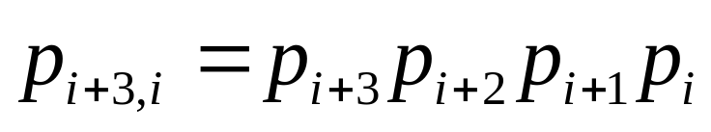
Generate p_{i+3,i}
p_{19,16}=1
Definition:
  p_{i+3,i} =1 if carry is propagated through bit i to i+3
a 3 b 5 c 8 9
+)
b 6 7 a 3 a 9
carry propagate, p_{i}=1
0 1 0 1
+)
1 0 1 0

Slide 24
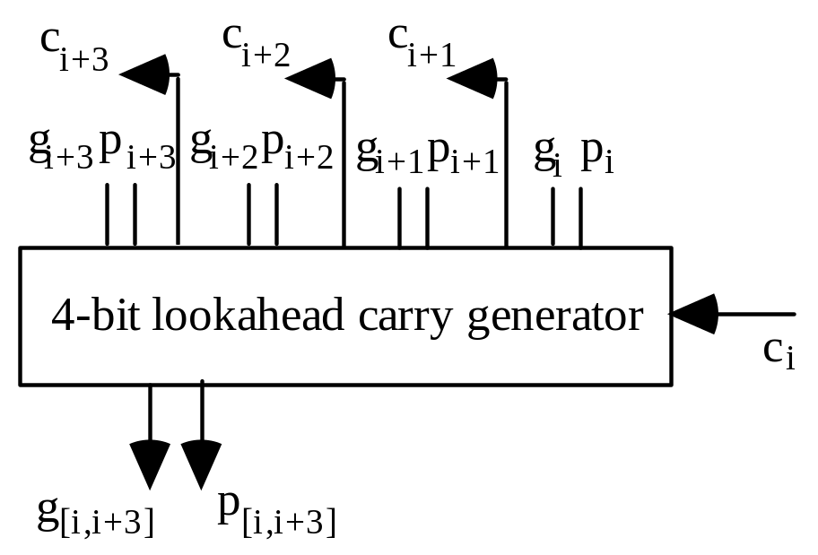
On-Class Exercise
Design the hardware
  Input: x[i+3:i], y[i+3:i], C_{i}
  Output:
    g_{i+3,i}
    p_{i+3,i}
    C_{i+1}, C_{i+2}, C_{i+3}

Slide 25
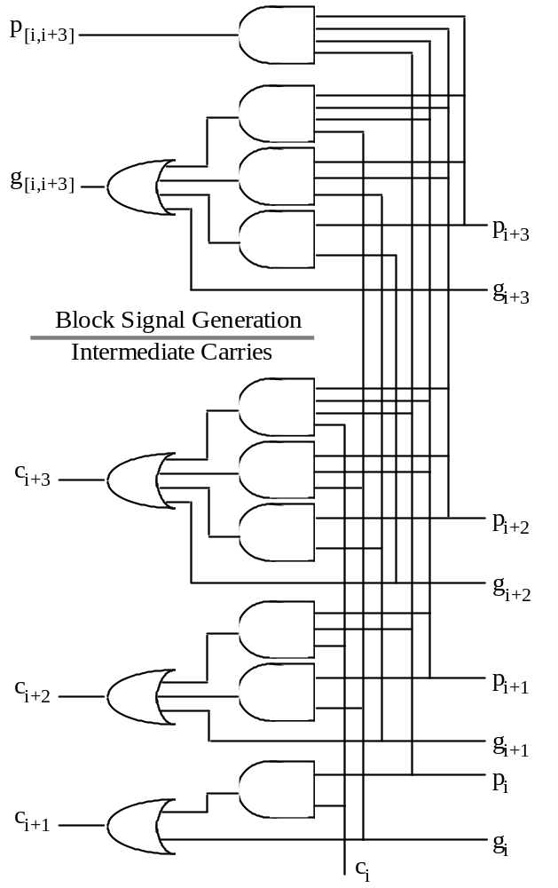
Lookahead carry generator (4-bit)

Slide 26
Compare the design
Fig. 6.2 Four-bit
lookahead
carry generator.
Fig. 6.1
Four-bit adder

Slide 27
Hardware Design: Carry-Lookahead Generator for radix-r addition

Slide 28
Back to hex addition
if we can generate these signals very fast,
  g_{i+3,i} =1 if carry is generated by x[i+3:i]+y[i+3:i]
  p_{i+3,i} =1 if carry is propagated through bit i to i+3
we can generate n-bit carry very fast
p_{15,12}=1
C₁₆=1
Similar to previous Boolean equation for carry lookahead
a 3 b 5 c 8 9
+)
b 6 7 a 3 a 9
g_{7,4}=1

Slide 29
On-Class Exercise
Hardware design: 4-digit (16-bit) carry-lookahead generator for hex addition
  Input:
    generate signals: g_{15,12}, g_{11,8}, g_{7,4}, g_{3,0}
    propagate signals: p_{15,12}, p_{11,8}, p_{7,4}, p_{3,0}
  Output:
    carry signals: C₁₆, C₁₂, C₈, C₄
    generate signal: g_{15,0}
    propagate signal: p_{15,0}
p_{15,12}=1
C₁₆=1
a 3 b 5 c 8 9
+)
b 6 7 a 3 a 9
g_{7,4}=1

Slide 30
On-Class Exercise
Hardware design: 4-digit (16-bit) carry-lookahead generator for hex addition
  Input:
    generate signals: g_{15,12}, g_{11,8}, g_{7,4}, g_{3,0}
    propagate signals: p_{15,12}, p_{11,8}, p_{7,4}, p_{3,0}
  Output:
    carry signals: C₁₆, C₁₂, C₈, C₄
    generate signal: g_{15,0}
    propagate signal: p_{15,0}
p_{15,12}=1
C₁₆=1
a 3 b 5 c 8 9
+)
b 6 7 a 3 a 9
g_{7,4}=1

Slide 31
On-Class Exercise
Hardware design: 4-digit (16-bit) carry-lookahead generator for hex addition
  Input:
    generate signals: g_{15,12}, g_{11,8}, g_{7,4}, g_{3,0}
    propagate signals: p_{15,12}, p_{11,8}, p_{7,4}, p_{3,0}
  Output:
    carry signals: C₁₆, C₁₂, C₈, C₄
    generate signal: g_{15,0}
    propagate signal: p_{15,0}
p_{15,12}=1
C₁₆=1
a 3 b 5 c 8 9
Just replace the signal names!
+)
b 6 7 a 3 a 9
g_{7,4}=1

Slide 32
Put it all together: a 64-bit CLA
carry-lookahead adder with hierarchical carry generation

Slide 33
Framework of CLA
CLA: carry-lookahead adder for X+Y
pg
pg
pg
pg
pg
lookahead carry generator
FA
FA
FA
FA
FA
…
full adders to get the sum without O(n) carry chain

Slide 34
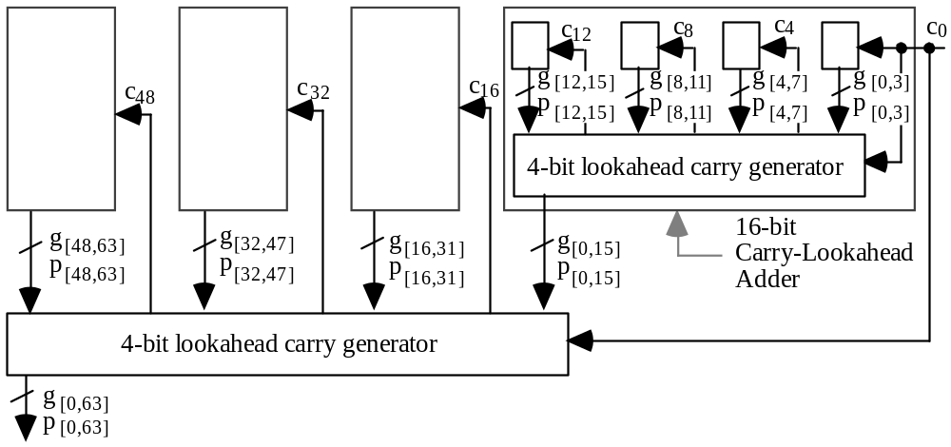
64-bit carry lookahead generator
Fig. 6.5 Building a 64-bit carry-lookahead adder from 16 4-bit adders and 5 lookahead carry generators.

Slide 35
64-bit carry lookahead generator
All blocks are the same!
Fig. 6.5 Building a 64-bit carry-lookahead adder from 16 4-bit adders and 5 lookahead carry generators.

Slide 36
On-Class Exercise
Q: how many gate-delay to generate C₄₅?
  show the data path

