Slide 1
Carry Lookahead as Parallel Prefix Sum
Lecture 05 (Part C)

Slide 2
Recap: carry lookahead adder

Slide 3
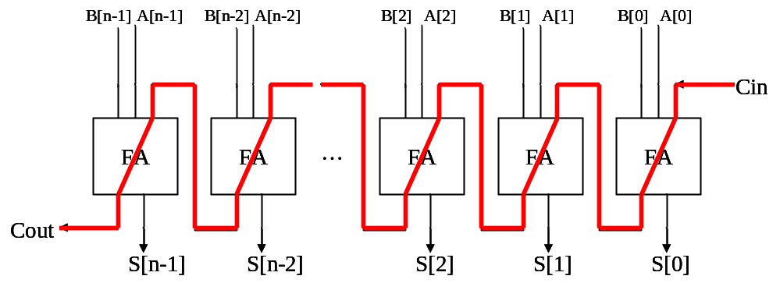
The core problem
Q: How to design a fast n-bit adder?
  attach the O(n) carry-chain delay

Slide 4





























Framework of CLA
CLA: carry-lookahead adder for X+Y
pg
pg
pg
pg
pg
lookahead carry generator
FA
FA
FA
FA
FA
…

Slide 5






Framework of CLA
CLA: carry-lookahead adder for X+Y
pg
pg
pg
pg
pg
0
0
0
0
0
0
1
0
1
lookahead carry generator
1
0
0
1
1
1
1
1
0
FA
FA
FA
FA
FA
…

Slide 6
Framework of CLA
CLA: carry-lookahead adder for X+Y
to implement Boolean equations
pg
pg
pg
pg
pg
lookahead carry generator
FA
FA
FA
FA
FA
…

Slide 7
Framework of CLA
CLA: carry-lookahead adder for X+Y
pg
pg
pg
pg
pg
lookahead carry generator
FA
FA
FA
FA
FA
…
full adders to get the sum without O(n) carry chain

Slide 8
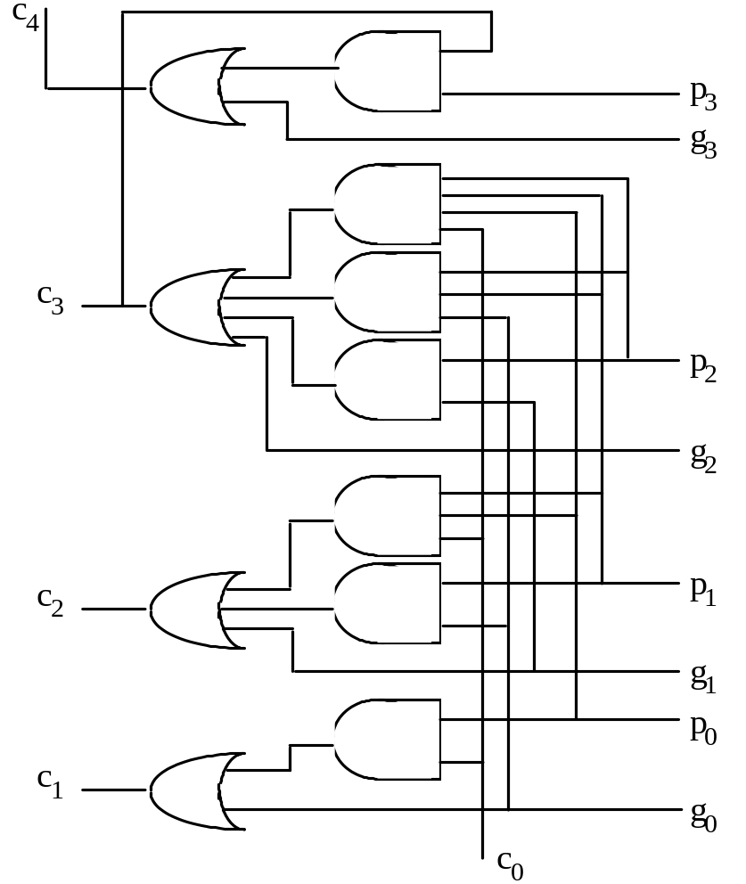
4-bit look-ahead carry generation
Fig. 6.1 Four-bit carry network with full lookahead.
Full carry lookahead is quite practical for a 4-bit adder
c₁ = g₀ ∨ c₀ p₀
c₂ = g₁ ∨ g₀ p₁ ∨ c₀ p₀ p₁
c₃ = g₂ ∨ g₁ p₂ ∨ g₀ p₁ p₂ ∨ c₀ p₀ p₁ p₂
c₄ = g₃ ∨ g₂ p₃ ∨ g₁ p₂ p₃ ∨ g₀ p₁ p₂ p₃
∨ c₀ p₀ p₁ p₂ p₃

Slide 9
Question
Q: How to design a general n-bit adder?
  brute-force Boolean equation expansion?
  the large fan-in problem
Schemes for n-bit lookahead carry generation
  Sec 6.2: hierarchical construction of lookahead carry generator
  Sec 6.3: parallel prefix computation

Slide 10
General n-bit carry lookahead
Consider a 32-bit adder
c₁ = g₀ ∨ c₀ p₀
c₂ = g₁ ∨ g₀ p₁ ∨ c₀ p₀ p₁
c₃ = g₂ ∨ g₁ p₂ ∨ g₀ p₁ p₂ ∨ c₀ p₀ p₁ p₂
.
.
.
c₃₁ = g₃₀ ∨ g₂₉ p₃₀ ∨ g₂₈ p₂₉ p₃₀ ∨ g₂₇ p₂₈ p₂₉ p₃₀ ∨ . . . ∨ c₀ p₀ p₁ p₂ p₃ ... p₂₉ p₃₀
32-input AND
. . .
High fan-ins necessitate tree-structured circuits
32-input OR

Slide 11
Today’s Goal
carry-lookahead generator in delay O(log n)
  hierarchical design (we’ve already seen)
  as parallel prefix sum (new)

Slide 12
Rewrite carry-lookahead as prefix sum
algebraic technique

Slide 13
Notation on signals
g[i,j]=1 if carry is generated by x[i:j]+y[i:j]
p[i,j]=1 if carry is propagated through x[i:j]+y[i:j]

Slide 14
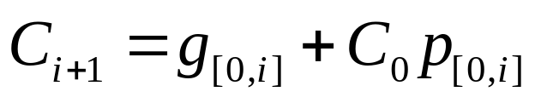
Question
Q: How to generate all of the following signals as fast as possible?
  g[0,1] & p[0,1]
  g[0,2] & p[0,2]
  g[0,3] & p[0,3]
  ...
The carry:
1 0 1 1
+)
0 1 1 1

Slide 15
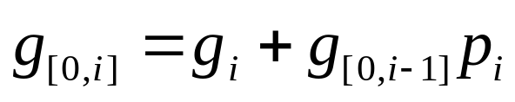
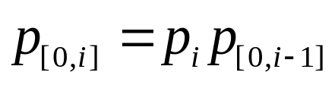
The recurrence relation
Q: can you explain the intuitive meaning?

Slide 16
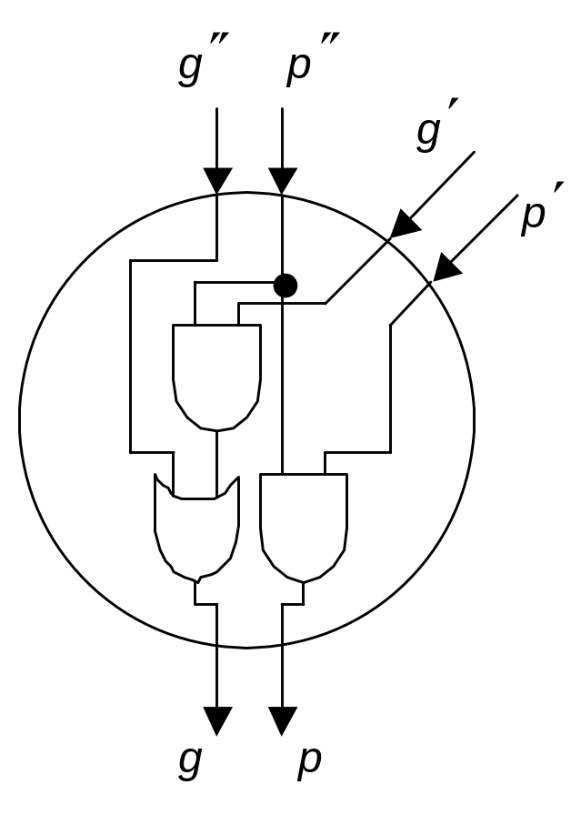
The operator
(g", p") (g', p')
¢
g = g" + g'p"
p = p'p"
(g, p)

Slide 17







Compute generate and propagate signal as prefix sum
(g", p") (g', p')
¢
¢
¢
¢
g = g" + g'p"
p = p'p"
(g, p)

Slide 18
Example Prefix-Based Carry Network
g₃, p₃
g₂, p₂
g₁, p₁
g₀, p₀
6
−1
2
5
+
+
Four-input
prefix sums
network
+
+
12
6
7
5
g_{[0,3]}, p_{[0,3]}
= (c₄, --)
g_{[0,2]}, p_{[0,2]}
= (c₃, --)
g_{[0,1]}, p_{[0,1]}
= (c₂, --)
g_{[0,0]}, p_{[0,0]}
= (c₁, --)
Scan order
g₃, p₃
g₂, p₂
g₁, p₁
g₀, p₀
¢
¢
Four-bit
Carry lookahead network
¢
¢
g_{[0,3]}, p_{[0,3]}
= (c₄, --)
g_{[0,2]}, p_{[0,2]}
= (c₃, --)
g_{[0,1]}, p_{[0,1]}
= (c₂, --)
g_{[0,0]}, p_{[0,0]}
= (c₁, --)

Slide 19
Criteria that you can do it as prefix sum
the operator is associative
prove by yourself
(g", p") (g', p')
¢
g = g" + g'p"
p = p'p"
(g, p)

Slide 20
How to do this efficiently?
prefix sum in O(log n)
x4
x3
x2
x1
x0
...
...
x0+x1
x0
x0+x1+x2
x0+x1+x2+x3
x0+x1+x2+x3+x4

Slide 21
Brent-Kung Graph
for parallel prefix sum in O(log n) delay

Slide 22
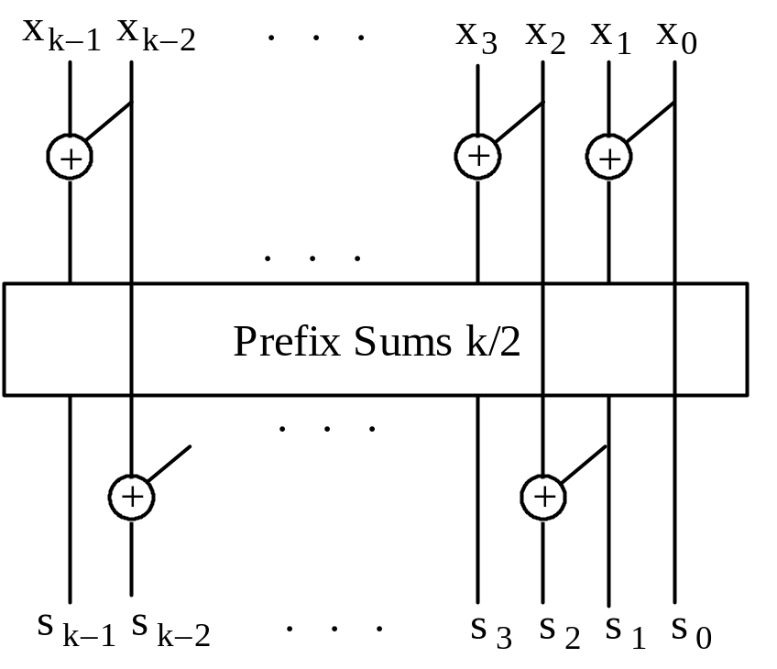
Strategy to construct parallel prefix
divide-and-conquer
Fig. 6.8 Parallel prefix sums network built of one k/2-input network and k – 1 adders.

Slide 23
How to construct?
x7
x6
x5
x4
x3
x2
x1
x0
Suppose you have:
  x0+x1
  x0+x1+x2+x3
  x0+x1+x2+x3+x4+x5
  x0+x1+x2+x3+x4+x5+x6+x7
How to build the following?
  x0+x1+x2
  x0+x1+x2+x3+x4
  x0+x1+x2+x3+x4+x5+x6
+
+
+
+
prefix sum for 4 numbers
x0+x1
x0+...+x3
x0+...+x5
x0+...+x7

Slide 24
How to construct?
x7
x6
x5
x4
x3
x2
x1
x0
Suppose you have:
  x0+x1
  x0+x1+x2+x3
  x0+x1+x2+x3+x4+x5
  x0+x1+x2+x3+x4+x5+x6+x7
How to build the following?
  x0+x1+x2
  x0+x1+x2+x3+x4
  x0+x1+x2+x3+x4+x5+x6
+
+
+
+
prefix sum for 4 numbers
x0+x1
x0+...+x3
x0+...+x5
+
x0+...+x7
x0+x1+x2

Slide 25
How to construct?
x7
x6
x5
x4
x3
x2
x1
x0
Suppose you have:
  x0+x1
  x0+x1+x2+x3
  x0+x1+x2+x3+x4+x5
  x0+x1+x2+x3+x4+x5+x6+x7
How to build the following?
  x0+x1+x2
  x0+x1+x2+x3+x4
  x0+x1+x2+x3+x4+x5+x6
+
+
+
+
prefix sum for 4 numbers
x0+x1
x0+...+x3
x0+...+x5
x0+...+x7
+
x0+x1+x2+x3+x4

Slide 26
Rule of the Thumb
divide-and-conquer
Fig. 6.8 Parallel prefix sums network built of one k/2-input network and k – 1 adders.

Slide 27
Rule of the Thumb
divide-and-conquer
even-odd
bypass
odd-even
Fig. 6.8 Parallel prefix sums network built of one k/2-input network and k – 1 adders.

Slide 28
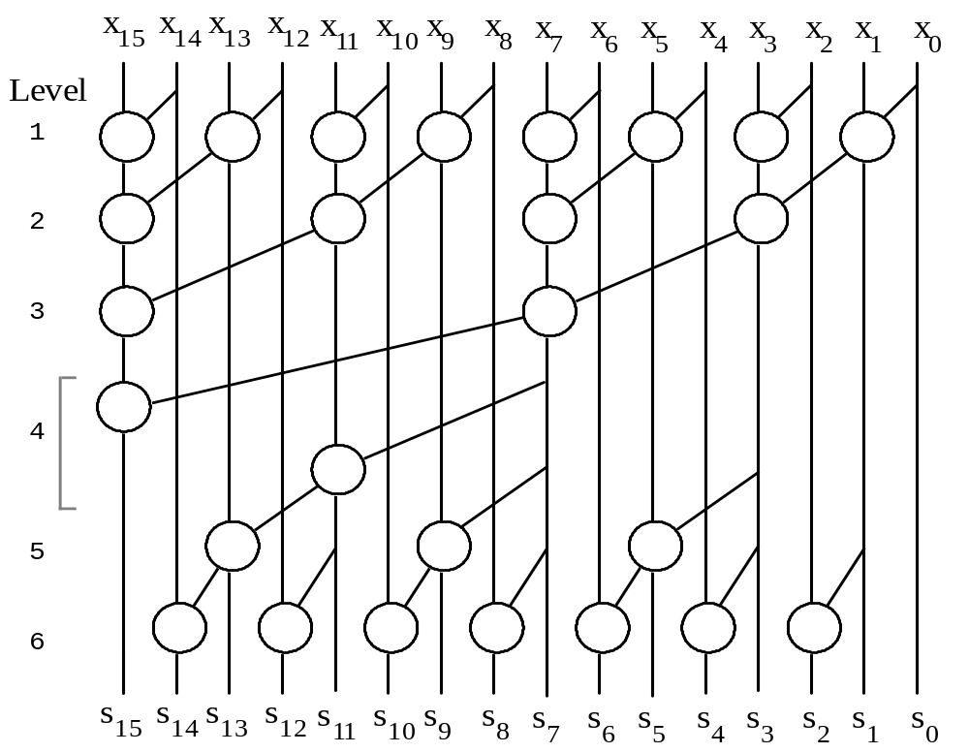
Brent-Kung Graph for 16 numbers
Fig. 6.9 Brent-Kung parallel prefix graph for
16 inputs.

Slide 29
Brent-Kung Graph for 16 numbers
prefix sum for 8 numbers
Fig. 6.9 Brent-Kung parallel prefix graph for
16 inputs.

Slide 30
Brent-Kung Graph for 16 numbers
prefix sum for 4 numbers
Fig. 6.9 Brent-Kung parallel prefix graph for
16 inputs.

Slide 31
Kogge-Stone Graph
parallel prefix sum with delay O(log n)

Slide 32
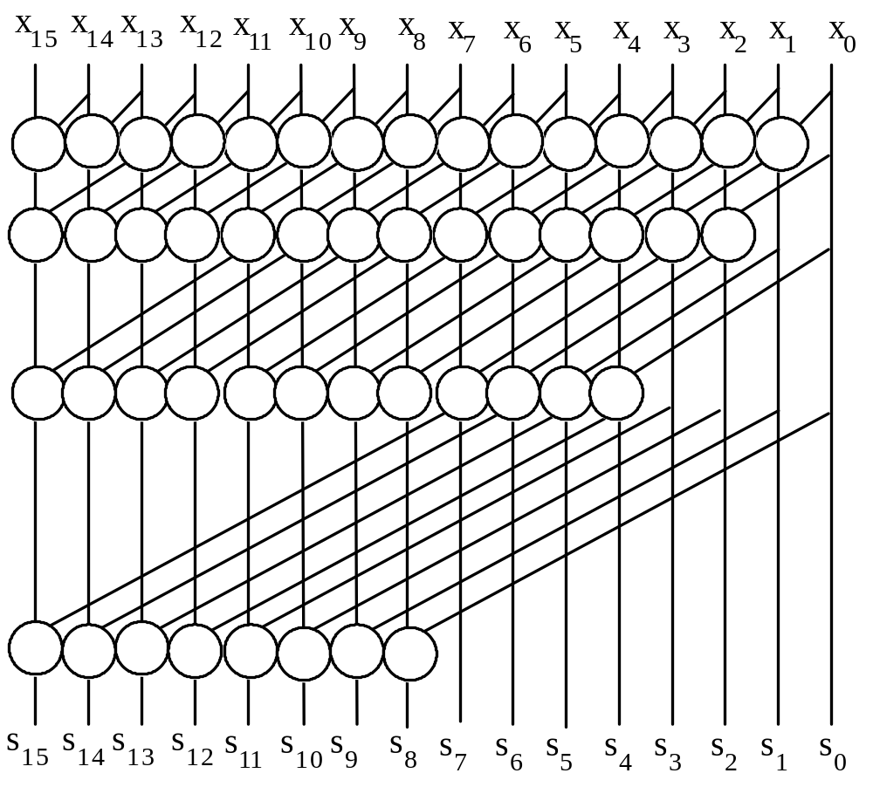
Strategy to build parallel prefix
Stage 1: generate sums of 2 consecutive numbers
  x0+x1,
  x1+x2,
  x2+x3,
  x3+x4,...
Stage 2: generate sums of 4 consecutive numbers
  x0+x1+x2+x3,
  x1+x2+x3+x4,
  x2+x3+x4+x5,...
Stage 3: generate sums of 8 consecutive numbers
Stage 4: generate sums of 16 consecutive numbers
...

Slide 33
How to build?
Suppose: we have sums of 2 consecutive numbers
  x0+x1, x1+x2, x2+x3,...
Want to Compute: sums of 4 consecutive numbers
  x0+x1+x2+x3, x1+x2+x3+x4, ...
x7
x6
x5
x4
x3
x2
x1
x0
x6+x7
x5+x6
x4+x5
x3+x4
x2+x3
x1+x2
x0+x1
x0
...
+
+
+
gap of 2
x0+x1+x2+x3
x1+x2+x3+x4
x2+x3+x4+x5

Slide 34
Strategy to build parallel prefix
Stage 1: generate sums of 2 consecutive numbers
  x0+x1, x1+x2, x2+x3, x3+x4,...
Stage 2: generate sums of 4 consecutive numbers
  x0+x1+x2+x3, x1+x2+x3+x4, x2+x3+x4+x5,...
Stage 3: generate sums of 8 consecutive numbers
Stage 4: generate sums of 16 consecutive numbers
...

Slide 35
Strategy to build parallel prefix
Stage 1: generate sums of 2 consecutive numbers
  x0+x1, x1+x2, x2+x3, x3+x4,...
Stage 2: generate sums of 4 consecutive numbers
  x0+x1+x2+x3, x1+x2+x3+x4, x2+x3+x4+x5,...
Stage 3: generate sums of 8 consecutive numbers
Stage 4: generate sums of 16 consecutive numbers
...
x1+x2
x0+x1

Slide 36
Strategy to build parallel prefix
Stage 1: generate sums of 2 consecutive numbers
  x0+x1, x1+x2, x2+x3, x3+x4,...
Stage 2: generate sums of 4 consecutive numbers
  x0+x1+x2+x3, x1+x2+x3+x4, x2+x3+x4+x5,...
Stage 3: generate sums of 8 consecutive numbers
Stage 4: generate sums of 16 consecutive numbers
...

Slide 37
Strategy to build parallel prefix
Stage 1: generate sums of 2 consecutive numbers
  x0+x1, x1+x2, x2+x3, x3+x4,...
Stage 2: generate sums of 4 consecutive numbers
  x0+x1+x2+x3, x1+x2+x3+x4, x2+x3+x4+x5,...
Stage 3: generate sums of 8 consecutive numbers
Stage 4: generate sums of 16 consecutive numbers
...
x0+x1+x2+x3

Slide 38
Strategy to build parallel prefix
Stage 1: generate sums of 2 consecutive numbers
  x0+x1, x1+x2, x2+x3, x3+x4,...
Stage 2: generate sums of 4 consecutive numbers
  x0+x1+x2+x3, x1+x2+x3+x4, x2+x3+x4+x5,...
Stage 3: generate sums of 8 consecutive numbers
Stage 4: generate sums of 16 consecutive numbers
...
x1+x2+x3+x4

Slide 39
More on parallel prefix sum
F. Thompson Leighton, Introduction to Parallel Algorithms and Architectures: Arrays, Trees, and Hypercubes

Slide 40
Wakeup!
How to realize carry lookahead generator with the architecture?
  what’s x_{i}s?
  the operator in each node?

