Slide 1
Carry-Select and Carry-Skip Adders
Lecture 05 (Part D)

Slide 2
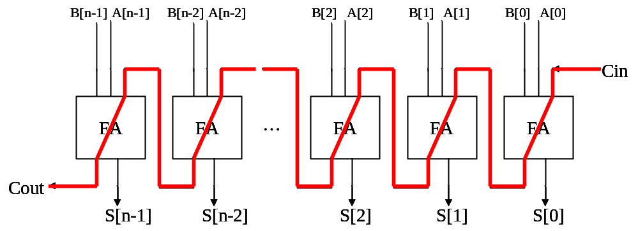
The core problem
Q: How to design a fast n-bit adder?
  attach the O(n) carry-chain delay

Slide 3
Carry-skip adder

Slide 4





























Still this framework
pg
pg
pg
pg
pg
lookahead carry generator
FA
FA
FA
FA
FA
…

Slide 5

Carry generation with recurrence relation
g3
p3
g2
p2
g1
p1
g0
p0
C4
C3
C2
C1
C0
stage 3
stage 2
stage 1
stage 0
enhance with circuit-level technology

Slide 6
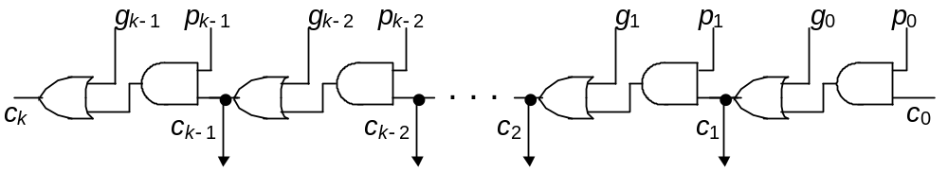
Carry-generation with recurrence relation
g3
p3
g2
p2
g1
p1
g0
p0
C4
C3
C2
C1
C0
stage 3
stage 2
stage 1
stage 0
gate-level design:

Slide 7
Carry-generation with recurrence relation
g3
p3
g2
p2
g1
p1
g0
p0
C4
C3
C2
C1
C0
stage 3
stage 2
stage 1
stage 0
How to accelerate the carry-chain
in gate-level/RTL design?
gate-level design:

Slide 8
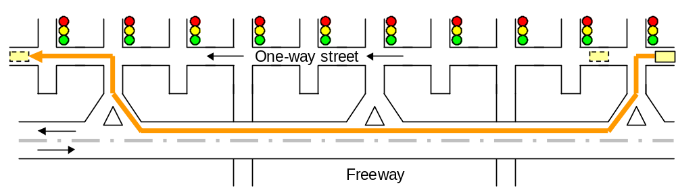
Observation from your daily life
what will you do if you got blocked on the street?

Slide 9
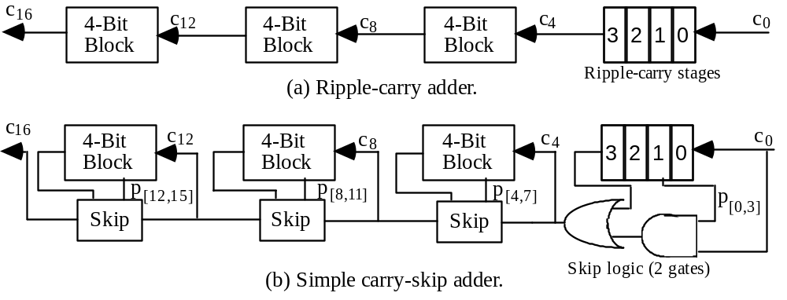
Scheme of the carry-skip adder
Fig. 7.1 Converting a 16-bit ripple-carry adder into a simple carry-skip adder with 4-bit skip blocks.

Slide 10
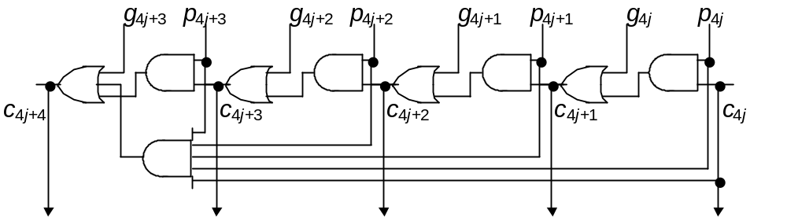
Analogy

Slide 11
In-Class Exercise: What’s the Boolean equation?
Fig. 7.1 Converting a 16-bit ripple-carry adder into a simple carry-skip adder with 4-bit skip blocks.

Slide 12
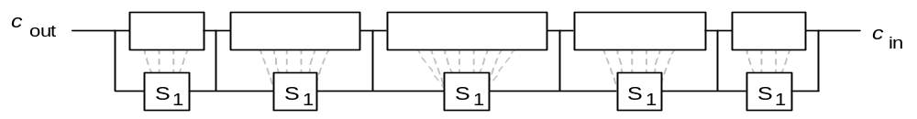
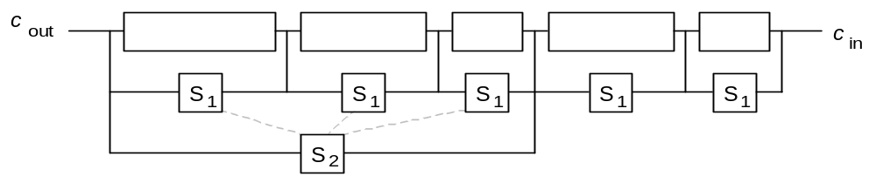
Multi-level carry-skip adder
Fig. 7.4 Example of a two-level carry-skip adder.
detailed derivation is left to you

Slide 13
Carry-Select Adder

Slide 14
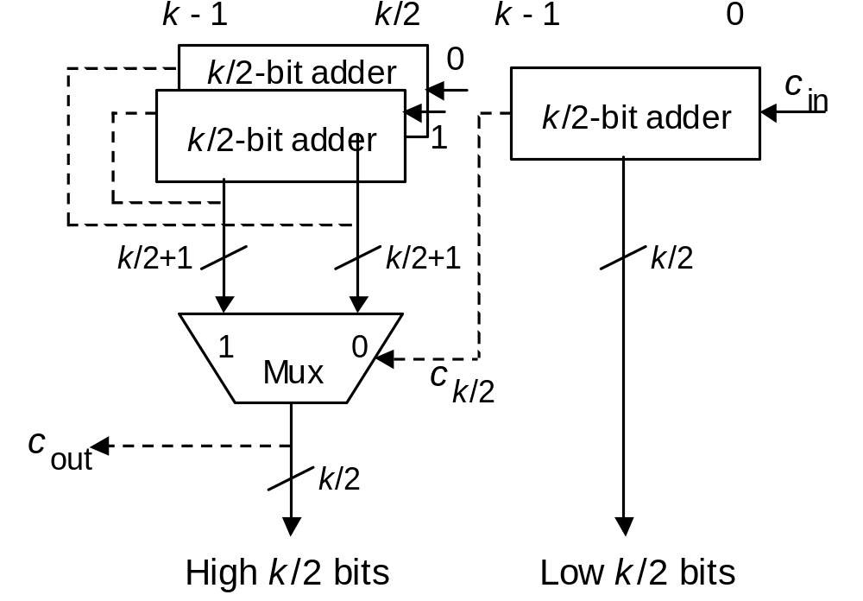
Scheme of carry-select adder
do the addition without carry sent!
Fig. 7.9 Carry-select adder for k-bit numbers built from three k/2-bit adders.

Slide 15
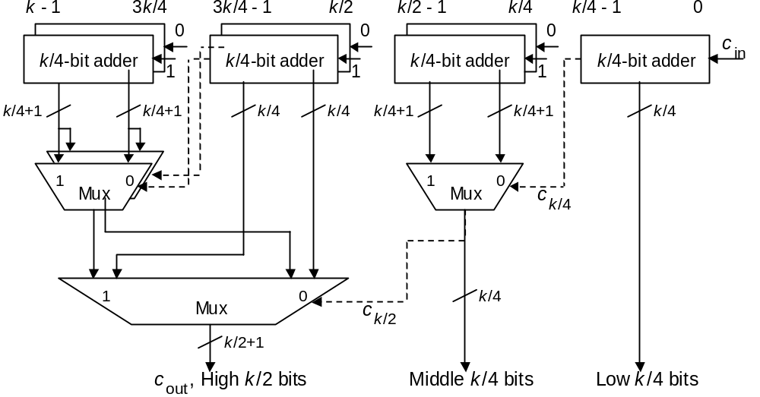
Multi-level carry-select adder
Fig. 7.10 Two-level carry-select adder built of k/4-bit adders.
Derive the design yourself

Slide 16
Summary of adder design
finally we finished this part!

Slide 17
How to design a fast adder
various architectures to reduce the carry-chain
  Chap. 6: Carry-lookahead adders
    hierarchical
    prefix computation
  Chap. 7:
    carry-skip adders
    carry-select adders
ESL design
(Electronic System Level)
RTL design
(Register Transfer Level)
gate-level design
circuit-level design
(transistor-level)
physical layout

Slide 18
How to design a fast adder
asynchronous circuit design
  Sec. 5.3-5.4
  (skip)
ESL design
(Electronic System Level)
RTL design
(Register Transfer Level)
gate-level design
circuit-level design
(transistor-level)
physical layout

Slide 19
How to design a fast adder
Manchester carry-chain (Sec. 5.6)
  a dynamic circuit technique
dual-rail logic network
ESL design
(Electronic System Level)
RTL design
(Register Transfer Level)
gate-level design
circuit-level design
(transistor-level)
physical layout

Slide 20
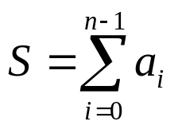
Skipped part
Chap. 8: Multi-Operand Addition
  we will talk about this at multiplier design

Slide 21
Lab 02
128-bit adder

Slide 22
Lab 02
Design a 128-bit adder
Design optimization: critical path delay as short as possible
No EDA-tool optimization
Grading:
  70%: basic requirement (simulation waveform, synthesis result, timing and area report)
  15%: critical path delay (ranking)
  15%: your report (How you shorten the critical path delay)

Slide 23
Your report for Lab 02
block diagram of your final design
How you optimize your design
  which style of adder you select? Why?
  how you optimize the design parameters?
  quantitative reasoning is preferred!

Slide 24
Schedule
05/19: the lab hour
05/22: DEMO

Slide 25
False path
Appendix

Slide 26
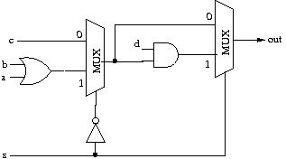
Q: max. clock rate of this circuit?
Assume: 10ns delay for MUX/AND/OR

Slide 27
Q: max. clock rate of this circuit?
Assume: 10ns delay for MUX/AND/OR
Q: How many of you come out the answer 1/40ns?
critical path

Slide 28
Q: max. clock rate of this circuit?
Assume: 10ns delay for MUX/AND/OR
Let’s do some case by case analysis
  s=1: 30 ns
  s=0
critical path

Slide 29
Q: max. clock rate of this circuit?
Assume: 10ns delay for MUX/AND/OR
Let’s do some case by case analysis
  s=1
  s=0: 30 ns
critical path

Slide 30
Q: max. clock rate of this circuit?
Assume: 10ns delay for MUX/AND/OR
We never have to wait for delay of this path!
false path

Slide 31
Advanced reading
How to find the false path automatically?
an active research topic in VLSI design automation
search for the database
  IEEE Explore: http://ieeexplore.ieee.org
  ACM portal: http://portal.acm.org
  with keyword “false path”

Slide 32
Do it yourself
Q: How to specify the false path?
check the manual of Synopsys Design Compiler

