Slide 1
Manchester Carry Chain
Lecture 05 (Part E)
circuit-level technique for fast adder design

Slide 2
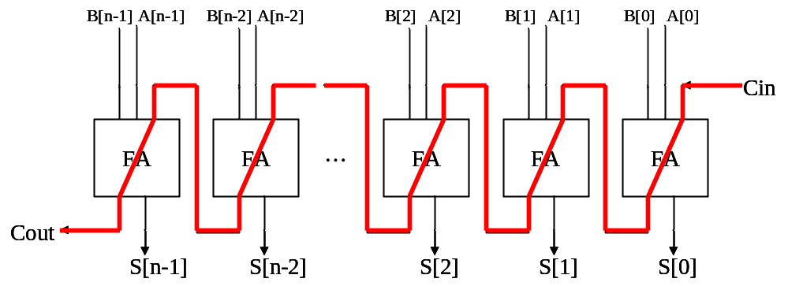
The core problem
Q: How to design a fast n-bit adder?
  attach the O(n) carry-chain delay

Slide 3





























Framework of CLA
CLA: carry-lookahead adder for X+Y
pg
pg
pg
pg
pg
lookahead carry generator
FA
FA
FA
FA
FA
…

Slide 4






Framework of CLA
CLA: carry-lookahead adder for X+Y
pg
pg
pg
pg
pg
0
0
0
0
0
0
1
0
1
lookahead carry generator
1
0
0
1
1
1
1
1
0
FA
FA
FA
FA
FA
…

Slide 5
Framework of CLA
CLA: carry-lookahead adder for X+Y
to implement Boolean equations
pg
pg
pg
pg
pg
lookahead carry generator
FA
FA
FA
FA
FA
…

Slide 6
Framework of CLA
CLA: carry-lookahead adder for X+Y
pg
pg
pg
pg
pg
lookahead carry generator
FA
FA
FA
FA
FA
…
full adders to get the sum without O(n) carry chain

Slide 7
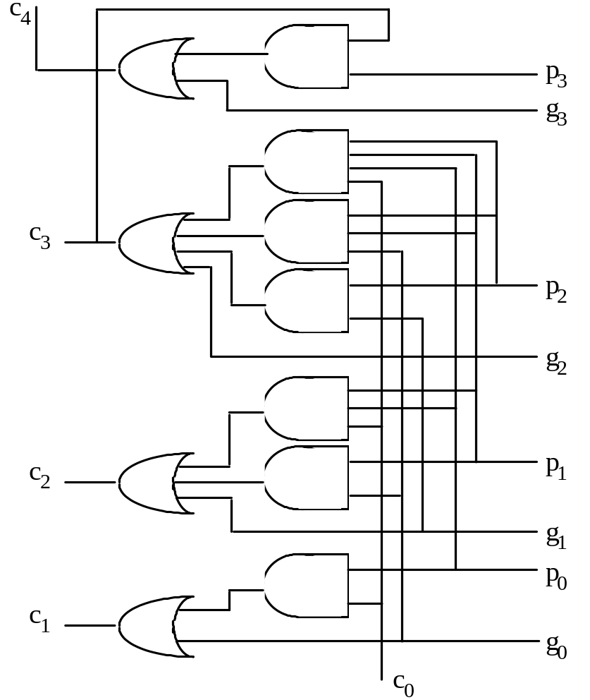
4-bit look-ahead carry generation
Fig. 6.1 Four-bit carry network with full lookahead.
Full carry lookahead is quite practical for a 4-bit adder
c₁ = g₀ ∨ c₀ p₀
c₂ = g₁ ∨ g₀ p₁ ∨ c₀ p₀ p₁
c₃ = g₂ ∨ g₁ p₂ ∨ g₀ p₁ p₂ ∨ c₀ p₀ p₁ p₂
c₄ = g₃ ∨ g₂ p₃ ∨ g₁ p₂ p₃ ∨ g₀ p₁ p₂ p₃
∨ c₀ p₀ p₁ p₂ p₃

Slide 8
Classifications of techniques for designing fast adder

Slide 9
How to design a fast adder
various architectures to reduce the carry-chain
  Chap. 6: Carry-lookahead adders
    hierarchical
    prefix computation
  Chap. 7:
    carry-skip adders
    carry-select adders
ESL design
(Electronic System Level)
RTL design
(Register Transfer Level)
gate-level design
circuit-level design
(transistor-level)
physical layout

Slide 10
How to design a fast adder
asynchronous circuit design
  Sec. 5.3-5.4
  (skip)
ESL design
(Electronic System Level)
RTL design
(Register Transfer Level)
gate-level design
circuit-level design
(transistor-level)
physical layout

Slide 11
How to design a fast adder
Manchester carry-chain (Sec. 5.6)
  a dynamic circuit technique
dual-rail logic network
ESL design
(Electronic System Level)
RTL design
(Register Transfer Level)
gate-level design
circuit-level design
(transistor-level)
physical layout

Slide 12
Reference: a fast full-adder with circuit-level optimization
Uyemura, Introduction to VLSI Circuits and Systems
  Sec. 12.1: full-adder with dual-rail logic network

Slide 13
Basic concepts of Manchester carry chain

Slide 14
Framework of CLA
CLA: carry-lookahead adder for X+Y
enhance with circuit-level technology
pg
pg
pg
pg
pg
lookahead carry generator
FA
FA
FA
FA
FA
…

Slide 15

Manchester carry-chain
g3
p3
g2
p2
g1
p1
g0
p0
C4
C3
C2
C1
C0
stage 3
stage 2
stage 1
stage 0
enhance with circuit-level technology

Slide 16
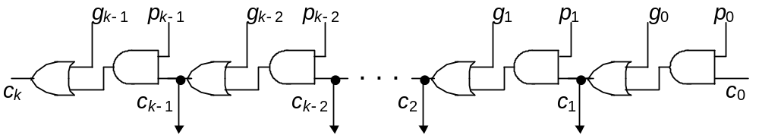
Manchester carry-chain
g3
p3
g2
p2
g1
p1
g0
p0
C4
C3
C2
C1
C0
stage 3
stage 2
stage 1
stage 0
gate-level design:

Slide 17
Manchester carry-chain
g3
p3
g2
p2
g1
p1
g0
p0
C4
C3
C2
C1
C0
stage 3
stage 2
stage 1
stage 0
V
DD
c'
i+1
c'
i
g
i
p
i
Q: Do you will something odd?
Clock
V
SS
(b) Possible CMOS realization.
Fig. 5.13 One stage in a Manchester carry chain.

Slide 18
Manchester carry-chain
g3
p3
g2
p2
g1
p1
g0
p0
C4
C3
C2
C1
C0
stage 3
stage 2
stage 1
stage 0
V
DD
c'
i+1
c'
i
???
g
i
p
i
Q: Do you will something odd?
Clock
V
SS
(b) Possible CMOS realization.
Fig. 5.13 One stage in a Manchester carry chain.

Slide 19
Dynamic Circuit
a CMOS design scheme for fast and small circuit

Slide 20
General scheme of dynamic circuit
Vdd
Mp
clock
out
in1
in2
nFETs
in3
precharge
Mp on
Mn off
...
evaluate
Mp off
Mn on
clock
Mn
time
precharge then evaluate
correct value only appears in short-period of time

Slide 21
How it works?
Example of an NAND gate
Vdd
clock
out = ~(a & b)
a
precharge
Mp on
Mn off
evaluate
Mp off
Mn on
b
time
clock

Slide 22
How it works?
Example of an NAND gate
Vdd
clock
out = ~(a & b)
a
precharge
Mp on
Mn off
evaluate
Mp off
Mn on
b
time
an equivalent capacitance
clock

Slide 23
How it works?
Example of an NAND gate
Vdd
clock
at precharge stage
charging
out = ~(a & b)
a
precharge
Mp on
Mn off
evaluate
Mp off
Mn on
b
time
clock

Slide 24
How it works?
Example of an NAND gate
Vdd
clock
at evaluate stage
out = ~(a & b)
a
precharge
Mp on
Mn off
evaluate
Mp off
Mn on
b
time
clock
case 1: a&b=1
case 2: a&b=0

Slide 25
How it works?
Example of an NAND gate
Vdd
clock
at evaluate stage
discharge
out = ~(a & b)
1
a
precharge
Mp on
Mn off
evaluate
Mp off
Mn on
1
b
time
1
clock
case 1: a&b=1
case 2: a&b=0

Slide 26
How it works?
Example of an NAND gate
Vdd
clock
at evaluate stage
out = ~(a & b)
1
a
ON
precharge
Mp on
Mn off
evaluate
Mp off
Mn on
0
b
OFF
time
1
clock
ON
case 1: a&b=1
case 2: a&b=0
No way to discharge
still remains high

Slide 27
General scheme of dynamic circuit
Vdd
Mp
clock
out
correct value
in1
in2
nFETs
in3
precharge
Mp on
Mn off
...
evaluate
Mp off
Mn on
clock
Mn
time
precharge than evaluate
correct value only appears in short-period of time

Slide 28
Drawback of dynamic circuit
Vdd
clock
Vout < Vdd
at evaluate stage
out = ~(a & b)
1
a
ON
precharge
Mp on
Mn off
evaluate
Mp off
Mn on
0
b
OFF
time
1
clock
ON
case 1: a&b=1
case 2: a&b=0
No way to discharge
still remains high

Slide 29
Domino circuit
Vdd
clock
at evaluate stage
out=a&b
1
a
ON
precharge
Mp on
Mn off
evaluate
Mp off
Mn on
0
b
OFF
time
1
clock
ON
case 1: a&b=1
case 2: a&b=0
No way to discharge

Slide 30
Domino circuit
Vdd
clock
at evaluate stage
out=a&b
1
a
ON
precharge
Mp on
Mn off
evaluate
Mp off
Mn on
a NOT gate to
compensate voltage drop
0
b
OFF
time
1
clock
ON
case 1: a&b=1
case 2: a&b=0
No way to discharge

Slide 31
Let’s back to Manchester carry-chain
now we can understand the design with knowledge of dynamic circuit

Slide 32
Manchester carry-chain
g3
p3
g2
p2
g1
p1
g0
p0
C4
C3
C2
C1
C0
stage 3
stage 2
stage 1
stage 0
to enhance with circuit-level technology

Slide 33
Manchester carry-chain
g3
p3
g2
p2
g1
p1
g0
p0
C4
C3
C2
C1
C0
stage 3
stage 2
stage 1
stage 0
V
DD
c'
i+1
c'
i
g
i
p
i
Q: How this circuit works?
Clock
V
SS
(b) Possible CMOS realization.
Fig. 5.13 One stage in a Manchester carry chain.

Slide 34
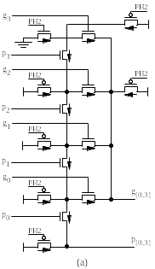
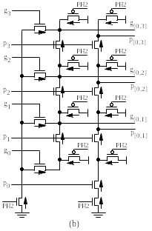
4-bit Manchester carry-chain
Fig. 6.12 Example four-bit Manchester carry chain designs in CMOS technology [Lync92].

Slide 35
Q: what’s the Boolean equation behind?
Fig. 6.12 Example four-bit Manchester carry chain designs in CMOS technology [Lync92].

