Slide 1
Cell-Based Design Flow for VLSI Design
Lecture 02 (Part B)
How to do your RTL homeworks

Slide 2
Recall: VLSI design flow
ESL design
(Electronic System Level)
RTL design
(Register Transfer Level)
gate-level design
circuit-level design
(transistor-level)
physical layout

Slide 3
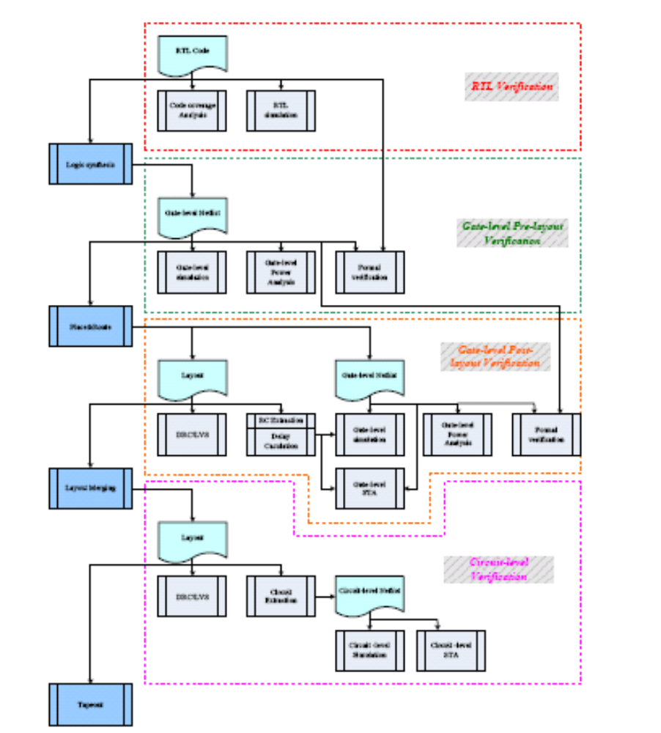
cell-based design flow

Slide 4

Logical synthesis
transform Verilog/VHDL code to gate-level netlist
  logic simplification
reg D;
always @(A or B or C)
D = (A&B) | C;

Slide 5
Place and Route

Slide 6
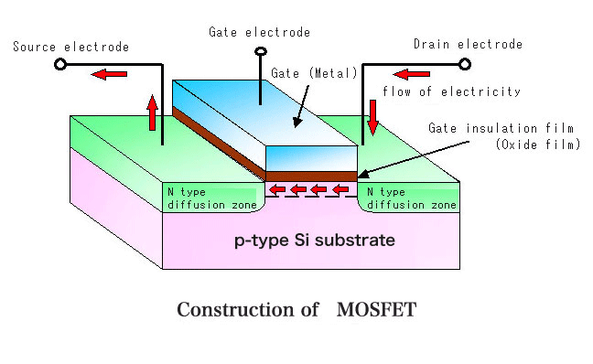
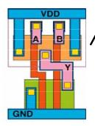
Layout merging
physical design

Slide 7
Lots of things to do
design
synthesis (transform to next level)
design analysis: timing, chip area, power consumption
verification

Slide 8
On RTL design stage

Slide 9
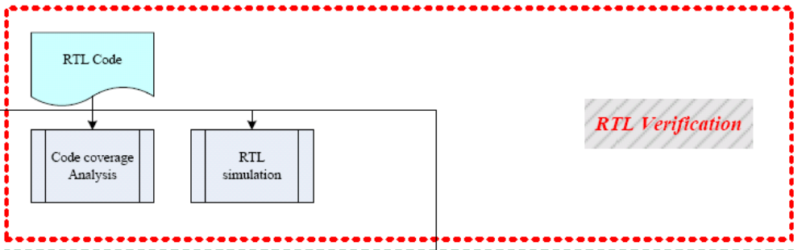
RTL design stage
analyze whether your test patterns touch every signal in your design

Slide 10
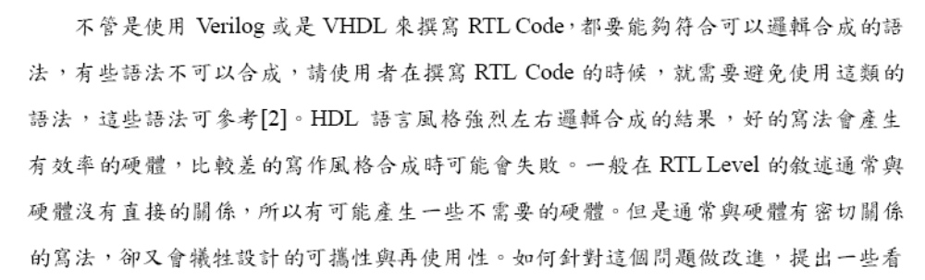
The most important thing in RTL design stage

Slide 11
Logic synthesis

Slide 12
Logical synthesis
transform Verilog/VHDL code to gate-level netlist
  logic simplification
reg D;
always @(A or B or C)
D = (A&B) | C;

Slide 13
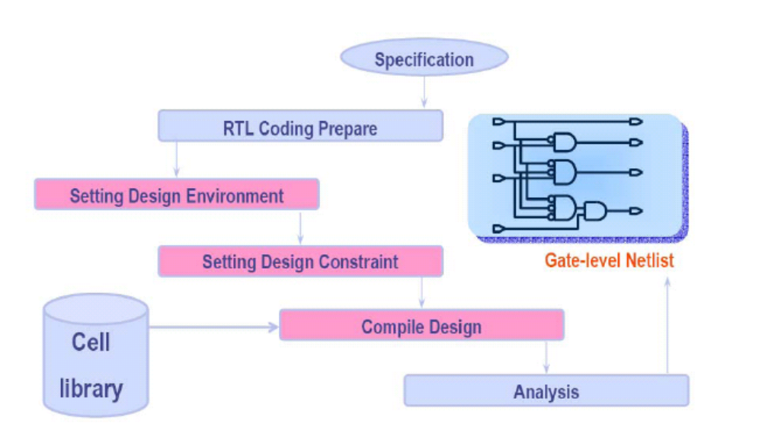
Environment of logical synthesis

Slide 14
Environment of logical synthesis
fab dependent
(SAED 32nm)

Slide 15
Environment of logical synthesis
set timing and area requirements

Slide 16
Design constraint
you can give such a command to EDA tool:
  path delay from A to D < 10ns

Slide 17
Environment of logical synthesis
report timing, area, and power consumption

Slide 18
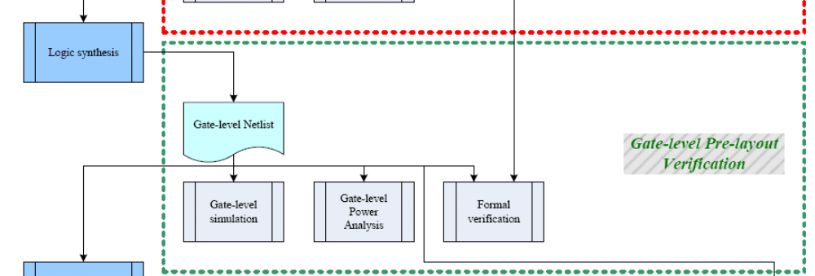
Verification after logical synthesis

Slide 19
Place & Route

Slide 20
What is cell-based design
compose a chip from library cells
a cell may be: AND gate, OR gate, D flip-flop, etc.

Slide 21
Basic scheme of cell-based design
planning on chip area

Slide 22
Basic scheme of cell-based design
to place cells
area to route wires

Slide 23
Placement
mapping logical gates (cells) onto locations for cells

Slide 24
Routing
route wires

Slide 25
Theory about place & route
Optimization issues
  timing (path delay)
  chip area
  power consumption
Theoretical foundation
  combinatorial optimization
  graph theory
  discrete geometry
many many NP-complete problems!
Reference:
  S. H. Gerez, Algorithms for VLSI Design Automation, Addison Wesley

Slide 26
Why we have to simulate so many times?
effect of different timing precision on simulation

Slide 27
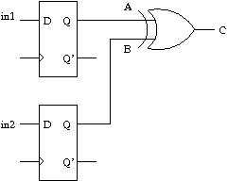
Example circuit

Slide 28
How we reasoning the timing in doing digital circuit design
the pre-layout simulation result
time
in1
0
1
in2
0
1
A
0
1
B
0
1
C
0

Slide 29
How we reasoning the timing in doing digital circuit design
the pre-layout simulation result
time
signal changes alias to clock edges
in1
0
1
in2
0
1
A
0
1
B
0
1
C
0

Slide 30
How we reasoning the timing in doing digital circuit design
the pre-layout simulation result
time
in1
0
1
in2
0
1
no signal glitches in cycle-based reasoning
A
0
1
B
0
1
C
0

Slide 31
What will happen in the real-world?
the post-layout simulation result
time
in1
0
1
in2
0
1
A
B
C

Slide 32
What will happen in the real-world?
the post-layout simulation result
time
signals may not arrive at the same time
in1
0
1
in2
0
1
A
B
C

Slide 33
What will happen in the real-world?
the post-layout simulation result
time
signals may not arrive at the same time
in1
0
1
in2
0
1
unexpected glitch
A
B
C

Slide 34
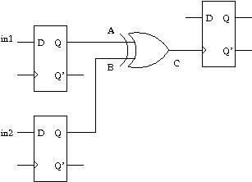
What will happen in the real-world?
the post-layout simulation result
unexpected behavior on the D flip-flop
time
in1
0
1
in2
0
1
unexpected glitch
A
B
C

Slide 35
Example: an adder

Slide 36
Adder as the example
in1
in0
+
dout

Slide 37
Observe the result of logic synthesis
Q: how to select cells?
Q: how to estimate the path delay?
Q: why a cell with multiple gates?

Slide 38
Observe the result of place & route
Q: effect of wire length and width?
Q: how to make all flip flops receive correct clock?

Slide 39
Materials come from
John P. Uyemura, Introduction to VLSI Circuits and Systems, John Wiley & Sons
Michael John Sebastian Smith, Application-Specific Integrated Circuits, Addison Wesley

