Slide 1
Residue Number System
Lecture 03 (Part E)
to demonstrate how number encoding may result in fast hardware

Slide 2
The Motivating Problem
Objective: to design a fast adder
  with critical path as short as possible

Slide 3
Critical path analysis for the adder

Slide 4
How a computer performs binary addition
0 1 1 0
A
for each bit i=0 to N-1 do {
{C[i+1], S[i]} = A[i]+B[i]+C[i]
}
+)
0 0 1 1
B
S

Slide 5
How a computer performs binary addition
Step 1: addition for bit 0
0 1 1 0
A
for each bit i=0 to N-1 do {
{C[i+1], S[i]} = A[i]+B[i]+C[i]
}
+)
0 0 1 1
B
S

Slide 6
How a computer performs binary addition
Step 1: addition for bit 0
Carry C[1]
0
0 1 1 0
A
for each bit i=0 to N-1 do {
{C[i+1], S[i]} = A[i]+B[i]+C[i]
}
+)
0 0 1 1
B
1
S
Sum S[0]

Slide 7
How a computer performs binary addition
Step 2: addition for bit 1 with carry
0
0 1 1 0
A
for each bit i=0 to N-1 do {
{C[i+1], S[i]} = A[i]+B[i]+C[i]
}
+)
0 0 1 1
B
1
S

Slide 8
How a computer performs binary addition
Step 2: addition for bit 1 with carry
1
0
0 1 1 0
A
for each bit i=0 to N-1 do {
{C[i+1], S[i]} = A[i]+B[i]+C[i]
}
+)
0 0 1 1
B
0
1
S

Slide 9
How a computer performs binary addition
Step 2: addition for bit 1 with carry
Carry C[2]
1
0
0
0 1 1 0
A
for each bit i=0 to N-1 do {
{C[i+1], S[i]} = A[i]+B[i]+C[i]
}
+)
0 0 1 1
B
0
1
S
Sum S[1]

Slide 10
How a computer performs binary addition
repeat the procedure and we get the result
0 1 1 0
A
for each bit i=0 to N-1 do {
{C[i+1], S[i]} = A[i]+B[i]+C[i]
}
+)
0 0 1 1
B
1 0 0 1
S
So, what’s the basic cell for the addition?

Slide 11
Full Adder: the basic component for an adder
a combinational circuit doing the following truth table
to perform addition for a bit i
Y
X
X
Y
Cin
Cout
S
1
0
0
0
0
0
0
0 1 1 0
A
Cin
0
0
1
0
1
+)
0 0 1 1
B
FA
0
1
0
0
1
0
1
1
1
0
0
1
S
1
0
0
0
1
1
0
1
1
0
S
1
1
0
1
0
Cout
1
1
1
1
1

Slide 12
Carry-Propagation Adder
B
A
always @(*)
{Cout, S} = A+B+Cin;
n
n
Cout
Adder
Cin
n
S
B[n-1]
A[n-1]
B[n-2]
A[n-2]
B[2]
A[2]
B[1]
A[1]
B[0]
A[0]
Cin
FA
FA
FA
FA
FA
…
Cout
S[n-1]
S[n-2]
S[2]
S[1]
S[0]

Slide 13
Critical path analysis
critical path for n-bit adder: O(n)
B[n-1]
A[n-1]
B[n-2]
A[n-2]
B[2]
A[2]
B[1]
A[1]
B[0]
A[0]
Cin
FA
FA
FA
FA
FA
…
Cout
S[n-1]
S[n-2]
S[2]
S[1]
S[0]

Slide 14
Core problem of fast adder design
How to reduce the O(n) critical path
residue number system (RNS) provides a way to “segment” the O(n) carry-chain

Slide 15
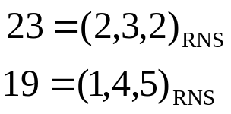
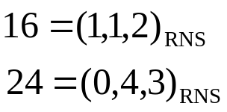


Strategy of RNS for fast adder design
transform scalar operation to be vector operation
  operate on vectors with smaller number
Example: RNS with primes {3,5,7}
+)
+)

Slide 16
Chinese remainder theorem – first visit
ad-hoc solution from ancient Chinese

Slide 17
The motivating problem
孫子算經:
  今有物不知其數，三三數之剩二，五五數之剩三，七七數之剩二，問物幾何？
Find an integer x such that
  x mod 3 = 2
  x mod 5 = 3
  x mod 7 = 2
Answer: x=23+3*5*7*k

Slide 18
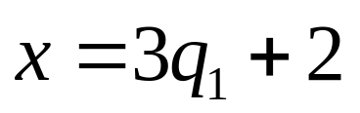
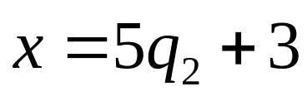
Solution strategy
simplify, simplify, and simplify,…
a simpler version of this problem:
  find an integer x such that
    for some integer q₁ and q₂

Slide 19




Roadmap for further simplify
Problem: find integer x such that
Problem: find integer x such that
Problem: find integer x such that

Slide 20
Simplified Problem (2)
Problem: find integer x such that
The trial:
  5, 10, 15, 20, 25, …
Observation: gap btw/ two solutions=15

Slide 21


Simplified Problem (2)
Problem: find integer x such that
The trial:
  3, 6, 9, 12, 15, 18, 21, 24, …
Observation: gap btw/ two solutions=15

Slide 22
Roadmap for further simplify
Problem: find integer x such that
Problem: find integer x such that
Problem: find integer x such that
solved!

Slide 23

Simplified Problem (1)
Problem:
  Given integer x₀: solution to
  Want to Find: integer x such that
    from x₀

Slide 24

Simplified Problem (1)
Analysis:
  x₀=10 is a solution to
  let’s check the real-line:
  x = 2*x₀ = 20 is a solution to
3q₁
1
3q₁
1
10
10
0

Slide 25

Simplified Problem (1)
Analysis:
  x₀=6 is a solution to
  the real-line:
  x = 3*x₀ = 18 is a solution to
5q₂
1
5q₂
1
5q₂
1
6
6
6
0

Slide 26



Simplified Problem (1)
General scheme:
  Let x₀ be a solution to
  Then x= x₀*r is a solution to
Justify:

Slide 27



Simplified target problem
Problem:
  Given:
    x₀: solution to
    x₁: solution to
  Want to Find: integer x such that

Slide 28
Simplified target problem
We have
  x₀=20 is a solution to
  x₁=18 is a solution to
Let x=x₀+x₁=20+18=38 and observe the real-line
5q₂
5q’₂
3
3q₁
2
3q’₁
20
18

Slide 29


Simplified target problem
Let x=x₀+x₁=20+18=38 and observe the real-line
5q₂
5q’₂
3
5q₂
5q’₂
3
3q₁
2
3q’₁
3q₁
2
3q’₁
20
18
20
18

Slide 30





Simplified target problem
General scheme:
  Let x₀: solution to
  Let x₁: solution to
  Then x= x₀ + x₁ is a solution to
Justify:

Slide 31
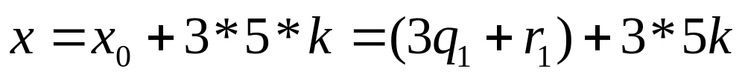
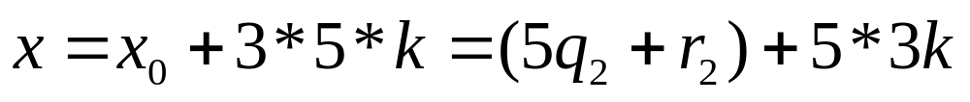
Simplified target problem
Observation: the solution appears with gap 3*5=15
  solutions: 8, 23, 38, 53, 68, …
Why? Justify

Slide 32



In-Class Exercise
Problem: find an integer x such that
  for some integers q₁, q₂, and q₃

Slide 33
Chinese remainder theorem revisited
from the view point of modern algebra

Slide 34
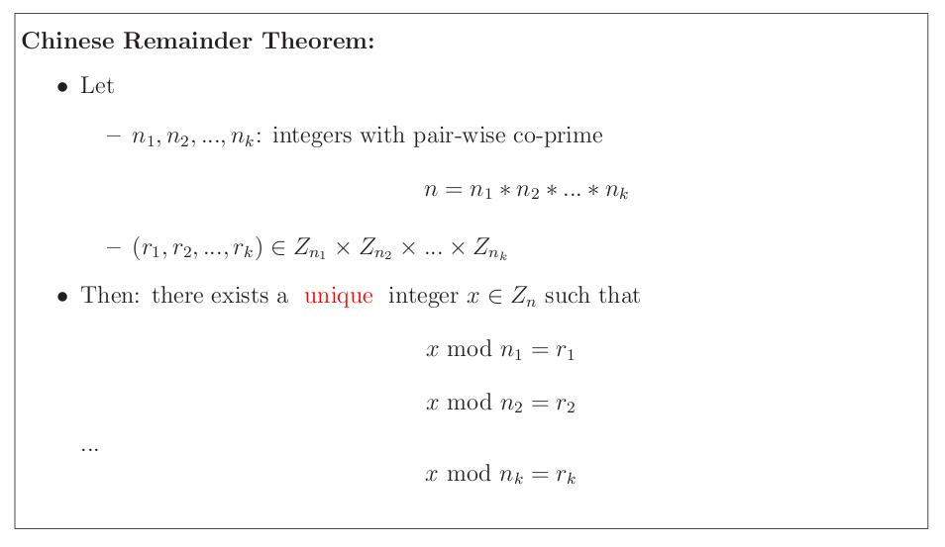
Chinese Remainder Theorem
Z_{k}={0, 1, 2, …, k-1}
How to prove it?
  Hint: quotient ring theory in abstract algebra
  see Herstein, Abstract Algebra

Slide 35
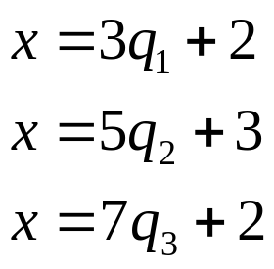
Example of CRT
Problem: find an integer x between 0 and 104 such that
Answer: x=23
Q: Can you find another x between 0 to 104?
Note: 3, 5, 7 are all primes!

Slide 36
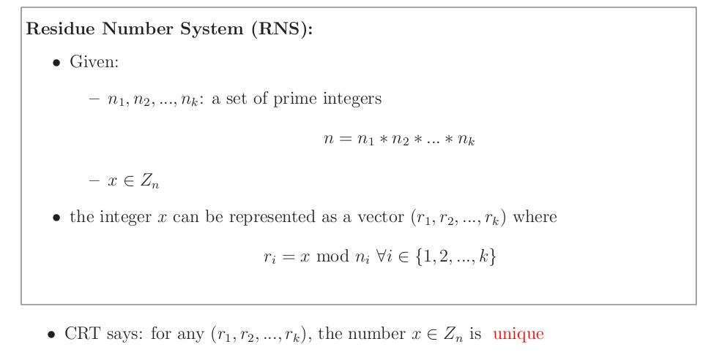
Residue Number System

Slide 37
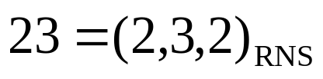
Example of RNS
fix the set of primes {3, 5, 7}
we denote
23 is the unique x in [0, 104] such that

Slide 38
In-Class Exercise
represent the numbers in RNS with base (3,5,7)
  47 = (?, ?, ?)
  15 = (?, ?, ?)
  68 = (?, ?, ?)

Slide 39
Why we want RNS
to design a fast adder
algebra to operate the vectors (a, b, c)_{RNS}

Slide 40
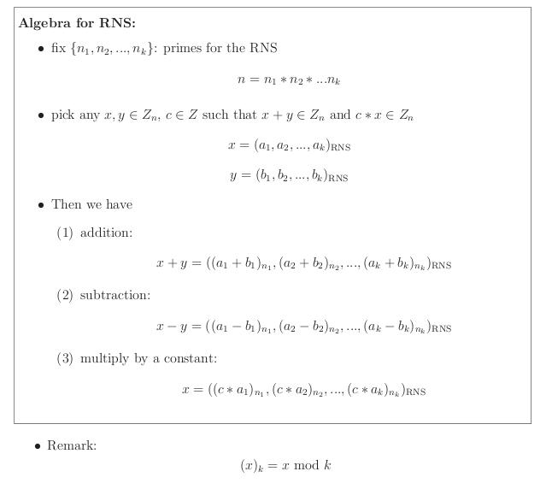
Algebra of RNS

Slide 41
Example: RNS addition
Consider: RNS with {3, 5, 7}
23=(2, 3, 2)_{RNS}
19=(1, 4, 5)_{RNS}
Justify: 42=(0, 2, 0)
  23 = 3*7+2
  19 = 3*6+1
  23+19 = 3*(7+6)+3 = 3*(7+6) + 3*1+0

Slide 42
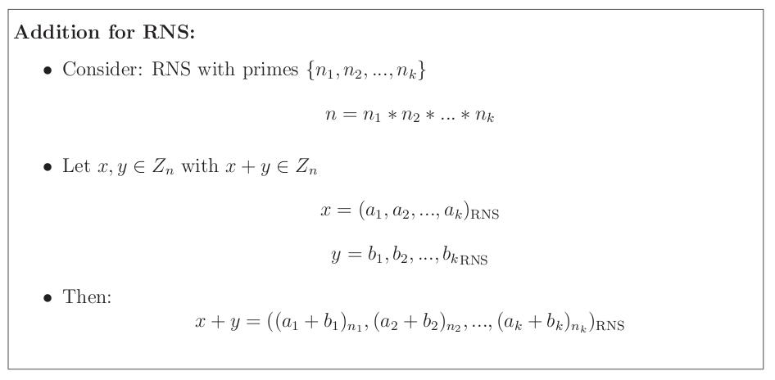
Addition for RNS

Slide 43
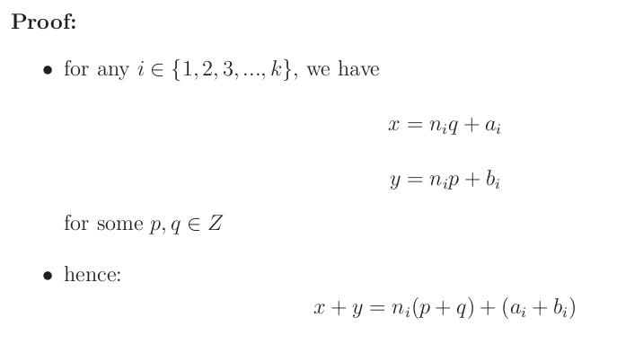
Proof of addition for RNS

Slide 44
In-Class Exercise
RNS addition with base (3, 5, 7)
  17+32
  25+36
  19+15

Slide 45
Algebra of RNS
Prove subtraction and multiply
by yourself

Slide 46
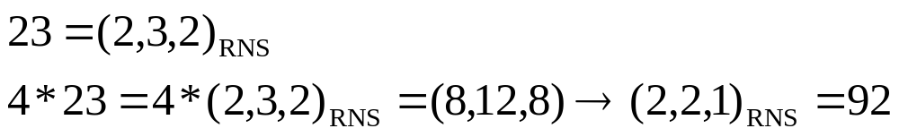
Example: RNS multiply
Consider: RNS with primes {3, 5, 7}
Justify:
  23=5*4+3
  23*4=5*4*4+3*4=5*16+12=5*16+5*2+2

Slide 47
Put it all together
compare the ad-hoc solution and linear algebra approach

Slide 48
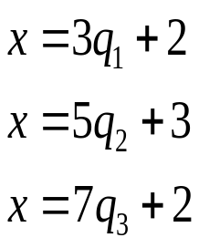
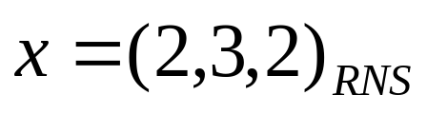
Example
Problem: find integer x such that
Problem:
  Consider RNS with primes {3, 5, 7}
  Find:

Slide 49
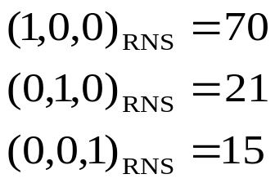
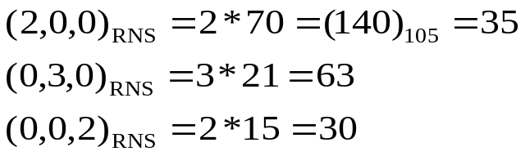
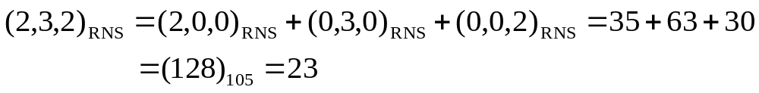
General scheme with example (2,3,2)_{RNS}
RNS with primes{3,5,7}
setup unit vectors
find value for each coordinate
take sum for all coordinates

Slide 50
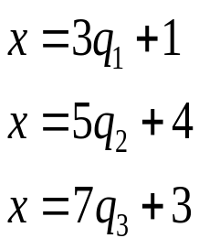
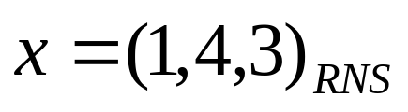
In-Class Exercise
Problem: find integer x such that
Problem:
  Consider RNS with primes {3, 5, 7}
  Find:

Slide 51
RNS Adder

Slide 52
Basic scheme of RNS adder
doing operation on vectors with smaller numbers
Example: RNS with primes {3,5,7}
+)
+)

Slide 53
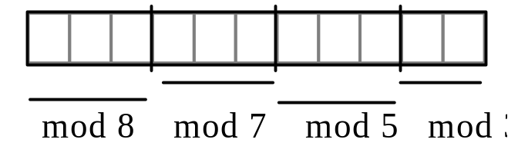
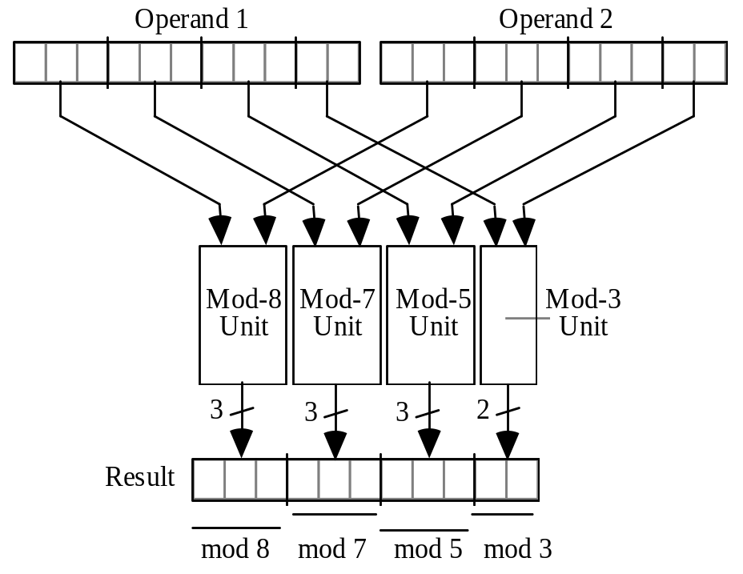
Example: an adder for RNS
with primes {3,5,7,8}
Fig. 4.1 Binary-coded format for RNS(8 | 7 | 5 | 3).
Fig. 4.2 The structure of an adder, subtractor, or multiplier for RNS(8|7|5|3).

Slide 54
Example: an adder for RNS
with primes {3,5,7,8}
dedicated truth-table
doing (a+b) mod 7
Fig. 4.1 Binary-coded format for RNS(8 | 7 | 5 | 3).
Fig. 4.2 The structure of an adder, subtractor, or multiplier for RNS(8|7|5|3).

Slide 55
Problems Remaining
How to convert RNS back to binary encoding?
  with small hardware
How to do complex arithmetic?
  multiply, division
  compare >, <, == (see Example 4.3 at page 65)
RNS is usually for signal processing, not individual scalar operation!

Slide 56
Homework #2
Prove the multiplication rule of RNS

Slide 57
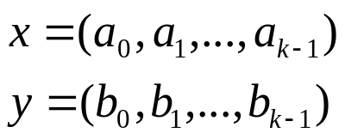
HW#2: Problem Description
Consider: an RNS formed by co-prime numbers (n₁, n₂, …, n_{k-1})
Let x and y be two integers in the range of the RNS
Suppose x*y is still in the range of the RNS
Prove:

