Slide 1
Signed Number Representation
Lecture 03 (Part C)

Slide 2
Two’s complement representation of signed number

Slide 3
Signed number representation (2’s complement)
the general format
  4-bit signed number
  representing -8 ~ 7
sign bit

Slide 4
Signed number representation (2’s complement)
Example: representing positive number +5
positive number
0
1
0
1
sign bit

Slide 5


Signed number representation (2’s complement)
Example: representing negative number -5
Rule:
A=+5
0
1
0
1
negative number
1
0
1
0
1
0
1
1
1
0
1
1
sign bit

Slide 6

Signed number representation (2’s complement)
Property:
A=-5
1
0
1
1
0
1
0
0
+5
0
1
0
1
0
1
0
1
sign bit

Slide 7
How to do subtraction
use adder with 2’s complement encoding

Slide 8
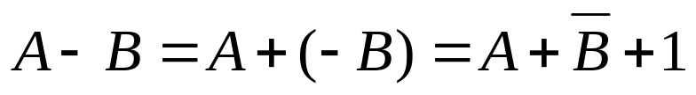


Method to do subtraction
Rule:
Example: A=5, B=3
A=5
0
0
1
1
0
1
0
1
B=3
-B=-3
+)
1
1
0
1
1
1
0
0
1
0
0
1
0
1
1
0
1
A-B=2

Slide 9
Method to do subtraction
Rule:
Example: A=3, B=5
A=3
0
1
0
1
0
0
1
1
B=5
-B=-5
+)
1
0
1
1
1
0
1
0
0
1
1
1
0
1
0
1
1
A-B=-2

Slide 10
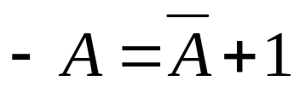
Summary: Rule of thumb
Key Properties:
Apply whenever positive or negative

Slide 11
Mathematics
show that –A=~A+1

Slide 12
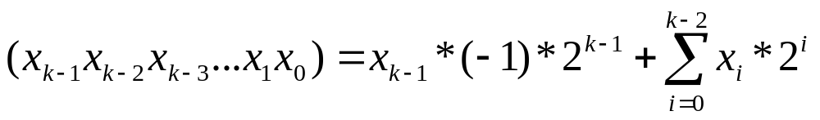
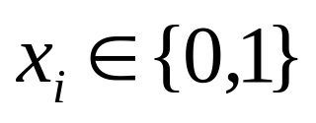
2’s complement representation: the vector formulation

Slide 13
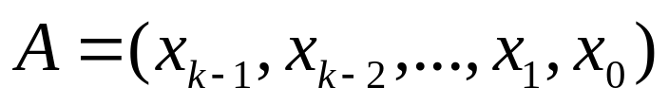
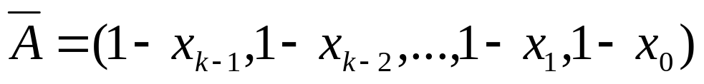
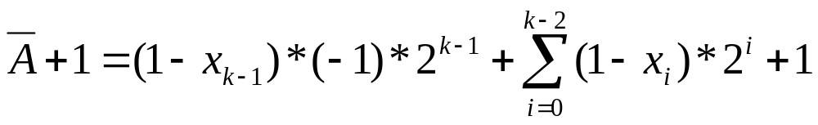
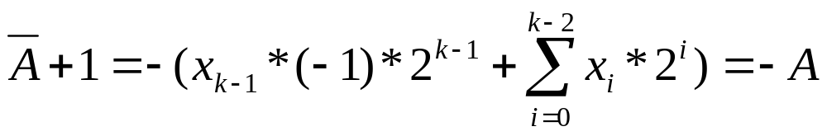
Show: -A=~A+1

Slide 14
Remark
this is the first example to show you the power of the vector math
subtraction becomes addition

Slide 15
In-Class Exercise
write a C-code to calculate |A-B|
  you cannot use the following operators: -, >, <, >=, <=
  only add(+) and bit-wise logical operators available

Slide 16
Appendix: Some legacy results on signed number representation

Slide 17
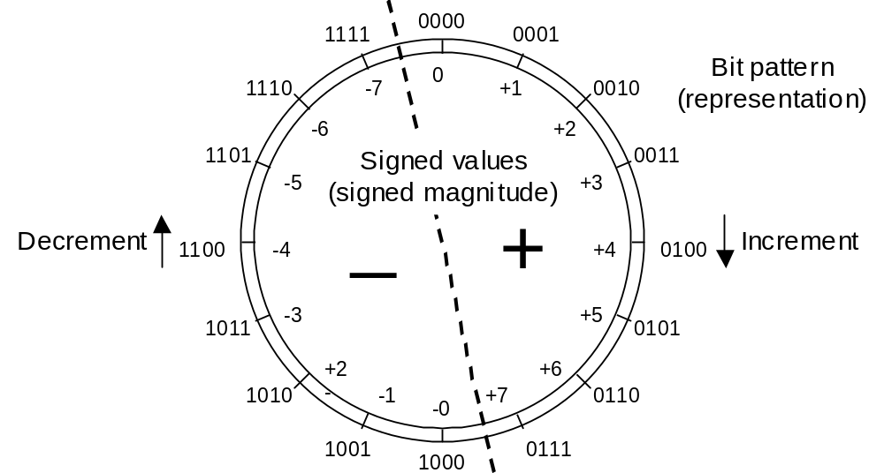
Signed-Magnitude Representation
-
Fig. 2.1 Four-bit signed-magnitude number representation system for integers.

Slide 18
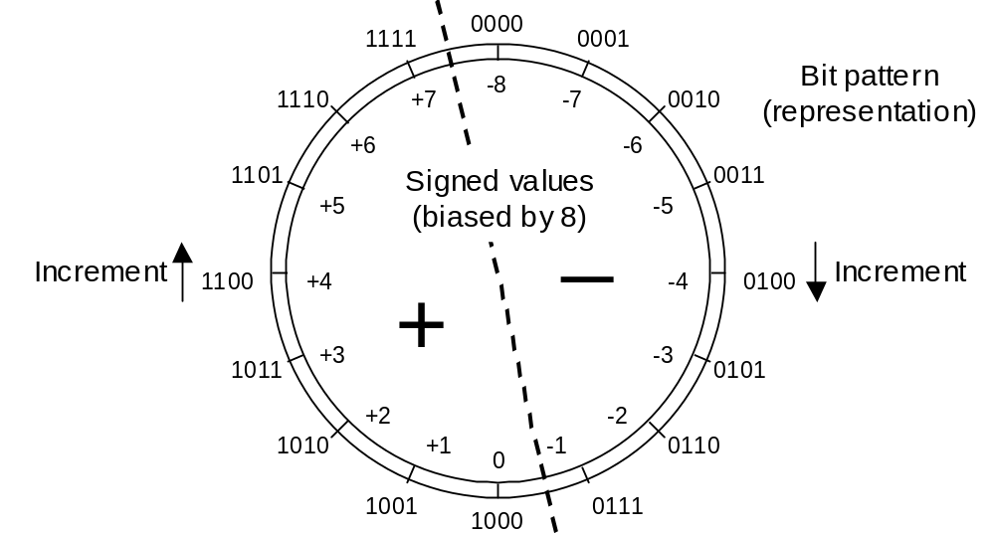
Biased Representations
Fig. 2.3 Four-bit biased integer number representation system with a bias of 8.

Slide 19
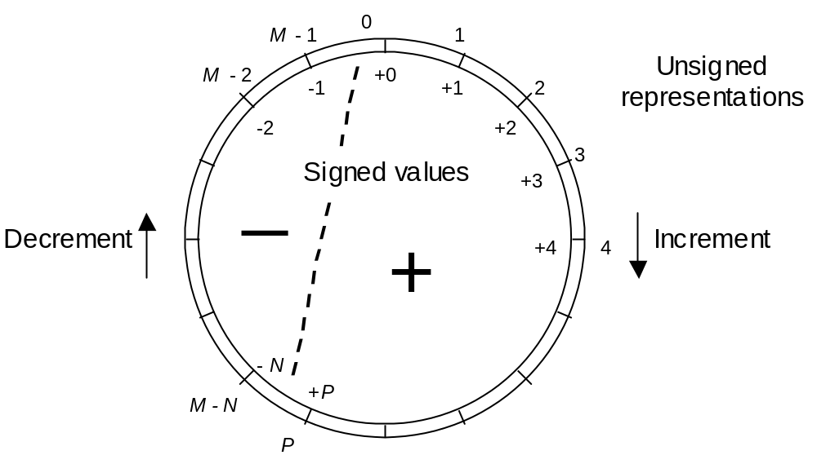
Complement Representations
Fig. 2.4 Complement representation of signed integers.

Slide 20
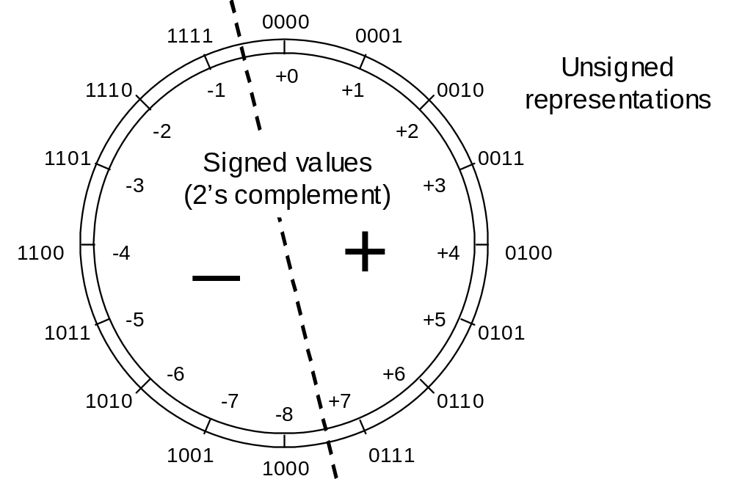
Two’s-Complement Numbers
Two’s complement = radix complement system for r = 2
M = 2^{k}
2^{k} – x = [(2^{k} – ulp) – x] + ulp
= x^{compl} + ulp
Range of representable numbers in with k whole bits:
from –2^{k–1} to 2^{k–1} – ulp
Fig. 2.5 A 4-bit 2’s-complement number representation system for integers.

Slide 21

One’s-Complement Number Representation
One’s complement = digit complement (diminished radix complement) system for r = 2
M = 2^{k} – ulp
(2^{k} – ulp) – x = x^{compl}
Range of representable numbers in with k whole bits:
from –2^{k–1} + ulp to 2^{k–1} – ulp
Fig. 2.6 A 4-bit 1’s-complement number representation system for integers.

Slide 22
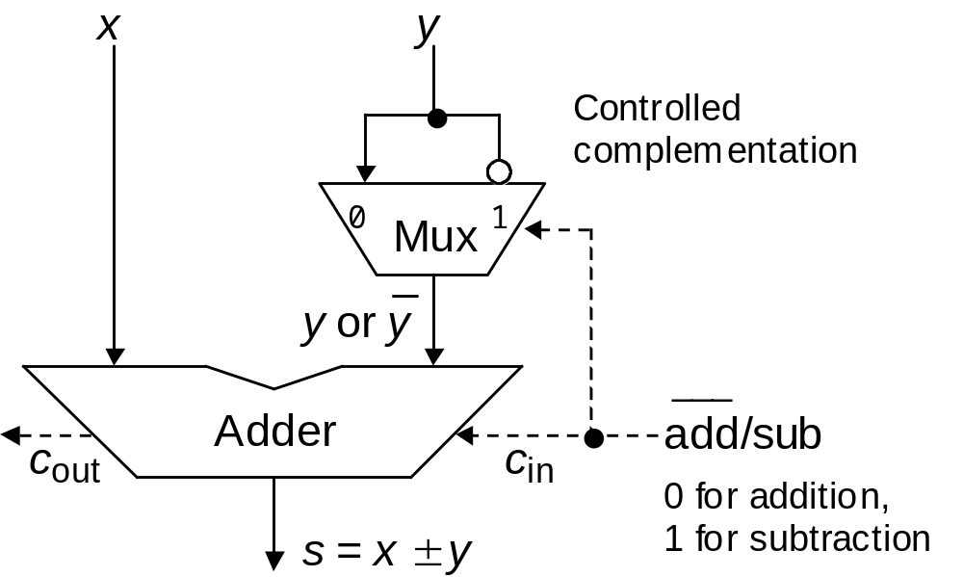
Why 2’s-Complement Is the Universal Choice
Fig. 2.7 Adder/subtractor architecture for 2’s-complement numbers.

Slide 23
Think by yourself
Design the hardware for x-y for each legacy signed number encoding
Show why 2’s complement encoding results in the simplest hardware

