Slide 1
Carry-Lookahead Adder: Basic Concepts
Lecture 05 (Part A)
a brute-force approach

Slide 2
Core Problem
Q: How to design an extremely fast adder?

Slide 3
Analysis to high-speed adder design

Slide 4
Ripple-Carry Adder
B
A
n
n
always @(*)
{Cout, S} = A+B+Cin;
Cout
Adder
Cin
n
S
B[n-1]
A[n-1]
B[n-2]
A[n-2]
B[2]
A[2]
B[1]
A[1]
B[0]
A[0]
0 1 1 0
A
+)
0 0 1 1
B
Cin
FA
FA
FA
FA
FA
1 0 0 1
S
…
Cout
S[n-1]
S[n-2]
S[2]
S[1]
S[0]

Slide 5
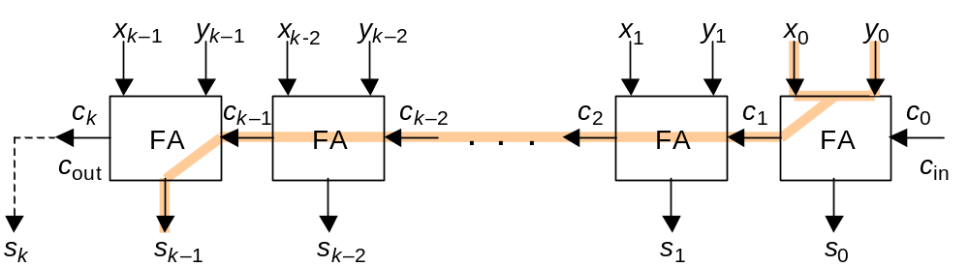
Critical path analysis
T_{ripple-add} = T_{FA}(x,y→c_{out}) + (k – 2)×T_{FA}(c_{in}→cout) + T_{FA}(c_{in}→s)
Fig. 5.5 Critical path in a k-bit ripple-carry adder.

Slide 6
Full Carry-Lookahead
x₃
y₃
x₂
y₂
x₁
y₁
x₀
y₀
c_{in}
. . .
s₃
s₂
s₁
s₀
Theoretically, it is possible to derive each sum digit directly from the inputs that affect it
Carry-lookahead adder design is simply a way of reducing the complexity of this ideal, but impractical, arrangement by hardware sharing among the various lookahead circuits

Slide 7















Framework of CLA
CLA: carry-lookahead adder for X+Y
Y
X
n
n
lookahead carry generator
FA
FA
FA
FA
FA
…

Slide 8
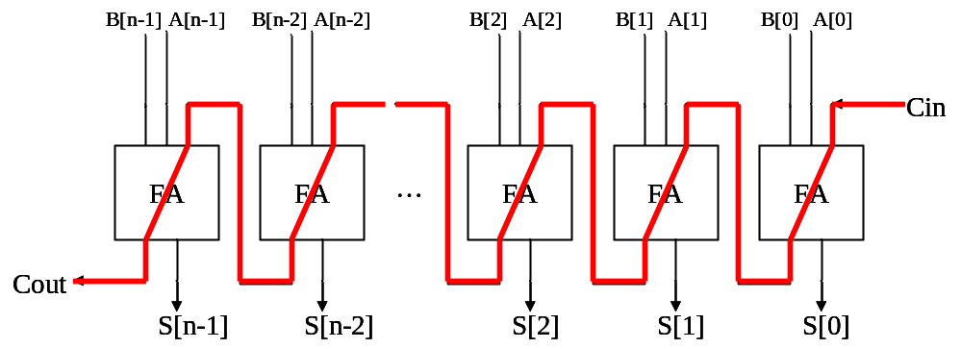
How to design a fast adder
various architectures to reduce the carry-chain
ESL design
(Electronic System Level)
RTL design
(Register Transfer Level)
gate-level design
circuit-level design
(transistor-level)
physical layout

Slide 9
How to design a fast adder
various architectures to reduce the carry-chain
  Carry-lookahead adders
    hierarchical
    prefix computation
  carry-skip adders
  carry-select adders
ESL design
(Electronic System Level)
RTL design
(Register Transfer Level)
gate-level design
circuit-level design
(transistor-level)
physical layout

Slide 10
How to design a fast adder
Manchester carry-chain (Sec. 5.6)
dual-rail logic network
dynamic circuit
ESL design
(Electronic System Level)
RTL design
(Register Transfer Level)
gate-level design
circuit-level design
(transistor-level)
physical layout

Slide 11
Observation: How a carry generated
Where’s the chance to speedup carry generation?

Slide 12
Traditional way to get the carry to bit i
take the sum of x[i-1:0]+y[i-1:0]
Q: can we do it faster?
the carry to bit i
1
0 0 1 0 1 1 0 1 0
+)
0 1 1 1 0 1 0 1 0
0 0 0 1 0 0

Slide 13
Observations
Concentrate and
find out the answers in 1 second

Slide 14
Case 1
Q: find C_{i} in 1 second
C_{i}=?
0 0 1 0 1 1 0 1 0
+)
0 1 1 1 0 1 0 1 0

Slide 15
Case 1
The answer
We only have to observe that x_{i-1}=1 and y_{i-1}=1
C_{i}=1
0 0 1 0 1 1 0 1 0
+)
0 1 1 1 0 1 0 1 0

Slide 16
Case 2
Q: find C_{i} in 1 second
C_{i}=?
0 0 1 0 1 1 0 1 0
+)
0 1 1 1 0 1 0 1 0

Slide 17
Case 2
The carry is generated from bit 3 and propagate to bit 6
generate the carry
C_{i}=1
0 0 1 0 1 1 0 1 0
+)
0 1 1 1 0 1 0 1 0

Slide 18
Case 3
Q: find C_{i} in 1 second
C_{i}=?
0 0 1 0 1 0 0 1 0
+)
0 1 1 1 0 1 0 1 0

Slide 19
Case 3
Carry is generated at bit 1 but propagation stops at by bit 3
generate the carry
C_{i}=0
0 0 1 0 1 0 0 1 0
+)
0 1 1 1 0 1 0 1 0
propagation stops here

Slide 20
Rules to get carry as fast as possible
summary of above observations

Slide 21
Rule of Thumb
How to observe the carry as fast as possible?
  find where carry is generated
  find if a generated carry will propagate to desired position
  carry generation and propagation depends on bit i only

Slide 22






Signals generated from bit j
Consider: How to compute {C_{j+1}, S_{j}}=x_{j}+y_{j}+C_{j}
g_{j}: carry generation
  g_{j}=1 if a carry is generated from bit j
p_{j}: carry propagation
  p_{j} =1 if a carry generated before bit j propagates through bit j
0
0
0
0
0
0
1
0
1
1
0
0
1
1
1
1
1
0

Slide 23
Case 1: carry generation
g_{j}=1: a carry is always generated regardless previous results
C_{i}=1
0 0 1 0 1 1 0 1 0
0
0
0
0
0
+)
0 1 1 1 0 1 0 1 0
0
1
0
1
1
0
0
1
1
1
1
1
0

Slide 24
Case 2: carry propagation
p_{j}=1: a carry generated in previous bit is propagated through bit j
generate the carry
C_{i}=1
0 0 1 0 1 1 0 1 0
0 1 1 1 0 1 0 1 0
0
0
0
0
0
+)
0
1
0
1
1
0
0
1
1
1
1
1
0

Slide 25
Case 3: stops carry propagation
p_{j}=0: stops carry propagation
generate the carry
C_{i}=0
0 0 1 0 1 0 0 1 0
+)
0 1 1 1 0 1 0 1 0
0
0
0
0
0
0
1
0
1
1
0
0
1
propagation stops here
1
1
1
1
0

Slide 26
Put these cases together: the Boolean equation

Slide 27
The Boolean equation to generate C_{i+1}
a carry is generated to bit i+1 if
  a carry is generated from bit i, or
  a carry is generated at bit i-1 and propagate through bit i, or
  a carry is generated at bit i-2 and propagate through bit i and i-1, or
  a carry is generated at bit i-3 and propagate through bit i-2 to i, or
  …

Slide 28
The Boolean equation to generate C_{i+1}
a carry is generated to bit i+1 if
  a carry is generated from bit i, or
  a carry is generated at bit i-1 and propagate through bit i, or
  a carry is generated at bit i-2 and propagate through bit i and i-1, or
  a carry is generated at bit i-3 and propagate through bit i-2 to i, or
  …
C_{i+1}=1
0
0
0
0
0
0 0 1 0 1 1 0 1 0
0
1
0
1
+)
0 1 1 1 0 1 0 1 0
1
0
0
1
1
1
1
1
0

Slide 29
The Boolean equation to generate C_{i+1}
a carry is generated to bit i+1 if
  a carry is generated from bit i, or
  a carry is generated at bit i-1 and propagate through bit i, or
  a carry is generated at bit i-2 and propagate through bit i and i-1, or
  a carry is generated at bit i-3 and propagate through bit i-2 to i, or
  …
generate the carry
C_{i+1}=1
0 0 1 0 1 1 0 1 0
0 1 1 1 0 1 0 1 0
0
0
0
0
0
+)
0
1
0
1
1
0
0
1
1
1
1
1
0

Slide 30
The Boolean equation to generate C_{i+1}
a carry is generated to bit i+1 if
  a carry is generated from bit i, or
  a carry is generated at bit i-1 and propagate through bit i, or
  a carry is generated at bit i-2 and propagate through bit i and i-1, or
  a carry is generated at bit i-3 and propagate through bit i-2 to i, or
  …
matches none
generate the carry
C_{i}=0
0 0 1 0 1 0 0 1 0
0
0
0
0
0
+)
0 1 1 1 0 1 0 1 0
0
1
0
1
1
0
0
1
propagation stops here
1
1
1
1
0

Slide 31
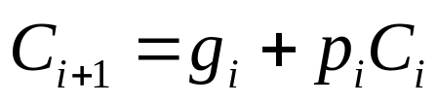
Justification
Proof outline:
  the recurrence relation:
  prove by induction

Slide 32
Implementation of CLA
CLA: carry-lookahead adder

Slide 33
Framework of CLA
CLA: carry-lookahead adder for X+Y
Y
X
n
n
lookahead carry generator
FA
FA
FA
FA
FA
…

Slide 34














Framework of CLA
CLA: carry-lookahead adder for X+Y
pg
pg
pg
pg
pg
lookahead carry generator
FA
FA
FA
FA
FA
…

Slide 35
Framework of CLA
CLA: carry-lookahead adder for X+Y
pg
pg
pg
pg
pg
0
0
0
0
0
0
1
0
1
lookahead carry generator
1
0
0
1
1
1
1
1
0
FA
FA
FA
FA
FA
…

Slide 36
Framework of CLA
CLA: carry-lookahead adder for X+Y
to implement Boolean equations
pg
pg
pg
pg
pg
lookahead carry generator
FA
FA
FA
FA
FA
…

Slide 37
Framework of CLA
CLA: carry-lookahead adder for X+Y
pg
pg
pg
pg
pg
lookahead carry generator
FA
FA
FA
FA
FA
…
full adders to get the sum without O(n) carry chain

Slide 38
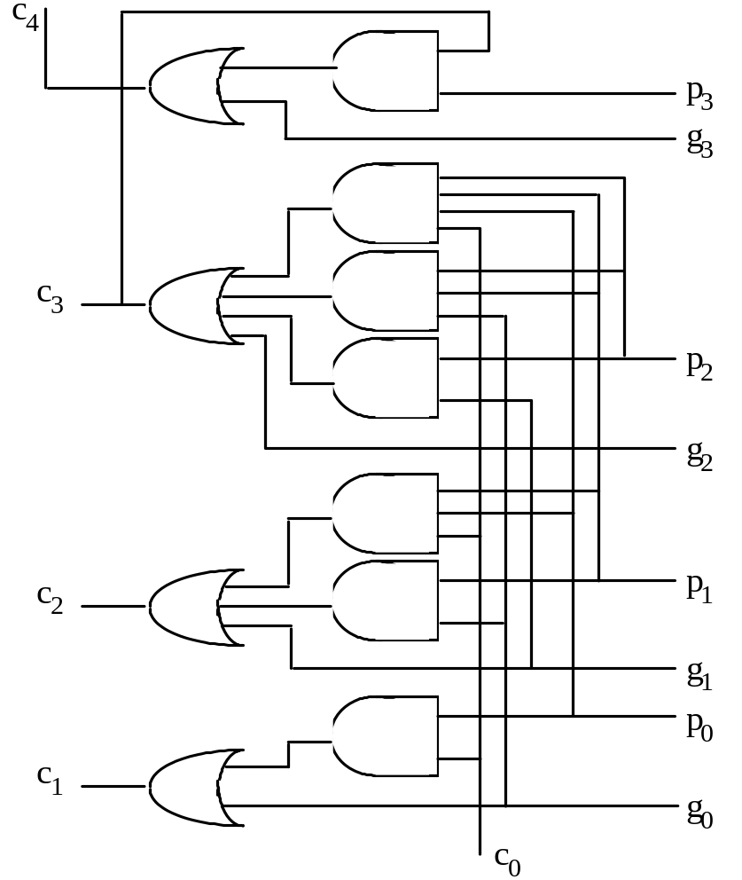
4-bit look-ahead carry generation
Fig. 6.1 Four-bit carry network with full lookahead.
Full carry lookahead is quite practical for a 4-bit adder
c₁ = g₀ ∨ c₀ p₀
c₂ = g₁ ∨ g₀ p₁ ∨ c₀ p₀ p₁
c₃ = g₂ ∨ g₁ p₂ ∨ g₀ p₁ p₂ ∨ c₀ p₀ p₁ p₂
c₄ = g₃ ∨ g₂ p₃ ∨ g₁ p₂ p₃ ∨ g₀ p₁ p₂ p₃
∨ c₀ p₀ p₁ p₂ p₃

Slide 39
On-Class Exercise
Q: How many gate delays to get S₃ and C₄

Slide 40
Question
Q: How to design a general n-bit adder?
  brute-force Boolean equation expansion?
  the large fan-in problem
Schemes for n-bit lookahead carry generation
  Sec 6.2: hierarchical construction of lookahead carry generator
  Sec 6.3: parallel prefix computation

Slide 41
General n-bit carry lookahead
Consider a 32-bit adder
c₁ = g₀ ∨ c₀ p₀
c₂ = g₁ ∨ g₀ p₁ ∨ c₀ p₀ p₁
c₃ = g₂ ∨ g₁ p₂ ∨ g₀ p₁ p₂ ∨ c₀ p₀ p₁ p₂
.
.
.
c₃₁ = g₃₀ ∨ g₂₉ p₃₀ ∨ g₂₈ p₂₉ p₃₀ ∨ g₂₇ p₂₈ p₂₉ p₃₀ ∨ . . . ∨ c₀ p₀ p₁ p₂ p₃ ... p₂₉ p₃₀
32-input AND
. . .
High fan-ins necessitate tree-structured circuits
32-input OR

