Slide 1
Computer Arithmetic
Lecture 00
the course introduction and outline

Slide 2
Today’s Content
Teaching goal and course content outline
Textbook and references
Rules of the game (grading, etc.)

Slide 3
What will be covered in this course
why you have to take this course

Slide 4
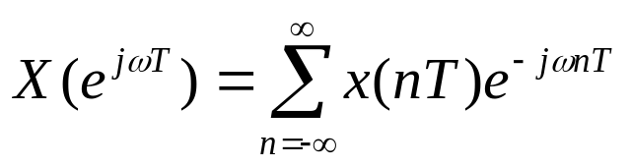
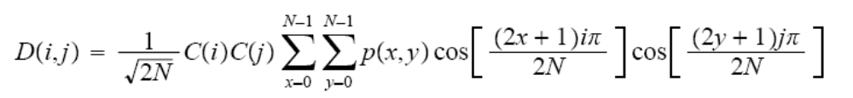
Ultimate Goal of this course
Let you have the ability to design multi-media SoC chips
  featuring complex mathematical computations
    Fourier Transform
    Discrete Cosine Transform (DCT)

Slide 5
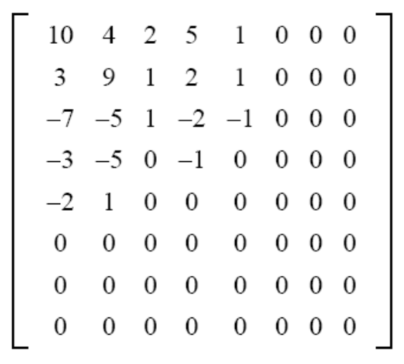
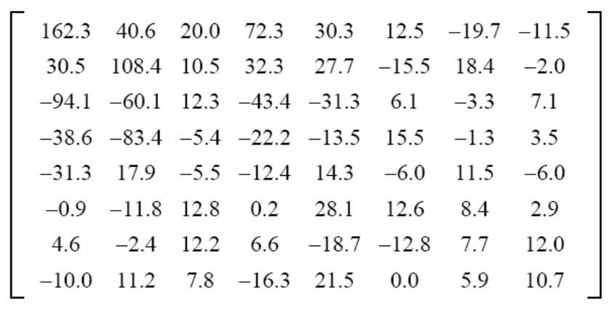
Example: want to build a digital camera?
discrete cosine transform
(DCT)
Quantization
raw image
compressed image

Slide 6
Example: want to build a digital camera?
How to deal with DCT?
Design challenges:
  speed
  chip area
  power consumption

Slide 7
Goals of this course
realize basic arithmetic operations (+,-,*,/) in hardware
Future: realize complex mathematical computation and reduce complexity

Slide 8
Course Outline
Part 0: hardware design basics
  realize your RTL design with UMC 90nm process
Part 1: number system
Part 2: fast addition
  e.g. how to do summation
Part 3: multiplication
  e.g. high-radix pipelined booth multiplication
Part 4: division
  e.g. radix-4 SRT division
Part 5: floating-point unit (optional)
Part 6: complex mathematical function (optional)

Slide 9
Preliminaries to learn computer arithmetic
Fundamentals on digital hardware design (Required)
  electronics, digital circuits & systems, computer organization
Mathematics knowledge (optional)
  mathematical analysis: calculus, complex analysis, numerical methods
  discrete mathematics: (may not be used in this course)
    scheduling and resource allocation for complex computations

Slide 10
Textbook and References

Slide 11
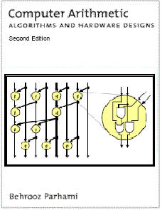
The Textbook
Behrooz Parhami, Computer Arithmetic: Algorithms and Hardware Designs, 2/e, Oxford Press, 2008

Slide 12
Advanced Readings
M. Flynn and S. F. Oberman, Advanced Computer Arithmetic Design, John Wiley & Sons, 2001
L. Wanhammar, DSP Integrated Circuits, Academic Press, 1999

Slide 13
Fundamentals on hardware design
M. Morris Mano, Logic and Computer Design Fundamentals, 4/e, Prentice-Hall 2008
D. A. Patterson and J. L. Hennessy, Computer Organization and Design: the Hardware/Software Interface, Elsevier
J. P. Uyemura, Introduction to VLSI Circuits and Systems, John Wiley & Sons, 2002

Slide 14
Rules of the game

Slide 15
Grading
Homework: 70% (HW implementation)
Term project: 50%
  Multimedia instruction set extension over RISC-V processor
    With compiler support (optional)
  To improve performance or energy efficiency over some benchmark program
    With complex numerical computation
  Team work rule:
    One person per group if your work is hardware only
    Up to 3 people per group if your work covers HW+compiler

Slide 16
Hardware implementation means
coding your RTL design in Verilog or VHDL
do logic synthesis with Synopsys SAED 32nm cell library
gate-level simulation to show correctness
Evaluate the design on:
  timing delay
  chip area
  power consumption

Slide 17
Resources
Course material
  https://github.com/CGUSystemCourses/CompArith-2016
RISC-V processor
  http://riscv.org/
LLVM compiler
  http://www.llvm.org/

