Slide 1
Digital System and RTL Design
Lecture 02
to remind you the most important thing you learned in present hardware course

Slide 2
Outline
Overview of a digital system
Why clock? the synchronous sequential circuit
  the most important thing on hardware design you learned so far
RTL design overview

Slide 3
What is digital circuit?
electronic circuits works in 0 and 1
the counter part: analog circuit

Slide 4
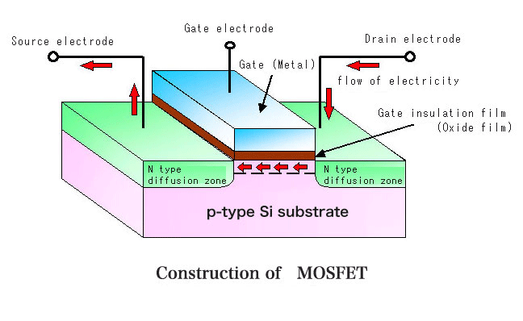
The basic device to build a chip:
MOS transistor
D
G
X
X=0
X=1
S

Slide 5

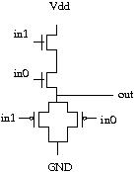
Circuit-Level Design
ESL design
(Electronic System Level)
RTL design
(Register Transfer Level)
gate-level design
circuit-level design
(transistor-level)
physical layout

Slide 6
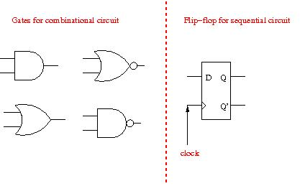
Components in a digital system
action whenever input signals change
memorize it’s input only upon clock trigger
The most important thing in doing design with HDL: distinguish sequential and combinational circuit

Slide 7
General framework of a synchronous digital system
combinational
circuit
…
clock

Slide 8
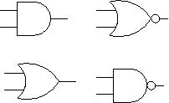
General framework of a synchronous digital system
combinational
circuit
…
clock

Slide 9

General framework of a synchronous digital system
combinational
circuit
…
clock

Slide 10
Why we need a clock?

Slide 11
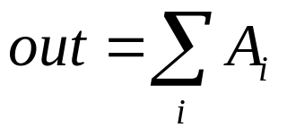
Example: accumulator
A
out
10, 20, 6, 5, 13
ACC
54

Slide 12
Example: Accumulator
input
+
storage device
Q: when will storage device store the outcome of the adder?

Slide 13
Example: accumulator in detail
FA
full adder
in3
in2
in1
in0
0
FA
FA
FA
FA
S
some storage device
S
S
S
S

Slide 14
Example: accumulator in detail
0101 + 0011 = 1000
0
0
1
1
in3
in2
in1
in0
0
FA
FA
FA
FA
S
S
S
S
0
1
0
1

Slide 15
Example: accumulator in detail
0101 + 0011 = 1000
0
0
1
1
in3
in2
in1
in0
0
time
FA
FA
FA
FA
F0
unstable
0
F1
unstable
0
F3
F2
F1
F0
F2
unstable
0
S
S
S
S
0
1
0
1
F3
unstable
1

Slide 16
Example: accumulator in detail
0101 + 0011 = 1000
0
0
1
1
in3
in2
in1
in0
0
time
FA
FA
FA
FA
F0
unstable
0
F1
unstable
0
F3
F2
F1
F0
F2
unstable
0
S
S
S
S
0
1
0
1
F3
unstable
1
When a storage device can memorize it’s input?

Slide 17
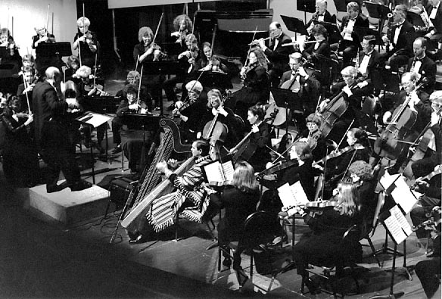
How an orchestration band works?

Slide 18
Solution: a clock
a signal received by all storage devices at the same time
S
storage device
time
F0
unstable
0
combinatorial circuit
F1
unstable
0
F2
unstable
0
S
S
S
S
F3
unstable
1
Clock

Slide 19
Realization of the scheme
a storage device triggered by clock signal
  e.g. the D flip-flop
D
Q
Q’

Slide 20
The D Flip-Flop
in
D
Q
out
clk
time
in
v0
v1
v2
v3
content
v0
v1
v2
v3
Q
v0
v1
v2
v3

Slide 21
The D Flip-Flop
in
D
Q
out
clk
time
in
0
1
content
xxxxxxx
0
1
Q
xxxxxxx

Slide 22
Back to the accumulator example
input
+
time
adder_out
clock
register AC
input
13
5
6
20
10
8
adder out
13
18
24
44
54
62
clock
AC
0
13
18
24
44
54

Slide 23
What I am telling you
keep in mind this general framework when you are doing hardware design
be aware of combinational circuit and sequential circuit
especially when writing Verilog/VHDL
combinational
circuit
…

Slide 24
The RTL design

Slide 25
What is RTL design
register transfer level
a method enabling fast design of synchronous sequential circuit
automatic transform of behavior description to hardware
input A [3:0];
input B [3:0];
input clock;
reg S [3:0];
always @(posedge clock)
S <= #1 A+B;

Slide 26
RTL design steps
desired behavior/algorithm
draw the data path and specify all control signals
draw the finite state machine (FSM) for control
elaborate FSM as the control unit

Slide 27
Multiplication Example
control unit
datapath
10111
load_reg
load_reg
B
0
*)
10011
add_B
add_B
MUX
10111
10111
shift_AQ
+
00000
00000
shift_AQ
A
Q
+)
10111
load_reg
Q[0]

Slide 28
Multiplication Example
control unit
datapath
load_reg
load_reg
B
0
Idle
add_B
add_B
MUX
shift_AQ
+
shift
shift_AQ
A
Q
load_reg
add
Q[0]

Slide 29
Notes on RTL design in HDL
You still have a hardware draft
  a high-level block diagram of the data path
  a finite state-machine in mind
  but don’t need to be precise to gate-level
You cannot write Verilog/VHDL as C!
You have to be aware of combinational circuit and sequential circuit
  different coding styles for Verilog/VHDL

Slide 30
Preview on Lab 1
design an 8-bit saturated unsigned accumulator
  temp = ACC+data_in
  if (temp>0xff) ACC=0xff;
  else ACC = temp;
At least doing up to logic synthesis with UMC-90nm process
Purpose: to let you be familiar on practical aspects of hardware design through out the course

Slide 31
Recent Schedule
03/10: synthesizable Verilog/VHDL coding style
  Volunteers wanted: teaching synthesizable VHDL coding style (+5% of total grading)
03/13: Lab hour
03/17: Lab hour and demo
03/20: a quick overview of number system
  Chap. 1-4 of our textbook [Parhami]

