Slide 1
Synthesizable Verilog Coding
Lecture 04
and your first lab as the review of preliminary knowledge

Slide 2
Outline
synthesizable Verilog coding
  overview
  structural description
  behavior description: combinational vs. sequential circuit
simulation support
Lab 01

Slide 3
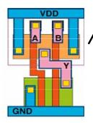
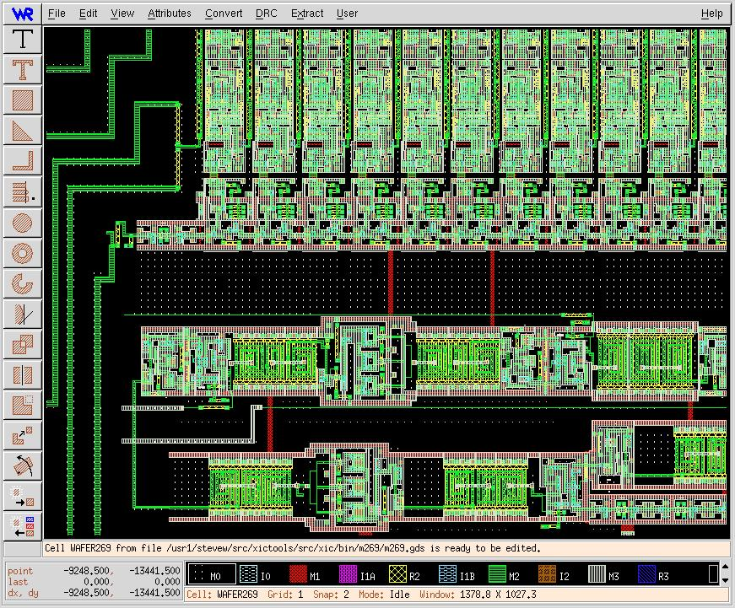
State-of-art chip design
always @(posedge clk)
A <= B+C;
RTL design
(Register Transfer Level)
gate-level design
circuit-level design
(transistor-level)
automatically
processed by EDA
tools
physical layout

Slide 4
Common error of beginners
non-synthesizable coding style
  a wrong code may result in correct simulation wave-form/FPGA outcome
synthesizable but without concrete imagine on hardware generated
  long path delay
  extremely large chip area

Slide 5
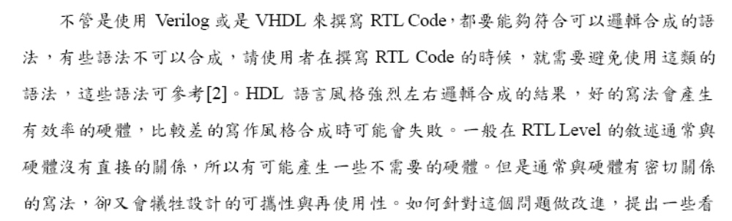
Caution

Slide 6
Correct method of doing RTL coding
Step 1: draw the block diagram of your hardware
  be aware of combinational and sequential circuit
Step 2: translate each block into Verilog/VHDL code
  follow fixed coding style

Slide 7
Verilog coding
structural description
  describe the hardware directly
behavior description
  most of beginners error

Slide 8
Structural description

Slide 9
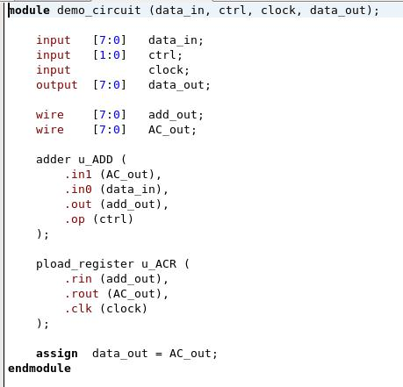
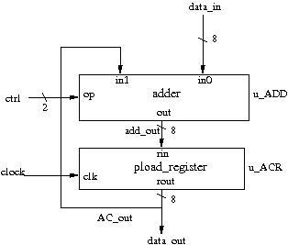
Example of structural description

Slide 10
Example of structural description
input/output specification

Slide 11
Example of structural description

Slide 12
Example of structural description

Slide 13
Instance Sub-Modules

Slide 14
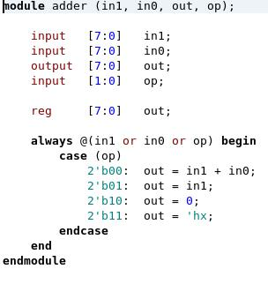
Hierarchical modules

Slide 15
Instance name of a module

Slide 16
Declare wires

Slide 17
Connecting ports of modules

Slide 18
Caution
always use “wire” to declare signals in structural description
no “always @(…)” in structural description

Slide 19
Behavior description

Slide 20
What is behavior description
declare with “reg”
  although some may be synthesized as wires
use “always @(…)” to describe the “rule to generate output”
  not a step-by-step executing program

Slide 21
Caution on behavior description
Be aware of which part is combinational circuit and which part is sequential circuit
use fixed coding style for
  combinational circuit
  sequential circuit
Do not try other coding styles!

Slide 22
Inferring combinational circuit with behavior description

Slide 23
The general scheme
for combinational circuit
A
B
C
always @(A or B or C) begin
…
// C code to compute D and E
…
end
hardware to be
simulated
D
E

Slide 24
Inferring combinational circuit
general coding style:
  always @(all signal list)
  always @(*)
  use blocking assignment “=“
    do not use “<= “
  you have to enumerate all cases to determine the output value

Slide 25
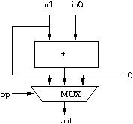
Example 1: combinational circuit

Slide 26
Example 1: combinational circuit
register is not a register!

Slide 27
Example 1: combinational circuit
C-like code to compute output from inputs

Slide 28
Example 1: combinational circuit
specify a don’t-care

Slide 29
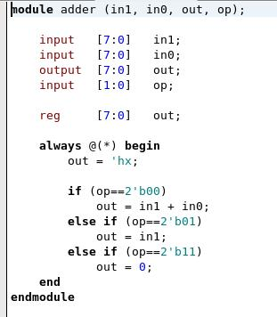
Example 1: combinational circuit
if-then-else rules also work!

Slide 30
Example 1: combinational circuit
This line is necessary to enforce
a combinational circuit

Slide 31
Example 1: combinational circuit
Verilog 2001 standard:
depends on all input signals

Slide 32
Inferring sequential circuit with behavior description

Slide 33
The general scheme
for sequential circuit
  only simulate when clock triggered
A
B
C
always @(posedge clk) begin
…
// C code to compute D and E
…
end
hardware to be
simulated
clk
D
E

Slide 34
Inferring sequential circuit
coding style:
  always @(posedge clk)
  use non-blocking assignment “<=“

Slide 35
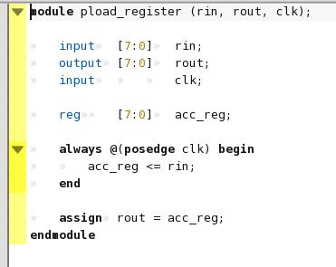
Example 2: sequential circuit
parallel D-FFs triggered by clock

Slide 36
Example 2: sequential circuit
parallel D-FFs triggered by clock
simulation triggered by clock

Slide 37
Example 2: sequential circuit
parallel D-FFs triggered by clock
Caution: You have to use non-blocking assignment
to generate registers!

Slide 38
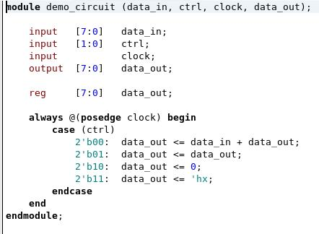
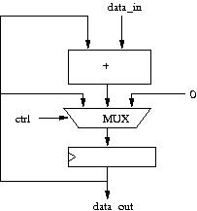
Example 3: sequential circuit
with combinational circuit for computation

Slide 39
I believe that most of you are confused with
  combinational circuit vs.
  sequential circuit

Slide 40
Example: the adder
combinational vs. sequential circuit

Slide 41
What’s the difference?
reg [3:0] A, B, C;
always @(*) begin
A = B+C;
end
reg [3:0] A, B, C;
always @(posedge clk) begin
A <= B+C;
end

Slide 42
What’s the difference?
reg [3:0] A, B, C;
always @(*) begin
A = B+C;
end
reg [3:0] A, B, C;
always @(posedge clk) begin
A <= B+C;
end
B
C
B
C
+
+
clk
register
A
A

Slide 43
What’s the difference?
reg [3:0] A, B, C;
always @(*) begin
A = B+C;
end
reg [3:0] A, B, C;
always @(posedge clk) begin
A <= B+C;
end
clk
clk
B
10
1
5
B
10
1
5
5
2
7
C
5
2
7
C
A
15
3
12
A
15
3
12

Slide 44
Simulation Support
code only for simulation, not to synthesize real hardware

Slide 45
General guidelines to coding for simulation support
in behavior descriptions only
event-driven programming and coding like C
system tasks to display results or dump waveform
Example:
  to dump the content of “out” signals every cycle
    always @(posedge clk) begin
      #2; //delay 2 units of simulation time
      $display (“out = %h”, out);
    end

Slide 46
Sample code for simulation support
to generate the clock signal
  initial clk=0;
  always #5 clk=~clk;
5 unit
clk
5 unit

Slide 47
Sample code for simulation support
to feed test patterns
time
Hardware you
designed
din1
sim_cycle
0
1
2
3
din2
don’t-care
0xa
0x5
0x9
din1
din2
don’t-care
0x2
0x4
0x5

Slide 48
Dump waveforms
IEEE standard waveform format (.vcd)
  specify the file name of the waveform:
    $dumpfile (“file_name”)
  specify the scope of signals to dump:
    $dumpvars (scope_and_signal_name);
  start waveform dumping:
    $dumpon;
  stop waveform dumping:
    $dumpoff;

Slide 49
Dump waveforms
Synopsys supported format (VPD+)
  specify the file name
    $vcdplusfile (“filename”);
  start dumping and specify the scope:
    $vcdpluson (scope_and_signals_name);
  stop dumping:
    $vcdplusoff;

Slide 50
More on simulation support
specify the timescale
call a complete task
call a C function
  Verilog standard: PLI (Programming Language Interface)
  Synopsys special: direct-C
Please check-out the manual!

Slide 51
Saturation Accumulator
Lab 01

Slide 52
Purpose of this lab
to refresh your hardware knowledge
learn how to use the EDA tools
  try the coding style
establish your feeling on
  path delay
  chip area

Slide 53
Spec of the accumulator
reset: clear the accumulator content (dout=0)
enable: accumulate incoming value (din) if enable=1
accumulate and saturation:
  temp = ACC+din
  if (temp>0xff) ACC=0xff;
  else ACC = temp;
1
SACC
enable
1
8
reset
dout
din
8

Slide 54
Requirements
RTL coding in Verilog or VHDL
do logic synthesis for UMC 90-nm process and report
  timing (longest path delay)
  chip area

Slide 55
Upload data for this lab
power-point slides including
  block-diagram design
  critical-path analysis and discussion along with the block-diagram design
  various coding style you tried to reduce chip area (discussion)
source code
simulation waveform
synthesis report

Slide 56
Remark: How coding style affects chip area
a
b
try this code
  always @(*) begin
    out = (sel)? a+b: a-b;
  end
Add/Sub
sel
a+b
a+(~b)+1
MUX

Slide 57
That’s the end of Part 0 “Review on hardware design”
we will start Chap. 1-4 “number system” at 03/17 (Tue.)

