Slide 1
Division Overview
Lecture 07 (Part A)

Slide 2
Today’s Content
Recap: basic division scheme
Strategy to design fast division
  write as recurrence relation
basic division scheme revisited: as recurrence relation
non-restoring division: as recurrence relation

Slide 3
Recap: basic division scheme

Slide 4
How the hardware performs division
Again, the method you learned in elementary school, but in binary
Example: 117/10
  117 = 0111 0101
  10 = 1010

Slide 5
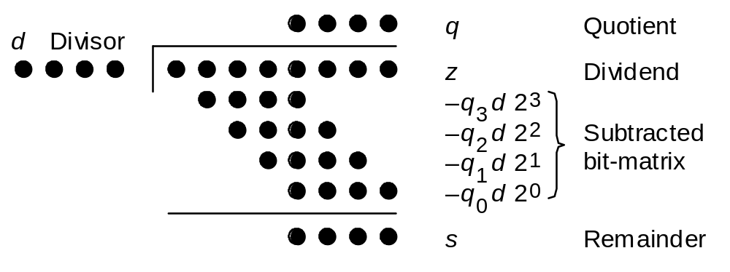
Basic division scheme
Notation for our discussion of division algorithms:
z Dividend z_{2k–1}z_{2k–2} . . . z₃z₂z₁z₀
d Divisor d_{k–1}d_{k–2} . . . d₁d₀
q Quotient q_{k–1}q_{k–2} . . . q₁q₀
s Remainder, z – (d × q) s_{k–1}s_{k–2} . . . s₁s₀
Initially, we assume unsigned operands
Fig. 13.1 Division of an 8-bit number by a 4-bit number in dot notation.

Slide 6
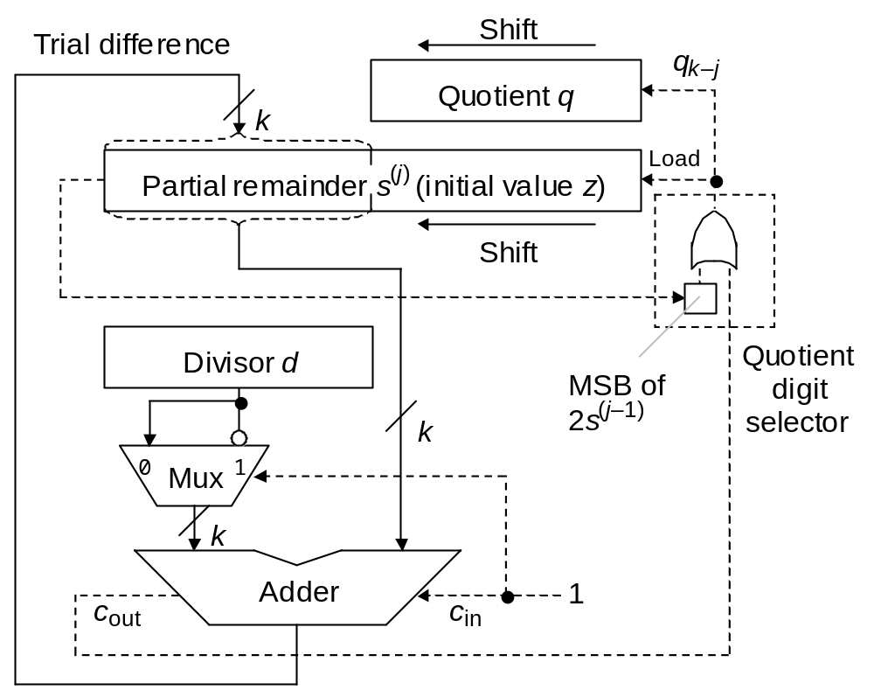
Divider hardware you learned before
Fig. 13.5 Shift/subtract sequential restoring divider.

Slide 7
How to do fast division?

Slide 8
Difficulties to do division
Division is more complex than multiplication:
Need for quotient digit selection or estimation
Overflow possibility: the high-order k bits of z
must be strictly less than d; this overflow check
also detects the divide-by-zero condition.
Pentium III latencies
Instruction Latency Cycles/Issue
Load / Store 3 1
Integer Multiply 4 1
Integer Divide 36 36
Double/Single FP Multiply 5 2
Double/Single FP Add 3 1
Double/Single FP Divide 38 38

Slide 9
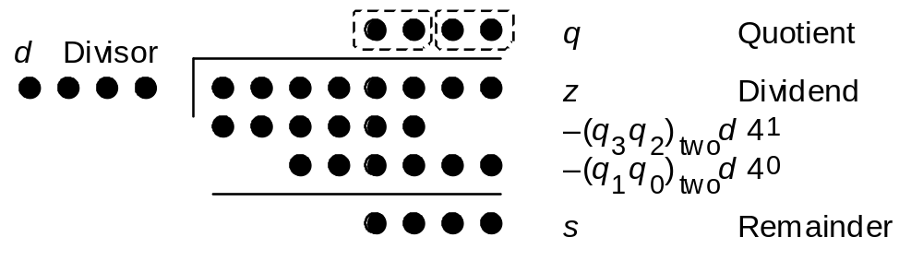
How we achieve fast division
high-radix division: deals with multiple bits in each step
guess the quotient bits and compensate (if error) at the next step
formulate as recurrence relation!
Fig. 14.1
Radix-4 division in dot notation

Slide 10
Basic division scheme revisited
formulate as recurrence relation

Slide 11

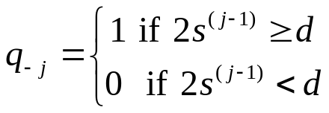

The recurrence relation
Given:
  z: dividend (2k-bit integer)
  d: divior (k-bit integer)
  (to do z/d)
Initialization:
Inductive Step:
Result: the bit vector (q₋₁, q₋₂, ..., q_{-k}) is the quotient and s^{(k)} is the remainder

Slide 12
In-class Exercise
Do the division 117/10 with the recurrence relation
  117 = 0111 0101
  10 = 1010

Slide 13
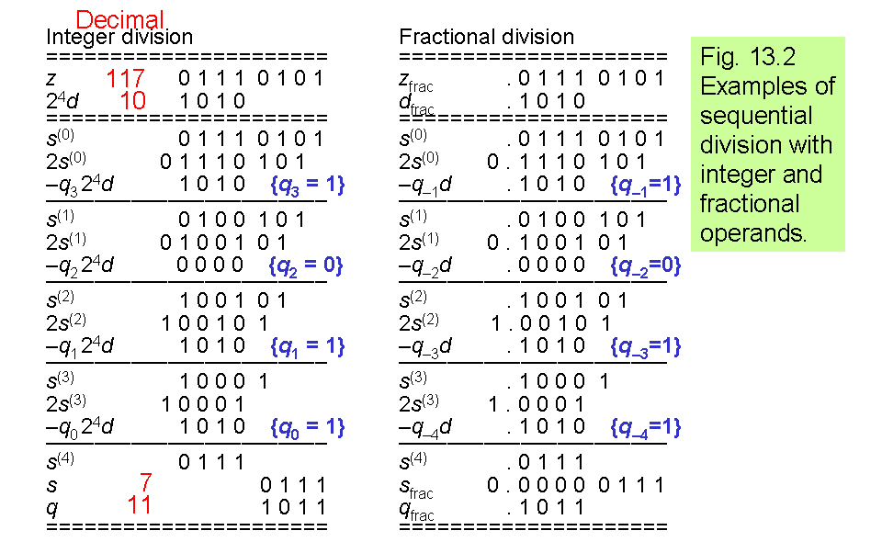
Example of basic division

Slide 14
Division recurrence
2z
0
2^{k} d
Fig. 13.1
k bits
k bits
Division with left shifts
s^{(j)} = 2s^{(j–1)} – q_{k–j} (2^{k} d) with s⁽⁰⁾ = z and
|–shift–| s^{(k)} = 2^{k}s
|––– subtract –––|
(There is no corresponding right-shift algorithm)

Slide 15
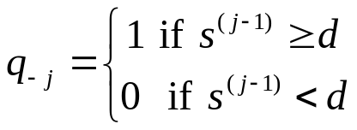
Difficulty with the recurrence relation
Needs comparison to determine q_{-j}

Slide 16
Non-restoring division as recurrence relation

Slide 17
Key Idea of the derivation
representing partial products in radix-2 number system with range [-1,1]

Slide 18
Radix-2 with range [-1,1]
Example:
  (-1, 1, 0, -1, 1, 0) representing

Slide 19
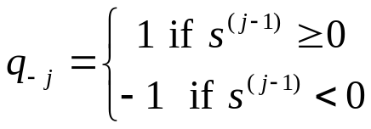
The recurrence relation for non-restoring division
Given:
  z: dividend (2k-bit integer)
  d: divior (k-bit integer)
  (to do z/d)
Initialization:
Inductive Step:
Result: the bit vector (q₋₁, q₋₂, ..., q_{-k}) is the quotient and s^{(k)} is the remainder

Slide 20
In-class Exercise
Do the division 117/10 with the recurrence relation
  117 = 0111 0101
  10 = 1010

Slide 21
In-Class Exercise
convert the vector to 2’s completement representation
  (1, 1, -1, 1)

Slide 22
Quotient conversion scheme
1 1 -1 1
1 1 0 1
+)
-1 -1 -1 -1
1 1 0 1
+)
-1
1

Slide 23
Quotient conversion scheme
1 1 -1 1
1 1 0 1
+)
-1 -1 -1 -1
1 1 0 1
+)
-1
1

Slide 24
Quotient conversion scheme
1 1 -1 1
1 1 0 1
+)
-1 -1 -1 -1
1 1 0 1
+)
-1
1

Slide 25
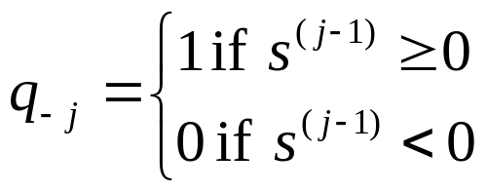
Question
How to implement non-restoring division?
  no -1
The rule to set quotient digit:
correct the quotient at final

Slide 26
In-Class Exercise
perform 117/10 in the implementation scheme

