Slide 1
High-Radix SRT Division
Lecture 07 (Part B)
Sweeney, Robertson, and Tocher’s division algorithm
(Chap. 14)

Slide 2
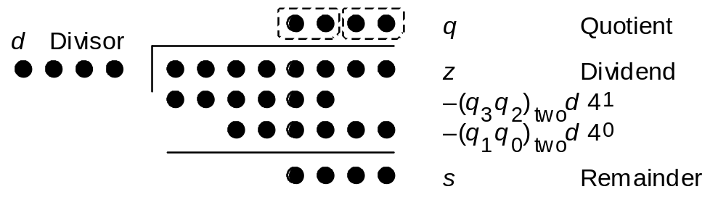
The Goal
do k-bit division with k/c cycles with c>1
set multiple quotient digit
at a time
Fig. 14.1
Radix-4 division in dot notation

Slide 3
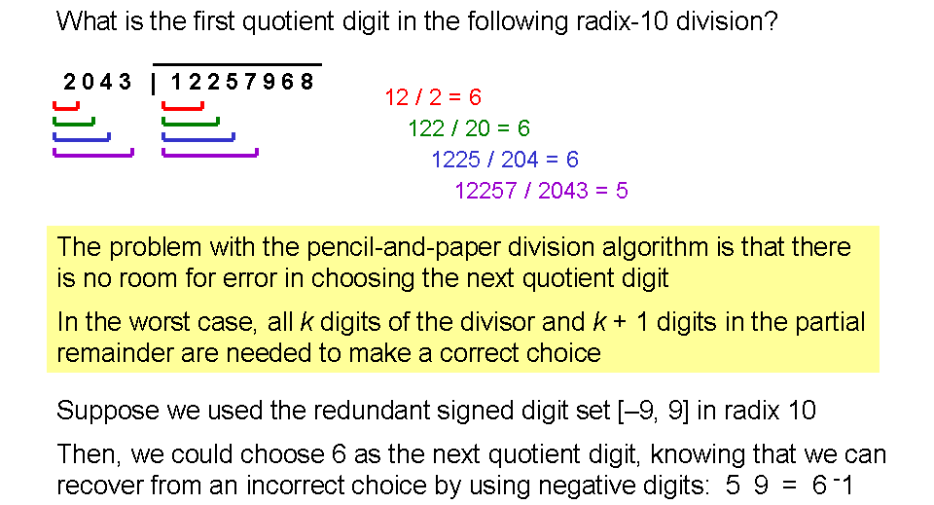
What’s the difficulty for high-radix division
the quotient digit selection
recall the paper-and-pencil division you learned in elementary school

Slide 4
Strategy to high-radix division
write the algorithm as recurrence relation
table-lookup for digit selection
  Key Issue: reduce the size of SRT division table
  Key trick: observe from p-d plot

Slide 5
Non-restoring division revisited
the SRT-2 division

Slide 6

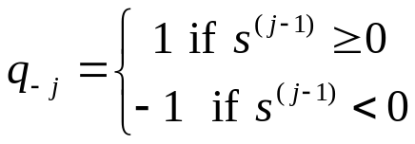
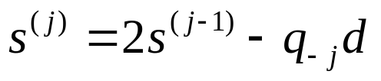
The recurrence relation for non-restoring division
Given:
  z: dividend (2k-bit integer)
  d: divior (k-bit integer)
  (to do z/d)
Initialization:
Inductive Step:
Result: the bit vector (q₋₁, q₋₂, ..., q_{-k}) is the quotient and s^{(k)} is the remainder

Slide 7
Question
Q: How to prove the correctness of the recurrence relation?
Want to Prove:
  z = q*d+s^{(k)}, and
  -d <s^{(k)} <d

Slide 8
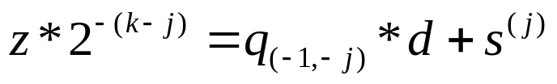

Outline of the correctness proof
prove by induction
the induction hypothesis:
Q: can you interpret the induction hypothesis from dot-diagram?

Slide 9
Generalization of the recurrence division scheme

Slide 10



Generalized recurrence scheme
Given:
  z: dividend (2k-bit integer)
  d: divior (k-bit integer)
  (to do z/d)
Initialization: normalization such that
At each Step:
Invariant: (keep this hold for each step)

Slide 11


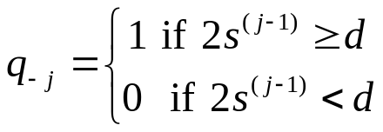
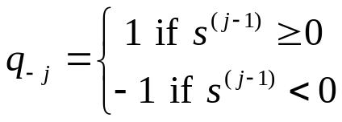
Generalized recurrence scheme
Given:
  z: dividend (2k-bit integer)
  d: divior (k-bit integer)
  (to do z/d)
Initialization: normalization such that
At each Step:
Invariant:
The recurrence scheme is not unique

Slide 12
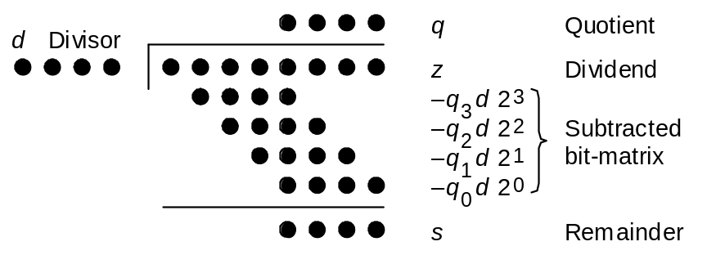
Generalized recurrence scheme
Given:
  z: dividend (2k-bit integer)
  d: divior (k-bit integer)
  (to do z/d)
Initialization: normalization such that
At each Step:
Invariant:
key to make it success
make the partial remainder shorter each step

Slide 13
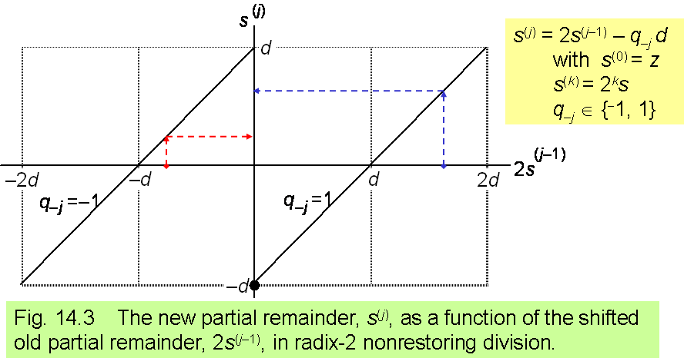

General way to select quotient digit from partial remainder

Slide 14
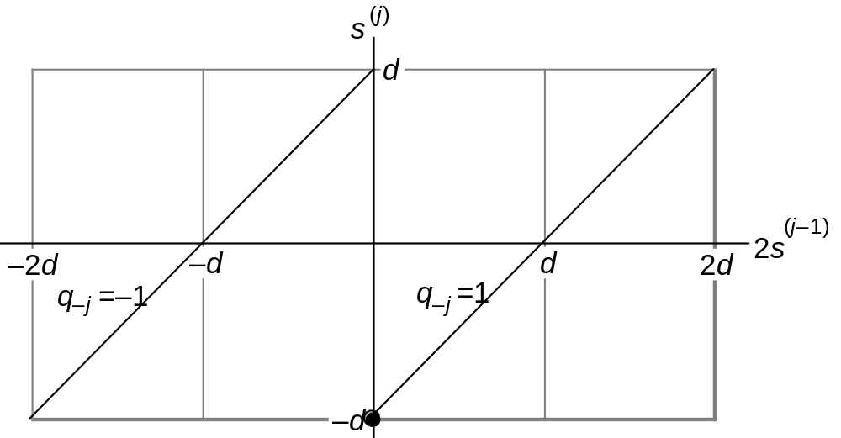
Non-restoring division
s^{(j)} = 2s^{(j–1)} – q_{–j} d
with s⁽⁰⁾ = z
s^{(k)} = 2^{k}s
q_{–j} ∈ {⁻1, 1}
Fig. 14.3 The new partial remainder, s^{(j)}, as a function of the shifted old partial remainder, 2s^{(j–1)}, in radix-2 nonrestoring division.

Slide 15

Non-restoring division
s^{(j)} = 2s^{(j–1)} – q_{–j} d
with s⁽⁰⁾ = z
s^{(k)} = 2^{k}s
q_{–j} ∈ {⁻1, 1}
Fig. 14.3 The new partial remainder, s^{(j)}, as a function of the shifted old partial remainder, 2s^{(j–1)}, in radix-2 nonrestoring division.

Slide 16

Non-restoring division
s^{(j)} = 2s^{(j–1)} – q_{–j} d
with s⁽⁰⁾ = z
s^{(k)} = 2^{k}s
q_{–j} ∈ {⁻1, 1}
Fig. 14.3 The new partial remainder, s^{(j)}, as a function of the shifted old partial remainder, 2s^{(j–1)}, in radix-2 nonrestoring division.

Slide 17
In-Class Exercise
derive another recurrence scheme for division
justify with the example: 117/10

Slide 18
Table lookup to select quotient digit

Slide 19
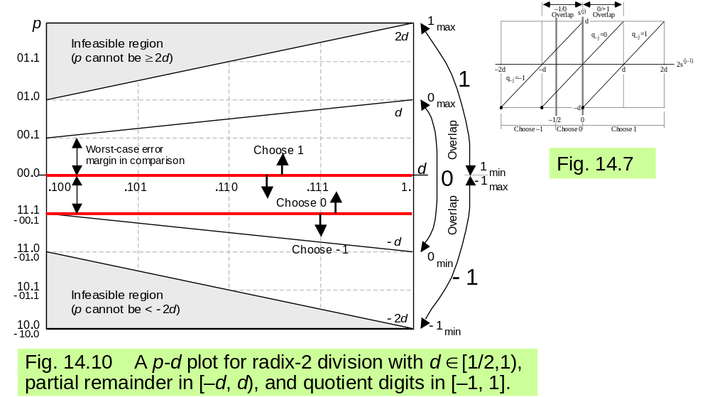
Observation: p-d plot
p: two times the partial remainder (2s^{(j)})
d: divisor

Slide 20


Observation: p-d plot
p: two times the partial remainder (2s^{(j)})
d: divisor
You can choose q_{-j}=0 if (p,d) fall in this area

Slide 21


Observation: p-d plot
p: two times the partial remainder (2s^{(j)})
d: divisor
You can choose q_{-j}=1 if (p,d) fall in this area

Slide 22

Observation: p-d plot
p: two times the partial remainder (2s^{(j)})
d: divisor
You can choose q_{-j}=-1 if (p,d) fall in this area

Slide 23
Table lookup from p-d plot
put a grid on the p-d plot
select q_{-j} from most significant bits of (p,d)

Slide 24
Table lookup from p-d plot
select q_{-j} for p=(01.0xxx) and d=(0.110xxx)
q_{-j}=1

Slide 25
In-Class Exercise
perform 117/10 using the table lookup scheme
  determine quotient digit from the most significant 3 bits of p and d

Slide 26
Remark
You don’t need a table if you just want to determine one bit of quotient digit
  the optimal scheme is
  explain from the p-d slot
But you need a table if you want to determine two bits of quotient digit at a time

Slide 27
The SRT-4 division
deal with 2 bits each time

Slide 28


Recurrence relation for SRT-4 division
Given:
  z: dividend (2k-bit integer)
  d: divior (k-bit integer)
  (to do z/d)
Initialization: normalize such that
Inductive Step:
Result: the bit vector (q₋₁, q₋₂, ..., q_{-k}) is the quotient and s^{(k)} is the remainder
the key issue!

Slide 29
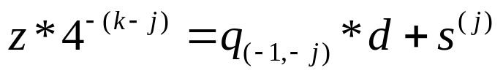
Strategy of the recurrence
the induction hypothesis:

Slide 30
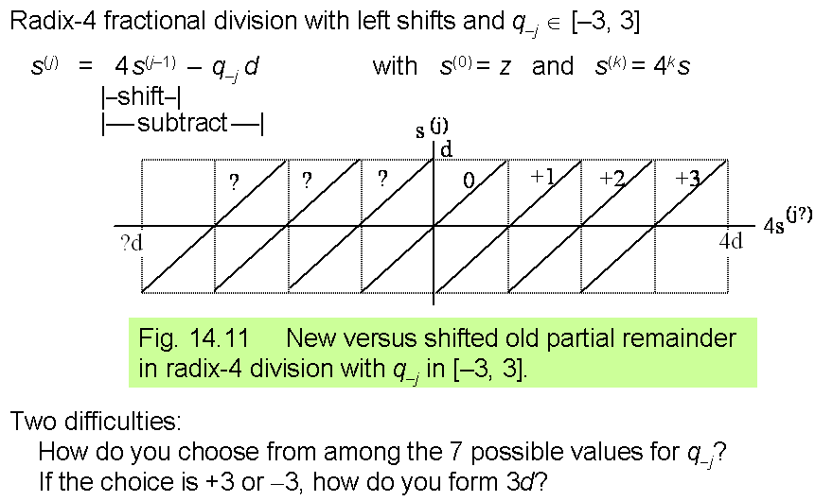
Q: what you found from the observation?

Slide 31
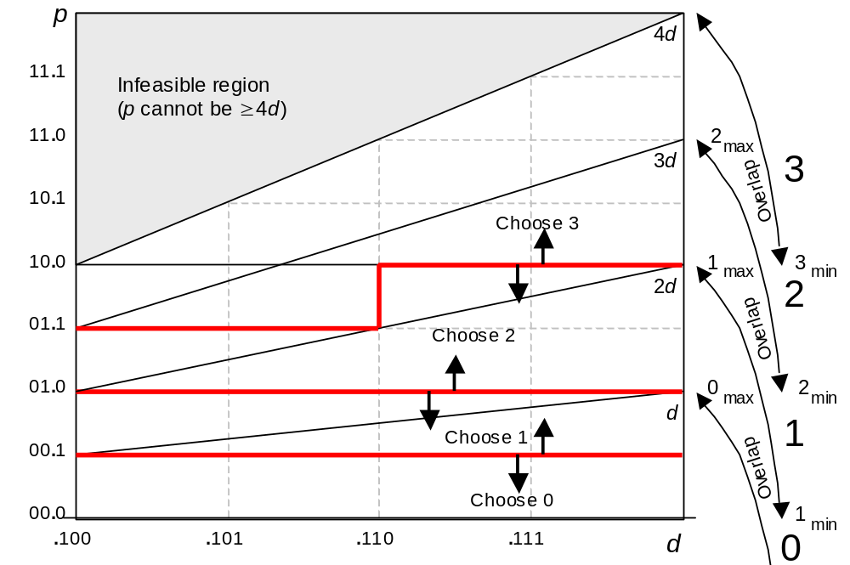
Table lookup from p-d plot

Slide 32
In-Class Exercise
compute 117/10 with the table lookup scheme
determine 2 bits in the quotient each time

Slide 33
Some final remarks

Slide 34
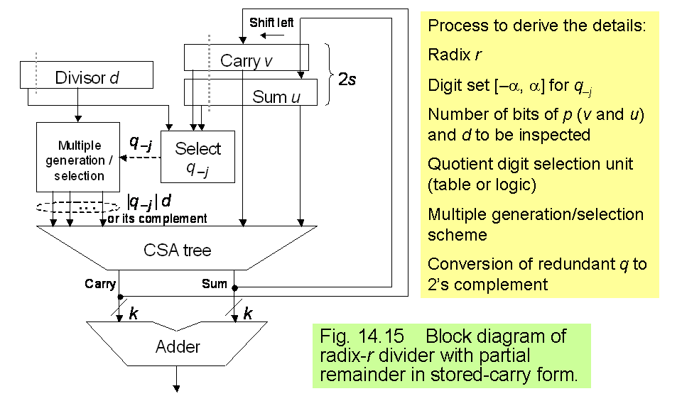
Hardware for high-radix division
use CSA tree to compute 3d, -3d, etc.

Slide 35
Summary: How to design fast divider
start from dot-diagram: try to deal with 2+ bits each step
derive the recurrence relation
  Strategy of the recurrence: -d < s^{(j)} < d
build the table to select quotient digit
  observation from the p-d plot

Slide 36
Q: How to minimize the SRT table?
a systematical way
see [Flynn]
  Michael J. Flynn and Stuart F. Oberman, Advanced Computer Arithmetic Design, 2001

