Slide 1
Number Systems Overview
Lecture 03 (Part A)
a quick review on all the number encoding techniques you learned

Slide 2
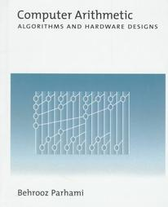
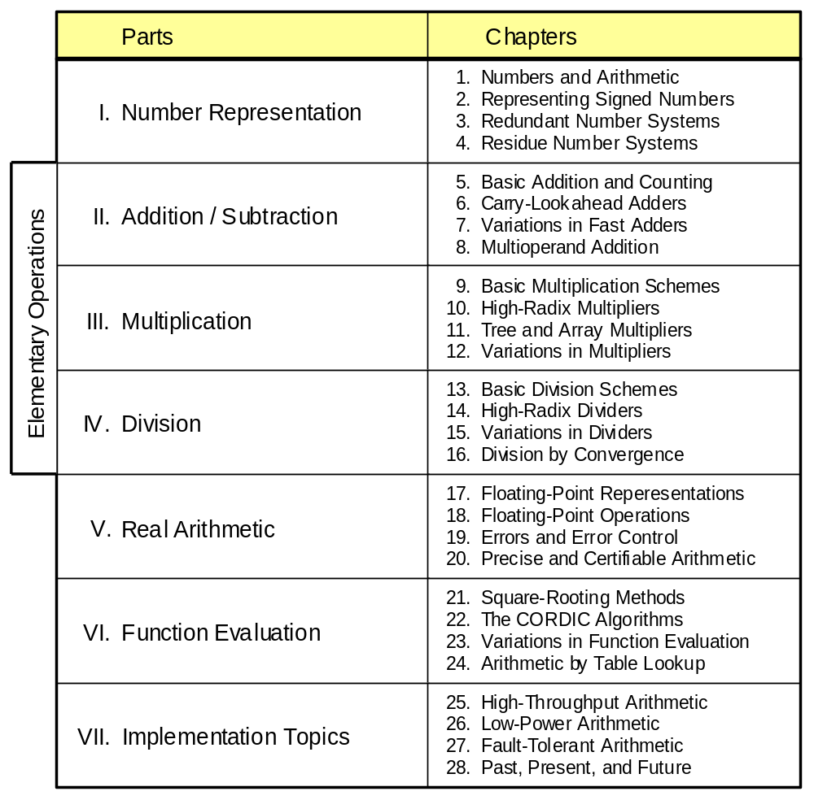
Part I
Number Representation

Slide 3
Materials coming from
Chap. 1 of the textbook

Slide 4
Today’s Goal
Review all the number encoding schemes you learned so far
Emphasize
  there is no way to represent real number system exactly
  error analysis is a must

Slide 5
Motivating Example
Using a calculator with √, x², and x^{y} functions, compute:
  u = √√ … √ 2 = 1.000 677 131 “1024th root of 2”
  v = 2^{1/1024} = 1.000 677 131
Save u and v; If you can’t save, recompute values when needed
  x = (((u²)²)...)² = 1.999 999 963
  x' = u¹⁰²⁴ = 1.999 999 973
  y = (((v²)²)...)² = 1.999 999 983
  y' = v¹⁰²⁴ = 1.999 999 994
Perhaps v and u are not really the same value

Slide 6
General number encoding schemes

Slide 7

Basic: binary number representation
Example: a 4-bit number
1 1 0 1

Slide 8
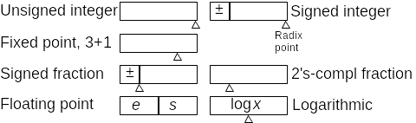
Numbers and Their Encodings
Some 4-bit number representation formats
Exponent in
{−2, −1, 0, 1}
Significand in
{0, 1, 2, 3}
Base-2
logarithm

Slide 9
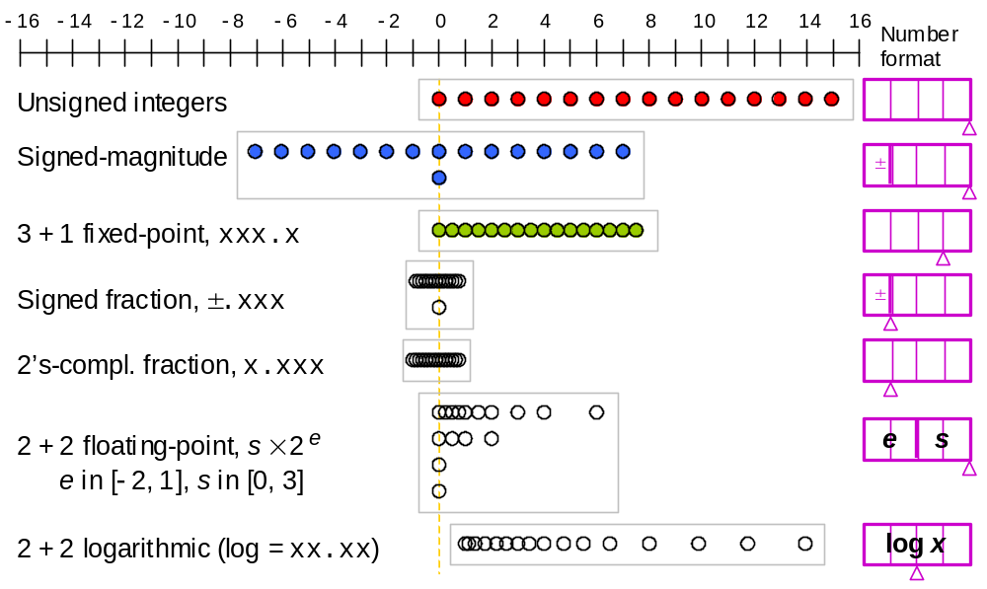
Encoding schemes varies on the range and precision

Slide 10
Unsigned Integers
−
16
−
14
−
12
−
10
−
8
−
6
−
4
−
2
0
2
4
6
8
10
12
14
16
Number
format
Unsigned integers
Example: (1011)₂ represents 11

Slide 11
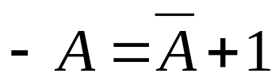
Signed number in 2’s complement
−
16
−
14
−
12
−
10
−
8
−
6
−
4
−
2
0
2
4
6
8
10
12
14
16
Number
format
Signed
-
magnitude
±
Rule:
Example:
  5 represented as (0101)₂
  (-5) represented as (1011)₂=~(0101)₂+1

Slide 12
Fixed-point
−
16
−
14
−
12
−
10
−
8
−
6
−
4
−
2
0
2
4
6
8
10
12
14
16
Number
format
3 + 1 fixed
-
point,
xxx.x
Example: (011.1)₂ = 3.5

Slide 13
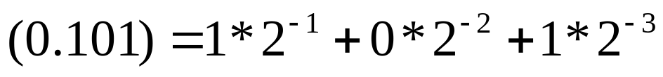
Signed Fractional Numbers
−
16
−
14
−
12
−
10
−
8
−
6
−
4
−
2
0
2
4
6
8
10
12
14
16
Number
format
Signed fraction,
±
.xxx
±
2’s
-
compl. fraction,
x.xxx

Slide 14
Floating Point
−
16
−
14
−
12
−
10
−
8
−
6
−
4
−
2
0
2
4
6
8
10
12
14
16
Number
format
2 + 2 floating
-
point,
s
∗
2
e
e
s
e
in [
−
2, 1],
s
in [0, 3]

Slide 15
Question & Discussion
Q: Can you represent the whole real number system exactly?
  Q: How many numbers you can express in n bits?
    A: 2^{n}
  Q: How many real numbers in [0,1]
    A: infinite
Answer: NO! You can just approximate

Slide 16
Carefully select encoding scheme for required range and precision

Slide 17
Case Study: the Patriot Missile
show you how the encoding scheme affects correctness

Slide 18
The Story (Feb. 25, 1991)
(http://www.ima.umn.edu/~arnold/disasters/disasters.html)
American Patriot Missile (愛國者飛彈) battery in Dharan, Saudi Arabia, failed to intercept incoming Iraqi Scud (飛毛腿飛彈) missile
The Scud struck an American Army barracks, killing 28
Cause, per GAO/IMTEC-92-26 report: “software problem”

Slide 19
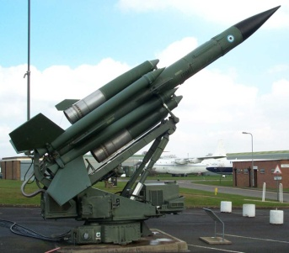
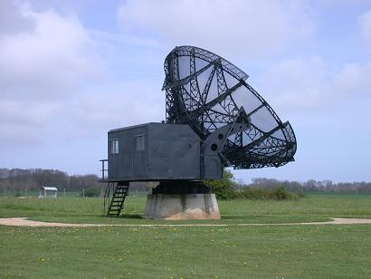
How the missile operates
each of the Patriot missile and the radar station has its own time counter
the radar station calculates the trace of the target and informs the Patriot to launch at time t
target
fire at time t

Slide 20
In-Class Exercise
Explain why the Patriot missed the target
Assumptions:
  the Patriot uses a 24-bit time counter
  the time counter refreshes every 1/10 second
  to get the time in seconds, the value of the time counter is multiplied by 1/10
  the Patriot has been in operation for 100 hours
  speed of the Scud: 1676 m/s

Slide 21
In-Class Exercise: the solution
Internal registers were 24 bits wide
1/10 = 0.0001 1001 1001 1001 1001 100 (chopped to 24 b)
Error ≈ 0.1100 1100 × 2^{–23} ≈ 9.5 × 10^{–8}
Error in 100-hr operation period
≈ 9.5 × 10^{–8} × 100 × 60 × 60 × 10 = 0.34 s
Distance traveled by Scud
  = (0.34 s) × (1676 m/s) ≈ 570 m
target
570 m
fire at time t

Slide 22
The lesson learned
do error analysis carefully when you are controlling a physical system

