Slide 1
Generalized Radix-R Number System
Lecture 03 (Part B)
useful math to help you design efficient hardware

Slide 2
Today’s Goal
to learn a mathematical tool:
  represent a number as a vector
you will find the math tool useful through out the course
  do arithmetic as vector operations
  to design efficient hardware

Slide 3
Materials coming from
Section 1.4-1.5 of textbook [Parhami]

Slide 4
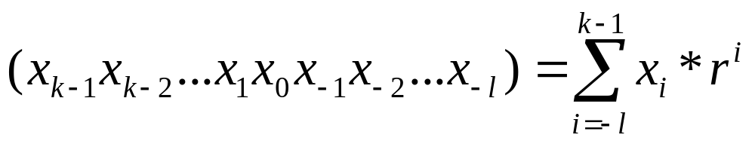
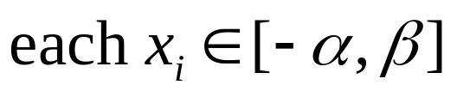
General formula: radix-r number system
the number represented by a vector:

Slide 5
Examples Part 1
things you familiar

Slide 6
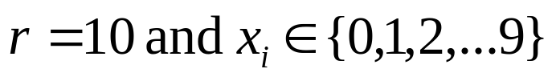
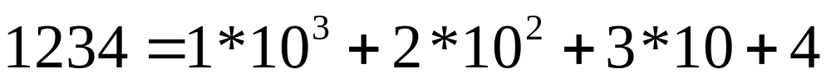
Radix-10 number system

Slide 7
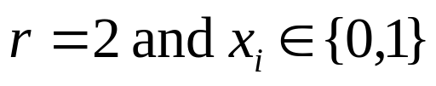
Radix-2 number system
(1001) represents 9
(10.11) represents 2.75

Slide 8
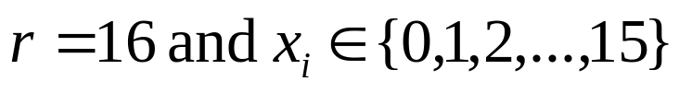
Hexdecimal number system

Slide 9
Example Part 2
Things you unfamiliar

Slide 10
General formula: radix-r number system
the number represented by a vector:
generalized range

Slide 11
Strange Examples
Example 1.3. Digit set [–4, 5] for r = 10:
(3 –1 5)_{ten} represents 295 = 300 – 10 + 5
Example 1.4. Digit set [–7, 7] for r = 10:
(3 –1 5)_{ten} = (3 0 –5)_{ten} = (1 –7 0 –5)_{ten}
Example 1.7. Quater-imaginary number system:
radix r = 2j, digit set [0, 3]

Slide 12
Why the strange representation
Example 1.3. Digit set [–4, 5] for r = 10:
(3 –1 5)_{ten} represents 295 = 300 – 10 + 5
Example 1.4. Digit set [–7, 7] for r = 10:
(3 –1 5)_{ten} = (3 0 –5)_{ten} = (1 –7 0 –5)_{ten}
Example 1.7. Quater-imaginary number system:
radix r = 2j, digit set [0, 3]
You will learn the use in
  signed multiplication
  fast division
  doing summation over more than 3 numbers

Slide 13
Radix Conversion

Slide 14
Number Radix Conversion
Whole part
Fractional part
u = w . v
= ( x_{k–1}x_{k–2} . . . x₁x₀ . x_{–1}x_{–2} . . . x_{–l} )_{r} Old
= ( X_{K–1}X_{K–2} . . . X₁X₀ . X_{–1}X_{–2} . . . X_{–L} )_{R} New
Example: (31)_{eight} = (25)_{ten} 31 Oct. = 25 Dec. Halloween = Xmas

Slide 15

Radix Conversion: Integer Part
Converting whole part w: (107)_{ten} = (?)_{five}
Repeatedly divide by five and take remainder
Quotient Remainder
107
21 2
4 1
0 4
Therefore, (107)_{ten} = (412)_{five}

Slide 16
Radix Conversion: the fractional part
Converting fractional part v: (0.486)_{ten} = (0.?)_{five}
Repeatedly multiply by five and take the integral part
Whole Part Fraction .486
2 .430
2 .150
0 .750
3 .750
3 .750
Therefore, (0.486)_{ten} ≅ (0.22033)_{five}

Slide 17
In-Class Exercise
convert the decimal number 23.583 to
  binary
  radix r=5

Slide 18
Summary

Slide 19
What you learned today
vector representation of a number
changing the radix
you may need the strange representation in the future (to design efficient hardware)
Example 1.3. Digit set [–4, 5] for r = 10:
(3 –1 5)_{ten} represents 295 = 300 – 10 + 5
Example 1.4. Digit set [–7, 7] for r = 10:
(3 –1 5)_{ten} = (3 0 –5)_{ten} = (1 –7 0 –5)_{ten}

Slide 20
Appendix
給數學狂看的

Slide 21
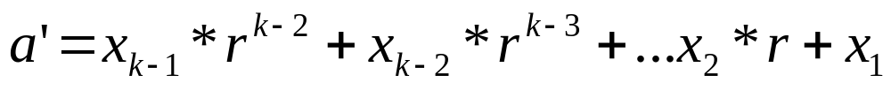
Mathematics for radix conversion
find x₀ from a?
  just divide by r and get the remainder
  the quotient a’:
to get x₁: repeat the same procedure for a’
to get x₂, x₃,…: repeat the same procedure again and again

Slide 22
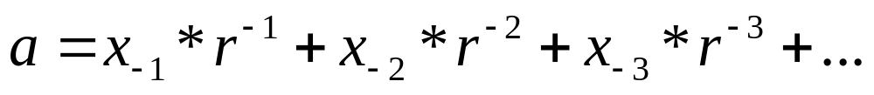
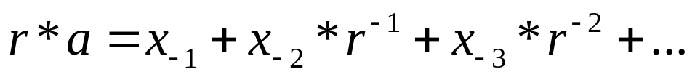
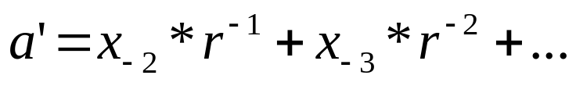
Mathematics for radix conversion: the fractional part
find x₋₁ from a?
  just multiply by r and get the integer part
  the remaining fractional part a’<1:
to get x₋₂: repeat the same procedure for a’
to get x₋₃, x₋₄,…: repeat the same procedure again and again

