Slide 1
Carry Free Addition with Redundant Number System
Lecture 03 (Part D)
Chap. 3 of the textbook [Parhami]

Slide 2
Today’s Goal
Show you how to design efficient hardware with mathematics
  the math: redundant number system
  the hardware: carry-free addition
Your Exercise: R=A+B+C
  A, B, C: n-bit numbers
  compute R in (n+1) times FA delay

Slide 3
Recap: number representation as a vector

Slide 4
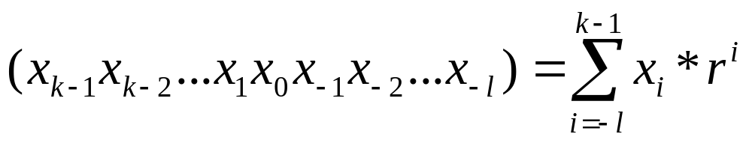
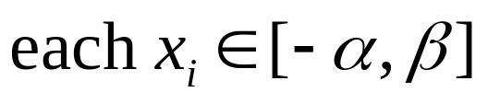
General formula: radix-r number system
the number represented by a vector:

Slide 5
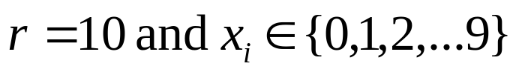
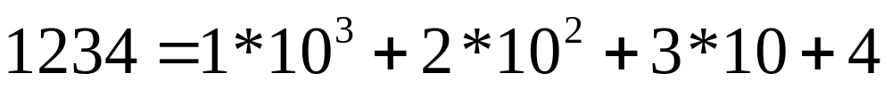
Radix-10 number system

Slide 6
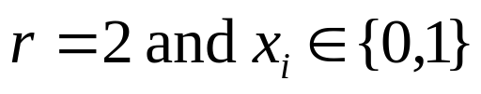
Radix-2 number system
(1001) represents 9
(10.11) represents 2.75

Slide 7
Strange Examples
Example 1.3. Digit set [–4, 5] for r = 10:
(3 –1 5)_{ten} represents 295 = 300 – 10 + 5
Example 1.4. Digit set [–7, 7] for r = 10:
(3 –1 5)_{ten} = (3 0 –5)_{ten} = (1 –7 0 –5)_{ten}
Example 1.7. Quater-imaginary number system:
radix r = 2j, digit set [0, 3]

Slide 8
The redundant number system

Slide 9
General formula: radix-r number system
the number represented by a vector:
more than r numbers in this range

Slide 10
Example: radix r=10
(11, 9, 17, 10, 12, 18) stands for

Slide 11
Example: radix r=2
(1,1,2,0,2,0) stands for

Slide 12
Digit Conversion
How to convert the strange representation to normal one?

Slide 13



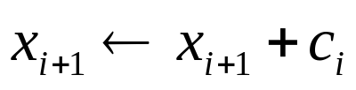
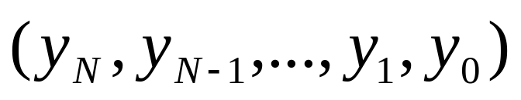
The method
Given:
examine each bit i from 0 to N-1 (right to left)
for each digit x_{i} at bit i:
  rewrite for conversion:
  carry in:
the result:

Slide 14
Example: radix r=10
Example 3.1: Convert from digit set [0, 18] to [0, 9] in radix 10
11 9 17 10 12 18 18 = 10 (carry 1) + 8
11 9 17 10 13 8 13 = 10 (carry 1) + 3
11 9 17 11 3 8 11 = 10 (carry 1) + 1
11 9 18 1 3 8 18 = 10 (carry 1) + 8
11 10 8 1 3 8 10 = 10 (carry 1) + 0
12 0 8 1 3 8 12 = 10 (carry 1) + 2
1 2 0 8 1 3 8 Answer;
all digits in [0, 9]

Slide 15
Example: radix r=10
Example 3.1: Convert from digit set [0, 18] to [0, 9] in radix 10
11 9 17 10 12 18 18 = 10 (carry 1) + 8
11 9 17 10 13 8 13 = 10 (carry 1) + 3
11 9 17 11 3 8 11 = 10 (carry 1) + 1
11 9 18 1 3 8 18 = 10 (carry 1) + 8
11 10 8 1 3 8 10 = 10 (carry 1) + 0
12 0 8 1 3 8 12 = 10 (carry 1) + 2
1 2 0 8 1 3 8 Answer;
all digits in [0, 9]
carry

Slide 16
Example: radix r=10
Example 3.1: Convert from digit set [0, 18] to [0, 9] in radix 10
11 9 17 10 12 18 18 = 10 (carry 1) + 8
11 9 17 10 13 8 13 = 10 (carry 1) + 3
11 9 17 11 3 8 11 = 10 (carry 1) + 1
11 9 18 1 3 8 18 = 10 (carry 1) + 8
11 10 8 1 3 8 10 = 10 (carry 1) + 0
12 0 8 1 3 8 12 = 10 (carry 1) + 2
1 2 0 8 1 3 8 Answer;
all digits in [0, 9]
checking:

Slide 17
Example: radix r=2
Example 3.2: Convert from digit set [0, 2] to [0, 1] in radix 2
1 1 2 0 2 0 2 = 2 (carry 1) + 0
1 1 2 1 0 0 2 = 2 (carry 1) + 0
1 2 0 1 0 0 2 = 2 (carry 1) + 0
2 0 0 1 0 0 2 = 2 (carry 1) + 0
1 0 0 0 1 0 0 Answer;
all digits in [0, 1]
checking:

Slide 18
In-Class Exercise
convert to normal representation
Ex1: (radix r=2)
  (0, 3, 2, 1,)
Ex2: (radix r=10)
  (7, 12, 8,15)

Slide 19
Why I have to study this?

Slide 20
Why the strange number system?
fast addition without carry!
5 7 8 2 4 9
6 2 9 3 8 9 Operand digits in [0, 9]
––––––––––––––––––––––––––––––––––
11 9 17 5 12 18 Position sums in [0, 18]
+

Slide 21
Recap: adder design
with performance analysis

Slide 22
How a computer performs binary addition
0 1 1 0
A
for each bit i=0 to N-1 do {
{C[i+1], S[i]} = A[i]+B[i]+C[i]
}
+)
0 0 1 1
B
S

Slide 23
How a computer performs binary addition
Step 1: addition for bit 0
0 1 1 0
A
for each bit i=0 to N-1 do {
{C[i+1], S[i]} = A[i]+B[i]+C[i]
}
+)
0 0 1 1
B
S

Slide 24
How a computer performs binary addition
Step 1: addition for bit 0
Carry C[1]
0
0 1 1 0
A
for each bit i=0 to N-1 do {
{C[i+1], S[i]} = A[i]+B[i]+C[i]
}
+)
0 0 1 1
B
1
S
Sum S[0]

Slide 25
How a computer performs binary addition
Step 2: addition for bit 1 with carry
0
0 1 1 0
A
for each bit i=0 to N-1 do {
{C[i+1], S[i]} = A[i]+B[i]+C[i]
}
+)
0 0 1 1
B
1
S

Slide 26
How a computer performs binary addition
Step 2: addition for bit 1 with carry
1
0
0 1 1 0
A
for each bit i=0 to N-1 do {
{C[i+1], S[i]} = A[i]+B[i]+C[i]
}
+)
0 0 1 1
B
0
1
S

Slide 27
How a computer performs binary addition
Step 2: addition for bit 1 with carry
Carry C[2]
1
0
0
0 1 1 0
A
for each bit i=0 to N-1 do {
{C[i+1], S[i]} = A[i]+B[i]+C[i]
}
+)
0 0 1 1
B
0
1
S
Sum S[1]

Slide 28
How a computer performs binary addition
repeat the procedure and we get the result
0 1 1 0
A
for each bit i=0 to N-1 do {
{C[i+1], S[i]} = A[i]+B[i]+C[i]
}
+)
0 0 1 1
B
1 0 0 1
S
So, what’s the basic cell for the addition?

Slide 29
Full Adder: the basic component for an adder
a combinational circuit doing the following truth table
to perform addition for a bit i
Y
X
X
Y
Cin
Cout
S
1
0
0
0
0
0
0
0 1 1 0
A
Cin
0
0
1
0
1
+)
0 0 1 1
B
FA
0
1
0
0
1
0
1
1
1
0
0
1
S
1
0
0
0
1
1
0
1
1
0
S
1
1
0
1
0
Cout
1
1
1
1
1

Slide 30
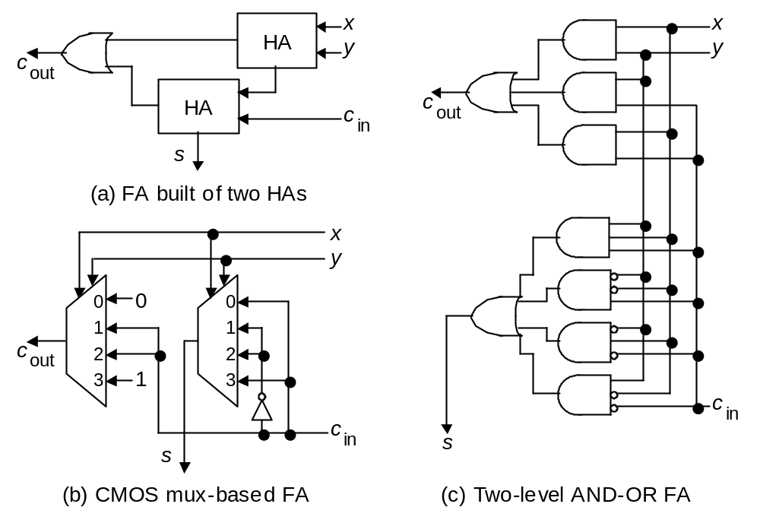
Full-adder implementation
Fig. 5.2 (alternate version) Possible designs for a full-adder in terms of half-adders, logic gates, and CMOS transmission gates.

Slide 31
Ripple-Carry Adder
B
A
n
n
always @(*)
{Cout, S} = A+B+Cin;
Cout
Adder
Cin
n
S
B[n-1]
A[n-1]
B[n-2]
A[n-2]
B[2]
A[2]
B[1]
A[1]
B[0]
A[0]
0 1 1 0
A
+)
0 0 1 1
B
Cin
FA
FA
FA
FA
FA
1 0 0 1
S
…
Cout
S[n-1]
S[n-2]
S[2]
S[1]
S[0]

Slide 32
Performance analysis for an adder

Slide 33
Path delay time
time
unstable signal value
A
10
20
A
+
C
B
5
B
C
15
xxx
25
delay

Slide 34
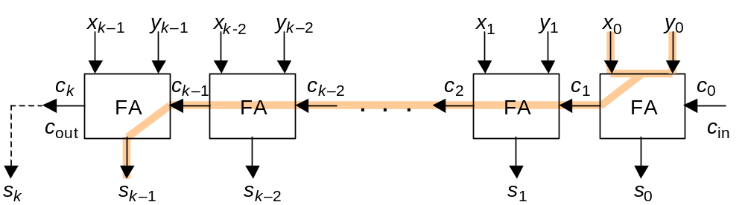
Critical path
critical path: the longest path in a circuit
signal delay time proportional to the length of the critical path
Fig. 5.5 Critical path in a k-bit ripple-carry adder.

Slide 35
Design efficient hardware with redundant number system
do R=X+Y+Z

Slide 36
The core problem
do R=X+Y+Z with (N+1) times FA delay
  X, Y, Z: N-bit numbers
Remark: is this approach fast enough?
Z
Y
X
+
+
R

Slide 37
Why the strange number system?
fast addition without carry!
there will be no carry delay if we can accept the strange representation
5 7 8 2 4 9
6 2 9 3 8 9 Operand digits in [0, 9]
––––––––––––––––––––––––––––––––––
11 9 17 5 12 18 Position sums in [0, 18]
+

Slide 38
Carry save adder
for carry-free addition on binary numbers

Slide 39
Carry free addition on binary numbers
1 0 0 1 1 0 1
0 1 1 1 1 0 0
+)
1 0 1 0 1 0 1
2 1 2 2 3 0 2
0 1 0 0 1 0 0
1 0 1 1 1 0 1

Slide 40
Carry free addition on binary numbers
How to implement?
  a full adder for a bit
inputs
1 0 0 1 1 0 1
0 1 1 1 1 0 0
FA
(full adder)
+)
1 0 1 0 1 0 1
2 1 2 2 3 0 2
C
S
outputs
0 1 0 0 1 0 0
1 0 1 1 1 0 1

Slide 41
Carry free addition on binary numbers
How to implement?
  parallel full adders for the addition
1 0 0 1 1 0 1
0 1 1 1 1 0 0
FA
...
FA
FA
FA
+)
1 0 1 0 1 0 1
C7
S6
C3
S3
C2
S2
C1
S0
2 1 2 2 3 0 2
CSA (Carry-Save Adder)
0 1 0 0 1 0 0
1 0 1 1 1 0 1

Slide 42
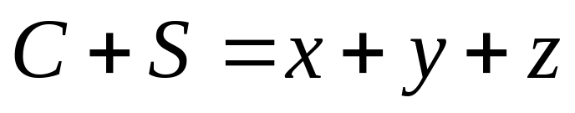
Carry-Save Adder (CSA)
z
y
x
CSA
FA
...
FA
FA
FA
C7
S6
C3
S3
C2
S2
C1
S0
C
S
CSA (Carry-Save Adder)

Slide 43
Back to R=X+Y+Z

Slide 44
Realizing R=X+Y+Z
the method: X+Y+Z=C+S=R
delay: (N+1) times FA delay!
Z
Y
X
1 0 0 1 1 0 1
0 1 1 1 1 0 0
CSA
+)
1 0 1 0 1 0 1
2 1 2 2 3 0 2
C
S
S
0 1 0 0 1 0 0
+
C
1 0 1 1 1 0 1
R

Slide 45
Your Lab

Slide 46
Lab 02
realizing hardware to do R=X+Y+Z
compare path delay of the two designs
Z
Y
X
Z
Y
X
CSA
+
C
S
+
+
R
R

Slide 47
Remark
Chap. 3 contains only the math
the hardware part is from
  Chap. 5: basic addition and counting
  Chap. 8: multi-operand addition

