Slide 1
Overview of VLSI Design Flow
Lecture 01

Slide 2
Part 00 of this course
review all what you have learned in
digital circuit
computer organization/architecture
electronics
guide you to build your first chip
Lab 01: design and synthesize a simple accumulator

Slide 3
Today’s Goal
Review all the hardware courses you have taken in CSIE
hardware/software codesign
ESL design
(Electronic System Level)
advanced
computer architecture
computer architecture
RTL design
(Register Transfer Level)
computer organization
gate-level design
digital circuit
circuit-level design
(transistor-level)
electronics
physical layout

Slide 4
How to make a (digital) chip

Slide 5
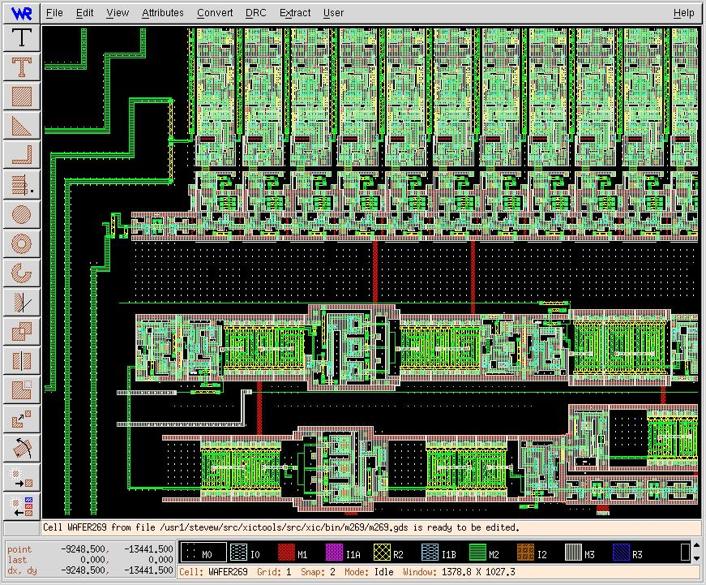
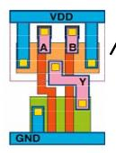
VLSI Design Flow in SoC Era
ESL design
(Electronic System Level)
RTL design
(Register Transfer Level)
gate-level design
circuit-level design
(transistor-level)
physical layout

Slide 6
Physical Layout
ESL design
(Electronic System Level)
RTL design
(Register Transfer Level)
gate-level design
circuit-level design
(transistor-level)
physical layout

Slide 7
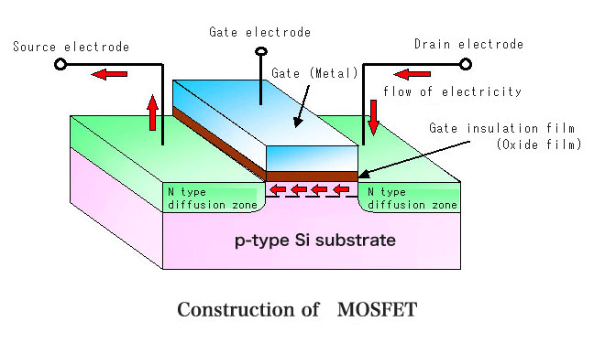
The basic device to build a chip: MOS transistor
ESL design
(Electronic System Level)
RTL design
(Register Transfer Level)
gate-level design
circuit-level design
(transistor-level)
D
G
physical layout
X
X=0
X=1
S

Slide 8
Physical layout of a chip
The image you find in fully-custom design

Slide 9

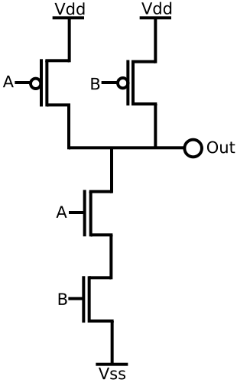
Circuit-level design
ESL design
(Electronic System Level)
RTL design
(Register Transfer Level)
gate-level design
circuit-level design
(transistor-level)
physical layout

Slide 10
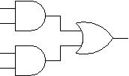
Gate-Level Design
ESL design
(Electronic System Level)
RTL design
(Register Transfer Level)
gate-level design
circuit-level design
(transistor-level)
physical layout

Slide 11
RTL Design
RTL: Register Transfer Level
input A [3:0];
input B [3:0];
input clock;
reg S [3:0];
always @(posedge clock)
S <= #1 A+B;
ESL design
(Electronic System Level)
RTL design
(Register Transfer Level)
gate-level design
circuit-level design
(transistor-level)
physical layout

Slide 12
Electronic System Level (ESL) Design
ESL design
(Electronic System Level)
RTL design
(Register Transfer Level)
gate-level design
circuit-level design
(transistor-level)
physical layout

Slide 13
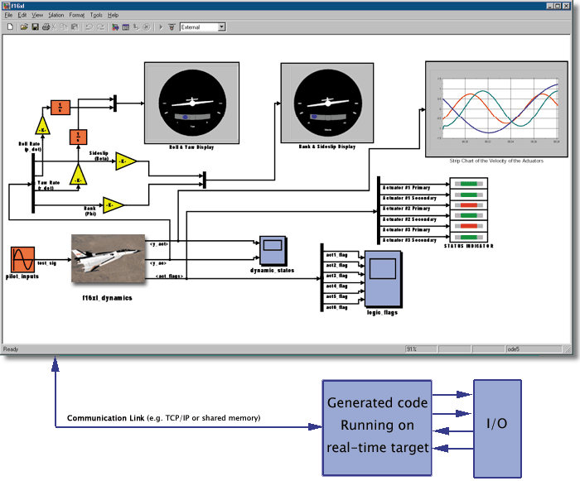
ESL Design
DSP
RISC
IP Library
DCT
FFT
Design Tools
RISC
DSP1
DSP2

Slide 14
Transform application algorithm to Silicon SoC (System-on-Chip)
in the SoC era, you have to design both hardware and software!
lots of SW works needs solid HW background
e.g. optimizing compiler design
application algorithm
system-on-chip
video
frames
motion
estimation
DCT
CPU
DSP
entropy
coding
Q
ME
memory

Slide 15
How to make a cell-phone play video?
Step 1: put everything on the CPU as a software program
application algorithm
video
frames
motion
estimation
DCT
system-on-chip
entropy
coding
Q
CPU
memory

Slide 16
How to make a cell-phone play video?
Step 2: put some specific hardware and move some tasks onto these hardware
do hardware specific program optimization
application algorithm
video
frames
motion
estimation
DCT
system-on-chip
CPU
DSP
entropy
coding
Q
ME
memory

Slide 17
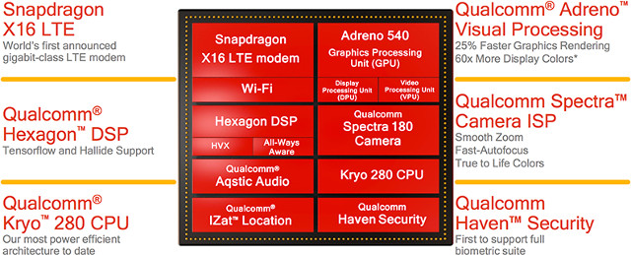
A typical SoC: Qualcomm Snapdragon 845

Slide 18
What a computer architect do
vertical integration of a computer system
from semiconductor to application program
software
application program
operating system
optimizing compiler
architecture design
RTL & gate-level design
circuit-level design
physical level design
hardware

Slide 19
Think of this problem after your finish the course
Consider
fast Fourier transform
discrete cosine transform
image recognition through convolution neural network
What’s the most efficient way to realize the transform?
speed, area, power consumption
which part hardware? which part software?

Slide 20
The IC industry in Taiwan
ESL design
(Electronic System Level)
RTL design
(Register Transfer Level)
design house: 聯發科, etc.…
IP supplier: ARM, CEVA, 晶心 (Andes)
gate-level design
circuit-level design
(transistor-level)
design service: 創鈺, 智源
physical layout
manufacture: 台積電, 聯電

Slide 21
Coming Up
Part A: RTL design revisited
Part B: How we realize this flow?
use of EDA tools
Lab 01: a simple accumulator chip
ESL design
(Electronic System Level)
RTL design
(Register Transfer Level)
gate-level design
circuit-level design
(transistor-level)
physical layout

