Slide 1
Synthesizable Verilog Coding
Lecture 01 (Part C)
review of preliminary knowledge

Slide 2
Outline
synthesizable Verilog coding
overview
structural description
behavior description: combinational vs. sequential circuit
simulation support
Lab 01

Slide 3
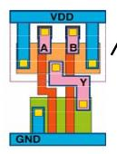
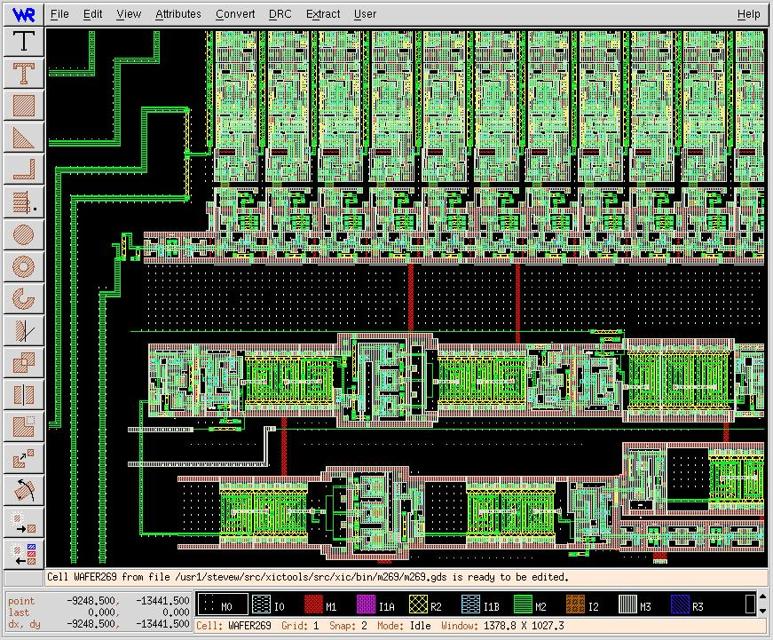
State-of-art chip design
always @(posedge clk)
A <= B+C;
RTL design
(Register Transfer Level)
gate-level design
circuit-level design
(transistor-level)
automatically
processed by EDA
tools
physical layout

Slide 4
Common error of beginners
non-synthesizable coding style
a wrong code may result in correct simulation wave-form/FPGA outcome
synthesizable but without concrete imagine on hardware generated
long path delay
extremely large chip area

Slide 5
Caution

Slide 6
Correct method of doing RTL coding
Step 1: draw the block diagram of your hardware
be aware of combinational and sequential circuit
Step 2: translate each block into Verilog/VHDL code
follow fixed coding style

Slide 7
Verilog coding
structural description
describe the hardware directly
behavior description
most of beginners error

Slide 8
Structural description

Slide 9
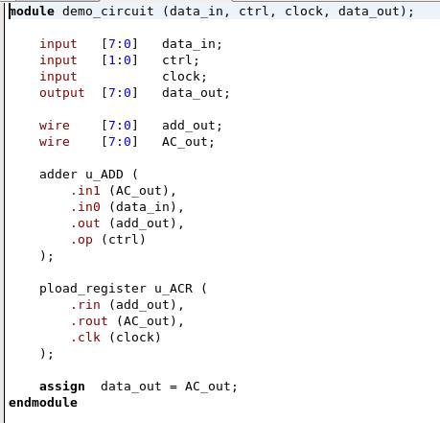
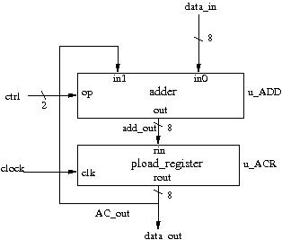
Example of structural description

Slide 10
Example of structural description
input/output specification

Slide 11
Example of structural description

Slide 12
Example of structural description

Slide 13
Instance Sub-Modules

Slide 14
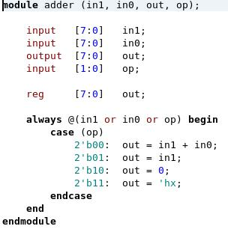
Hierarchical modules

Slide 15
Instance name of a module

Slide 16
Declare wires

Slide 17
Connecting ports of modules

Slide 18
Caution
always use “wire” to declare signals in structural description
no “always @(…)” in structural description

Slide 19
Behavior description

Slide 20
What is behavior description
declare with “reg”
although some may be synthesized as wires
use “always @(…)” to describe the “rule to generate output”
not a step-by-step executing program

Slide 21
Caution on behavior description
Be aware of which part is combinational circuit and which part is sequential circuit
use fixed coding style for
combinational circuit
sequential circuit
Do not try other coding styles!

Slide 22
Inferring combinational circuit with behavior description

Slide 23
The general scheme
for combinational circuit
A
B
C
always @(A or B or C) begin
…
// C code to compute D and E
…
end
hardware to be
simulated
D
E

Slide 24
Inferring combinational circuit
general coding style:
always @(all signal list)
always @(*)
use blocking assignment “=“
do not use “<= “
you have to enumerate all cases to determine the output value

Slide 25
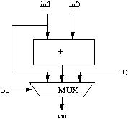
Example 1: combinational circuit

Slide 26
Example 1: combinational circuit
register is not a register!

Slide 27
Example 1: combinational circuit
C-like code to compute output from inputs

Slide 28
Example 1: combinational circuit
specify a don’t-care

Slide 29
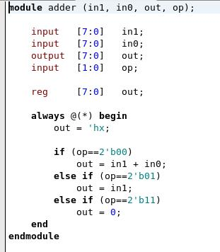
Example 1: combinational circuit
if-then-else rules also work!

Slide 30
Example 1: combinational circuit
This line is necessary to enforce
a combinational circuit

Slide 31
Example 1: combinational circuit
Verilog 2001 standard:
depends on all input signals

Slide 32
Inferring sequential circuit with behavior description

Slide 33
The general scheme
for sequential circuit
only simulate when clock triggered
A
B
C
always @(posedge clk) begin
…
// C code to compute D and E
…
end
hardware to be
simulated
clk
D
E

Slide 34
Inferring sequential circuit
coding style:
always @(posedge clk)
use non-blocking assignment “<=“

Slide 35
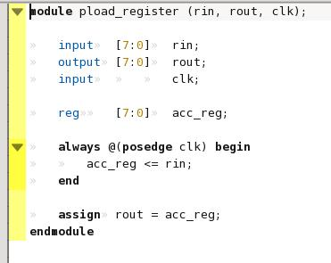
Example 2: sequential circuit
parallel D-FFs triggered by clock

Slide 36
Example 2: sequential circuit
parallel D-FFs triggered by clock
simulation triggered by clock

Slide 37
Example 2: sequential circuit
parallel D-FFs triggered by clock
Caution: You have to use non-blocking assignment
to generate registers!

Slide 38
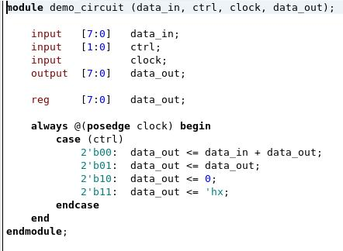
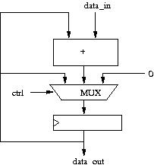
Example 3: sequential circuit
with combinational circuit for computation

Slide 39
I believe that most of you are confused with
combinational circuit vs.
sequential circuit

Slide 40
Example: the adder
combinational vs. sequential circuit

Slide 41
What’s the difference?
reg [3:0] A, B, C;
always @(*) begin
A = B+C;
end
reg [3:0] A, B, C;
always @(posedge clk) begin
A <= B+C;
end

Slide 42
What’s the difference?
reg [3:0] A, B, C;
always @(*) begin
A = B+C;
end
reg [3:0] A, B, C;
always @(posedge clk) begin
A <= B+C;
end
B
C
B
C
+
+
clk
register
A
A

Slide 43
What’s the difference?
reg [3:0] A, B, C;
always @(*) begin
A = B+C;
end
reg [3:0] A, B, C;
always @(posedge clk) begin
A <= B+C;
end
clk
clk
B
10
1
5
B
10
1
5
5
2
7
C
5
2
7
C
A
15
3
12
A
15
3
12

Slide 44
Simulation Support
code only for simulation, not to synthesize real hardware

Slide 45
General guidelines to coding for simulation support
in behavior descriptions only
event-driven programming and coding like C
system tasks to display results or dump waveform
Example:
to dump the content of “out” signals every cycle
always @(posedge clk) begin
#2; //delay 2 units of simulation time
$display (“out = %h”, out);
end

Slide 46
Sample code for simulation support
to generate the clock signal
initial clk=0;
always #5 clk=~clk;
5 unit
clk
5 unit

Slide 47
Sample code for simulation support
to feed test patterns
time
Hardware you
designed
din1
sim_cycle
0
1
2
3
din2
don’t-care
0xa
0x5
0x9
din1
din2
don’t-care
0x2
0x4
0x5

Slide 48
Dump waveforms
IEEE standard waveform format (.vcd)
specify the file name of the waveform:
$dumpfile (“file_name”)
specify the scope of signals to dump:
$dumpvars (scope_and_signal_name);
start waveform dumping:
$dumpon;
stop waveform dumping:
$dumpoff;

Slide 49
Dump waveforms
Synopsys supported format (VPD+)
specify the file name
$vcdplusfile (“filename”);
start dumping and specify the scope:
$vcdpluson (scope_and_signals_name);
stop dumping:
$vcdplusoff;

Slide 50
More on simulation support
specify the timescale
call a complete task
call a C function
Verilog standard: PLI (Programming Language Interface)
Synopsys special: direct-C
Please check-out the manual!

