Slide 1
Adder with Residual Number System
Lab 02

Slide 2
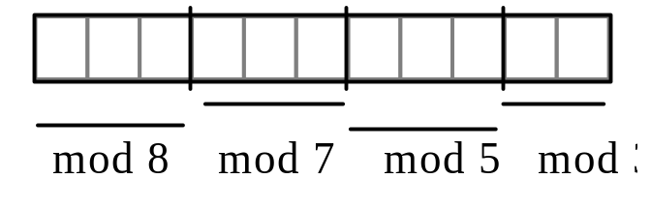
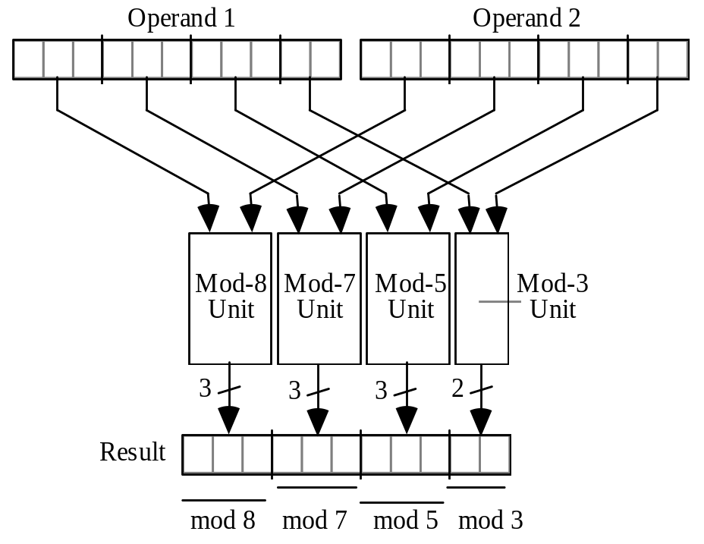
The Task: Realize an adder in RNS
with primes {3,5,7,8}
Fig. 4.1 Binary-coded format for RNS(8 | 7 | 5 | 3).
Fig. 4.2 The structure of an adder, subtractor, or multiplier for RNS(8|7|5|3).

Slide 3
Requirements
Synthesize the RNS adder with SAED-32 cell library
Demo:
  Simulation of the RTL code (show waveform)
  Pre-layout simulation of the synthesized gate-level netlist (show waveform)
  Timing report
  Show the synthesized gate-level netlist

