Slide 1
Usage of FPGA Experiment Board
Lab 01

Slide 2
Goals of this lab
Let you know how to work with our FPGA board
FPGA: Field Programmable Gate Array
a special hardware architecture to simulate digital circuit design
Establish your imagination on timing analysis

Slide 3
Your Tasks
Task 1: show the timing waveform of a given circuit
Task 2: the traffic light controller

Slide 4
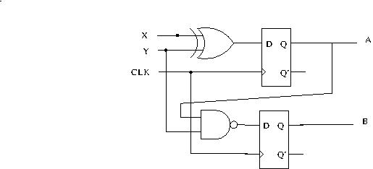
Task 1
Draw the circuit and demo the timing waveform of the simulation to TA
Remind: use asynchronous preset/clean to set the initial value of D flip flops from a RESET signal

Slide 5

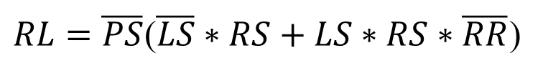
Task 2
Demo the traffic-light control of our quiz on the FPGA board
Input: (dip switch)
PS: car pool lane sensor
LS: left lane sensor
RS: right lane sensor
RR: round robin (left 1, right 0)
Output: (LED)
PL: car pool lane light
LL: left lane light
RL: right lane light
$$PL=PS$$
$$LL=\overline{PS}(LS∗\overline{RS}+LS∗RS∗RR)$$
$RL=\overline{PS}$($\overline{LS}∗RS+LS∗RS∗\overline{RR}$)

