Slide 1
期中考解答

Slide 2
1
X | Y | Q0 | Q1 | Q0’ | Q1’
0 | 1 | 0 | 0 | 1 | 0
0 | 0 | 1 | 0 | 0 | 0
1 | 1 | 0 | 0 | 1 | 0
1 | 0 | 1 | 0 | 0 | 1

Slide 3
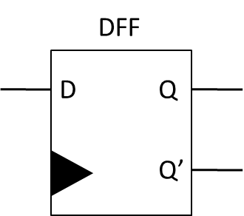
2
Q0 | Q1 | X | Y | Q0’ | Q1’
0 | 0 | 0 | x | 0 | 0
0 | 0 | 1 | x | 0 | 1
0 | 1 | x | x | 1 | 0
1 | 0 | x | 0 | 1 | 1
1 | 0 | x | 1 | 1 | 0
1 | 1 | 0 | 0 | 1 | 1
1 | 1 | 0 | 1 | 0 | 0
1 | 1 | 1 | 0 | 0 | 1
1 | 1 | 1 | 1 | 1 | 1
Combinational Circuit
S0
S0
S1
X
Y
S1
Combinational Circuit Table

Slide 4
3
Combinational
Circuit
S0
D0
S0
D1
S1
D2
S2
D3
S3

Slide 5
4-b
Pause
Start
Pause
Start
Hold
Counter Down
Pause
00
Start
01
10
Pause
Z=00:00
Z=00:00

Slide 6
4-c
5
L
9
L
5
L
9
L
En
En
En
En
Count
Down
6
Count
Down
10
Count
Down
6
Count
Down
10
Z

Slide 7
4-c
Sta |  | S | P | Z | En | L | Sta’
0 | 0 | 0 | 0 | 0 | 0 | 0 | 0 | 0
0 | 0 | 0 | 0 | 1 | 0 | 0 | 0 | 0
0 | 0 | 0 | 1 | 0 | 0 | 0 | 0 | 0
0 | 0 | 0 | 1 | 1 | 0 | 0 | 0 | 0
0 | 0 | 1 | 0 | 0 | 1 | 1 | 0 | 1
0 | 0 | 1 | 0 | 1 | 1 | 1 | 0 | 1
0 | 0 | 1 | 1 | 0 | 0 | 0 | 0 | 0
0 | 0 | 1 | 1 | 1 | 0 | 0 | 0 | 0
0 | 1 | 0 | 0 | 0 | 1 | 0 | 0 | 1
0 | 1 | 0 | 0 | 1 | 0 | 0 | 0 | 0
0 | 1 | 0 | 1 | 0 | 0 | 0 | 1 | 0
0 | 1 | 0 | 1 | 1 | 0 | 0 | 1 | 0
Sta |  | S | P | Z | En | L | Sta’
0 | 1 | 1 | 0 | 0 | 1 | 0 | 0 | 1
0 | 1 | 1 | 0 | 1 | 0 | 0 | 0 | 0
0 | 1 | 1 | 1 | 0 | 1 | 0 | 0 | 1
0 | 1 | 1 | 1 | 1 | 0 | 0 | 0 | 0
1 | 0 | 0 | 0 | 0 | 0 | 0 | 1 | 0
1 | 0 | 0 | 0 | 1 | 0 | 0 | 0 | 0
1 | 0 | 0 | 1 | 0 | 0 | 0 | 1 | 0
1 | 0 | 0 | 1 | 1 | 0 | 0 | 0 | 0
1 | 0 | 1 | 0 | 0 | 1 | 0 | 0 | 1
1 | 0 | 1 | 0 | 1 | 0 | 0 | 0 | 0
1 | 0 | 1 | 1 | 0 | 0 | 0 | 1 | 0
1 | 0 | 1 | 1 | 1 | 0 | 0 | 0 | 0

Slide 8
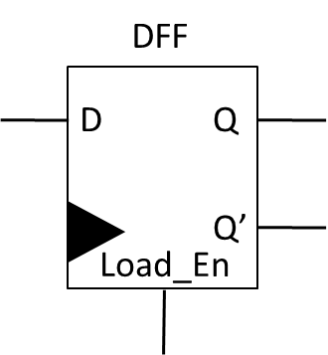
5
0
Adder
1
R0
2
A
3
S1
S0
S0
B
0
1
R1
2
3
S1
S0
S1

Slide 9
6-a
00
01
X=1
R(t+1)
↑
C
R(t+1)
↑
R(t)+D
A+B>0
00
01
10
11
X=0
Cin=0
Cin=1
Cin=0
Cin=1
Y=0
R(t+1)
↑
C
R(t+1)
↑
R(t)+D+1
R(t+1)
↑
R(t)
R(t+1)
↑
R(t)+1

Slide 10
6-b
Adder
C
Y
D
D
X
Cin
S0
S1
Compare
C
Compare
A+B
X
Y
0
D

Slide 11
7-a
MSO=0
Counter 1
Counter 4
Counter 8
idle
start
MSO=1
Slave ID
data
X
00
MSO=1
01
C
10
C
11
C

Slide 12
7-b
Counter
Compare
1
C
4
8
X |  | C | MSO | X
0 | 0 | X | 0 | 0 | 0
0 | 0 | X | 1 | 0 | 1
0 | 1 | 0 | X | 0 | 1
0 | 1 | 1 | 1 | 1 | 0
1 | 0 | 0 | X | 1 | 0
1 | 0 | 1 | X | 1 | 1
1 | 1 | 0 | X | 1 | 1
1 | 1 | 1 | X | 0 | 0
X1
X0
Slave
Combinational Circuit
C
MSO
X0
X1
Combinational Circuit Table

