Slide 1
期中考解答

Slide 2
1
0
0
00
01
X | A | B | A’ | B’
0 | 0 | 0 | 0 | 0
0 | 0 | 1 | 0 | 0
0 | 1 | 0 | 1 | 0
0 | 1 | 1 | 1 | 0
1 | 0 | 0 | 1 | 1
1 | 0 | 1 | 1 | 1
1 | 1 | 0 | 0 | 0
1 | 1 | 1 | 0 | 0
1
1
1
1
10
11
0
0

Slide 3
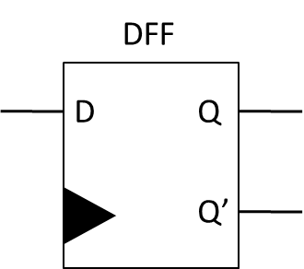
2
S1 | S0 | X1 | X0 | S1’ | S0’
0 | 0 | 0 | 0 | 0 | 0
0 | 0 | 0 | 1 | 0 | 0
0 | 0 | 1 | 0 | 0 | 1
0 | 0 | 1 | 1 | 0 | 1
0 | 1 | 0 | 0 | 0 | 1
0 | 1 | 0 | 1 | 1 | 0
0 | 1 | 1 | 0 | 1 | 0
0 | 1 | 1 | 1 | 1 | 0
1 | 0 | 0 | 0 | 0 | 1
1 | 0 | 0 | 1 | 0 | 0
1 | 0 | 1 | 0 | 0 | 0
1 | 0 | 1 | 1 | 0 | 1
Combinational Circuit
S0
S0
S1
X0
X1
S1
Combinational Circuit Table

Slide 4
3
L3
S3
L1
S2
L2
S1
L0
S0
GND

Slide 5
4-b
Pause
Start
Pause
Start
Hold
Counter Down
Pause
00
Start
01
10
Pause
Z=00:00
Z=00:00

Slide 6
4-c
5
L
9
L
5
L
9
L
En
En
En
En
Count
Down
6
Count
Down
10
Count
Down
6
Count
Down
10
Z

Slide 7
4-c
Sta |  | S | P | Z | En | L | Sta’
0 | 0 | 0 | 0 | 0 | 0 | 0 | 0 | 0
0 | 0 | 0 | 0 | 1 | 0 | 0 | 0 | 0
0 | 0 | 0 | 1 | 0 | 0 | 0 | 0 | 0
0 | 0 | 0 | 1 | 1 | 0 | 0 | 0 | 0
0 | 0 | 1 | 0 | 0 | 1 | 1 | 0 | 1
0 | 0 | 1 | 0 | 1 | 1 | 1 | 0 | 1
0 | 0 | 1 | 1 | 0 | 0 | 0 | 0 | 0
0 | 0 | 1 | 1 | 1 | 0 | 0 | 0 | 0
0 | 1 | 0 | 0 | 0 | 1 | 0 | 0 | 1
0 | 1 | 0 | 0 | 1 | 0 | 0 | 0 | 0
0 | 1 | 0 | 1 | 0 | 0 | 0 | 1 | 0
0 | 1 | 0 | 1 | 1 | 0 | 0 | 1 | 0
Sta |  | S | P | Z | En | L | Sta’
0 | 1 | 1 | 0 | 0 | 1 | 0 | 0 | 1
0 | 1 | 1 | 0 | 1 | 0 | 0 | 0 | 0
0 | 1 | 1 | 1 | 0 | 1 | 0 | 0 | 1
0 | 1 | 1 | 1 | 1 | 0 | 0 | 0 | 0
1 | 0 | 0 | 0 | 0 | 0 | 0 | 1 | 0
1 | 0 | 0 | 0 | 1 | 0 | 0 | 0 | 0
1 | 0 | 0 | 1 | 0 | 0 | 0 | 1 | 0
1 | 0 | 0 | 1 | 1 | 0 | 0 | 0 | 0
1 | 0 | 1 | 0 | 0 | 1 | 0 | 0 | 1
1 | 0 | 1 | 0 | 1 | 0 | 0 | 0 | 0
1 | 0 | 1 | 1 | 0 | 0 | 0 | 1 | 0
1 | 0 | 1 | 1 | 1 | 0 | 0 | 0 | 0

Slide 8
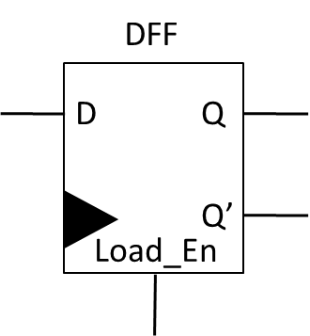
5
Adder
R0
A
S0
B
R1
S1
S0

Slide 9
6-a
00
01
10
11
C=0
R(t+1)
↑
A
R(t+1)
↑
R(t)+B
R(t+1)
↑
R(t)+C
R(t+1)
↑
R(t)+D
A>B
00
01
10
11
C=1
Cin=0
Cin=1
Cin=0
Cin=1
R(t+1)
↑
A
R(t+1)
↑
R(t)+B+1
R(t+1)
↑
R(t)+C
R(t+1)
↑
R(t)+D+1

Slide 10
6-b
Adder
A
B
B
C
D
D
Cin
S0
S1
A
Compare
C
C
B

Slide 11
7-a
Counter 5
Counter 75
Counter 10
Counter 70
XR
XG
XY
XR
X
00
Cx
01
Cx
10
Cx
11
Cx
Counter 95
Counter 55
Counter 10
YR
XG
XY
Y
00
Cy
01
Cy
10
Cy

Slide 12
7-b
Counter
100
Compare
5
75
Cx
10
X
70
X/Y |  | Cx | X |  | Y
0 | 0 | 0 | 0 | 0 | 0 | 0
0 | 0 | 1 | 0 | 1 | 0 | 1
0 | 1 | 0 | 0 | 1 | 0 | 1
0 | 1 | 1 | 1 | 0 | 1 | 0
1 | 0 | 0 | 1 | 0 | 1 | 0
1 | 0 | 1 | 1 | 1 | 0 | 0
1 | 1 | 0 | 1 | 1 | X | X
1 | 1 | 1 | 0 | 0 | X | X
X1
X0
X0
Combinational Circuit
XR
X1
XG
XY
Counter
100
Compare
5
75
Cy
10
Y
Y1
Y0
Y0
Combinational Circuit
YR
Y1
YG
Combinational Circuit Table
YY

