Slide 1
Registers
Lecture 03
Section 6-1 & 6-6

Slide 2
About Chapter 6
title “Registers and Register Transfers”
Goal: RTL design methodology
a standard method to design any digital IC
You should be able to design any digital electronics product after finishing this chapter!
alarm, stop watch, CPU, etc.

Slide 3
What is RTL design?
a quick overview

Slide 4
What is a register
a variable in a chip
an n-bit storage device
triggered by clock
D flip-flop is an 1-bit register
in
D
Q
out
D
Q
4
4
clk
clock

Slide 5
What is RTL design
RTL: Register Transfer Level (Language)
a standard method to design any digital IC
Feature:
designer specify rules to transfer data from one register to another register
EDA (electronic design automation) tool synthesis RTL code to real hardware
B
C
Verilog code
+
reg [3:0] A, B, C;
always @(posedge clk) begin
A <= B+C;
end
clk
register
A

Slide 6
Remark
Why I don’t allow you to write Verilog/VHDL code now?
EDA tools are not as smart as you think
You should have a hardware picture in mind while writing Verilog/VHDL code
Writing Verilog/VHDL like C may result in incorrect/poor hardware!

Slide 7
Coming Up
We will go into Chap. 6
Lecture 03: registers design
Section 6.1: register with parallel load
Section 6.6: shift registers
Lecture 04: counters design and their applications
Section 6.6
with your digital clock lab
Lecture 05: RTL design
RTL: register-transfer level design
go through whole Chap. 6

Slide 8
Register
an n-bit box for storage

Slide 9
What is a register?
a box capable of storing n-bit data
n=4 in this example
D[0]
D
Q[0]
D[1]
D
Q[1]
D
Q
D[2]
D
Q[2]
4
4
D[3]
D
Q[3]
clock
clock

Slide 10
Timing behavior of the register
D[0]
D
Q[0]
D[1]
D
Q[1]
time
D[2]
D
Q[2]
clock
Q[3:0]
x
v0
v1
v2
D[3]
D
Q[3]
D[3:0]
v0
v1
v2
clock

Slide 11
Timing behavior of the register
D[0]
D
Q[0]
D[1]
D
Q[1]
time
D[2]
D
Q[2]
clock
Q[3:0]
x
0011
1010
1110
D[3]
D
Q[3]
D[3:0]
0011
1010
1110
clock

Slide 12
Various types of registers we will talk about
register with load enable
shift register
rotation register
shift register with parallel load
bi-directional shift register
accumulator (not mentioned in the textbook)

Slide 13
Register with load enable
a register that only memorize input when required

Slide 14
Spec: register with load enable
an n-bit box that only memorizes the input when Load=1
Load
register
D
Q
4
4
clock

Slide 15
Spec: register with load enable
an n-bit box that only memorizes the input when Load=1
Load
time
register
clock
D
Q
4
Q[3:0]
x
v0
4
D[3:0]
v0
clock
Load
1
cycle t
cycle t+1

Slide 16
Spec: register with load enable
an n-bit box that only memorizes the input when Load=1
Load
time
register
clock
D
Q
4
Q[3:0]
x
0011
4
D[3:0]
0011
clock
Load
1
cycle t
cycle t+1

Slide 17
Spec: register with load enable
an n-bit box that only memorizes the input when Load=1
Load
time
register
clock
D
Q
4
Q[3:0]
u
u
4
D[3:0]
v0
clock
Load
0
cycle t
cycle t+1

Slide 18
Spec: register with load enable
an n-bit box that only memorizes the input when Load=1
Load
time
register
clock
D
Q
4
Q[3:0]
1010
1010
4
D[3:0]
0011
clock
Load
0
cycle t
cycle t+1

Slide 19
How to design a register with load enable

Slide 20
My Steps
draw the framework of the circuit
Observation: the transfer function for bit i
Re-draw the framework: separate part for bit i
Draw the detailed circuit for bit i from the transfer function

Slide 21
Always start from this framework
Figure 4-1

Slide 22
The framework
combinational
circuit
D
D
Load
Load
D
register
D
Q
4
4
D
clock
clock

Slide 23
My Steps
draw the framework of the circuit
Observation: the transfer function for bit i
Re-draw the framework: separate part for bit i
Draw the detailed circuit for bit i from the transfer function

Slide 24
Transfer function for a bit
time
clock
Q[3:0]
x
0011
D[3:0]
0011
Load
1
cycle t
cycle t+1

Slide 25
Transfer function for a bit
time
time
clock
clock
Q[3:0]
x
0101
x
1
D[3:0]
0101
1
Load
1
Load
1
1
cycle t
cycle t+1
cycle t
cycle t+1

Slide 26
Transfer function for a bit
time
time
clock
clock
Q[3:0]
0010
0010
0
0
D[3:0]
0101
1
Load
0
Load
0
0
cycle t
cycle t+1
cycle t
cycle t+1

Slide 27
My Steps
draw the framework of the circuit
Observation: the transfer function for bit i
Re-draw the framework: separate part for bit i
Draw the detailed circuit for bit i from the transfer function

Slide 28
The framework
Load
D
D
D
D
clock

Slide 29
My Steps
draw the framework of the circuit
Observation: the transfer function for bit i
Re-draw the framework: separate part for bit i
Draw the detailed circuit for bit i from the transfer function

Slide 30
The combinational part for bit i
Load
Load
0
0
0
0
0
0
1
1
0
1
0
0
0
1
1
1
1
0
0
0
1
0
1
0
1
1
0
1
Load
1
1
1
1

Slide 31
The complete circuit
4-bit register with load enable
Figure 6-2

Slide 32
A simple shift register

Slide 33
Various types of registers we will talk about
register with load enable
shift register
rotation register
shift register with parallel load
bi-directional shift register
accumulator

Slide 34
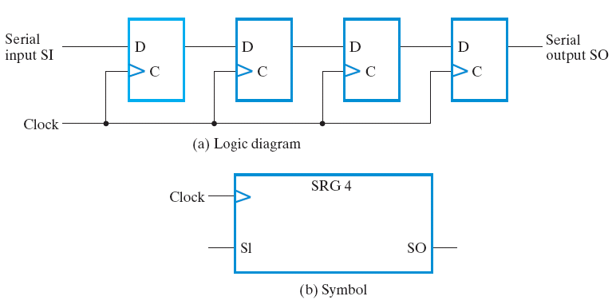
A simple shift register
a 4-bit shift register in Figure 6-9

Slide 35
Function of the simple shift register
initial state at cycle 0
1
0
0
0
0
time
clock
Q[3:0]
0000
SI
1
SO
0

Slide 36
Function of the simple shift register
initial state at cycle 1
0
1
0
0
0
time
clock
Q[3:0]
0000
1000
SI
1
0
SO
0
0

Slide 37
Function of the simple shift register
initial state at cycle 2
0
0
1
0
0
time
clock
Q[3:0]
0000
1000
0100
SI
1
0
0
SO
0
0
0

Slide 38
Function of the simple shift register
The transfer function:
0
0
0
1
0
time
clock
Q[3:0]
0000
1000
0100
SI
1
0
0
SO
0
0
0

Slide 39
Exercise: rotation register with serial input select

Slide 40
Various types of registers we will talk about
register with load enable
shift register
rotation register
shift register with parallel load
bi-directional shift register
accumulator

Slide 41
The Problem
SEL
RReg
SI
clock
4
Q
design a 4-bit register with the following function:
SEL=0: shift right with serial input
SEL=1: rotate right
time
clock
Q[3:0]
SI
SEL

Slide 42
The Problem
SEL
RReg
SI
clock
4
Q
design a 4-bit register with the following function:
SEL=0: shift right with serial input
SEL=1: rotate right
time
clock
Q[3:0]
0110
1011
SI
1
SEL
0

Slide 43
The Problem
SEL
RReg
SI
clock
4
Q
design a 4-bit register with the following function:
SEL=0: shift right with serial input
SEL=1: rotate right
time
clock
Q[3:0]
0110
0011
SI
1
SEL
1

Slide 44
Recall: the multiplexer
combinational circuit to select from multiple inputs
A
B
MUX
0
1
S
C

Slide 45
Recall: the multiplexer
combinational circuit to select from multiple inputs
A
B
MUX
0
1
0
S
C

Slide 46
Recall: the multiplexer
combinational circuit to select from multiple inputs
A
B
MUX
0
1
1
S
C

Slide 47
The circuit design
SI
0
1
SEL
MUX

Slide 48
How the circuit works?
1
0
time
clock
Q[3:0]
0110
1011
SI
1
SEL
0

Slide 49
How the circuit works?
1
1
time
clock
Q[3:0]
0110
0011
SI
1
SEL
1

Slide 50
Bi-directional shift register with parallel load

Slide 51
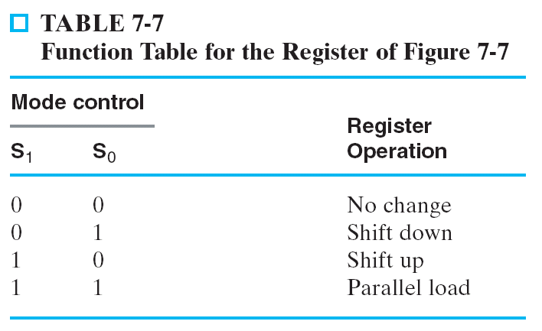
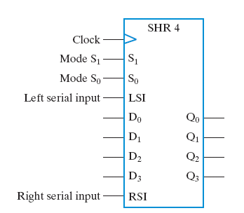
The design spec
time
clock
Q[3:0]
D[3:0]
S[1:0]
LSI
RSI

Slide 52
The design spec
time
0
0
clock
Q[3:0]
0101
0101
D[3:0]
xxxx
S[1:0]
00
LSI
x
RSI
x

Slide 53
The design spec
time
0
1
clock
1
Q[3:0]
0101
1011
D[3:0]
xxxx
S[1:0]
01
LSI
1
RSI
x

Slide 54
The design spec
time
1
0
clock
Q[3:0]
0101
1010
D[3:0]
xxxx
S[1:0]
10
1
x
LSI
RSI
1

Slide 55
The design spec
time
1
1
clock
0
Q[3:0]
0101
1100
0
1100
1
D[3:0]
1
S[1:0]
11
LSI
x
RSI
x

Slide 56
My Steps to derive the design
Observation: the rules to set Q_{i}
Re-draw the circuit framework from the rules to set Q_{i}
Logic simplification and finish the final design

Slide 57
Recall: the multiplexer
combinational circuit to select from multiple inputs
A
B
MUX
0
1
S
C

Slide 58
Recall: the multiplexer
combinational circuit to select from multiple inputs
A
B
MUX
0
1
0
S
C

Slide 59
Recall: the multiplexer
combinational circuit to select from multiple inputs
A
B
MUX
0
1
1
S
C

Slide 60
The circuit design

Slide 61
The circuit design
time
00
clock
Q[3:0]
0101
0101
D[3:0]
xxxx
S[1:0]
00
LSI
x
RSI
x

Slide 62
The circuit design
time
01
clock
Q[3:0]
0101
1011
D[3:0]
xxxx
S[1:0]
01
LSI
1
RSI
x

Slide 63
The circuit design
time
10
clock
Q[3:0]
0101
1010
D[3:0]
xxxx
S[1:0]
10
LSI
x
RSI
1

Slide 64
The circuit design
time
11
clock
Q[3:0]
0101
1100
D[3:0]
1100
S[1:0]
00
LSI
x
RSI
x

