Slide 1
Registers
Lecture 03
Section 6-1 & 6-6

Slide 2
About Chapter 6
title “Registers and Register Transfers”
Goal: RTL design methodology
a standard method to design any digital IC
You should be able to design any digital electronics product after finishing this chapter!
alarm, stop watch, CPU, etc.

Slide 3
What is RTL design?
a quick overview

Slide 4
What is a register
a variable in a chip
an n-bit storage device
triggered by clock
D flip-flop is an 1-bit register
in
D
Q
out
D
Q
4
4
clk
clock

Slide 5
What is RTL design
RTL: Register Transfer Level (Language)
a standard method to design any digital IC
Feature:
designer specify rules to transfer data from one register to another register
EDA (electronic design automation) tool synthesis RTL code to real hardware
B
C
Verilog code
+
reg [3:0] A, B, C;
always @(posedge clk) begin
A <= B+C;
end
clk
register
A

Slide 6
Remark
Why I don’t allow you to write Verilog/VHDL code now?
EDA tools are not as smart as you think
You should have a hardware picture in mind while writing Verilog/VHDL code
Writing Verilog/VHDL like C may result in incorrect/poor hardware!

Slide 7
Coming Up
We will go into Chap. 6
Lecture 03: registers design
Section 6.1: register with parallel load
Section 6.6: shift registers
Lecture 04: counters design and their applications
Section 6.6
with your digital clock lab
Lecture 05: RTL design
RTL: register-transfer level design
go through whole Chap. 6

Slide 8
Register
an n-bit box for storage

Slide 9
What is a register?
a box capable of storing n-bit data
n=4 in this example
D[0]
D
Q[0]
D[1]
D
Q[1]
D
Q
D[2]
D
Q[2]
4
4
D[3]
D
Q[3]
clock
clock

Slide 10
Timing behavior of the register
D[0]
D
Q[0]
D[1]
D
Q[1]
time
D[2]
D
Q[2]
clock
Q[3:0]
x
v0
v1
v2
D[3]
D
Q[3]
D[3:0]
v0
v1
v2
clock

Slide 11
Timing behavior of the register
D[0]
D
Q[0]
D[1]
D
Q[1]
time
D[2]
D
Q[2]
clock
Q[3:0]
x
0011
1010
1110
D[3]
D
Q[3]
D[3:0]
0011
1010
1110
clock

Slide 12
Various types of registers we will talk about
register with load enable
shift register
rotation register
shift register with parallel load
bi-directional shift register
accumulator (not mentioned in the textbook)

Slide 13
Register with load enable
a register that only memorize input when required

Slide 14
Spec: register with load enable
an n-bit box that only memorizes the input when Load=1
Load
register
D
Q
4
4
clock

Slide 15
Spec: register with load enable
an n-bit box that only memorizes the input when Load=1
Load
time
register
clock
D
Q
4
Q[3:0]
x
v0
4
D[3:0]
v0
clock
Load
1
cycle t
cycle t+1

Slide 16
Spec: register with load enable
an n-bit box that only memorizes the input when Load=1
Load
time
register
clock
D
Q
4
Q[3:0]
x
0011
4
D[3:0]
0011
clock
Load
1
cycle t
cycle t+1

Slide 17
Spec: register with load enable
an n-bit box that only memorizes the input when Load=1
Load
time
register
clock
D
Q
4
Q[3:0]
u
u
4
D[3:0]
v0
clock
Load
0
cycle t
cycle t+1

Slide 18
Spec: register with load enable
an n-bit box that only memorizes the input when Load=1
Load
time
register
clock
D
Q
4
Q[3:0]
1010
1010
4
D[3:0]
0011
clock
Load
0
cycle t
cycle t+1

Slide 19
How to design a register with load enable

Slide 20
My Steps
draw the framework of the circuit
Observation: the transfer function for bit i
Re-draw the framework: separate part for bit i
Draw the detailed circuit for bit i from the transfer function

Slide 21
Always start from this framework
Figure 4-1

Slide 22
The framework
combinational
circuit
D
D
Load
Load
D
register
D
Q
4
4
D
clock
clock

Slide 23
My Steps
draw the framework of the circuit
Observation: the transfer function for bit i
Re-draw the framework: separate part for bit i
Draw the detailed circuit for bit i from the transfer function

Slide 24
Transfer function for a bit
time
clock
Q[3:0]
x
0011
D[3:0]
0011
Load
1
cycle t
cycle t+1

Slide 25
Transfer function for a bit
time
time
clock
clock
Q[3:0]
x
0101
x
1
D[3:0]
0101
1
Load
1
Load
1
1
cycle t
cycle t+1
cycle t
cycle t+1

Slide 26
Transfer function for a bit
time
time
clock
clock
Q[3:0]
0010
0010
0
0
D[3:0]
0101
1
Load
0
Load
0
0
cycle t
cycle t+1
cycle t
cycle t+1

Slide 27
My Steps
draw the framework of the circuit
Observation: the transfer function for bit i
Re-draw the framework: separate part for bit i
Draw the detailed circuit for bit i from the transfer function

Slide 28
The framework
Load
D
D
D
D
clock

Slide 29
My Steps
draw the framework of the circuit
Observation: the transfer function for bit i
Re-draw the framework: separate part for bit i
Draw the detailed circuit for bit i from the transfer function

Slide 30
The combinational part for bit i
Load
Load
0
0
0
0
0
0
1
1
0
1
0
0
0
1
1
1
1
0
0
0
1
0
1
0
1
1
0
1
Load
1
1
1
1

Slide 31
The complete circuit
4-bit register with load enable
Figure 6-2

Slide 32
A simple shift register

Slide 33
Various types of registers we will talk about
register with load enable
shift register
rotation register
shift register with parallel load
bi-directional shift register
accumulator

Slide 34
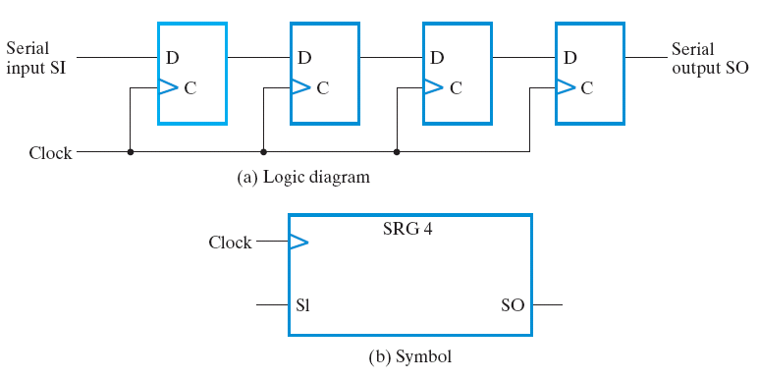
A simple shift register
a 4-bit shift register in Figure 6-9

Slide 35
Function of the simple shift register
initial state at cycle 0
1
0
0
0
0
time
clock
Q[3:0]
0000
SI
1
SO
0

Slide 36
Function of the simple shift register
initial state at cycle 1
0
1
0
0
0
time
clock
Q[3:0]
0000
1000
SI
1
0
SO
0
0

Slide 37
Function of the simple shift register
initial state at cycle 2
0
0
1
0
0
time
clock
Q[3:0]
0000
1000
0100
SI
1
0
0
SO
0
0
0

Slide 38
Function of the simple shift register
The transfer function:
0
0
0
1
0
time
clock
Q[3:0]
0000
1000
0100
SI
1
0
0
SO
0
0
0

Slide 39
Application of shift register

Slide 40
Recall our lab
8
…
8
display
En0
En1
En7
display

Slide 41
Recall our lab
8
…
8
display
En0
En1
En7
display
decoded signal
for “2”
1

Slide 42
Q: How to display more than two digits?
Hint: How the cartoon works?

Slide 43
Shift register control
8
…
8
display
En0
En1
En7
display

Slide 44
Shift register control
8
…
8
display
En0
En1
En7
display

Slide 45
Shift register control
8
…
8
display
En0
En1
En7
display

Slide 46
Exercise: rotation register with serial input select

Slide 47
Various types of registers we will talk about
register with load enable
shift register
rotation register
shift register with parallel load
bi-directional shift register
accumulator

Slide 48
The Problem
SEL
RReg
SI
clock
4
Q
design a 4-bit register with the following function:
SEL=0: shift right with serial input
SEL=1: rotate right
time
clock
Q[3:0]
SI
SEL

Slide 49
The Problem
SEL
RReg
SI
clock
4
Q
design a 4-bit register with the following function:
SEL=0: shift right with serial input
SEL=1: rotate right
time
clock
Q[3:0]
0110
1011
SI
1
SEL
0

Slide 50
The Problem
SEL
RReg
SI
clock
4
Q
design a 4-bit register with the following function:
SEL=0: shift right with serial input
SEL=1: rotate right
time
clock
Q[3:0]
0110
0011
SI
1
SEL
1

Slide 51
Recall: the multiplexer
combinational circuit to select from multiple inputs
A
B
MUX
0
1
S
C

Slide 52
Recall: the multiplexer
combinational circuit to select from multiple inputs
A
B
MUX
0
1
0
S
C

Slide 53
Recall: the multiplexer
combinational circuit to select from multiple inputs
A
B
MUX
0
1
1
S
C

Slide 54
The circuit design
SI
0
1
SEL
MUX

Slide 55
How the circuit works?
1
0
time
clock
Q[3:0]
0110
1011
SI
1
SEL
0

Slide 56
How the circuit works?
1
1
time
clock
Q[3:0]
0110
0011
SI
1
SEL
1

Slide 57
Shift register with parallel load

Slide 58
Various types of registers we will talk about
register with load enable
shift register
rotation register
shift register with parallel load
bi-directional shift register
accumulator

Slide 59
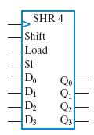
The Problem (design spec)
design a register with the following functions
time
clock
Q[3:0]
D[3:0]
Shift
Load
SI

Slide 60
The Problem (design spec)
design a register with the following functions
time
clock
Q[3:0]
0011
0011
D[3:0]
1101
Shift
0
Load
0
SI
1

Slide 61
The Problem (design spec)
design a register with the following functions
time
clock
Q[3:0]
0011
1101
D[3:0]
1101
Shift
0
Load
1
SI
1

Slide 62
The Problem (design spec)
design a register with the following functions
time
clock
Q[3:0]
0011
0111
D[3:0]
1101
Shift
1
Load
0
SI
1

Slide 63
My Steps
Observation: the rules to set Q_{i}
Re-draw the circuit framework from the rules to set Q_{i}
Logic simplification and finish the final design

Slide 64
Rules to set bit i
D
D
D
D
clock

Slide 65
Rules to set bit i
D
D
D
D
clock

Slide 66
Rules to set bit i
D
D
D
D
clock

Slide 67
Rules to set bit i
D
D
D
D
clock

Slide 68
My Steps
Observation: the rules to set Q_{i}
Re-draw the circuit framework from the rules to set Q_{i}
Logic simplification and finish the final design

Slide 69
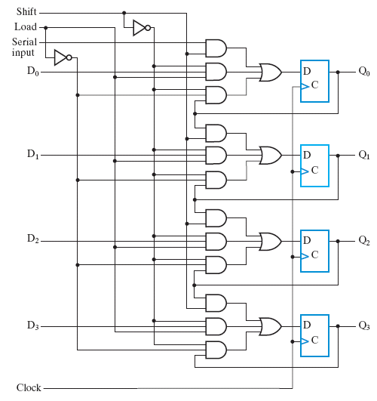
Re-draw the circuit framework
combinational
circuit
combinational
circuit
combinational
circuit
combinational
circuit

Slide 70
My Steps
Observation: the rules to set Q_{i}
Re-draw the circuit framework from the rules to set Q_{i}
Logic simplification and finish the final design

Slide 71
Logic simplification and completes the design

Slide 72
Bi-directional shift register with parallel load

Slide 73
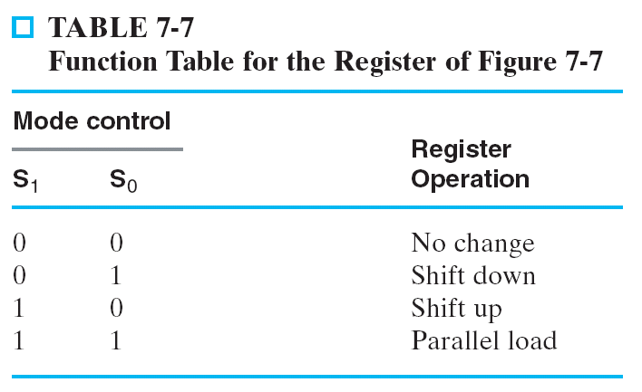
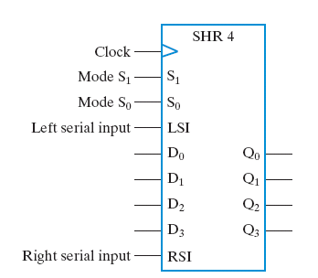
The design spec
time
clock
Q[3:0]
D[3:0]
S[1:0]
LSI
RSI

Slide 74
The design spec
time
0
0
clock
Q[3:0]
0101
0101
D[3:0]
xxxx
S[1:0]
00
LSI
x
RSI
x

Slide 75
The design spec
time
0
1
clock
1
Q[3:0]
0101
1011
D[3:0]
xxxx
S[1:0]
01
LSI
1
RSI
x

Slide 76
The design spec
time
1
0
clock
Q[3:0]
0101
1010
D[3:0]
xxxx
S[1:0]
10
1
x
LSI
RSI
1

Slide 77
The design spec
time
1
1
clock
0
Q[3:0]
0101
1100
0
1100
1
D[3:0]
1
S[1:0]
11
LSI
x
RSI
x

Slide 78
My Steps to derive the design
Observation: the rules to set Q_{i}
Re-draw the circuit framework from the rules to set Q_{i}
Logic simplification and finish the final design

Slide 79
Recall: the multiplexer
combinational circuit to select from multiple inputs
A
B
MUX
0
1
S
C

Slide 80
Recall: the multiplexer
combinational circuit to select from multiple inputs
A
B
MUX
0
1
0
S
C

Slide 81
Recall: the multiplexer
combinational circuit to select from multiple inputs
A
B
MUX
0
1
1
S
C

Slide 82
The circuit design

Slide 83
The circuit design
time
00
clock
Q[3:0]
0101
0101
D[3:0]
xxxx
S[1:0]
00
LSI
x
RSI
x

Slide 84
The circuit design
time
01
clock
Q[3:0]
0101
1011
D[3:0]
xxxx
S[1:0]
01
LSI
1
RSI
x

Slide 85
The circuit design
time
10
clock
Q[3:0]
0101
1010
D[3:0]
xxxx
S[1:0]
10
LSI
x
RSI
1

Slide 86
The circuit design
time
11
clock
Q[3:0]
0101
1100
D[3:0]
1100
S[1:0]
00
LSI
x
RSI
x

