Slide 1
RTL Coding with Verilog
Lab 08

Slide 2
Purpose of this lab
to learn Verilog grammar and synthesizable coding style
setup of your imagination of transform a hardware diagram to Verilog
B
C
+
reg [3:0] A, B, C;
always @(posedge clk) begin
A <= B+C;
end
clk
register
A

Slide 3
Your Tasks (70% basics)
Ex1: block design in structural description
Ex2: design a combinational circuit by specifying Boolean equations
Ex 3: circuit design from truth table (behavior description)
Ex 4: realizing a state-diagram with behavior description (if-then-else)

Slide 4
Your Task: (+20% bonus) Problem: Max-Min Circuit
Design a circuit to
find the minimum and maximum number
from a series of 4 input numbers
output max and min in series
Design Constraint:
only two n-bit registers are allowed to store the value for computation
time
min-max
circuit
start
start
1
0
Y
n
X
1000
1100
0010
0001
XXXX
X
n
XXXX
1100
0001
Y

Slide 5
Block Design with Structural Description
Exercise 01

Slide 6
Exercise 01
Write a Verilog module for this accumulator circuit
provided that the following sub-modules are given
adder
MUX
register with load enable
A
8
8
adder
in1
in0
0
MUX
S
8
Register R
L
Load
D
Q
8

Slide 7
Combinational Circuit Design with Boolean Equation
Exercise 02

Slide 8
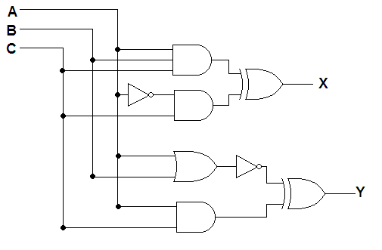
Exercise 02
Design the circuit with “assign” statements
write the Boolean equations

Slide 9
Circuit design with truth table
Exercise 03

Slide 10
Exercise 03
design the circuit with behavior description
specify the truth table/state-transition diagram

Slide 11
Realizing state-diagram with behavior description
Exercise 04

Slide 12
Exercise 04
Design a sequential circuit to realize the state diagram
use behavior description
use if-then-else and case statements
A
B
C
D

Slide 13
Requirements to your reports

Slide 14
Requirements to your Pre-Lab Reports
Verilog coding
synthesized circuit
please map each part of your code to the synthesized circuit
simulation waveform for typical cases

