Slide 1
In-Class Exercise
ALU Design

Slide 2
Problem
to compute Q: maximum even number not exceeding (A-B)+C
using the ALU we taught today
n
Hardware to be
designed
A
n
B
n
Q
C
n
START

Slide 3
Problem
to compute Q: maximum even number not exceeding (A-B)+C
using the ALU we taught today
Example 1: A=7, B=3, C=5
(A-B)+C=9
output Q=8
Example 2: A=7, B=3, C=4
(A-B)+C=8
output Q=8

Slide 4
Problem
to compute Q: maximum even number not exceeding (A-B)+C
using the ALU we taught today
control
unit
???
No status signal
sent to control unit
S[2:0]
ALU
Cin
register Q
load

Slide 5
Spec of the ALU

Slide 6
Requirements to your answers
data path with control signals specified
state diagram of the control unit, specifying
operation of each state
value of control signals for each state

Slide 7
Control Unit
~start
S0
Q=Q
start
Combinational circuit
S1
Q=A-B
state
S2
Q=Q+C
start
control
signals
S3
Q=Q&(111…110)₂

Slide 8
Control Unit: Check Operations
~start
S0
Q=Q
start
S1
Q=A-B
S2
Q=Q+C
S3
Q=Q&(111…110)₂

Slide 9
Control Unit: Check Operations
~start
S0
Q=Q
start
S1
Q=A-B
S2
Q=Q+C
S3
Q=Q&(111…110)₂

Slide 10
Control Unit: Check Operations
~start
S0
Q=Q
start
S1
Q=A-B
S2
Q=Q+C
S3
Q=Q&(111…110)₂

Slide 11
Data Path
A
Q
B
C
(111…110)₂
ML
MUX
MUX
MR
S[2:0]
ALU
Cin
L
register Q
load

Slide 12
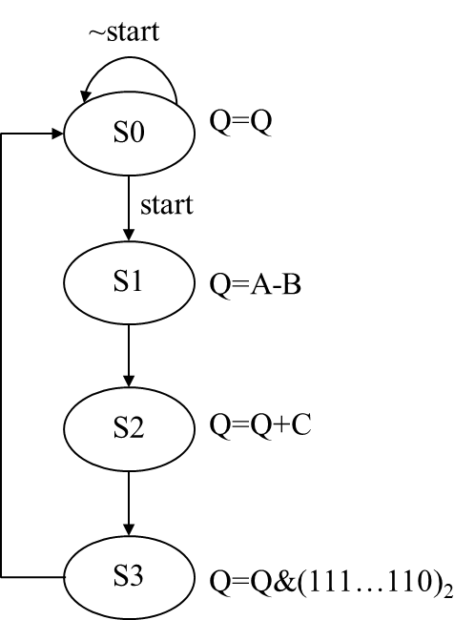
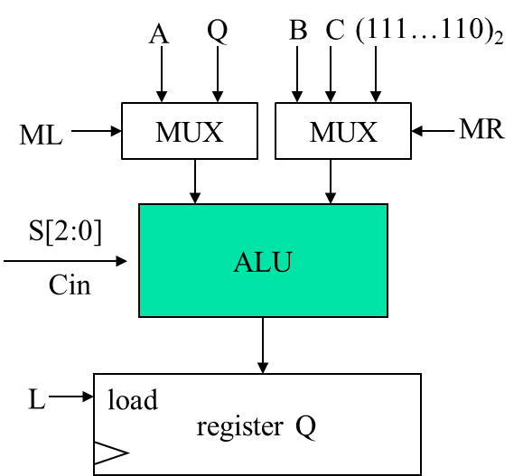
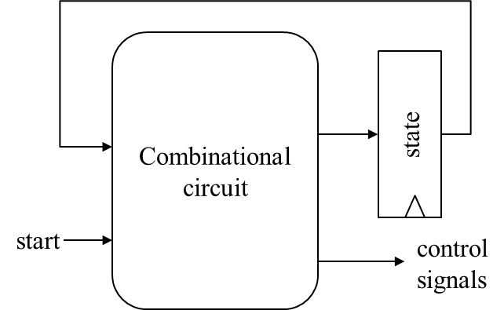
Put It All Together
Control Unit
Data Path
Control
signals

Slide 13
Put It All Together
Control Unit
Data Path
Control
signals

Slide 14
Cycle 1
Control Unit
Data Path
Control
signals
SUB
1

Slide 15
Cycle 2
Control Unit
Data Path
Control
signals
ADD
1

Slide 16
Cycle 3
Control Unit
Data Path
Control
signals
AND
1

