Slide 1
Hints to Selected Problems in the Midterm Exam
Remark: you have to elaborate the detail by yourself

Slide 2
Problem 3
RTL design to realize Q=(A+B)/2 + (C+D)/4

Slide 3
Behavior Design
S0
Idle
A
C
Q
B
D
R
S1
M0
MUX
MUX
M1
R=A+B
S2
R=R>>1
+
S3
Q=C+D
S4
LR
Load
register R
LQ
Load
register Q
Q=Q>>1
SR
Shift
SQ
Shift
S5
Q=Q>>1
S6
Q=Q+R

Slide 4
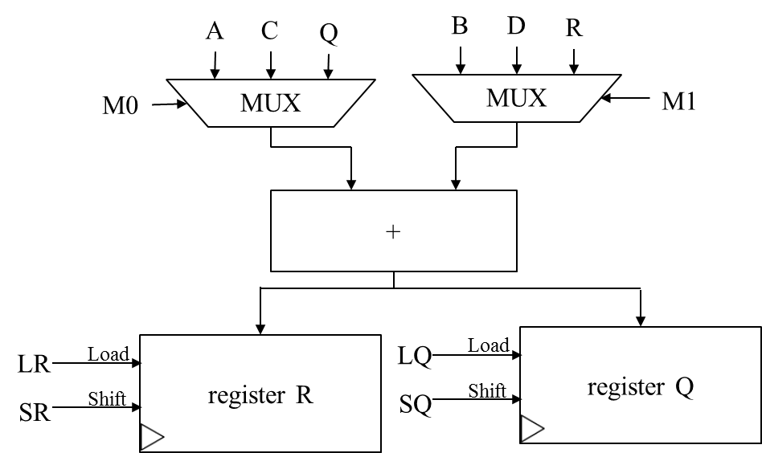
Control Unit Design
S0
Idle
S1
State S | M0 | M1 | LR | SR | LQ | SQ
000 | X | X | 0 | 0 | 0 | 0
001 | 00 | 00 | 1 | 0 | 0 | 0
010 | X | X | 0 | 1 | 0 | 0
011 | 01 | 01 | 0 | 0 | 1 | 0
100 | X | X | 0 | 0 | 0 | 1
101 | X | X | 0 | 0 | 0 | 1
110 | 10 | 10 | 0 | 0 | 1 | 0
111 | X | X | X | X | X | X
R=A+B
S2
R=R>>1
S3
Q=C+D
S4
Q=Q>>1
S5
Q=Q>>1
S6
Q=Q+R

Slide 5
Problem 6
The Vending Machine

Slide 6
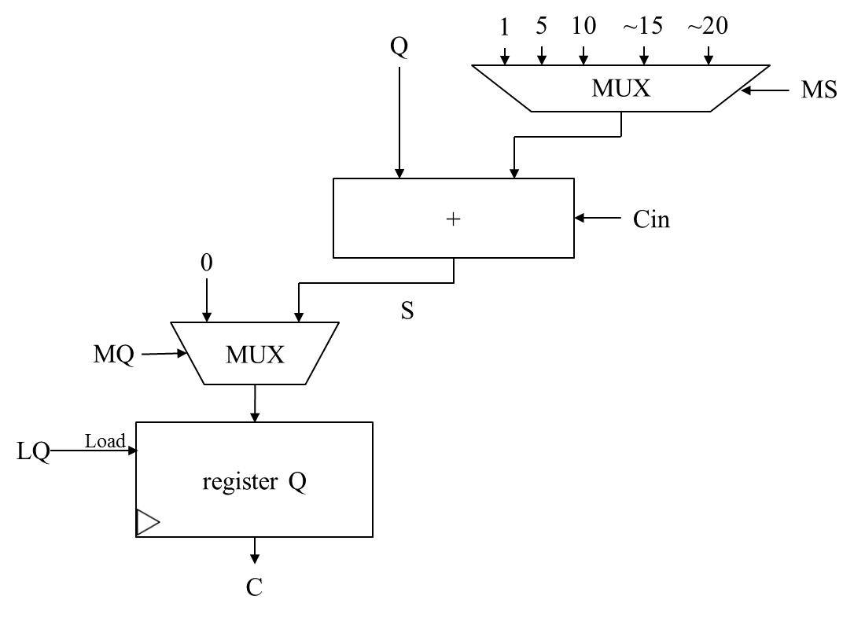
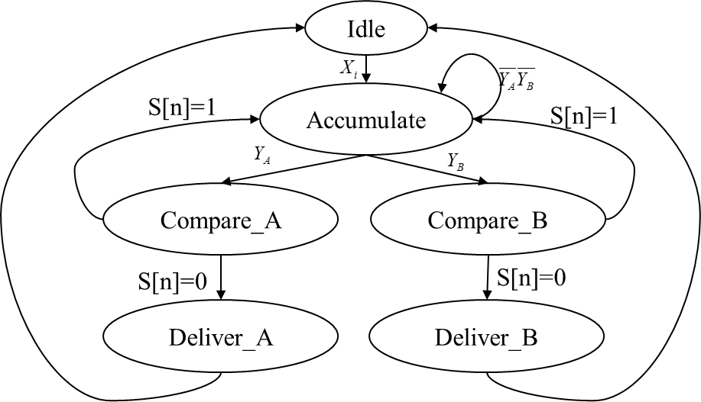
Behavior Design
Fill the detail by yourself!

Slide 7
Behavior of the control unit
Idle
S[n]=1
Accumulate
S[n]=1
Compare_A
Compare_B
S[n]=0
S[n]=0
Deliver_A
Deliver_B

Slide 8
Data path
1
5
10
~15
~20
Q
MUX
MS
+
Cin
0
S
MQ
MUX
LQ
Load
register Q
C

