Slide 1
Midterm Review
Covers Chap. 5 & 7

Slide 2
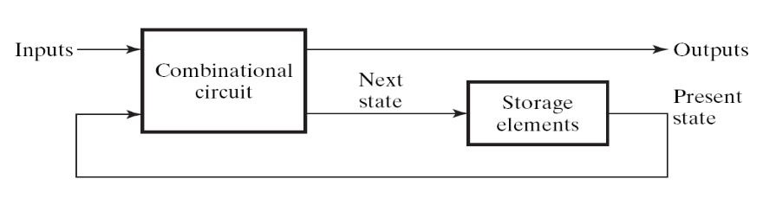
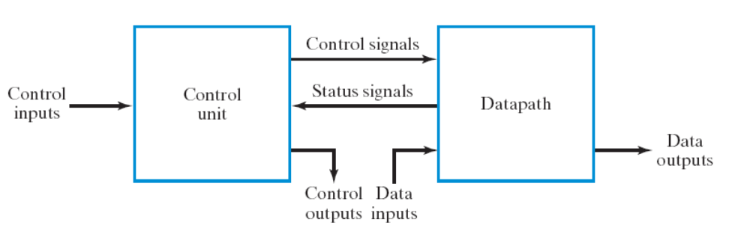
Coverage of your midterm exam
be familiar with the two design techniques:
  sequential circuit design from the general framework (Chap. 5, Sec. 7.1, Sec. 7.6)
  RTL design (Sec. 7.2 – 7.4)
clock

Slide 3
General procedure to design a sequential circuit
Step 1: draw the state diagram and state table
Step 2: assign state values and flip flops
Step 3: draw the spec of the combinational part
  draw the truth table
Step 4: realize the combinational part
  logic simplification if necessary
clock

Slide 4
Steps of RTL Design
Step 1: always starts from the general framework
  control signals: the order sent from control unit
  status signals: reports from data path
Step 2: specify the behavior of each part
  control unit: state-diagram
  data path: micro-operation
Step 3: design circuits from behavior specification
  control unit: state-diagram to circuit (Chapter 5)
  data path: micro-operation to circuit (Sec. 7.3 – 7.6)

Slide 5
General Rules of the Exam
Open Book (but no discussion)
You can use any circuit mentioned in the textbook as a building block (without drawing detailed gate-level circuit)
  unless special restrictions are imposed
Just specify the Boolean equation for a combinational circuit

Slide 6
Problems
for you to prepare the exam

Slide 7
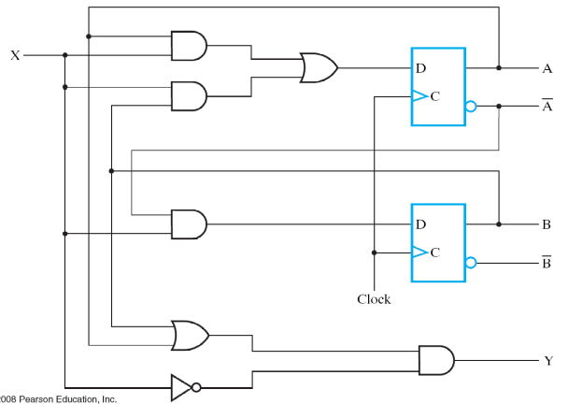


Problem 1: sequential circuit analysis (15%)
Given: a circuit diagram
Draw the timing waveform from the circuit diagram
time
clock
A
0
0
1
0
0
state
B
0
1
1
0
0
input
X
1
1
0
0
0
(circuit will be changed!)

Slide 8
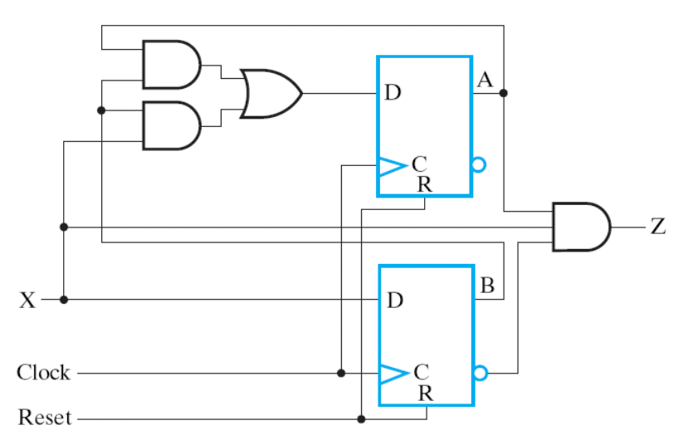
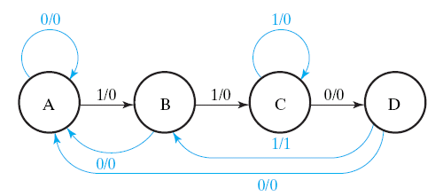
Problem 2: sequential circuit design from state diagram (15%)
Given: a state diagram
Draw the circuit to realize the state diagram
(state diagram will be changed!)

Slide 9
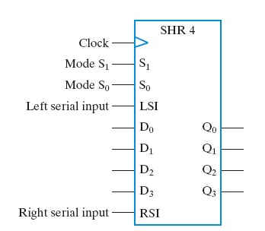
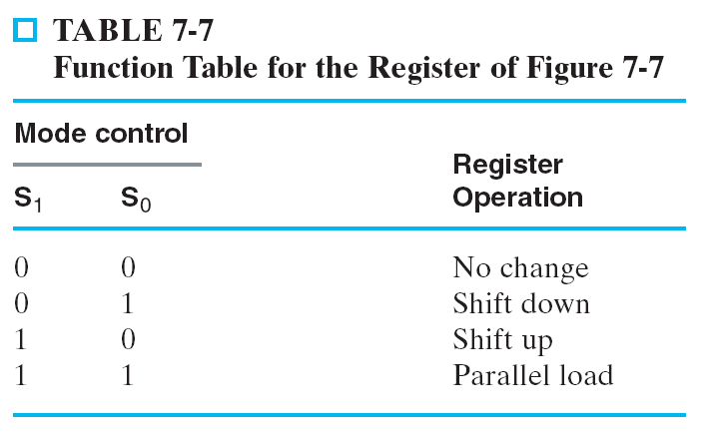
Problem 3: Design of a shift register/counter (15%)
Implement one of the shift register/counter mentioned in the textbook
Using D flip flops and basic logical gates (AND/OR/NOT/XOR, etc.)

Slide 10
Problem 4: Stop Watch Design (15%)
start counting when “START” button pressed
  00.00 → 00.01 → 00.02 → 00.99 → 01.00 → 01.01
  refresh every 0.01 second
stop counting and hold the time when “STOP” button pressed
  resume counting from stopped time when “START” pressed again
reset the time to 00.00 when “RESET” pressed
(Hint: use RTL design method)
EN
Start
count-down timer
4
Stop
display
Reset
8
minute
second
1 KHz clock

Slide 11


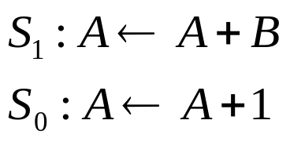


Problem 5: Data Path Design from Micro-Operations (15%)
1
MUX
adder
Register A
OR
Load
(The micro-operations will be changed)

Slide 12
Problem 6: RTL Design to Realize an Equation Evaluation (20%)
use only one adder to compute Q=A+B+C+D
You should give:
  State-transition diagram of the control unit
  Circuit design of the data path
A
n
Accumulator
B
n
(The equation will be changed!)
C
n
Q
n
D
n
FINISH
START

Slide 13
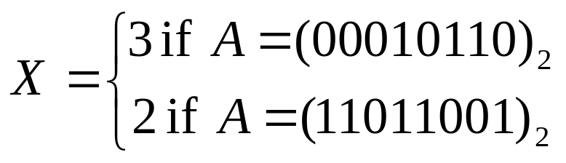
Problem 7: Counting amount of leading sign bits (20%)
A circuit used in floating-point unit
  X=amount of leading 0s if A>=0
  X=amount of leading 1s if A<0
Your
Design
A
n
n
X
FINISH
START

