Slide 1
Midterm Exam
problems and solutions

Slide 2
Problem 1
draw the timing waveform from a given circuit

Slide 3
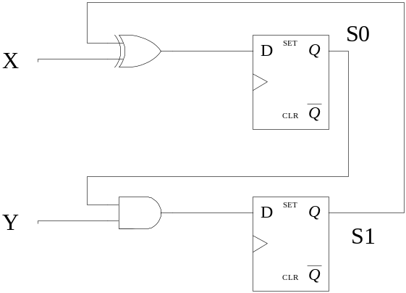
Problem Description
draw the waveform of the circuit
time
clock
state S[1:0]
00
???
X
0
1
0
0
0
Y
0
0
1
0
0

Slide 4
Problem Description
draw the waveform of the circuit
time
clock
state S[1:0]
00
00
01
10
01
X
0
1
0
0
0
Y
0
0
1
0
0

Slide 5
Problem 2
realizing a state-transition diagram

Slide 6
Problem Description
realizing the following state-transition diagram
X=0
X=1
your
design
00
01
X=0
state
S[1:0]
X=1
X=1
10
11
X
X=0

Slide 7
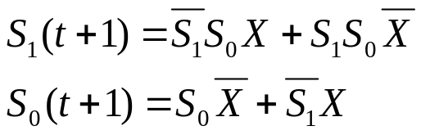


Solution
S1
S0
X
S1(t+1)
S0(t+1)
0
0
0
0
0
0
0
1
0
1
0
1
0
0
1
0
1
1
1
1
combinational
circuit
D
1
0
0
0
0
1
0
1
0
0
1
1
0
1
1
D
1
1
1
0
0
X

Slide 8
Problem 3
bi-directional rotation register

Slide 9
Problem Description
S
function
2
Your
Design
S
00
Hold (Q=Q)
4
4
Q
01
Load (Q=D)
D
10
Rotate Left
11
Rotate Right

Slide 10
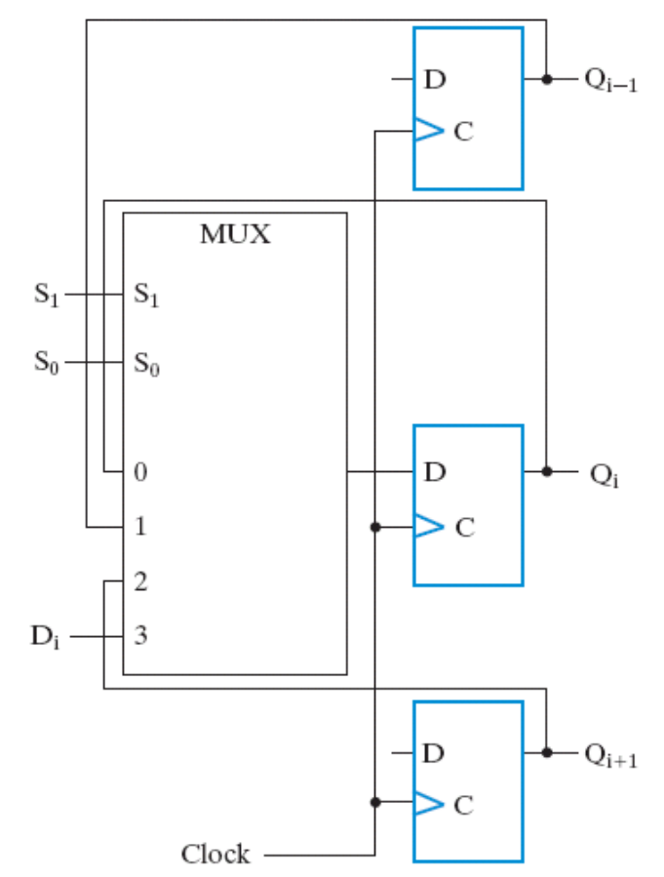
The Solution
S
function
00
Hold (Q=Q)
01
Load (Q=D)
10
Rotate Left
11
Rotate Right
modified from Figure 7-11
for rotate:
  Q0->Q3
  Q3->Q0
00
10
11
01

Slide 11
Problem 4
the count-down timer

Slide 12
Problem Description
start counting down when “START” button pressed
  59:59 -> 59:58 -> … ->00:00
  refresh every one second
stop count down and hold the time when “STOP” button pressed
  resume count down from stopped time when “START” pressed again
reset the time to 59:59 when “RESET” pressed
(Hint: use RTL design method)
EN
Start
count-down timer
4
Stop
display
Reset
8
minute
second
1 KHz clock

Slide 13
Brief on the solution
almost the same to my stopwatch example
the only difference is up counters are replaced by down counters

Slide 14
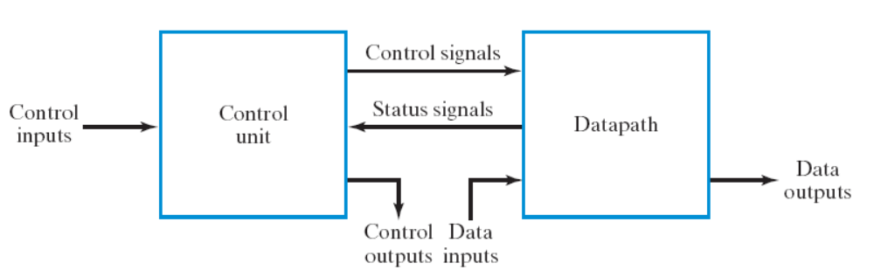
The framework of stopwatch
Control signals:
  E: count enable (E: 01:23 -> 01:24)
  R: reset (R: 00:00)
E
R

Slide 15
The data path
R(Reset)
digit
display
pulser
EN
Core Counters
4
E
pout
count
m1
4
(Enable)
m0
4
s1
4
s0
4
display
8
m1
m0
s1
s0
(minute)
(second)

Slide 16
The data path
R(Reset)
digit
display
pulser
EN
Core Counters
4
E
pout
count
m1
4
(Enable)
m0
4
s1
4
s0
4
display
8
1 cycle
pout
1 second
m1
m0
s1
s0
(minute)
(second)

Slide 17
Scheme to design the pulser
up-counter within the pulser
send out a pulse when counter==999
clock
…
counter
0
1
…
998
999
0
1
pout
0
0
0
0
1
0
0
1 second

Slide 18
Pulser design
Load
up
counter
Count
1
Q
Q==999
D
pout
0
10
10
clock

Slide 19
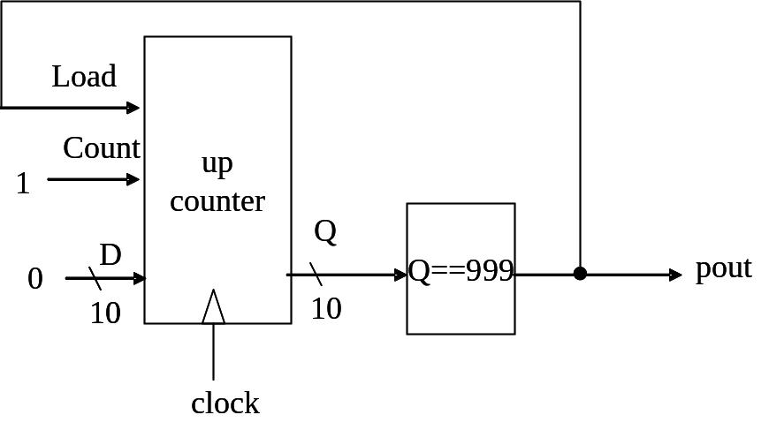
How the pulser works
time
clock
…
counter
0
1
…
998
999
0
1
pout
0
0
0
0
1
0
0
load
0
0
0
0
1
0
0
force the up counter
to load input 0

Slide 20
The data path
R(Reset)
digit
display
pulser
EN
Core Counters
4
E
pout
count
m1
4
(Enable)
m0
4
s1
4
s0
4
display
8
4 BCD counters to count the time m1m0: s1s0
(BCD: binary coded decimal)
m1
m0
s1
s0
(minute)
(second)

Slide 21
Architecture of the core counter
minute
second
Mod-6
Down
Counter
BCD
Down
Counter
Mod-6
Down
Counter
BCD
Down
Counter
CO
EN
CO
EN
CO
EN
CO
EN
Q
Q
Q
Q
m1
R(reset)
m0
R(reset)
s1
R(reset)
s0
R(reset)

Slide 22
Architecture of the core counter
minute
second
Mod-6
Down
Counter
BCD
Down
Counter
Mod-6
Down
Counter
BCD
Down
Counter
CO
EN
CO
EN
CO
EN
CO
EN
Q
Q
Q
Q
CO=1 iff Q==0
m1
R(reset)
m0
R(reset)
s1
R(reset)
s0
R(reset)

Slide 23
Modulo-N counter with reset
use an (up) counter with parallel load (Figure 7-14)
load a zero when count-up to N-1 or R=1 (reset)
OR
Load
down
counter
R(reset)
Count
EN
Q
Q==0
EQ
D
AND
0
n
n
CO
EN
clock

Slide 24
State diagram for the control unit
E=1
E=1
Start
send reset signal (R) to data path directly
Hold
Count
Stop
E=0
E=0
E
R

Slide 25
Problem 5
max/min circuit

Slide 26
Problem: Max-Min Circuit
Design a circuit to
  find the minimum and maximum number
  from a series of 4 input numbers
  output max and min in series
Design Constraint:
  only two n-bit registers are allowed to store the value for computation
time
min-max
circuit
start
start
1
0
Y
n
X
1000
1100
0010
0001
XXXX
X
n
XXXX
1100
0001
Y

Slide 27
The Solution to Problem 5
data path circuit
control signals

Slide 28
Step-by-Step Computation
use two registers:
  R: the maximum value
  Q: the minimum value
Hold
start=0
start=1
R=X; Q=X
Step 1
R=(X>R)? X: R; Q=(Q<X)? Q: X;
Step 2
R=(X>R)? X: R; Q=(Q<X)? Q: X;
Step 3
R=(X>R)? X: R; Q=(Q<X)? Q: X;
Step 4
Y=R
Step 5
Y=Q

Slide 29





The data path design
X
X
0
1
0
1
MUX
comparator
MUX
comparator
register R
GT
register Q
LT
load
load
MUX
Y

Slide 30

State-diagram for the control unit
Hold
(0, 0, X, X, X)
start=0
start=1
R=X; Q=X
(1, 1, 0, 0, X)
Step 1
R=(X>R)? X: R; Q=(Q<X)? Q: X;
(1, 1, ~GT, ~LT, X)
Step 2
R=(X>R)? X: R; Q=(Q<X)? Q: X;
(1, 1, ~GT, ~LT, X)
Step 3
R=(X>R)? X: R; Q=(Q<X)? Q: X;
(1, 1, ~GT, ~LT, X)
Step 4
Y=R
(0, 0, X, X, 0)
Step 5
Y=Q
(0, 0, X, X, 1)

Slide 31

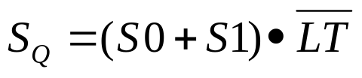
Remark: realization of the control unit
combinational
circuit
D
S0
start
D
S1
GT
LT

Slide 32
How to devise the design
Part 1: overview and the algorithm

Slide 33
Steps of RTL Design
Step 1: always starts from the general framework
  control signals: the order sent from control unit
  status signals: reports from data path
Step 2: specify the behavior of each part
  control unit: state-diagram
  data path: micro-operation
Step 3: design circuits from behavior specification
  control unit: state-diagram to circuit (Chapter 5)
  data path: micro-operation to circuit (Sec. 7.3 – 7.6)

Slide 34
Step-by-Step Computation
Hold
use two registers:
  R: the maximum value
  Q: the minimum value
start=0
start=1
R=X; Q=X
Step 1
R=(X>R)? X: R; Q=(Q<X)? Q: X;
Step 2
R=(X>R)? X: R; Q=(Q<X)? Q: X;
Step 3
R=(X>R)? X: R; Q=(Q<X)? Q: X;
Step 4
Y=R
Step 5
Y=Q

Slide 35
Step-by-Step Computation
initial R to the 1st input value
Hold
use two registers:
  R: the maximum value
  Q: the minimum value
start=0
start=1
R=X; Q=X
Step 1
R=(X>R)? X: R; Q=(Q<X)? Q: X;
Step 2
R=(X>R)? X: R; Q=(Q<X)? Q: X;
Step 3
R=(X>R)? X: R; Q=(Q<X)? Q: X;
Step 4
Y=R
set R to the max. value given so far
Step 5
Y=Q

Slide 36
How to devise the design
Part 2: data path design

Slide 37
The data path design
X
X
0
1
0
1
MUX
comparator
MUX
comparator
register R
GT
register Q
LT
load
load
MUX
Y

Slide 38
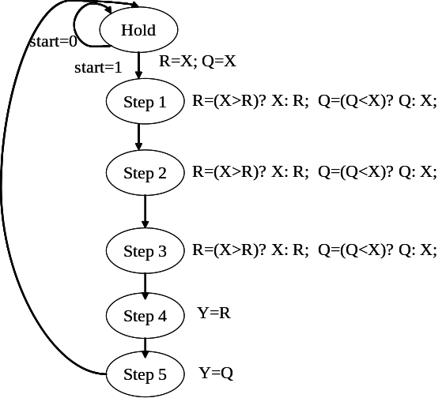
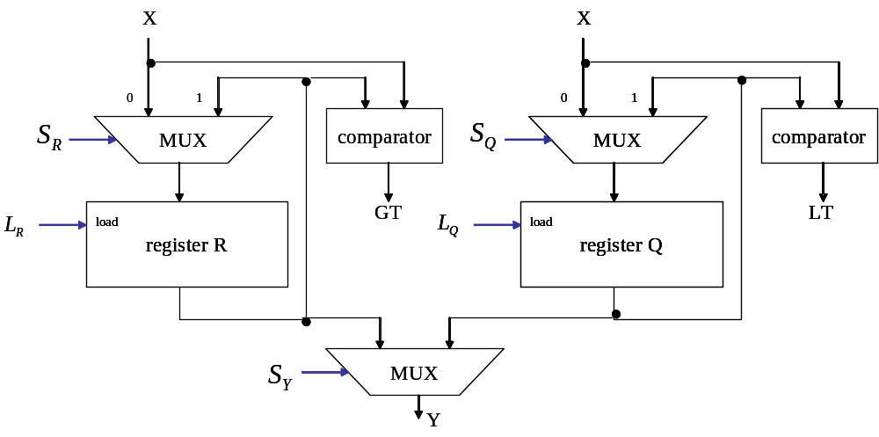
Devising the data path
registers for each stored value
MUX selection to set register value
control signals for MUX selection and register load
status signals to report compare results

Slide 39
Devising the data path
registers for each stored value
MUX selection to set register value
control signals for MUX selection and register load
status signals to report compare results

Slide 40
Devising the data path
registers for each stored value
MUX selection to set register value
control signals for MUX selection and register load
status signals to report compare results
R = either R or X
Q = either Q or X

Slide 41
Devising the data path
registers for each stored value
MUX selection to set register value
control signals for MUX selection and register load
status signals to report compare results

Slide 42
Devising the data path
registers for each stored value
MUX selection to set register value
control signals for MUX selection and register load
status signals to report compare results
check digital circuit course for the comparator design
GT=1 if R>X
LT=1 if Q<X

Slide 43
How to devise the design
Part 3: the control unit

Slide 44

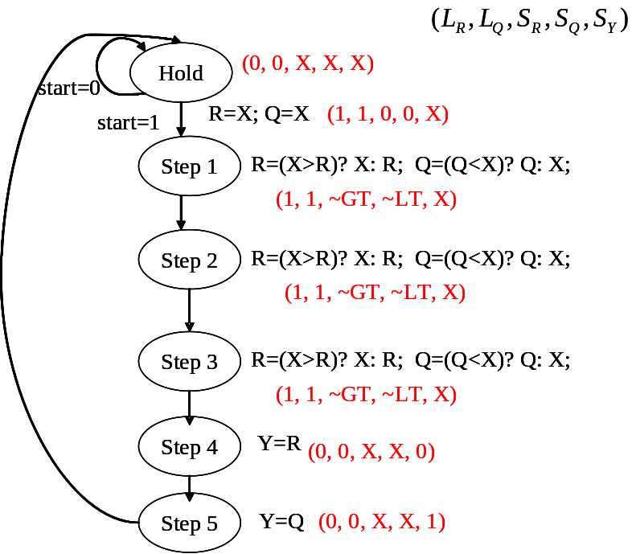
State-diagram from the algorithm
replace with control signals value

Slide 45
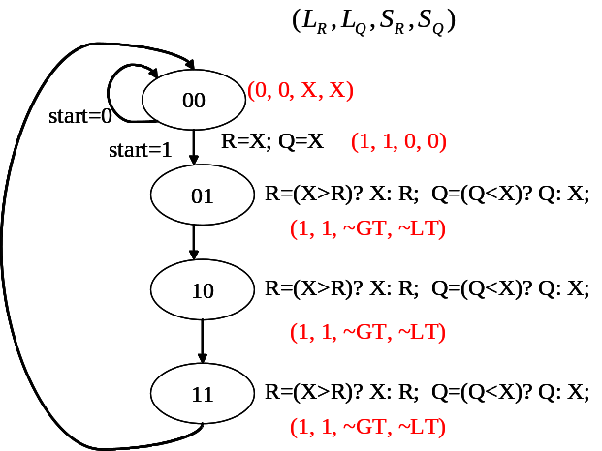
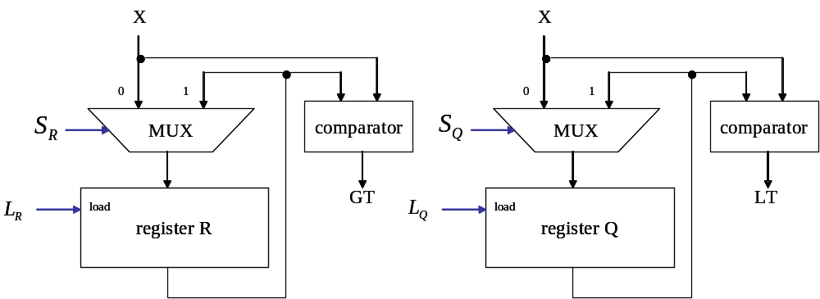
Control signal to realize required operations
selection from the comparison result

Slide 46

Remark: realization of the control unit
combinational
circuit
D
S0
start
D
S1
GT
LT

Slide 47
Problem 6
realizing a series of computation

Slide 48
Problem Description
Design the data path to realize the following computation:
  Step 1: A ←X
  Step 2: B ←X
  Step 3: C ←A+B
  Step 4: D ←X
  Step 5: C ←C-D
where each of the value A, B, C, D has a dedicated register
Specify:
  circuit of the data path with control signals named
  value of each control signal to realize each step of the computation
control
signals
your design
X
C
n
n

Slide 49
The Solution to Problem 6
data path circuit
control signals

Slide 50







Solution: the data path circuit
X
A
C
0
B
MUX
MUX
adder
Cin
register D
register A
load
load
register B
load
register C
load

Slide 51
Solution: control signals
Step | Operation | Control Signal (L_{A}, L_{B}, L_{C}, L_{D}, M_{L}, M_{R}, Cin)
1 | A←X | (1, 0, 0, 0, 00, 00, 0)
2 | B ←X | (0, 1, 0, 0, 00, 00, 0)
3 | C ←A+B | (0, 0, 1, 0, 01, 01, 0)
4 | D ←X | (0, 0, 0, 1, 00, 00, 0)
5 | C ←C-D | (0, 0, 1, 0, 10, 10, 1)

Slide 52
How to devise the solution
Part 1: devise the data path

Slide 53
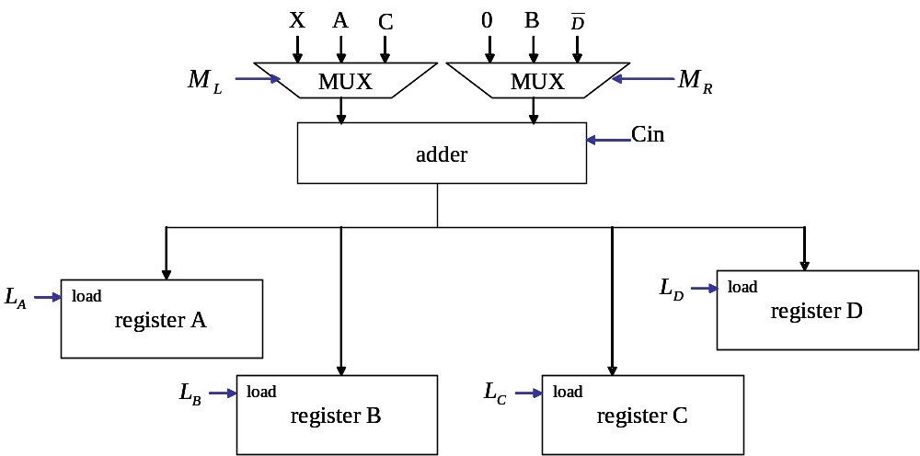
Devising the data path
place a register for each variable
  use register with load enable
place an adder
  re-write each operation as add
place MUXs to select value for addition
name control signals for MUXs and registers
  Cin for adder is also a control signal

Slide 54
Devising the data path
place a register for each variable
  use register with load enable
place an adder
  re-write each operation as add
place MUXs to select value for addition
name control signals for MUXs and registers
  Cin for adder is also a control signal
register with load enable
(Figure 7-2)

Slide 55



Devising the data path
place a register for each variable
  use register with load enable
place an adder
  re-write each operation as add
place MUXs to select value for addition
name control signals for MUXs and registers
  Cin for adder is also a control signal

Slide 56
Devising the data path
make sure each operation can be realized by MUX selections
place a register for each variable
  use register with load enable
place an adder
  re-write each operation as add
place MUXs to select value for addition
name control signals for MUXs and registers
  Cin for adder is also a control signal

Slide 57
Devising the data path
place a register for each variable
  use register with load enable
place an adder
  re-write each operation as add
place MUXs to select value for addition
name control signals for MUXs and registers
  Cin for adder is also a control signal

Slide 58
How to devise the solution
Part 2: the control signals value

Slide 59
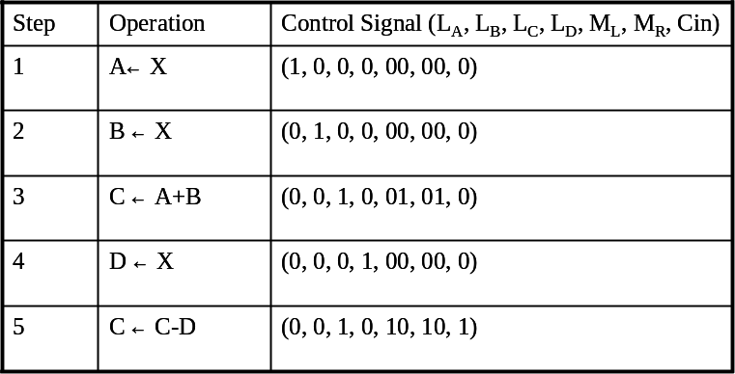
Devising Control Signal Values
Rule-of-thumb: each operation can be realized by MUX selections

Slide 60
Devising Control Signal Values
Rule-of-thumb: each operation can be realized by MUX selections
only “Load C” enabled

Slide 61

Devising Control Signal Values
Rule-of-thumb: each operation can be realized by MUX selections
1

Slide 62
Problem 7
realizing a series of computation
with minimum amount of registers

Slide 63
Problem Description
Design the data path to realize the following computation:
  Step 1: A ← X
  Step 2: B ←X
  Step 3: C ←A+B
  Step 4: D ←X
  Step 5: C ←C-D
minimize amount of registers
Specify:
  circuit of the data path with control signals named
  value of each control signal to realize each step of the computation
control
signals
your design
X
C
n
n

Slide 64
The Solution to Problem 7

Slide 65

Data path circuit
X
R0
0
R1
ML
MUX
MUX
MR
adder
Cin
reg R0
reg R1
L0
load
L1
load

Slide 66




Control signals
Step | Operation | Operation on physical registers | Control Signal(L0, L1, ML, MR, Cin)
1 | A←X |  | (1, 0, 0, 00, 0)
2 | B ←X |  | (0, 1, 0, 00, 0)
3 | C ←A+B |  | (1, 0, 1, 01, 0)
4 | D ←X |  | (0, 1, 0, 0, 0)
5 | C ←C-D |  | (1, 0, 1, 11, 1)

Slide 67
How to devise the solution

Slide 68





Life-time analysis
A B C D C’
R0 R1
A
A
B
B
C
C
D
D
C’
C’
time

Slide 69
Life-time analysis
the time value of A is set
life time of A
A B C D C’
R0 R1
A
A
B
B
C
C
D
D
the last time A is used
C’
C’
time
we don’t have to store the value of A in this time interval

Slide 70
Life-time analysis
A B C D C’
R0 R1
A
A
B
B
C
C
D
D
C’
C’
time
we store values of A, C, and C’ at the same register R0

Slide 71
Life-time analysis
A B C D C’
R0 R1
A
A
B
B
C
C
D
D
C’
C’
time
two registers required for the computation

Slide 72
Operations using physical registers
A B C D C’
R0 R1
A
A
B
B
C
C
D
D
C’
C’
time

Slide 73
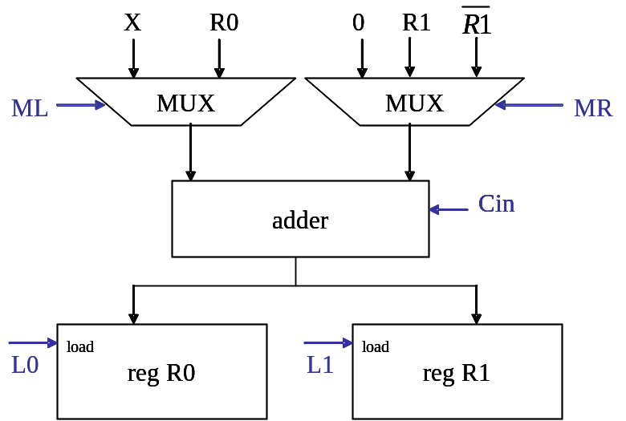
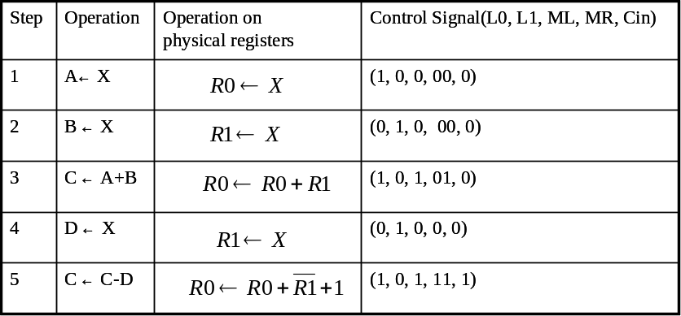
Devise the data path
from operations on physical registers

Slide 74
Graph coloring to minimize amount of registers
Appendix
a systematic approach

Slide 75
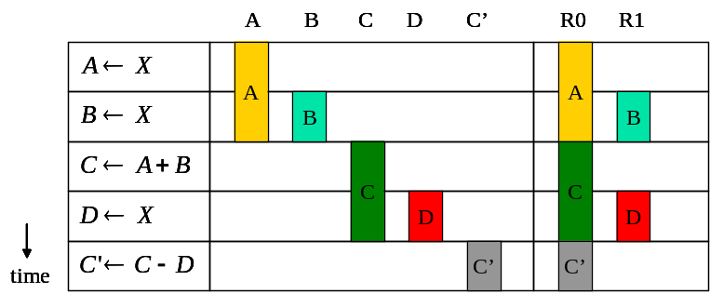
Interference Graph
Rules:
  a vertex: a symbolic register
  edge: life times of the two symbolic register overlaps
A
B
C’
C
D

Slide 76
Graph coloring to assign physical registers
Coloring Rules:
  adjacent vertices cannot be assigned the same color
  a color = a physical register
  use as few colors as possible
R0
A
R1
R0
B
C’
R0
C
D
R1

