Slide 1
Midterm Problems and Solutions

Slide 2
Problem 1
Draw the timing waveform to show how a circuit works

Slide 3
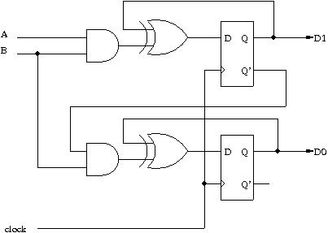
Problem Description
Draw the timing waveform to show how the circuit

Slide 4
Problem Description (cont’d)
Fill in the timing waveform
time
D[1:0]
00
???
A
1
1
0
0
B
1
1
1
0

Slide 5
Solution
Fill in the timing waveform
time
D[1:0]
00
11
01
00
00
A
1
1
0
0
B
1
1
1
0

Slide 6
Problem 2
Sequential circuit design to realize a state-transition diagram

Slide 7
Problem Description
Design a circuit to realize the state-transition diagram
A
B
D
C

Slide 8
Solution
to design this part
A
B
00
01
combinational
circuit
S1
A1
D
D
C
11
10
S0
X
A0
D
Y

Slide 9
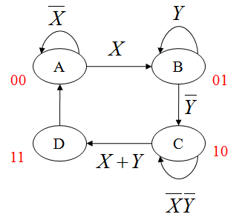
Solution
S1 | S0 | X | Y | A1 | A0
0 | 0 | 0 | X | 0 | 0
0 | 0 | 1 | X | 0 | 1
0 | 1 | X | 0 | 1 | 0
0 | 1 | X | 1 | 0 | 1
1 | 0 | 0 | 0 | 1 | 0
1 | 0 | 0 | 1 | 1 | 1
1 | 0 | 1 | 0 | 1 | 1
1 | 0 | 1 | 1 | 1 | 1
1 | 1 | X | X | 0 | 0
to design this part
combinational
circuit
S1
A1
D
S0
X
A0
D
Y

Slide 10
Problem 3
Up/down counter with parallel load

Slide 11
Problem Description
Gate-level design of a up/down counter with parallel load
2
S[1]
S[0]
Q(t+1)
S
counter
0
0
Q(t+1)=Q(t)
D
Q
Q(t+1)=Q(t)-1
4
4
0
1
1
0
Q(t+1)=Q(t)+1
clock
Q(t+1)=D(t)
1
1

Slide 12
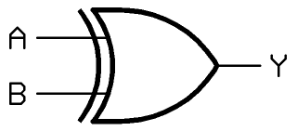
The Solution
S
\ 2
Q0
1
Q0
M
U
X
D
Q0
Q0
1
D0
>
Q1
Q1
M
U
X
D
Q1
Q1
Q0
D1
>
Q2
Q2
M
U
X
D
Q2
Q2
Q0Q1
D2
>
Q3
Q3
M
U
X
D
Q3
Q3
Q0Q1Q2
D3
>

Slide 13
Problem 4
Stop watch design

Slide 14
Problem 4: Stop Watch Design (15%)
start counting when “START” button pressed
00.00 → 00.01 → 00.02 → 00.99 → 01.00 → 01.01
refresh every 0.01 second
stop counting and hold the time when “STOP” button pressed
resume counting from stopped time when “START” pressed again
reset the time to 00.00 when “RESET” pressed
EN
Start
count-down timer
4
Stop
display
Reset
8
minute
second
10 KHz clock

Slide 15
Answer (a)
1
E
Q
mod-100 down counter
compare
P
clk
>

Slide 16

Answer (b)
c0
c0
c0
E
P
mod-10 counter
mod-10 counter
mod-10 counter
mod-10 counter
count.enable
>
>
>
>
Reset
Reset
Reset
Reset

Slide 17
Answer (c)
START
count.enable = 0
Hold
Count
count.enable = 1
STOP

Slide 18
Answer (d)
digit
decode
8
display
4
2
encoder
4
MUX
rotation register
4
4
4
4

Slide 19
Problem 5
Data path design from micro-operations

Slide 20
Problem Description

Slide 21
Solution
R1
R2
0
1
CC
mux
CB + CC
Load
reg. R0
R0
R2
0
1
CC
mux
CA + CC
Load
reg. R1
R0
CB
Load
reg. R2

Slide 22
Problem 6
RTL design for equation evaluation

Slide 23
Problem Description
use only one adder to compute Q=A+B+max{C,D}
You should give:
State-transition diagram of the control unit
Circuit design of the data path
A
n
Your
Design
B
n
C
n
Q
n
D
n
FINISH
START

Slide 24
Answer (a)
(L, SEL0, SEL1, SEL2, Cin)
S0
(0, x, x, x, x)
START
S1
Q <- A
(1, 0, x, x, x)
S2
Q <- Q + B
(1, 1, 0, 0, 0)
S3
(0, x, 1, 11, 1)
Q<-Q
Adder_out =
R
S5
S4
Q<-Q + D
Q<-Q + C
(1, 1, 0, 10, 01)
(1, 1, 0, 01, 1)

Slide 25
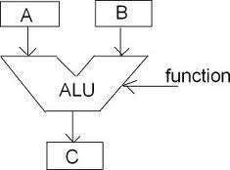
Answer (b)
B
C
D
Q
C
mux
SEL2
SEL1
mux
+
Cin
A
Adder_out
1
0
SEL0
mux
L
Load
reg. Q

Slide 26
Problem 7
Normalization in a floating point unit

Slide 27
Problem Description
A circuit used in floating-point unit
X=amount of leading 0s if A>=0
X=amount of leading 1s if A<0
Your
Design
A
X
n
n
FINISH
START

Slide 28
Answer (a)
(CL, S, CR, Cout)
Hold
(0, x, 0, 0)
START
F
prepare
Q <- A,
CTR<-0
(1, 0, 1, 0)
cout
Q <- Q <<1,
CTR<-CTR+1
(0, 1, 0, 1)

Slide 29
Answer (b)
A
n
SI
F
L
Load
Shift reg. Q
S
Shift
n
0
Q
D
CR
Load
CTR
Cout
Cout
n
X

