Slide 1
Midterm Review
Covers Chap. 5 & 7

Slide 2
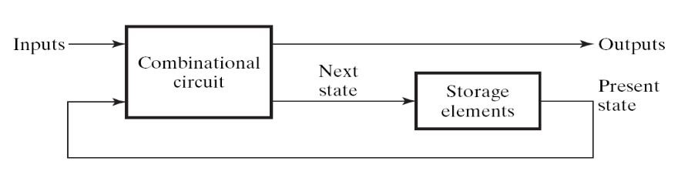
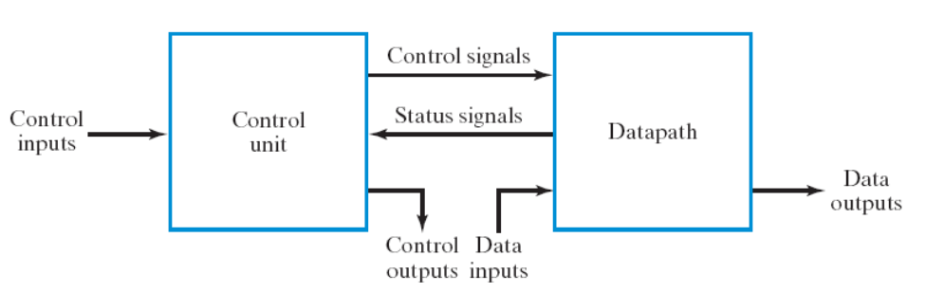
Coverage of your midterm exam
be familiar with the two design techniques:
  sequential circuit design from the general framework (Chap. 5, Sec. 7.1, Sec. 7.6)
  RTL design (Sec. 7.2 – 7.4)
clock

Slide 3
General procedure to design a sequential circuit
Step 1: draw the state diagram and state table
Step 2: assign state values and flip flops
Step 3: draw the spec of the combinational part
  draw the truth table
Step 4: realize the combinational part
  logic simplification if necessary
clock

Slide 4
Steps of RTL Design
Step 1: always starts from the general framework
  control signals: the order sent from control unit
  status signals: reports from data path
Step 2: specify the behavior of each part
  control unit: state-diagram
  data path: micro-operation
Step 3: design circuits from behavior specification
  control unit: state-diagram to circuit (Chapter 5)
  data path: micro-operation to circuit (Sec. 7.3 – 7.6)

Slide 5
General Rules of the Exam
Open Book (but no discussion)
You can use any circuit mentioned in the textbook as a building block (without drawing detailed gate-level circuit)
  unless special restrictions are imposed
Just specify the Boolean equation for a combinational circuit

Slide 6
Problems (Part 1)
Standard exercises
(details may be modified)

Slide 7
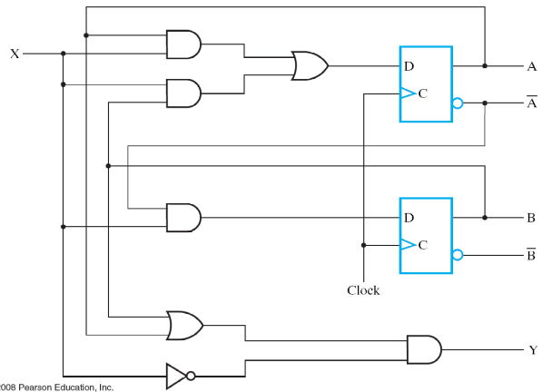


Problem 1: sequential circuit analysis (15%)
Given: a circuit diagram
Draw the timing waveform from the circuit diagram
time
clock
A
0
0
1
0
0
state
B
0
1
1
0
0
input
X
1
1
0
0
0
(circuit will be changed!)

Slide 8
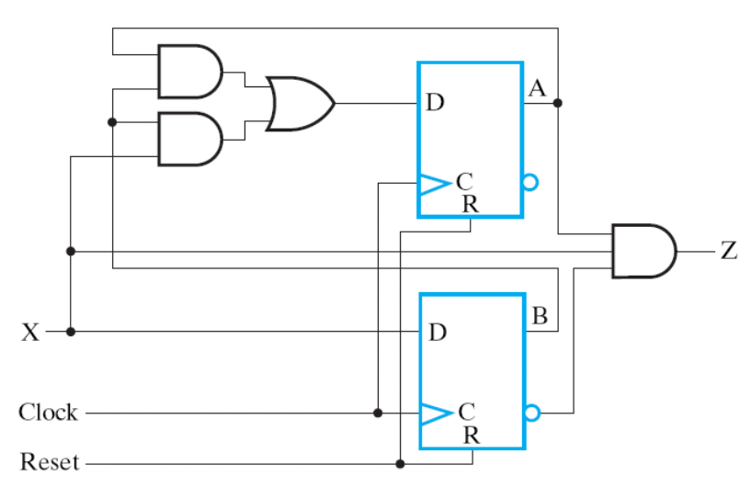
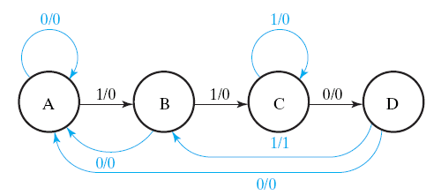
Problem 2: sequential circuit design from state diagram (15%)
Given: a state diagram
Draw the circuit to realize the state diagram
(state diagram will be changed!)

Slide 9
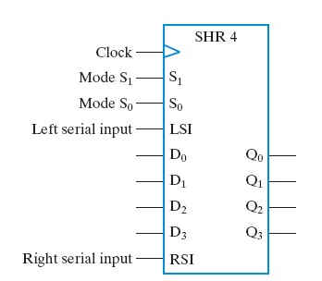
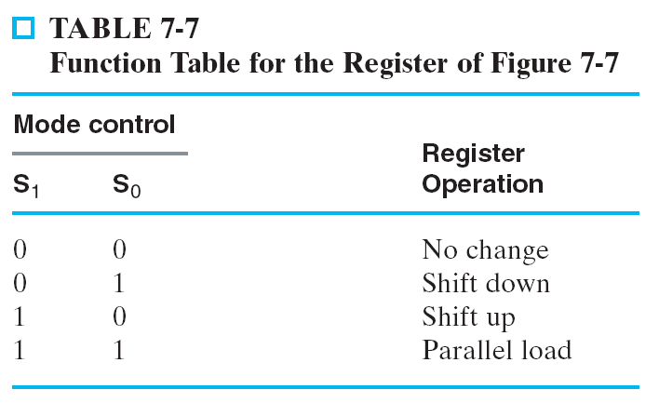
Problem 3: Some Kind of Shift Register or Counter (15%)
You have to explain how you devise the design!
The shift register/counter to be designed may be changed!

Slide 10
Problem 4: Timer (15%)
(Actual function may be changed)
start counting down when “START” button pressed
  59:59 -> 59:58 -> … ->00:00
  refresh every one second
stop count down and hold the time when “STOP” button pressed
  resume count down from stopped time when “START” pressed again
reset the time to 59:59 when “RESET” pressed
(Hint: use RTL design method)
EN
Start
count-down timer
4
Stop
display
Reset
8
minute
second
1 KHz clock

Slide 11
Problem 5: Data path design to realize a series of computing (20%)
Design the data path to realize the following computation
  C=A+B
  D=E+F
  A=C-D
  D=D+A
  output the content of D
each of A, B, C, D, E, F has a dedicated register
Write-down:
  micro-operations with control signals specified
  circuit of the data path
the computation may
be changed

Slide 12
Problems (Part 2)
Creative Exercises

Slide 13
Problem 6: Minimize Amount of Registers in a Circuit (20%)
Design the data path to realize the following computation
  C=A+B
  D=E+F
  A=C-D
  D=D+A
  output the content of D
use minimum amount of registers to store values A-F
  each of A, B, C, D, E, F not necessary has a dedicated register
Write-down:
  micro-operations with control signals specified
  circuit of the data path
  how you minimize amount of registers
the computation may
be changed

Slide 14
Problem 7: Greatest Common Divisor (25%)
Find the greatest common divisor (最大公因數) for two integers A and B
  Hardware algorithm
  State-diagram of the control unit
  Circuit diagram of the data path
GCD
Finish
start
A
Q
n
n
B
n

