Slide 1
Quiz 01
Review on digital circuits

Slide 2
Problem 1
Lighting control

Slide 3
Application Scenario of lighting control
Light L
A
B

Slide 4
Circuit framework
Your
Design
Button
control
A
A’
Button
control
L
B
B’

Slide 5
Problem 2
Drawing the waveform

Slide 6
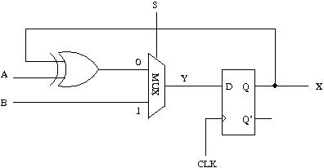
Circuit Diagram

Slide 7
Timing waveform
time
CLK
S
1
1
0
0
0
A
1
1
1
1
0
B
0
1
0
0
0
Y
?
X
?

