Slide 1
Quiz 01
Review on digital circuits

Slide 2
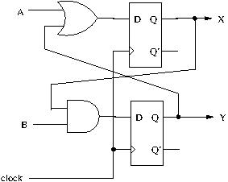
Circuit Diagram

Slide 3

Timing waveform
time
clock
A
1
1
0
1
0
B
0
1
1
0
0
X
?
Y
0
?

