Slide 1
Registers
Lecture 03
Section 7-1 & 7-6

Slide 2
About Chapter 7
title “Registers and Register Transfers”
Goal: RTL design methodology
  a standard method to design any digital IC
You should be able to design any digital electronics product after finishing this chapter!
  alarm, stop watch, CPU, etc.

Slide 3
What is RTL design?
a quick overview

Slide 4
What is a register
a variable in a chip
an n-bit storage device
  triggered by clock
  D flip-flop is an 1-bit register
in
D
Q
out
D
Q
4
4
clk
clock

Slide 5
What is RTL design
RTL: Register Transfer Level (Language)
a standard method to design any digital IC
Feature:
  designer specify rules to transfer data from one register to another register
  EDA (electronic design automation) tool synthesis RTL code to real hardware
B
C
Verilog code
+
reg [3:0] A, B, C;
always @(posedge clk) begin
A <= B+C;
end
clk
register
A

Slide 6
Remark
Why I don’t allow you to write Verilog/VHDL code now?
  EDA tools are not as smart as you think
  You should have a hardware picture in mind while writing Verilog/VHDL code
  Writing Verilog/VHDL like C may result in incorrect/poor hardware!

Slide 7
Coming Up
We will go into Chap. 7
Lecture 03: registers design
  Section 7.1: register with parallel load
  Section 7.6: shift registers
Lecture 04: counters design and their applications
  Section 7.6
  with your digital clock lab
Lecture 05: RTL design
  RTL: register-transfer level design
  go through whole Chap. 7

Slide 8
How about Chap. 6?
Chap. 6: “Selected Design Topics”
  a quick review on your “electronics” course
  the implementation aspects of VLSI design
We will go back to Chap. 6 before your start your CPU term project
  Recall: implement CPU with UMC 90nm process!

Slide 9
Register
an n-bit box for storage

Slide 10
What is a register?
a box capable of storing n-bit data
  n=4 in this example
D[0]
D
Q[0]
D[1]
D
Q[1]
D
Q
D[2]
D
Q[2]
4
4
D[3]
D
Q[3]
clock
clock

Slide 11
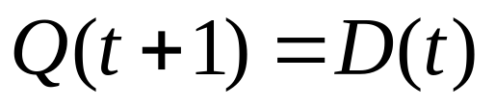
Timing behavior of the register
D[0]
D
Q[0]
D[1]
D
Q[1]
time
D[2]
D
Q[2]
clock
Q[3:0]
x
v0
v1
v2
D[3]
D
Q[3]
D[3:0]
v0
v1
v2
clock

Slide 12
Timing behavior of the register
D[0]
D
Q[0]
D[1]
D
Q[1]
time
D[2]
D
Q[2]
clock
Q[3:0]
x
0011
1010
1110
D[3]
D
Q[3]
D[3:0]
0011
1010
1110
clock

Slide 13
Various types of registers we will talk about
register with load enable
shift register
rotation register
shift register with parallel load
bi-directional shift register
accumulator (not mentioned in the textbook)

Slide 14
Register with load enable
a register that only memorize input when required

Slide 15
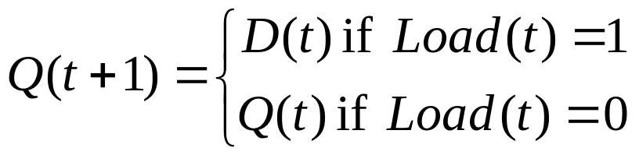
Spec: register with load enable
an n-bit box that only memorizes the input when Load=1
Load
register
D
Q
4
4
clock

Slide 16
Spec: register with load enable
an n-bit box that only memorizes the input when Load=1
Load
time
register
clock
D
Q
4
Q[3:0]
x
v0
4
D[3:0]
v0
clock
Load
1
cycle t
cycle t+1

Slide 17
Spec: register with load enable
an n-bit box that only memorizes the input when Load=1
Load
time
register
clock
D
Q
4
Q[3:0]
x
0011
4
D[3:0]
0011
clock
Load
1
cycle t
cycle t+1

Slide 18
Spec: register with load enable
an n-bit box that only memorizes the input when Load=1
Load
time
register
clock
D
Q
4
Q[3:0]
u
u
4
D[3:0]
v0
clock
Load
0
cycle t
cycle t+1

Slide 19
Spec: register with load enable
an n-bit box that only memorizes the input when Load=1
Load
time
register
clock
D
Q
4
Q[3:0]
1010
1010
4
D[3:0]
0011
clock
Load
0
cycle t
cycle t+1

Slide 20
How to design a register with load enable

Slide 21
My Steps
draw the framework of the circuit
Observation: the transfer function for bit i
Re-draw the framework: separate part for bit i
Draw the detailed circuit for bit i from the transfer function

Slide 22
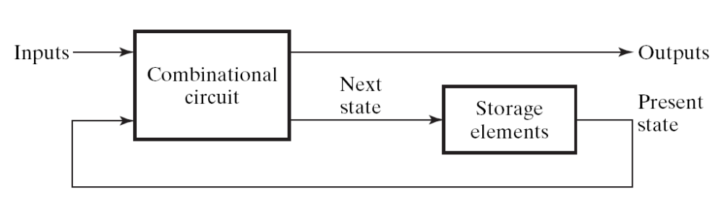
Always start from this framework
Figure 5-1

Slide 23












The framework
combinational
circuit
D
D
Load
Load
D
register
D
Q
4
4
D
clock
clock

Slide 24
My Steps
draw the framework of the circuit
Observation: the transfer function for bit i
Re-draw the framework: separate part for bit i
Draw the detailed circuit for bit i from the transfer function

Slide 25
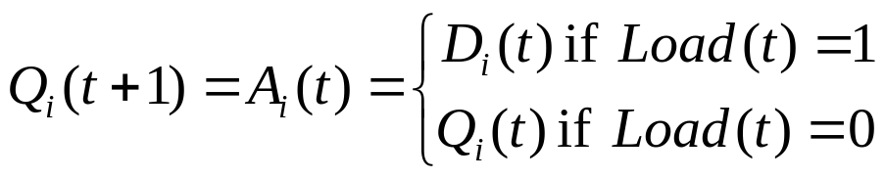
Transfer function for a bit
time
clock
Q[3:0]
x
0011
D[3:0]
0011
Load
1
cycle t
cycle t+1

Slide 26


Transfer function for a bit
time
time
clock
clock
Q[3:0]
x
0101
x
1
D[3:0]
0101
1
Load
1
Load
1
1
cycle t
cycle t+1
cycle t
cycle t+1

Slide 27
Transfer function for a bit
time
time
clock
clock
Q[3:0]
0010
0010
0
0
D[3:0]
0101
1
Load
0
Load
0
0
cycle t
cycle t+1
cycle t
cycle t+1

Slide 28
My Steps
draw the framework of the circuit
Observation: the transfer function for bit i
Re-draw the framework: separate part for bit i
Draw the detailed circuit for bit i from the transfer function

Slide 29
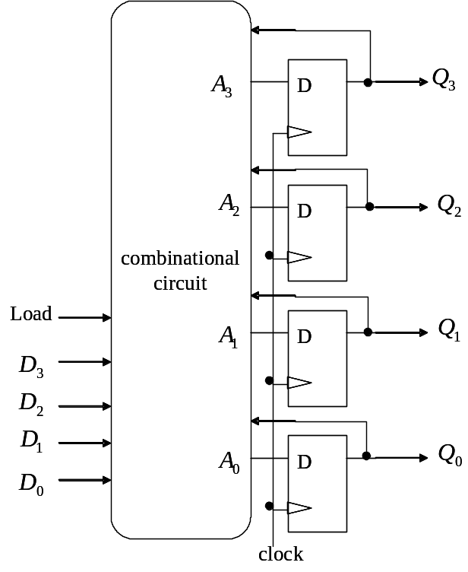
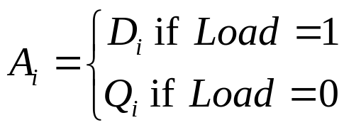
The framework
Load
D
D
D
D
clock

Slide 30
My Steps
draw the framework of the circuit
Observation: the transfer function for bit i
Re-draw the framework: separate part for bit i
Draw the detailed circuit for bit i from the transfer function

Slide 31



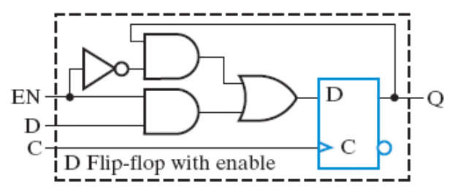
The combinational part for bit i
Load
Load
0
0
0
0
0
0
1
1
0
1
0
0
0
1
1
1
1
0
0
0
1
0
1
0
1
1
0
1
Load
1
1
1
1

Slide 32
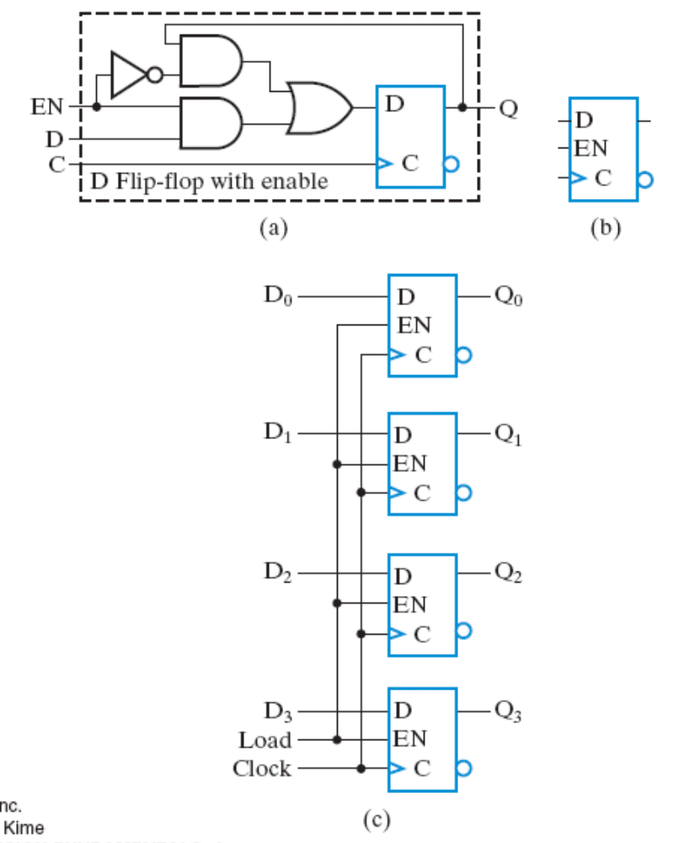
The complete circuit
4-bit register with load enable
Figure 7-2

Slide 33
A simple shift register

Slide 34
Various types of registers we will talk about
register with load enable
shift register
rotation register
shift register with parallel load
bi-directional shift register
accumulator

Slide 35
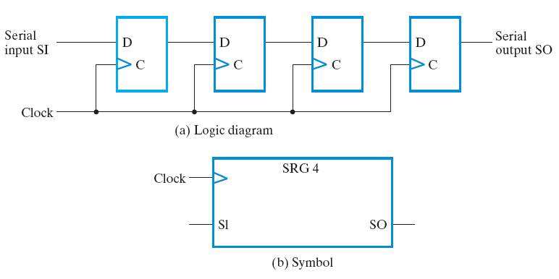
A simple shift register
a 4-bit shift register in Figure 7-9

Slide 36

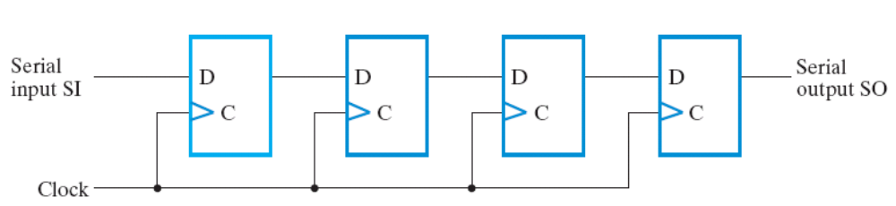
Function of the simple shift register
initial state at cycle 0
1
0
0
0
0
time
clock
Q[3:0]
0000
SI
1
SO
0

Slide 37
Function of the simple shift register
initial state at cycle 1
0
1
0
0
0
time
clock
Q[3:0]
0000
1000
SI
1
0
SO
0
0

Slide 38
Function of the simple shift register
initial state at cycle 2
0
0
1
0
0
time
clock
Q[3:0]
0000
1000
0100
SI
1
0
0
SO
0
0
0

Slide 39
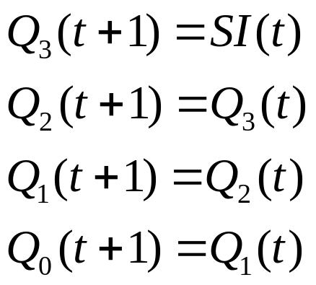
Function of the simple shift register
The transfer function:
0
0
0
1
0
time
clock
Q[3:0]
0000
1000
0100
SI
1
0
0
SO
0
0
0

Slide 40
Application of shift register

Slide 41
Recall our lab
8
…
8
display
En0
En1
En7
display

Slide 42
Recall our lab
8
…
8
display
En0
En1
En7
display
decoded signal
for “2”
1

Slide 43
Q: How to display more than two digits?
Hint: How the cartoon works?

Slide 44
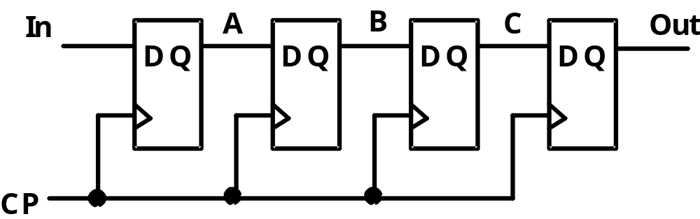
Shift register control
8
…
8
display
En0
En1
En7
display

Slide 45
Shift register control
8
…
8
display
En0
En1
En7
display

Slide 46
Shift register control
8
…
8
display
En0
En1
En7
display

Slide 47
Exercise: rotation register with serial input select

Slide 48
Various types of registers we will talk about
register with load enable
shift register
rotation register
shift register with parallel load
bi-directional shift register
accumulator

Slide 49
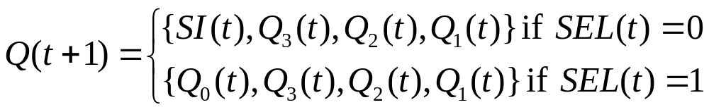
The Problem
SEL
RReg
SI
clock
4
Q
design a 4-bit register with the following function:
  SEL=0: shift right with serial input
  SEL=1: rotate right
time
clock
Q[3:0]
SI
SEL

Slide 50
The Problem
SEL
RReg
SI
clock
4
Q
design a 4-bit register with the following function:
  SEL=0: shift right with serial input
  SEL=1: rotate right
time
clock
Q[3:0]
0110
1011
SI
1
SEL
0

Slide 51
The Problem
SEL
RReg
SI
clock
4
Q
design a 4-bit register with the following function:
  SEL=0: shift right with serial input
  SEL=1: rotate right
time
clock
Q[3:0]
0110
0011
SI
1
SEL
1

Slide 52
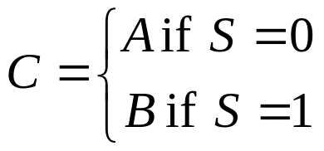
Recall: the multiplexer
combinational circuit to select from multiple inputs
A
B
MUX
0
1
S
C

Slide 53
Recall: the multiplexer
combinational circuit to select from multiple inputs
A
B
MUX
0
1
0
S
C

Slide 54
Recall: the multiplexer
combinational circuit to select from multiple inputs
A
B
MUX
0
1
1
S
C

Slide 55
The circuit design
SI
0
1
SEL
MUX

Slide 56
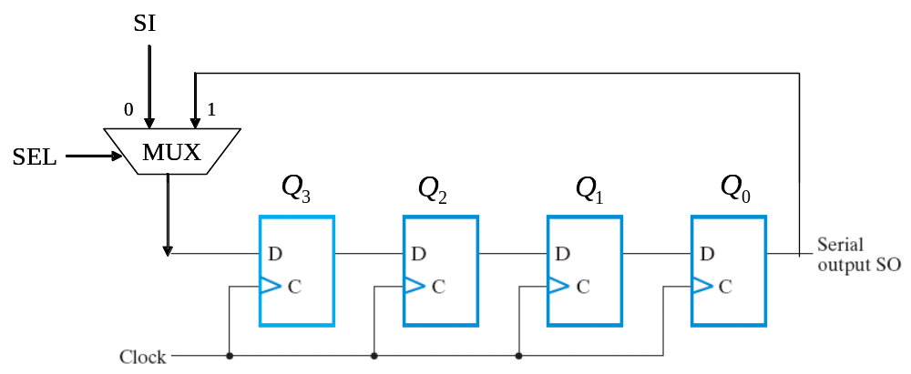
How the circuit works?
1
0
time
clock
Q[3:0]
0110
1011
SI
1
SEL
0

Slide 57
How the circuit works?
1
1
time
clock
Q[3:0]
0110
0011
SI
1
SEL
1

Slide 58
Shift register with parallel load

Slide 59
Various types of registers we will talk about
register with load enable
shift register
rotation register
shift register with parallel load
bi-directional shift register
accumulator

Slide 60
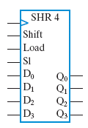
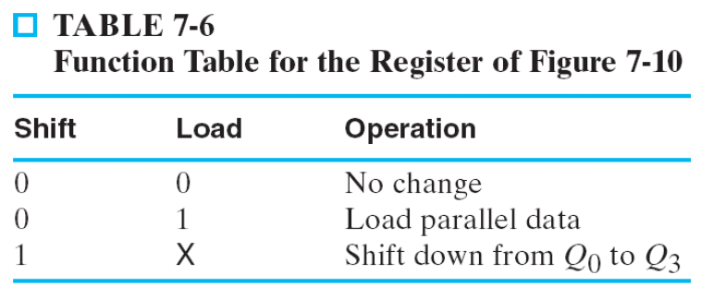
The Problem (design spec)
design a register with the following functions
time
clock
Q[3:0]
D[3:0]
Shift
Load
SI

Slide 61
The Problem (design spec)
design a register with the following functions
time
clock
Q[3:0]
0011
0011
D[3:0]
1101
Shift
0
Load
0
SI
1

Slide 62
The Problem (design spec)
design a register with the following functions
time
clock
Q[3:0]
0011
1101
D[3:0]
1101
Shift
0
Load
1
SI
1

Slide 63
The Problem (design spec)
design a register with the following functions
time
clock
Q[3:0]
0011
0111
D[3:0]
1101
Shift
1
Load
0
SI
1

Slide 64
My Steps
Observation: the rules to set Q_{i}
Re-draw the circuit framework from the rules to set Q_{i}
Logic simplification and finish the final design

Slide 65
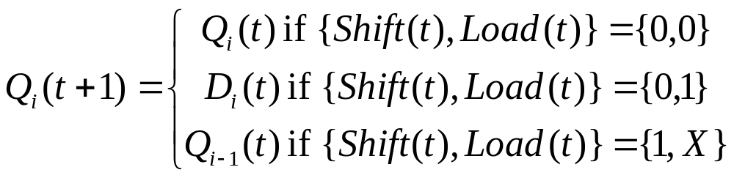
Rules to set bit i
D
D
D
D
clock

Slide 66
Rules to set bit i
D
D
D
D
clock

Slide 67
Rules to set bit i
D
D
D
D
clock

Slide 68
Rules to set bit i
D
D
D
D
clock

Slide 69
My Steps
Observation: the rules to set Q_{i}
Re-draw the circuit framework from the rules to set Q_{i}
Logic simplification and finish the final design

Slide 70
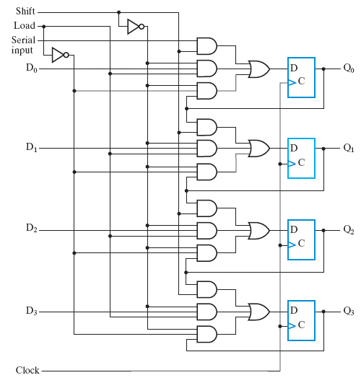
Re-draw the circuit framework
combinational
circuit
combinational
circuit
combinational
circuit
combinational
circuit

Slide 71
My Steps
Observation: the rules to set Q_{i}
Re-draw the circuit framework from the rules to set Q_{i}
Logic simplification and finish the final design

Slide 72
Logic simplification and completes the design

Slide 73
Bi-directional shift register with parallel load

Slide 74
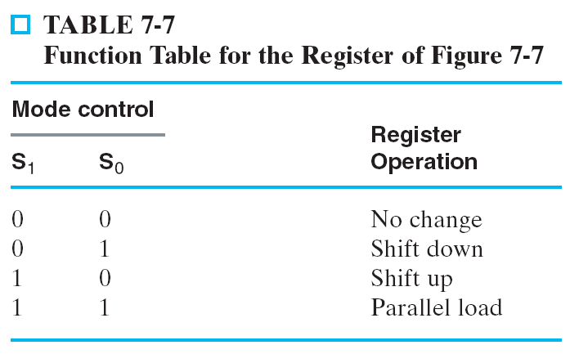
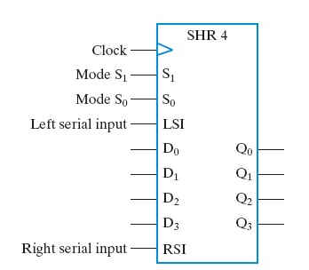
The design spec
time
clock
Q[3:0]
D[3:0]
S[1:0]
LSI
RSI

Slide 75
The design spec
time
0
0
clock
Q[3:0]
0101
0101
D[3:0]
xxxx
S[1:0]
00
LSI
x
RSI
x

Slide 76
The design spec
time
0
1
clock
1
Q[3:0]
0101
1011
D[3:0]
xxxx
S[1:0]
01
LSI
1
RSI
x

Slide 77
The design spec
time
1
0
clock
Q[3:0]
0101
1010
D[3:0]
xxxx
S[1:0]
10
1
x
LSI
RSI
1

Slide 78
The design spec
time
1
1
clock
0
Q[3:0]
0101
1100
0
1100
1
D[3:0]
1
S[1:0]
11
LSI
x
RSI
x

Slide 79
My Steps to derive the design
Observation: the rules to set Q_{i}
Re-draw the circuit framework from the rules to set Q_{i}
Logic simplification and finish the final design

Slide 80
Recall: the multiplexer
combinational circuit to select from multiple inputs
A
B
MUX
0
1
S
C

Slide 81
Recall: the multiplexer
combinational circuit to select from multiple inputs
A
B
MUX
0
1
0
S
C

Slide 82
Recall: the multiplexer
combinational circuit to select from multiple inputs
A
B
MUX
0
1
1
S
C

Slide 83
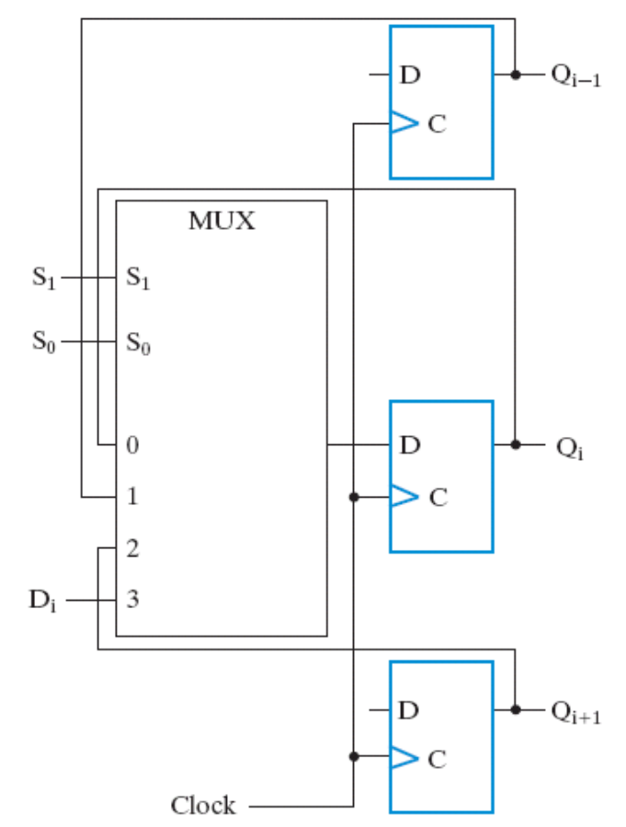
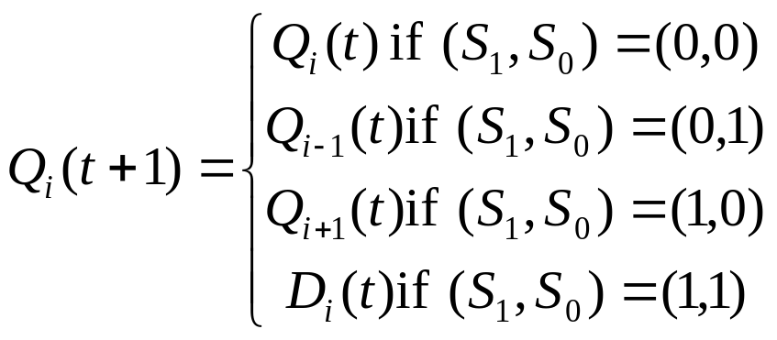
The circuit design

Slide 84
The circuit design
time
00
clock
Q[3:0]
0101
0101
D[3:0]
xxxx
S[1:0]
00
LSI
x
RSI
x

Slide 85
The circuit design
time
01
clock
Q[3:0]
0101
1011
D[3:0]
xxxx
S[1:0]
01
LSI
1
RSI
x

Slide 86
The circuit design
time
10
clock
Q[3:0]
0101
1010
D[3:0]
xxxx
S[1:0]
10
LSI
x
RSI
1

Slide 87
The circuit design
time
11
clock
Q[3:0]
0101
1100
D[3:0]
1100
S[1:0]
00
LSI
x
RSI
x

Slide 88
Preview on the next lecture

Slide 89
Coming Up
Lecture 04: Counters Design
  (Section 7-6, page 377-384)
  Synchronous binary counter (Figure 7-13)
  Binary counter with parallel load (Figure 7-14)
  BCD counter (page 381-382)
A quiz to guide you to design a digital clock
  open book, may discuss with others
  composition of counters

