Slide 1
硬體產業透視與趨勢簡介
資訊工程概論
馬詠程
Tel: 3611
E-mail: ycma@mail.cgu.edu.tw

Slide 2
What I want to tell you
There is no pure hardware industry at all!
The IC industry needs lots of programmers
CS-guys are more suitable for IC industry than EE-guys

Slide 3
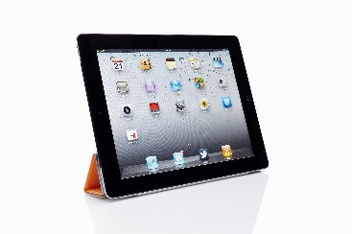


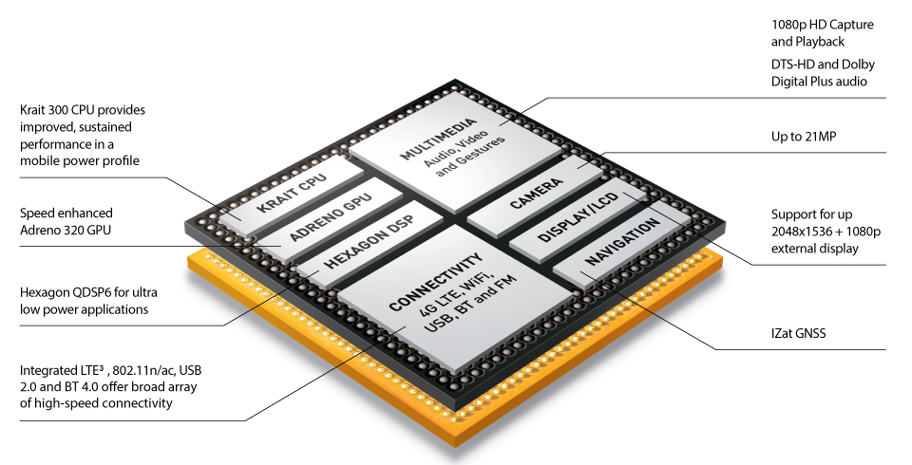

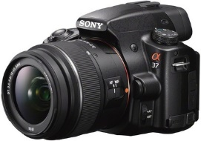
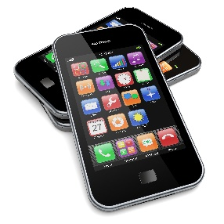
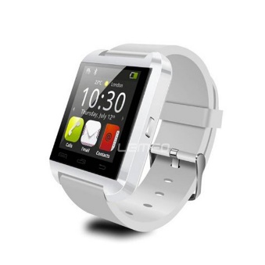

Products Contributed by Computer Science Guys

Slide 4
Players in the IC Industry
Semiconductor Manufacturing
  TSMC (台積電), UMC (聯電)
  Global Foundry, Samsung
IC Design
  Fabless IC Vendor: MediaTek (聯發科), Qualcomm, Marvell, etc.
  IP (Intellectual Property): ARM
  IC Vender: Intel, AMD, Apple, Samsung
IC Design Service: Artisan, Faraday
EDA tools: Synopsys, Cadence, Menter Graphics
System Products
  Apple, Samsung, hTC (宏達電), 廣達, 仁寶, 華碩, 研華, …

Slide 5
IC industry at 21th century
the system-on-chip industry
who involved?
  application programmer (e.g. video codec, voice recognition, etc.)
  system software programmer (compiler, OS)
  EDA (Electronic Design Automation) tool programmer
  processor architect and designer
  system simulation programmer
  circuit layout engineer
  semiconductor process engineer
  printed board layout engineer
  IC test engineer
  … and a lot more …

Slide 6
Inside the desktop computer
the traditional view of hardware industry

Slide 7
Hardware components of a PC
CPU
memory
chipset
graphics
processor
network
interface

Slide 8
Hardware components of a PC
Intel, AMD
CPU
memory
chipset
graphics
processor
network
interface

Slide 9
Hardware components of a PC
CPU
memory
chipset
graphics
processor
矽統, 威盛, Ali
network
interface

Slide 10
Hardware components of a PC
nVidia, ATI
CPU
memory
chipset
graphics
processor
network
interface

Slide 11
Hardware components of a PC
CPU
memory
chipset
graphics
processor
network
interface
broadcom

Slide 12
Hardware components of a PC
旺宏, 華邦
CPU
memory
chipset
graphics
processor
network
interface

Slide 13
Don’t restrict yourself to PCs!

Slide 14
A new world – embedded system

Slide 15
What is embedded system
a computer that works in somewhere you do not see a computer in it
  motor control in a car
  printer
  DVD player
  cell-phone
  PDA
  keyboard
  …a lot more…

Slide 16
Players about a Smart-Phone
Application processors supplier
  Qualcomm, MediaTek, Apple, Samsung, …
System designer
  Apple, Samsung, hTC, …
Software and service provider
  Apple, Google, various App developers, …

Slide 17
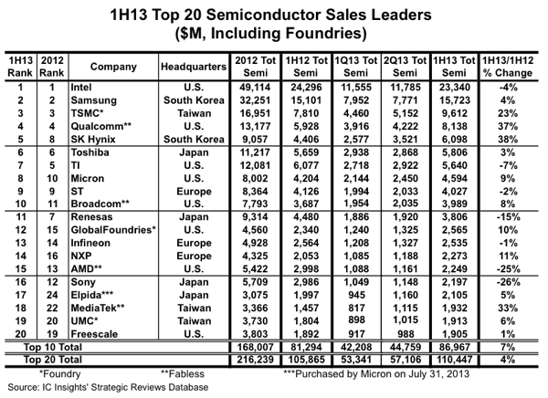
Top Players
http://www.icinsights.com/news/bulletins/IC-Insights-Reveals-Big-Changes-To-1H13-Top-20-Semiconductor-Supplier-Ranking/

Slide 18
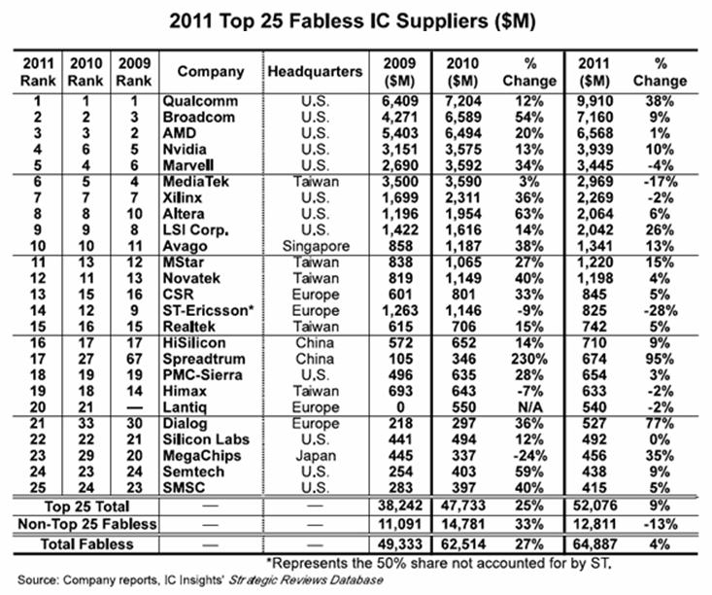
Top Players --- Fabless IC Suppliers
http://www.eetimes.com/document.asp?doc_id=1261538

Slide 19
Inside a Smart-Phone: the System-on-Chip (SoC)
Snapdragon application processor by Qualcomm
http://www.qualcomm.com/snapdragon/processors/600

Slide 20
What Qualcomm provides for a smart-phone
Application processor
Sample experiment board
Software
  Assembler, linker, optimizing compiler, OS kernels, peripheral drivers, …
Check these websites:
  https://developer.qualcomm.com/
  https://developer.qualcomm.com/mobile-development/mobile-technologies/multimedia-optimization-hexagon-dsp-sdk

Slide 21
How to make a (digital) chip
the standard flow

Slide 22
Why digital?
why not analog?
answer this question after you finish the electronics course!
A(t)
S(t)=A(t)+B(t)
B(t)

Slide 23
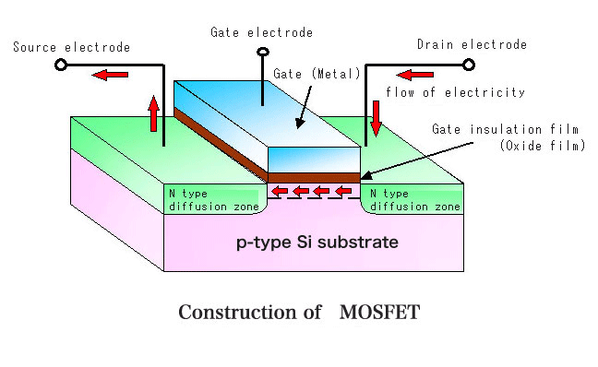
The basic device to build a chip:
MOS transistor
D
G
X
X=0
X=1
S

Slide 24
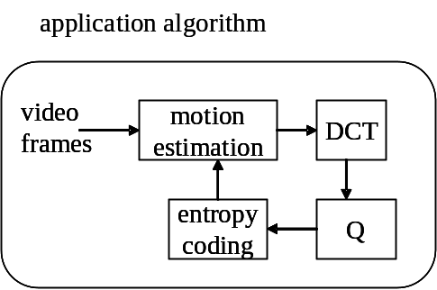
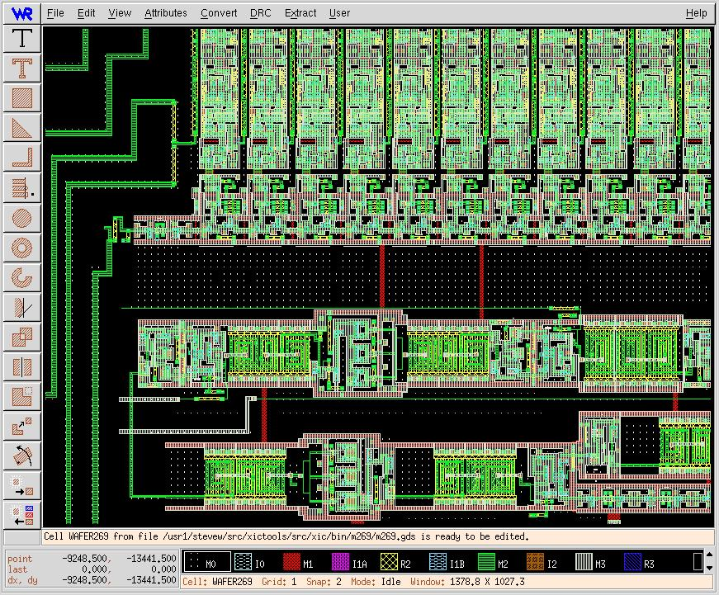
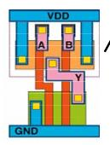
VLSI Design Flow in SoC Era
Starting from software-like algorithms!
ESL design
(Electronic System Level)
RTL design
(Register Transfer Level)
gate-level design
circuit-level design
(transistor-level)
physical layout

Slide 25
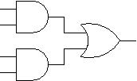
Gate-Level Design
deal with signals in 0 or 1
ESL design
(Electronic System Level)
RTL design
(Register Transfer Level)
gate-level design
circuit-level design
(transistor-level)
physical layout

Slide 26

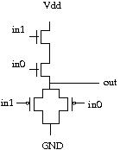
Circuit-Level Design
ESL design
(Electronic System Level)
RTL design
(Register Transfer Level)
gate-level design
circuit-level design
(transistor-level)
physical layout

Slide 27
Physical Layout
ESL design
(Electronic System Level)
RTL design
(Register Transfer Level)
gate-level design
circuit-level design
(transistor-level)
physical layout

Slide 28
RTL Design
RTL: Register Transfer Level
input A [3:0];
input B [3:0];
input clock;
reg S [3:0];
always @(posedge clock)
S <= #1 A+B;
ESL design
(Electronic System Level)
RTL design
(Register Transfer Level)
gate-level design
circuit-level design
(transistor-level)
physical layout

Slide 29
What is RTL design
RTL: Register Transfer Level (Language)
a standard method to design any digital IC
Feature:
  designer specify rules to transfer data from one register to another register
  EDA (electronic design automation) tool synthesis RTL code to real hardware
B
C
Verilog code
+
reg [3:0] A, B, C;
always @(posedge clk) begin
A <= B+C;
end
clk
register
A

Slide 30
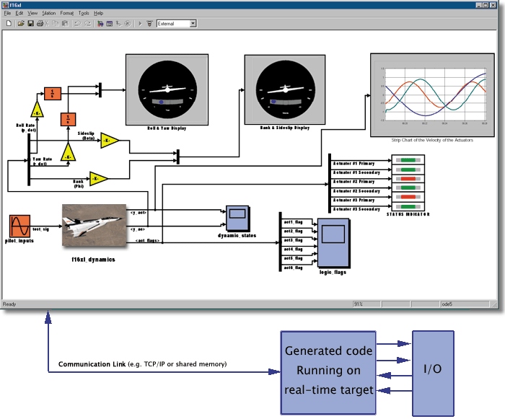
ESL Design
DSP
RISC
IP Library
DCT
FFT
Design Tools
RISC
DSP1
DSP2

Slide 31
How CGU/CSIE helps to establish yourself as IC designer
hardware/software codesign
ESL design
(Electronic System Level)
advanced
computer architecture
computer architecture
RTL design
(Register Transfer Level)
computer organization
gate-level design
digital circuit
circuit-level design
(transistor-level)
electronics
physical layout

Slide 32
The IC industry in Taiwan
ESL design
(Electronic System Level)
RTL design
(Register Transfer Level)
design house: 矽統, 威盛, 聯發科,…
gate-level design
circuit-level design
(transistor-level)
design service: 創鈺, 智源
physical layout
manufacture: 台積電, 聯電

Slide 33
Who involves in this flow?
software guys?
hardware guys?
who writes EDA tools?
ESL design
(Electronic System Level)
RTL design
(Register Transfer Level)
gate-level design
circuit-level design
(transistor-level)
mostly deals with by EDA tools
(Electronics Design Automation tools)
physical layout

Slide 34
What a CS-guy will do in IC design industry

Slide 35
Transform application algorithm to Silicon SoC (System-on-Chip)
in the SoC era, you have to design both hardware and software!
lots of SW works needs solid HW background
  e.g. optimizing compiler design
application algorithm
system-on-chip
video
frames
motion
estimation
DCT
CPU
DSP
entropy
coding
Q
ME
memory

Slide 36
How to make a cell-phone play video?
Step 1: put everything on the CPU as a software program
application algorithm
video
frames
motion
estimation
DCT
system-on-chip
entropy
coding
Q
CPU
memory

Slide 37
How to make a cell-phone play video?
Step 2: put some specific hardware and move some tasks onto these hardware
do hardware specific program optimization
application algorithm
video
frames
motion
estimation
DCT
system-on-chip
CPU
DSP
entropy
coding
Q
ME
memory

Slide 38
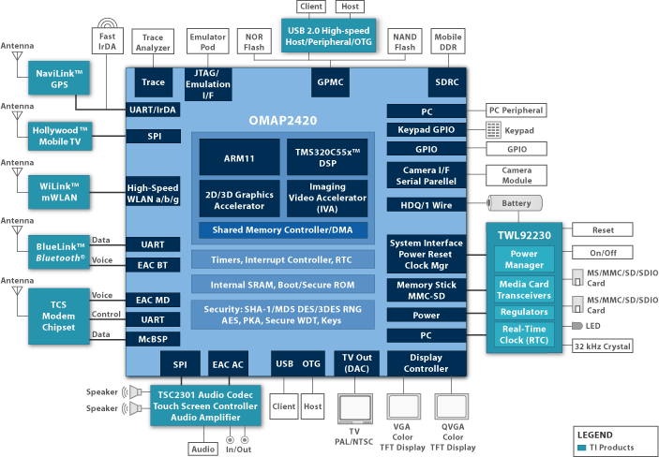
A typical SoC for cell-phone:
TI OMAP processor

Slide 39
In the SoC era, making a chip is not just hardware guys’ business
HW+SW integrated design is a must!

Slide 40
What a computer architect do
vertical integration of a computer system
from semiconductor to application program
software
application program
operating system
optimizing compiler
architecture design
RTL & gate-level design
circuit-level design
physical level design
hardware

Slide 41
Frequently studied problems in computer architecture
Which part should be in hardware and which part should be in software
How the system software optimizes the use of hardware architecture
  optimizing compiler, operating systems
Hardware design techniques to optimize for speed/area/energy
  superscalar/VLIW
  clock-gating
All about how to mapping application algorithms
onto silicon in an efficient way

Slide 42
Why you need to major in computer science
to be with complete knowledge on both hardware and software
to lead EE guys to build a chip!

