Slide 1
Midterm Review
Lecture 0A
Sec Q.A-#.$

Slide 2
What is your score?
You don’t say

Slide 3
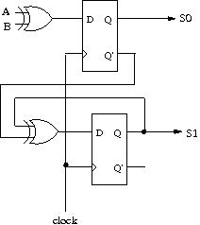
Q1
(10 pts) Draw the state-transition diagram to explain the behavior of the circuit in Figure 1.

Slide 4
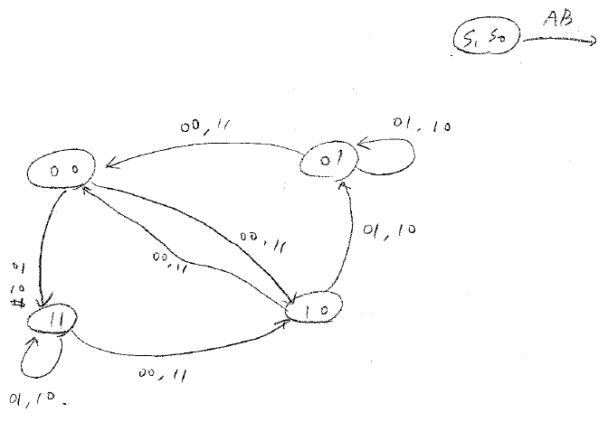
A1
S1 | S0 | A | B | S1 | S0
0 | 0 | 0 | 0 | 1 | 0
0 | 0 | 0 | 1 | 1 | 1
0 | 0 | 1 | 0 | 1 | 1
0 | 0 | 1 | 1 | 1 | 0
0 | 1 | 0 | 0 | 0 | 0
0 | 1 | 0 | 1 | 0 | 1
0 | 1 | 1 | 0 | 0 | 1
0 | 1 | 1 | 1 | 0 | 0
1 | 0 | 0 | 0 | 0 | 0
1 | 0 | 0 | 1 | 0 | 1
1 | 0 | 1 | 0 | 0 | 1
1 | 0 | 1 | 1 | 0 | 0
1 | 1 | 0 | 0 | 1 | 0
1 | 1 | 0 | 1 | 1 | 1
1 | 1 | 1 | 0 | 1 | 1
1 | 1 | 1 | 1 | 1 | 0

Slide 5
G1
Right state-transition diagram
  10 points
Right truth table
  10 points
One mistake
  8 points
More than two mistakes
  3 ~ 5 points
Too many mistakes
  0 points

Slide 6
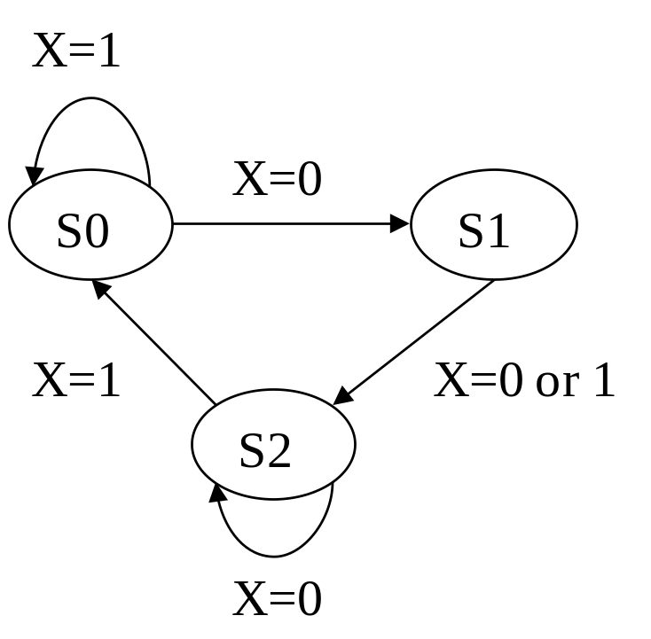
Q2
(15 pts) Design a circuit with the behavior specified in the state-transition diagram shown in Figure 2. The circuit has three states and one input signal X.

Slide 7
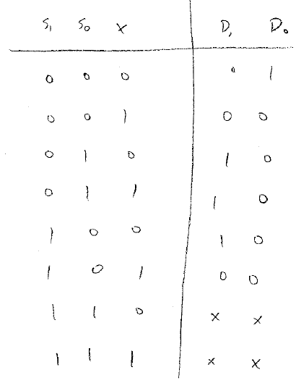


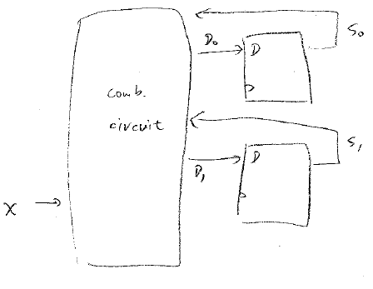
A2

Slide 8
G2
Only True table (10 points)
  One mistake (8 points)
  More than two mistakes (3~5 points)
Circuit (15 points)
  One mistake (13/12 points)
  More than two mistakes (8~10 points)
Too many mistakes (0 points)

Slide 9
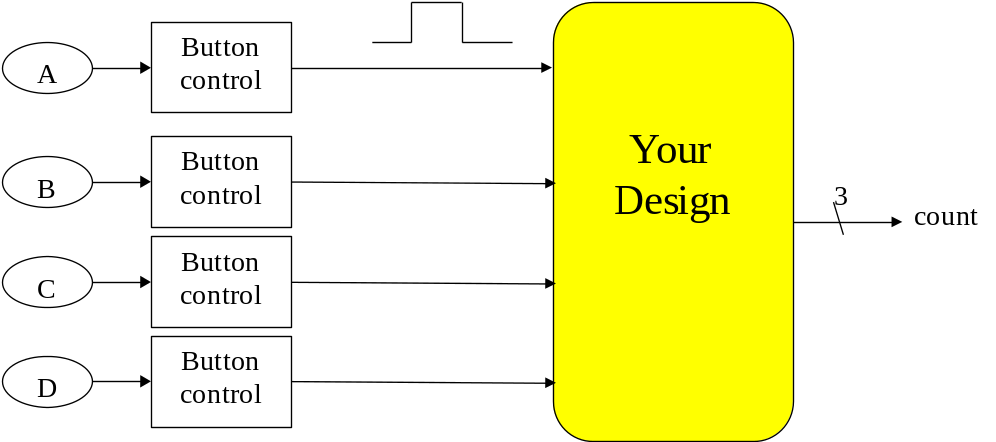
Q3
(20 pts) You are asked to design a circuit for counting votes in a Yes/No polling. The spec is shown in Figure 3. There are at most four people in a poll and each one hits a button in his seat to express “Yes” for the poll. Hitting a button twice or more won’t change the answer and one does not have to hold the button until the polling outcome appears. Each button is routed to a button control unit and a 1-cycle pulse is sent whenever the button is hit once. Your task is to design the circuit that counts amount of buttons hit and send out the result with a 3-bit bus named “count”.

Slide 10
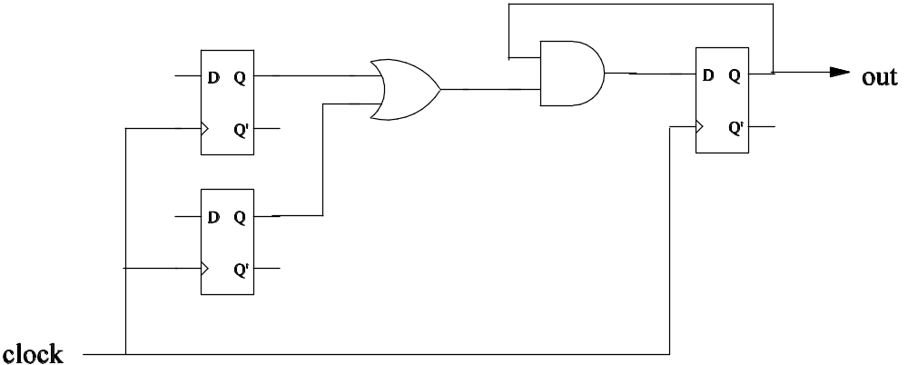
Q4
(15 pts) You are asked to analyze the performance of the circuit in Figure 4. Suppose:(1) the delay of an AND gate is 3 ns. (2) the delay of an OR gate is 4 ns. (3) the setup time and clock-to-output time of a D flip-flop is 2 ns and 1 ns, respectively.
What is the maximum clock frequency that the circuit can work correctly?

Slide 11
A4
Critical path
4ns
3ns
2ns
1ns
1ns
T = 1 + 4 + 3 + 2 = 10 (ns)
f = 100MHz

Slide 12
G4
100MHz / 10ns
  15 points
Around 10⁸ Hz (Scientific notation)
  8 points

Slide 13
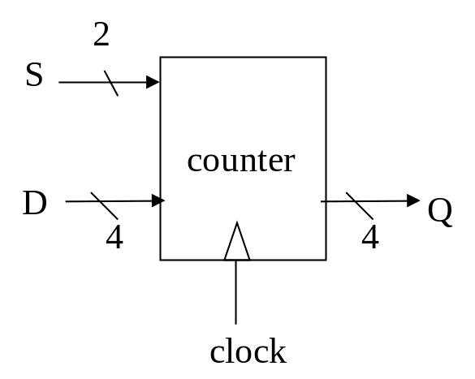
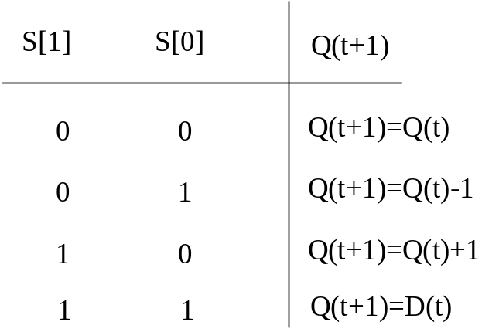
Q5
(15 pts) You are asked to design a 4-bit up/down counter with parallel load. Figure 5 shows the specification. Please design the circuit with basic logical cells such as AND/OR/NOT/XOR/multiplexer/D flip-flops.
(a)Input/output interface (b) Function specification

Slide 14
Q6
(20 pts) Design a 4-digit count-down timer specified as follows. The timer refreshes every one second and counts down from 59:59 to 00:00. The count-down is driven by a clock signal with 1KHz frequency. Please show that how a set of counters can be connected to realize the count-down timer.

Slide 15
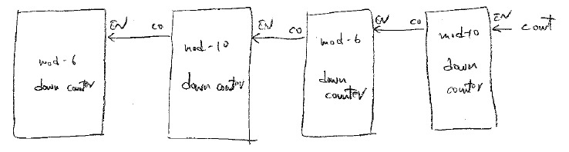
A6.1
Clock counter with state (mod 6 / mod 10 / show your design)

Slide 16
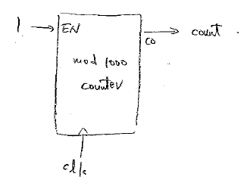
A6.2
Pulser counter with state (mod 1000 / show your design)

Slide 17
G6
Clock counter (10 points)
  without state mod 6 / mod 10 / design (5 points)
Pulser counter (10 points)
  without state mod 1000 / design (5 points)

Slide 18
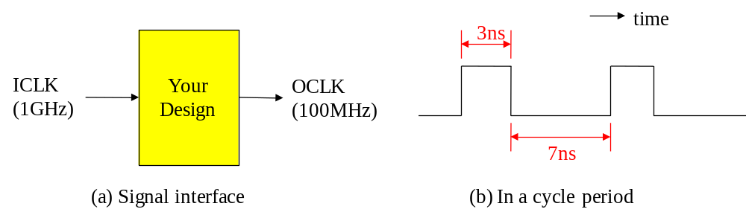
Q7
(20 pts) You are asked to design a frequency divider in responsible of generating a slower clock from a faster clock signal. The specification is shown in Figure 6. The frequency divider receives an input clock ICLK with 1GHz frequency and generates an output clock OCLK in 100MHz. Moreover, the generated clock has 30% duty-cycle: each cycle period has 3 ns in logic 1 and 7ns in logic 0. Please design the circuit of the frequency divider.

