Slide 1
Midterm Review
Covers Chap. 5 & 7

Slide 2
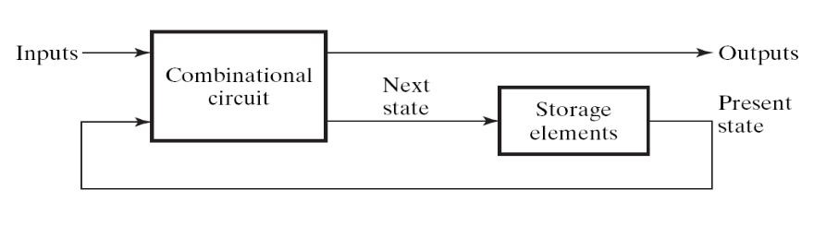
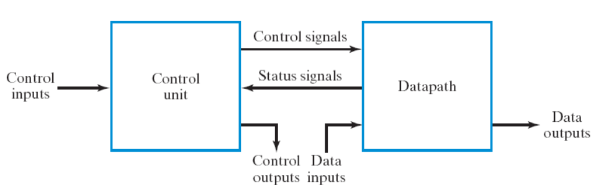
Coverage of your midterm exam
be familiar with the two design techniques:
  sequential circuit design from the general framework (Chap. 5, Sec. 7.1, Sec. 7.6)
  RTL design (Sec. 7.2 – 7.4)
clock

Slide 3
General procedure to design a sequential circuit
Step 1: draw the state diagram and state table
Step 2: assign state values and flip flops
Step 3: draw the spec of the combinational part
  draw the truth table
Step 4: realize the combinational part
  logic simplification if necessary
clock

Slide 4
Steps of RTL Design
Step 1: always starts from the general framework
  control signals: the order sent from control unit
  status signals: reports from data path
Step 2: specify the behavior of each part
  control unit: state-diagram
  data path: micro-operation
Step 3: design circuits from behavior specification
  control unit: state-diagram to circuit (Chapter 5)
  data path: micro-operation to circuit (Sec. 7.3 – 7.6)

Slide 5
General Rules of the Exam
Open Book (but no discussion)
You can use any circuit mentioned in the textbook as a building block (without drawing detailed gate-level circuit)
  unless special restrictions are imposed
Just specify the Boolean equation for a combinational circuit

Slide 6
Problems
for you to prepare the exam

Slide 7
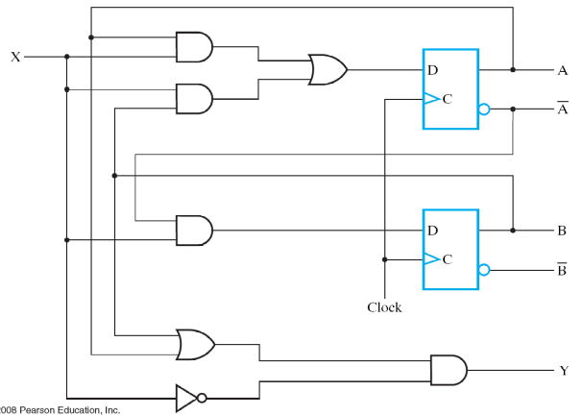


Problem 1: sequential circuit analysis (15%)
Given: a circuit diagram
Draw the timing waveform from the circuit diagram
time
clock
A
0
0
1
0
0
state
B
0
1
1
0
0
input
X
1
1
0
0
0
(circuit will be changed!)

Slide 8
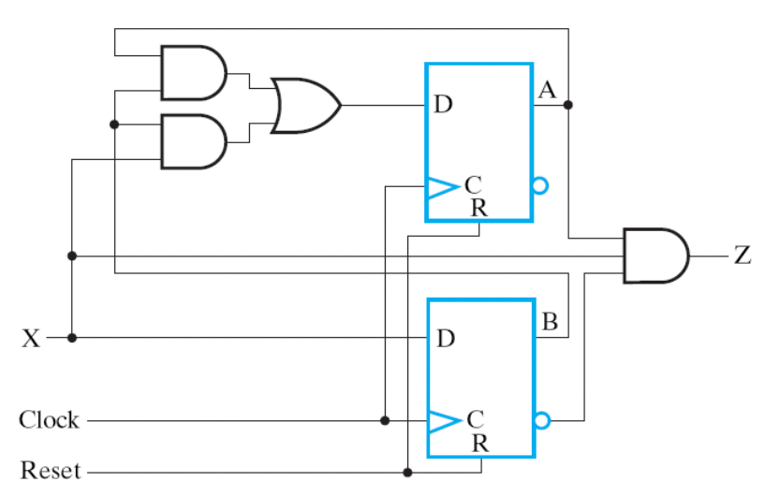
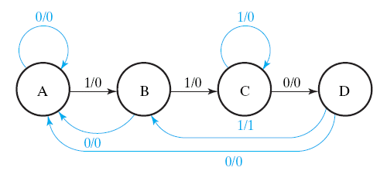
Problem 2: sequential circuit design from state diagram (15%)
Given: a state diagram
Draw the circuit to realize the state diagram
(state diagram will be changed!)

Slide 9
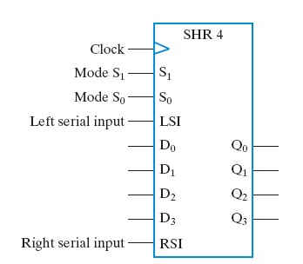
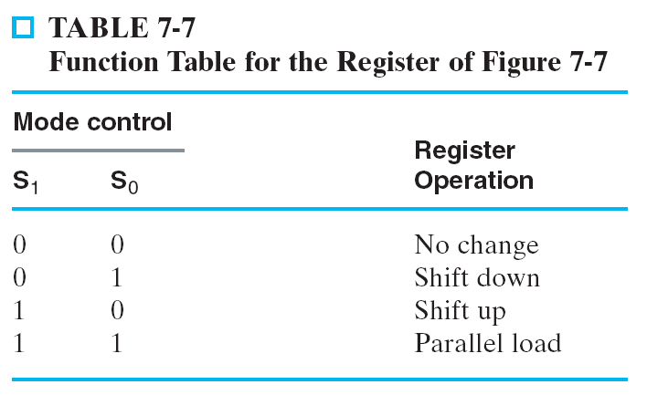
Problem 3: Bi-Directional Shift Register with Parallel Load (15%)

Slide 10
Problem 4: count-down timer (15%)
start counting down when “START” button pressed
  59:59 -> 59:58 -> … ->00:00
  refresh every one second
stop count down and hold the time when “STOP” button pressed
  resume count down from stopped time when “START” pressed again
reset the time to 59:59 when “RESET” pressed
(Hint: use RTL design method)
EN
Start
count-down timer
4
Stop
display
Reset
8
minute
second
1 KHz clock

Slide 11
Problem 5: Data path design to realize a series of computing (20%)
Design the data path to realize the following computation
  C=A+B
  D=E+F
  A=C-D
  D=D+A
  output the content of D
each of A, B, C, D, E, F has a dedicated register
Write-down:
  micro-operations with control signals specified
  circuit of the data path
the computation may
be changed

Slide 12
Problem 6: Min-Max Circuit (20%)
Design a circuit to
  find the minimum and maximum number
  from a series of 4 input numbers
  output max and min in series
Design Constraint:
  only two n-bit registers are allowed to store the value for computation
time
min-max
circuit
start
start
1
0
Q
n
D
1000
1100
0010
0001
XXXX
D
n
XXXX
1100
0001
Q

Slide 13
Problem 7: Minimize Amount of Registers in a Circuit (25%)
Design the data path to realize the following computation
  C=A+B
  D=E+F
  A=C-D
  D=D+A
  output the content of D
use minimum amount of registers to store values A-F
  each of A, B, C, D, E, F not necessary has a dedicated register
Write-down:
  micro-operations with control signals specified
  circuit of the data path
  how you minimize amount of registers
the computation may
be changed

