Slide 1
Solutions to Quiz 01
Review on digital circuit design

Slide 2
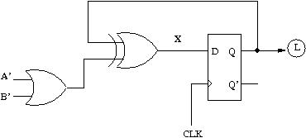
Solution to Problem 1
The lighting control

Slide 3
Solution to Problem 2
time
CLK
S
1
1
0
0
0
A
1
1
1
1
0
B
0
1
0
0
0
Y
0
1
0
1
1
X
X
0
1
0
1

