Slide 1
Quiz 01
Review on digital circuits

Slide 2
Problem 1
Drawing the waveform

Slide 3
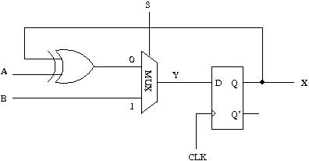
Circuit Diagram

Slide 4
Timing waveform
time
CLK
S
1
1
0
0
0
A
1
1
1
1
0
B
0
1
0
0
0
Y
?
X
?

Slide 5
Problem 2
S[1:0] | OCLK Frequency
00 | 100 MHz
01 | 50 MHz
10 | 25 MHz
11 | 12.5 MHz
2
Your Design
S
OCLK
ICLK
(100 MHz
clock)

