Slide 1
Introduction to SoC Lab Research
Yung-Cheng Ma (馬詠程)
Email: ycma@mail.cgu.edu.tw
Tel: 3611

Slide 2





My Research Expertise: Computer Architecture
Computer architecture is the science and art of selecting and interconnecting
hardware components and designing the hardware/software interface to create a
computer that meets functional, performance, energy consumption, cost, and other specific goals.
by Onur Mutlu from CMU
Computer architecture is the core to push every technology innovation
My Core Skills:
Algorithms, Graph Theory, Combinatorial Optimization, Topology
Digital Systems and VLSI Design
Compilers, Operating Systems, and Systems Software

Slide 3
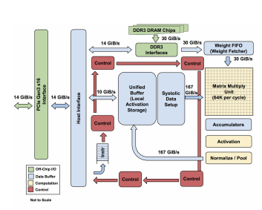
What is Computer Architecture Research
Vertical integration of systems design: from application software down to semiconductor physics
Example: Google’s artificial intelligence cloud
Neural network algorithm for machine learning
Large scale clustered computing
With a dedicated chip: the Tensor Processing Unit (ISCA 2017)

Slide 4
The Challenge: Dark Silicon
Trend of Moore’s law is slowing
Surge of leakage current in deep submicron process
Dynamic (switching) power
Static (leakage) power
The end of Dennard Scaling
No longer constant power density
50%+ of the chip area has to be powered off in 10-nm process

Slide 5
Dark Silicon Approach
Power-Gating + Heterogeneous computing

Slide 6
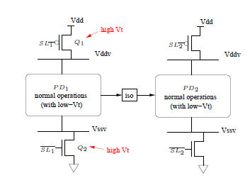
Dark Silicon Approach
Power-Gating + Heterogeneous computing
Power-gating is not free
Careful design on architecture and software supporting required

Slide 7
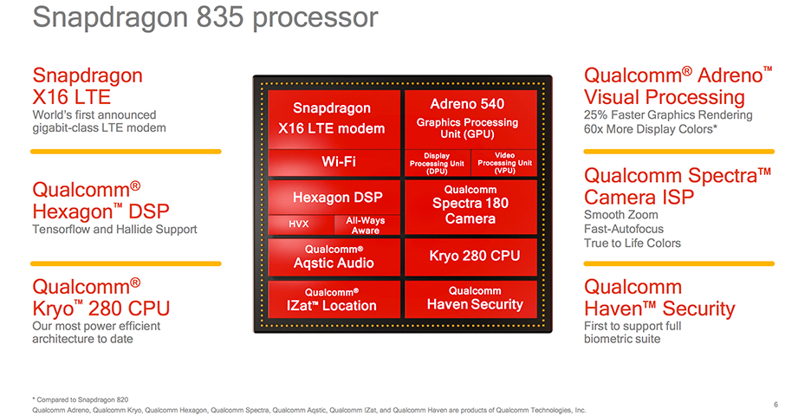
Dark Silicon Approach
Power-Gating + Heterogeneous computing

Slide 8
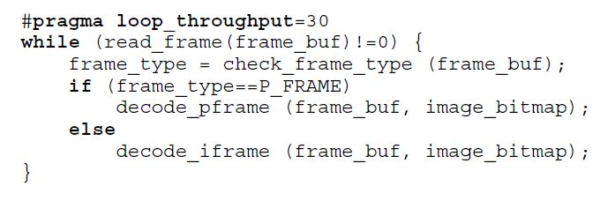
Our Approach for Energy Efficiency
Parallelism scaling on power-gated processor
Program specified with performance requirements
Execute on the power-gated VLIW
Parallelism selection
Instruction scheduling
Register allocation
Insert power-gating instructions
Compiler Analysis

Slide 9
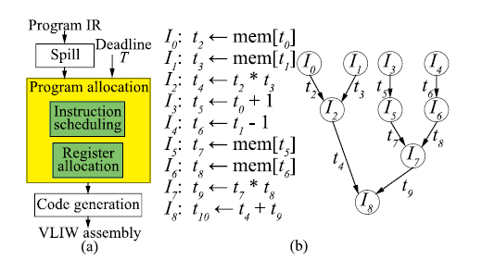
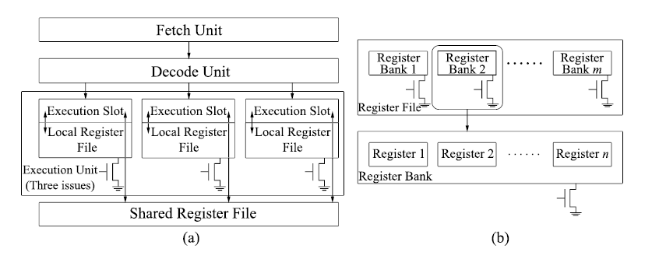
Major Result: PGRF-VLIW Architecture with DCCS Compiler Scheduling
Published on ACM Transactions on Architecture and Code Optimization

Slide 10
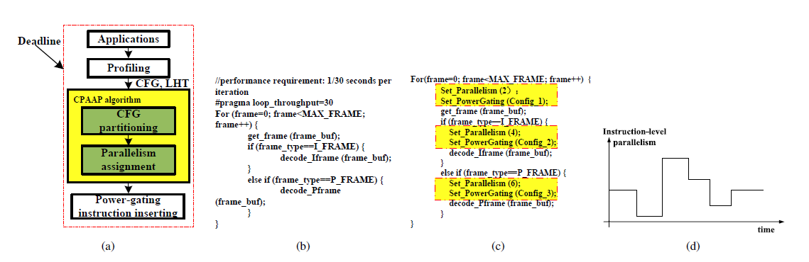
Major Result: Parallelism Scaling
Published on IEEE Transactions on VLSI Systems, April 2017.

Slide 11
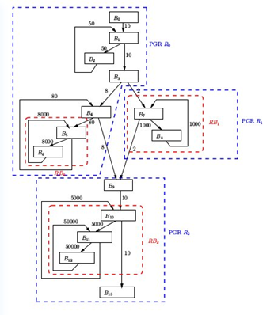
On-Going and Future Works
Parallelism scaling for energy-proportionality (working)
Optimality proof through topology!
Software pipelining
Energy proportionality for computing kernels
Exploit memory-level parallelism
Reconfigurable VLIW core
Easy to deploy custom instructions

Slide 12

Prototyping Environment
Synopsys + Cadence EDA tool-chain
From Verilog to physical layout of a semiconductor chip
TSMC 40nm cell library
With power-gating cells support
RISC-V processor cores
Open source processor cores
LLVM compiler platform
Open source compiler for algorithmic experiments

Slide 13
Other Interesting RISC-V + LLVM Projects
Power-gating on FPU (floating point unit)
Power-gating on instruction window of the superscalar processor
Scheduling for big.LITTLE architecture
Intrinsic support using LLVM
… and more …

Slide 14
Who is eligible for the SoC lab
Open your eyes on the world
Learn by yourself
Q:How I learned topology?
Like puzzle solving
Design algorithms to solve a problem you have never seen before
And prove it!
Find your own research directions
From the support of the lab environment

