Slide 1
Computer Organization
Lecture 00
Instructor: Yung-Cheng Ma (馬詠程)
E-mail: ycma@mail.cgu.edu.tw
Tel: 3611

Slide 2
Where to get my slides?
https://github.com/CGUSystemCourses/ComputerOrg-2015.git

Slide 3
Course Materials
Text Book:
  M. Morris Mano and Charles R. Kime, “Logic and Computer Design Fundamentals,” 4/e, Prentice-Hall, 2008
Reference:
  your textbooks of “digital circuit”, “physics”, “electronics”
  … and a lot …
  read behind syllabus!

Slide 4
Grading
Quiz/Homework/Q&A(40%)
Mid-term Exam: 30%
Final Exam: 30%

Slide 5
What you will expect in this course
You have to work harder than EE students
(比電機系還操!!!)

Slide 6
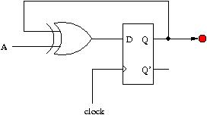
Goals of this course
implement a digital IC down-to gate-level
  using RTL (register-transfer level) design
implement hardware of a computer
  especially CPU
always @(posedge clock) begin
if (A==1’b1)
Q <= ~Q;
else
Q <= Q;
end

Slide 7
Course Outline
Part 0: recall from “digital circuit course”
  Chap. 5: sequential circuit
Part 1: RTL (register transfer level) design
  Chap. 7
Part 2: CPU design
  Chap. 9-11

Slide 8
VLSI design flow
hardware/software codesign
ESL design
(Electronic System Level)
advanced
computer architecture
computer architecture
RTL design
(Register Transfer Level)
computer organization
gate-level design
digital circuit
circuit-level design
(transistor-level)
electronics
physical layout
Preliminary knowledge of this course:
  digital circuit
  electronics (in parallel with this course)

Slide 9
Course Requirements
In-Class Exercises:
  quiz may be given without inform you before the class
  In-class Q&A will be part of your grading
What you will find in the exam: things you never learned in the class/textbooks
  training your problem-solving ability is my focus!
Learn by yourself!
  at least 9 hours per week! (exclude the class/lab hours)

Slide 10
The next lecture
Recall: sequential circuit design
  Chap. 5 of our textbook
  you can also find similar material in your “digital circuit” textbook

Slide 11
What you should do after this class
Buy the textbook
Read the material for the next lecture
Recall what you learned in digital circuit course
Give yourself a goal:
  Electronics products you should be able to design after finishing this course

Slide 12
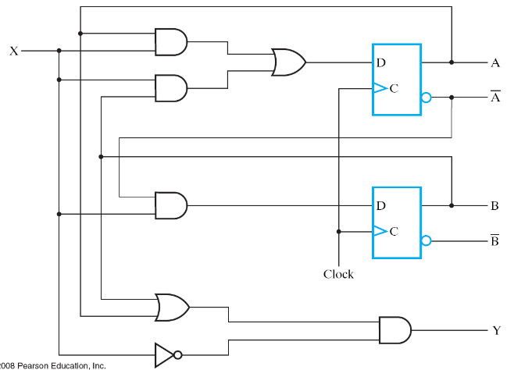
Quiz at the next meeting
9/18 (Friday) 1:10 – 2:00 PM
Coverage: all content of digital circuit course
  draw the waveform from circuit diagram
  circuit design from functional specification
time
clock
A
0
0
1
0
0
state
B
0
1
1
0
0
input
X
1
1
0
0
0

