Slide 1
Usage of FPGA Experiment Board
Lab 01

Slide 2
Today’s Goals
Let you know how to work with our FPGA board
  FPGA: Field Programmable Gate Array
  a special hardware architecture to simulate digital circuit design
Establish your imagination on timing analysis

Slide 3
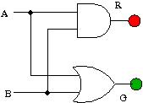
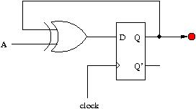
Your Work Today
Draw the two circuits and demo how it works on FPGA
  Connects buttons, LEDs, and clock signal with FPGA pins
In your report:
  Put the timing waveform and explain why this waveform in your final report
  Explain why the sequential circuit seems not reliable

