Slide 1
RTL Design for Control
Lecture 06 (Part A)
integrate everything on Chap. 7
prepare for Section 7-10

Slide 2
Mid-Term Project (Lab)
multi-function stop-watch

Slide 3
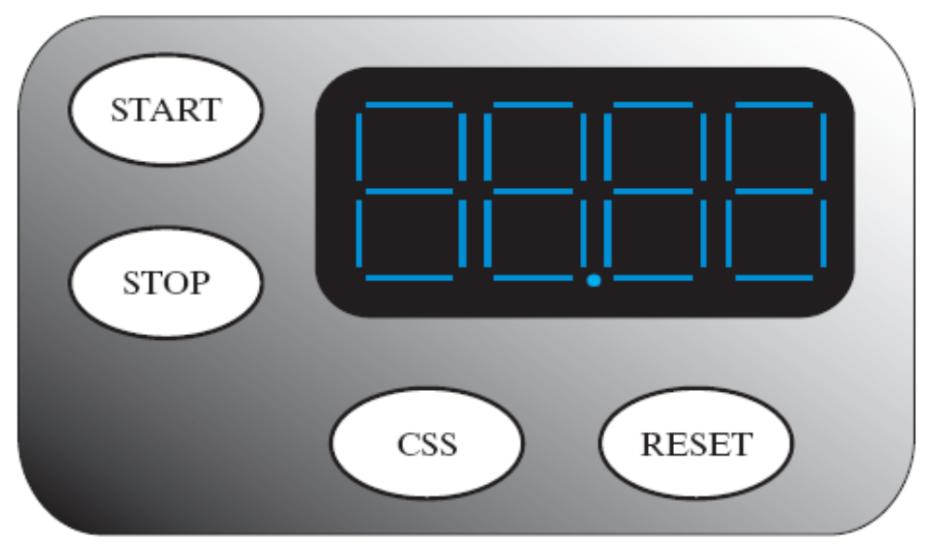
Your Task: Design a stopwatch
start timer counting when “start” button pressed
stop timer counting when “stop” button pressed
reset time to zero when “reset” button pressed
(Figure 7-23, Section 7-10)

Slide 4
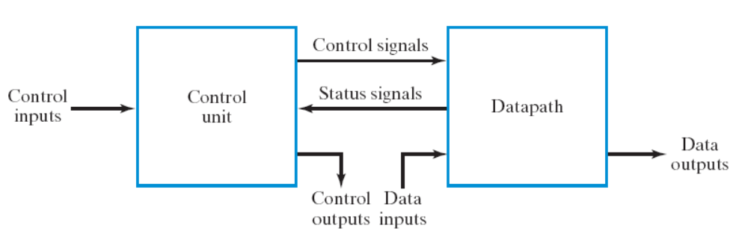
Purpose of the lab
to learn the RTL design methodology (Section 7-2)
new!
the digital clock in Lab 05

Slide 5
Grading Policy
Basic: 60%
  time refresh every 0.01 second (needs modification to digital clock)
  carry: 00.99 -> 01.00, 59.99 -> 00.00
  start, stop, reset button
Option 1: background counting (+10%)
  additional button A to let the displayed time freeze
  but the timer still counting in the background
  turn the display to current time when A pressed again
Option 2: CSS (compare-and-store) (+10%)
  additional button CSS
  compare and store the maximum value in an internal register
  press another button B to recall the maximum value
Option 3: CSS to sort and store the top-4 values (+20%)
Report: 10%

Slide 6
Pre-Lab Report
(1) your paper design (power-point/word/latex/Quartus II) of this lab
  data path
  control unit:
    finite state machine
    the circuit
(2) expected timing waveform for each sub-module of your design
  list typical working cases for each sub-module
  in power point/word/latex
(3) timing waveform for each sub-module of your design
  Quartus II simulation
Remark: modular design required!
  no more than (3/2)² times the screen size when you can see every word clearly
  TAs may refuse debugging support if you do not follow the constraint

Slide 7
What is RTL design?
a quick overview

Slide 8
What is a register
a variable in a chip
an n-bit storage device
  triggered by clock
  D flip-flop is an 1-bit register
may with various control signals (load, shift, counting, etc.)
in
D
Q
out
D
Q
4
4
clk
clock

Slide 9
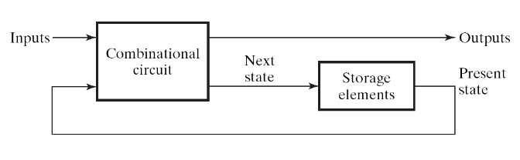
What is RTL design (1)
(What’s the clock for?)
Answer: to make the circuit doing step-by-step computation
  clock signal is fed to all registers of the circuit
  to let a sequential circuit performs its task in step-by-step manner
    one step: a micro-operation (Section 7-3)
  forms a sequence of state change on flip flops
    imagine the flip flops as variables for programming
sequence of state change
time
registers A, B, C, …
clock
A
0010
0111
1001
1111
1100
registers
B
0101
1000
1010
0000
0011
A=B+C
clock
input
X
1
1
0
0
0
Figure 5-1

Slide 10
What is RTL design
RTL: Register Transfer Level (Language)
a standard method to design any digital IC
Feature:
  designer specify rules to transfer data from one register to another register
  EDA (electronic design automation) tool synthesis RTL code to real hardware
B
C
Verilog code
+
reg [3:0] A, B, C;
always @(posedge clk) begin
A <= B+C;
end
clk
register
A

Slide 11
RTL Design Methodology
an overview

Slide 12
Steps of RTL Design
Step 1: always starts from the general framework
  control signals: the order sent from control unit
  status signals: reports from data path
Step 2: specify the behavior of each part
  control unit: state-diagram
  data path: micro-operation
Step 3: design circuits from behavior specification
  control unit: state-diagram to circuit (Chapter 5)
  data path: micro-operation to circuit (Sec. 7.3 – 7.6)

Slide 13
Steps of RTL Design
Step 1: always starts from the general framework
  control signals: the order sent from control unit
  status signals: reports from data path
Step 2: specify the behavior of each part
  control unit: state-diagram
  data path: micro-operation
Step 3: design circuits from behavior specification
  control unit: state-diagram to circuit (Chapter 5)
  data path: micro-operation to circuit (Sec. 7.3 – 7.6)
Hey you, do A=B+C
A=B+C, where A, B, C are registers

Slide 14
Steps of RTL Design
Step 1: always starts from the general framework
  control signals: the order sent from control unit
  status signals: reports from data path
Step 2: specify the behavior of each part
  control unit: state-diagram
  data path: micro-operation
Step 3: design circuits from behavior specification
  control unit: state-diagram to circuit (Chapter 5)
  data path: micro-operation to circuit (Sec. 7.3 – 7.6)
I got overflow from A=B+C, sir

Slide 15
Steps of RTL Design
Step 1: always starts from the general framework
  control signals: the order sent from control unit
  status signals: reports from data path
Step 2: specify the behavior of each part
  control unit: state-diagram
  data path: micro-operation
Step 3: design circuits from behavior specification
  control unit: state-diagram to circuit (Chapter 5)
  data path: micro-operation to circuit (Sec. 7.3 – 7.6)

Slide 16
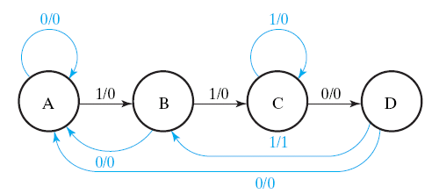
Steps of RTL Design
Step 1: always starts from the general framework
  control signals: the order sent from control unit
  status signals: reports from data path
Step 2: specify the behavior of each part
  control unit: state-diagram
  data path: micro-operation
Step 3: design circuits from behavior specification
  control unit: state-diagram to circuit (Chapter 5)
  data path: micro-operation to circuit (Sec. 7.3 – 7.6)

Slide 17
Steps of RTL Design
Step 1: always starts from the general framework
  control signals: the order sent from control unit
  status signals: reports from data path
Step 2: specify the behavior of each part
  control unit: state-diagram
  data path: micro-operation
Step 3: design circuits from behavior specification
  control unit: state-diagram to circuit (Chapter 5)
  data path: micro-operation to circuit (Sec. 7.3 – 7.6)
K
K: A=B+C
(if (K==1) then A=B+C;)

Slide 18
Steps of RTL Design
Step 1: always starts from the general framework
  control signals: the order sent from control unit
  status signals: reports from data path
Step 2: specify the behavior of each part
  control unit: state-diagram
  data path: micro-operation
Step 3: design circuits from behavior specification
  control unit: state-diagram to circuit (Chapter 5)
  data path: micro-operation to circuit (Sec. 7.3 – 7.6)

Slide 19
Steps of RTL Design
Step 1: always starts from the general framework
  control signals: the order sent from control unit
  status signals: reports from data path
Step 2: specify the behavior of each part
  control unit: state-diagram
  data path: micro-operation
Step 3: design circuits from behavior specification
  control unit: state-diagram to circuit (Chapter 5)
  data path: micro-operation to circuit (Sec. 7.3 – 7.6)
K
K: A=B+C
(if (K==1) then A=B+C;)

Slide 20
RTL Design Example (1)
a simple counter started by a button and holds the final result

Slide 21
The design spec
start counting after START button pressed
holds when 9 reached
START
time
counter
9
9
0
1
2
…
8
9
9
start
0
1
0

Slide 22
Design Steps
Step 1: always starts from the general framework
Step 2: specify the behavior of each part
Step 3: design circuits from behavior specification

Slide 23
Step 2.1
behavior specification for data path

Slide 24
Behavior spec for data path
to do counting
  we need a 4-bit register Q to do Q=Q+1
sometimes counts and sometimes not counting
  we need a control signal K to enable/disable counting
to start counting from zero
  we need a control signal L to load Q as 0
K
L
Q

Slide 25
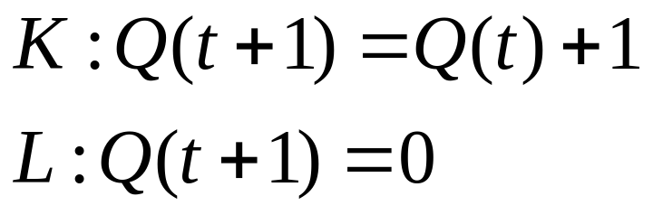
Behavior spec for data path
The micro-operation:
K
L
Q

Slide 26
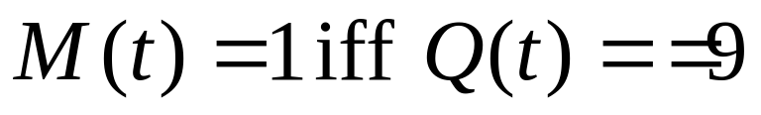
Behavior spec for data path
we need to tell the commander that 9 has reached
  a status signal M to tell that Q==9
K
M
Q

Slide 27
Behavior spec (micro-operation) for data path (FINAL)
K
L
M
Q

Slide 28
Step 2.2
Behavior specification of control unit
(draw the state diagram)

Slide 29
Behavior spec of control unit
So we start from here
K
L
M
Start
Q

Slide 30
Behavior spec of control unit
sometimes we count and sometimes not count
Start
Hold
Count
M
K
L
M
Start
Q

Slide 31
Behavior spec of control unit
(FINAL)
sending out command for counting
K=1
L=1
Start
K=0
L=0
K=1
L=0
Hold
Count
M
K=0
L=0
K
L
M
Start
Q

Slide 32
Step 3
Circuit design from behavior spec

Slide 33
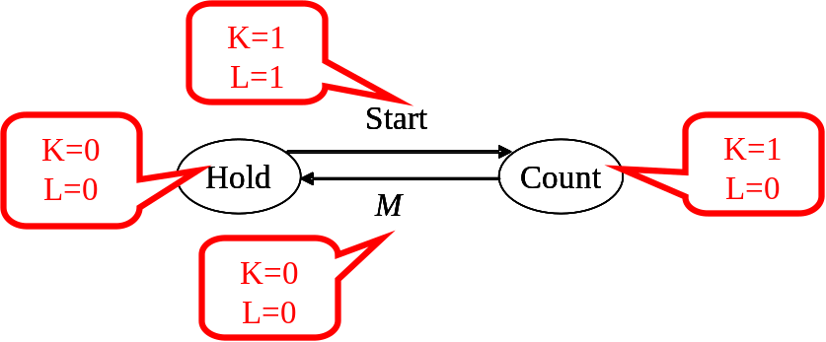
Behavior spec of the circuit
sending out command for counting
K
L
M
Start
Q

Slide 34
Circuit design from behavior spec
control unit: realizing a state diagram
  standard method from Chap. 5
  complete by your self!
K=1
L=1
Start
K=0
L=0
K=1
L=0
Hold
Count
M
S
combinational
circuit
K=0
L=0
D
Start
K
M
L

Slide 35
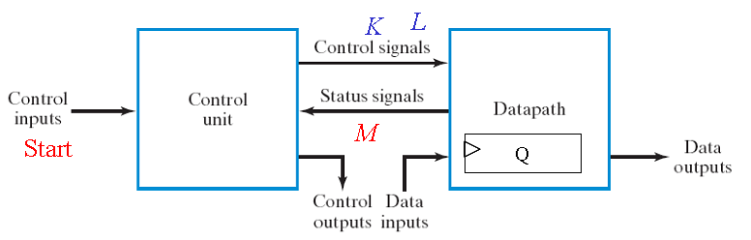
Circuit design from behavior spec
Load
counter
L
Count
K
Q
Q==9
D
0
M
4
4
clock

Slide 36
The complete design
Verify the timing diagram yourself!
Load
counter
combinational
circuit
S
L
D
Count
K
Start
Q
Q==9
D
K
0
M
M
4
4
L
clock

Slide 37
Design Example 2
count-up then count-down

Slide 38
The design spec
start counting up after START button pressed
count-down when 9 reached
holds when 0 reached again
START
time
counter
0
1
2
…
9
8
…
0
start
1
0

Slide 39
Data path design of the up/down counter

Slide 40
Steps of RTL Design
Step 1: always starts from the general framework
  control signals: the order sent from control unit
  status signals: reports from data path
Step 2: specify the behavior of each part
  control unit: state-diagram
  data path: micro-operation
Step 3: design circuits from behavior specification
  control unit: state-diagram to circuit (Chapter 5)
  data path: micro-operation to circuit (Sec. 7.3 – 7.6)

Slide 41
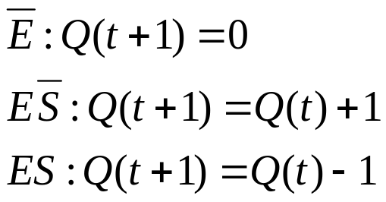
Behavior spec for data path
to count up and down
  we need a 4-bit register Q
  sometimes doing Q(t+1)=Q(t)+1
  sometimes doing Q(t+1)=Q(t)-1
  sometimes holds Q(t+1)=0
two control signals E and S
  E: count enable
  S: select count-up or down
E
S
Q

Slide 42
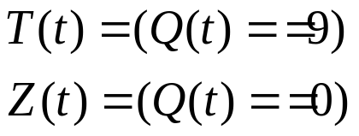
Behavior spec for data path
to tell 9 is reached
  signal T
  T=1 iff Q(t)=9
to tell 0 is reached
  signal Z
  Z=1 iff Q(t)=0
T
Z
Q

Slide 43
Behavior spec for data path (FINAL)
E
S
T
Z
Q

Slide 44
Behavior spec of control unit
the state-diagram

Slide 45
So we begin to design the control unit
E
S
T
Z
Q

Slide 46
Developing the state diagram
sometimes hold, count-up, and down
Start
T
Hold
Up
Down
Z
E
S
T
Z
Start
Q

Slide 47
What we want from the state diagram
Start
T
Hold
Up
Down
Z
time
State
Hold
Up
Down
Hold
counter Q
0
1
2
…
9
8
7
…
1
0
0

Slide 48
Developing the state diagram
state transition
turn to count down when 9 reached
Start
T
Hold
Up
Down
Z
E
S
T
Z
Start
Q

Slide 49
Developing the state diagram
state transition
Start
T
Hold
Up
Down
Z
turn to hod state when 0 reached
E
S
T
Z
Start
Q

Slide 50




Developing the state diagram
the orders to data path
Start
T
Hold
Up
Down
Z
E
S
T
Z
Start
Q

Slide 51
Developing the state diagram
the orders to data path
Start
T
Hold
Up
Down
not counting
Z
E
S
T
Z
Start
Q

Slide 52
Developing the state diagram
the orders to data path
Start
T
Hold
Up
Down
Z
E
S
T
Z
Start
Q

Slide 53
Developing the state diagram
check remaining orders by yourself!
Start
T
Hold
Up
Down
Z
E
S
T
Z
Start
Q

Slide 54
Timing diagram of the behavior specification

Slide 55
The complete behavior spec
Start
T
Hold
Up
Down
Z
E
S
T
Z
Start
Q

Slide 56
Status when counting up
Start
T
Hold
Up
Down
Z
E
S
T
Z
Start
Q

Slide 57
Timing when counting up
time
state
Up
Up
Up
Up
Up
(E,S)
(1,0)
(1,0)
(1,0)
(1,0)
(1,0)
Q
0
1
2
3
4

Slide 58
Status of switching to counting up
Start
T
Hold
Up
Down
Z
E
S
T
Z
Start
Q

Slide 59
Timing of switching to counting up
time
state
Hold
Hold
Up
Up
Up
(E,S)
(0,X)
(1,0)
(1,0)
(1,0)
(1,0)
Q
0
0
1
2
3
Start
0
1
0
0
0

Slide 60
Check timing for each state and transition yourself!
Start
T
Hold
Up
Down
Z
E
S
T
Z
Start
Q

Slide 61
Circuit design of the data path

Slide 62
The complete behavior spec
E
S
T
Z
Start
Q

Slide 63
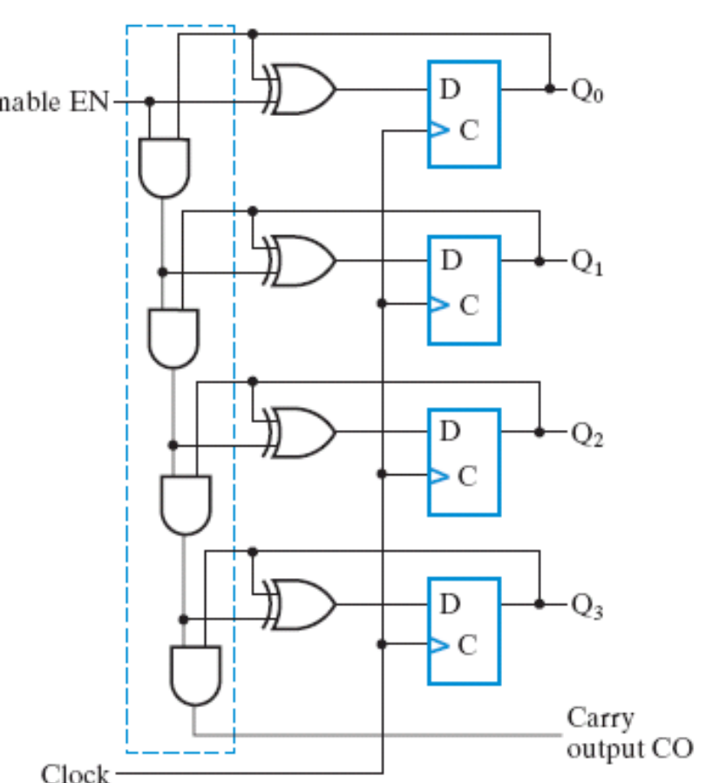


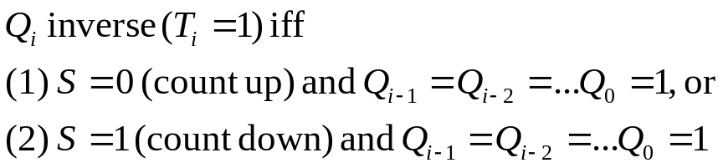




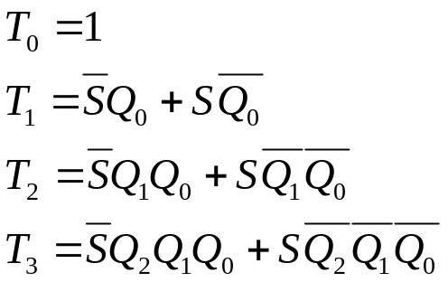


Up-down counter
Control signal:
  S=0: count down
  S=1: count up
Observe when Q_{i} inversed
combinational
circuit
S
(page 379)

Slide 64










Up-down counter with clean
combinational
circuit
(A=Q+1/Q-1)
E
MUX
D
MUX
D
MUX
D
S
MUX
D

Slide 65
Complete data path circuit
up-down
counter
S
E
==9
T
4
Q
==0
Z

Slide 66
Circuit design for control unit
realization of the state diagram

Slide 67
Behavior spec of the control unit
Start
T
Hold
Up
Down
Z
E
S
T
Z
Start
Q

Slide 68




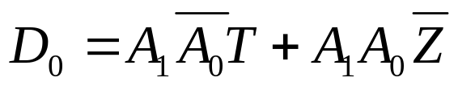
Circuit design
combinational
circuit
start
2
2
A
T
D
Z
00
11
E
Start
T
S
Hold
Up
Down
10
Z
Start
T
Z
E
S
0
0
0
X
X
0
0
0
X
0
0
1
X
X
1
0
1
0
1
0
X
0
X
1
0
1
0
1
0
X
1
X
1
1
1
1
1
1
X
X
0
1
1
1
1
1
1
X
X
1
0
0
0
X
0
1
X
X
X
0
0
0
X

Slide 69
Circuit design
combinational
circuit
start
2
2
A
T
D
Z
00
11
E
Start
T
S
Hold
Up
Down
10
Z
Start
T
Z
E
S
0
0
0
X
X
0
0
0
X
0
0
1
X
X
1
0
1
0
You need an EDA tool to
help you simplify the circuit
1
0
X
0
X
1
0
1
0
1
0
X
1
X
1
1
1
1
1
1
X
X
0
1
1
1
1
1
1
X
X
1
0
0
0
X
0
1
X
X
X
0
0
0
X

Slide 70
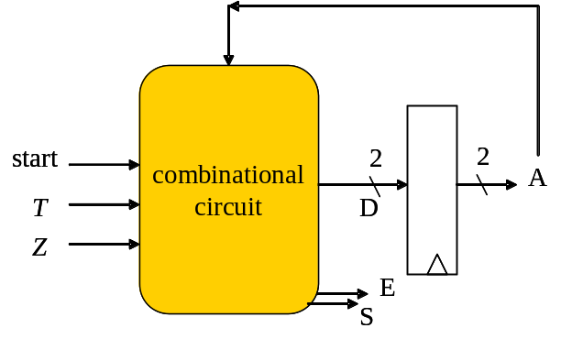
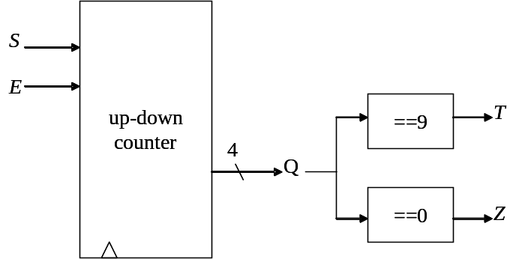
The complete circuit
E
S
T
Z
Start
Q

