Slide 1
Dash Watch
Lecture 06 (Part B)
Example for RTL system design
(Section 7-10)

Slide 2
Recall: RTL design method
what Chap. 7 talks about

Slide 3
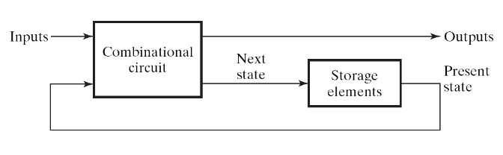
What is RTL design
(What’s the clock for?)
Answer: to make the circuit doing step-by-step computation
  clock signal is fed to all registers of the circuit
  to let a sequential circuit performs its task in step-by-step manner
    one step: a micro-operation (Section 7-3)
  forms a sequence of state change on flip flops
    imagine the flip flops as variables for programming
sequence of state change
time
registers A, B, C, …
clock
A
0010
0111
1001
1111
1100
registers
B
0101
1000
1010
0000
0011
A=B+C
clock
input
X
1
1
0
0
0
Figure 5-1

Slide 4
What is RTL design
RTL: Register Transfer Level (Language)
a standard method to design any digital IC
Feature:
  designer specify rules to transfer data from one register to another register
  EDA (electronic design automation) tool synthesis RTL code to real hardware
B
C
Verilog code
+
reg [3:0] A, B, C;
always @(posedge clk) begin
A <= B+C;
end
clk
register
A

Slide 5
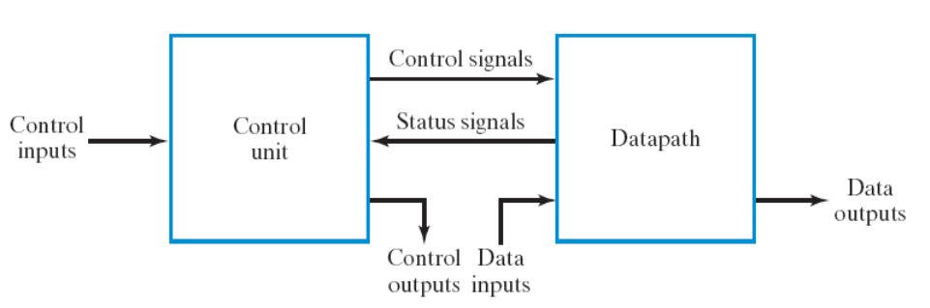
Steps of RTL Design
Step 1: always starts from the general framework
  control signals: the order sent from control unit
  status signals: reports from data path
Step 2: specify the behavior of each part
  control unit: state-diagram
  data path: micro-operation
Step 3: design circuits from behavior specification
  control unit: state-diagram to circuit (Chapter 5)
  data path: micro-operation to circuit (Sec. 7.3 – 7.6)

Slide 6
Steps of RTL Design
Step 1: always starts from the general framework
  control signals: the order sent from control unit
  status signals: reports from data path
Step 2: specify the behavior of each part
  control unit: state-diagram
  data path: micro-operation
Step 3: design circuits from behavior specification
  control unit: state-diagram to circuit (Chapter 5)
  data path: micro-operation to circuit (Sec. 7.3 – 7.6)
Hey you, do A=B+C
A=B+C, where A, B, C are registers

Slide 7
Steps of RTL Design
Step 1: always starts from the general framework
  control signals: the order sent from control unit
  status signals: reports from data path
Step 2: specify the behavior of each part
  control unit: state-diagram
  data path: micro-operation
Step 3: design circuits from behavior specification
  control unit: state-diagram to circuit (Chapter 5)
  data path: micro-operation to circuit (Sec. 7.3 – 7.6)
I got overflow from A=B+C, sir

Slide 8
Steps of RTL Design
Step 1: always starts from the general framework
  control signals: the order sent from control unit
  status signals: reports from data path
Step 2: specify the behavior of each part
  control unit: state-diagram
  data path: micro-operation
Step 3: design circuits from behavior specification
  control unit: state-diagram to circuit (Chapter 5)
  data path: micro-operation to circuit (Sec. 7.3 – 7.6)

Slide 9
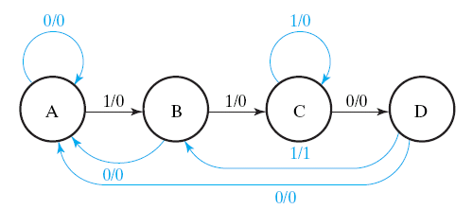
Steps of RTL Design
Step 1: always starts from the general framework
  control signals: the order sent from control unit
  status signals: reports from data path
Step 2: specify the behavior of each part
  control unit: state-diagram
  data path: micro-operation
Step 3: design circuits from behavior specification
  control unit: state-diagram to circuit (Chapter 5)
  data path: micro-operation to circuit (Sec. 7.3 – 7.6)

Slide 10
Steps of RTL Design
Step 1: always starts from the general framework
  control signals: the order sent from control unit
  status signals: reports from data path
Step 2: specify the behavior of each part
  control unit: state-diagram
  data path: micro-operation
Step 3: design circuits from behavior specification
  control unit: state-diagram to circuit (Chapter 5)
  data path: micro-operation to circuit (Sec. 7.3 – 7.6)
K
K: A=B+C
(if (K==1) then A=B+C;)

Slide 11
Steps of RTL Design
Step 1: always starts from the general framework
  control signals: the order sent from control unit
  status signals: reports from data path
Step 2: specify the behavior of each part
  control unit: state-diagram
  data path: micro-operation
Step 3: design circuits from behavior specification
  control unit: state-diagram to circuit (Chapter 5)
  data path: micro-operation to circuit (Sec. 7.3 – 7.6)

Slide 12
Steps of RTL Design
Step 1: always starts from the general framework
  control signals: the order sent from control unit
  status signals: reports from data path
Step 2: specify the behavior of each part
  control unit: state-diagram
  data path: micro-operation
Step 3: design circuits from behavior specification
  control unit: state-diagram to circuit (Chapter 5)
  data path: micro-operation to circuit (Sec. 7.3 – 7.6)
K
K: A=B+C
(if (K==1) then A=B+C;)

Slide 13
Content of Chap. 7
Sec. 7.1 to Sec. 7.6
  basic concepts of RTL design
Sec. 7.8 – end of Chap 7: various design examples and tricks
  Example 1: serial addition (Sec 7.9)
  Example 2: dash watch (Sec 7.10, Example 7-3)
  Example 3: PIG Game (Sec 7.10, Example 7-4)

Slide 14
Now let’s talk about the dash watch
Example 7-3 of the textbook

Slide 15
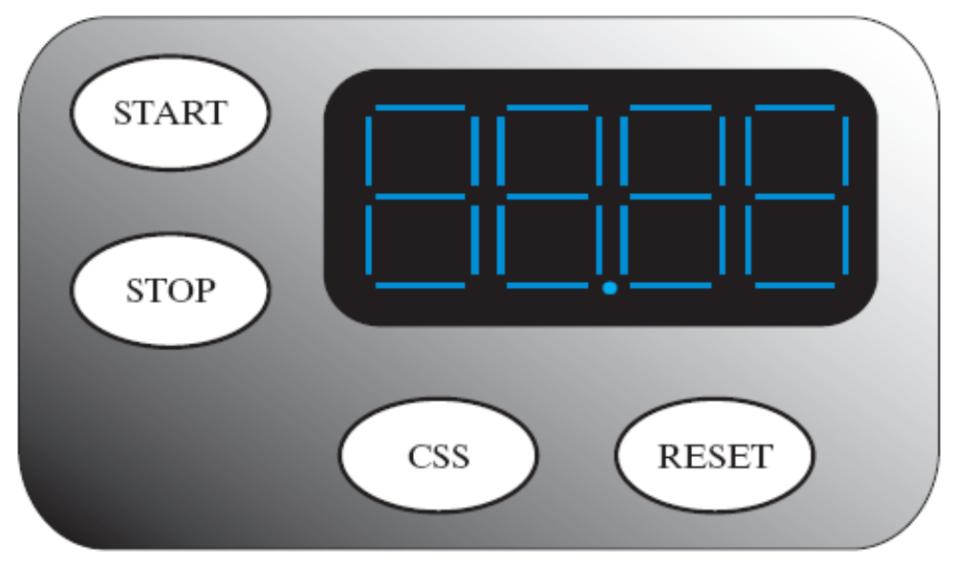
The Spec
start counting when “START” button pressed
  refresh every 0.01 second
  00.00 -> 00.01 -> 00.02 ->…00.99 -> 01.00 ->…
stop counting and holds current time when “STOP” button pressed
reset time to zero when “reset” button pressed
CSS: compare-and-store
  store the fastest value in internal storage
  e.g. 10.02 will replace 11.23
(Figure 7-23, Section 7-10)

Slide 16
Steps of RTL Design
Step 0: write-down the “step-by-step” flow-chart for the task
Step 1: starts from the general framework
Step 2: specify the behavior of each part
  control unit: state-diagram
  data path: micro-operation
Step 3: design circuits from behavior specification
  control unit: state-diagram to circuit (Chapter 5)
  data path: micro-operation to circuit (Sec. 7.3 – 7.6)

Slide 17
Step-by-step flow-chart for the dash watch
corresponding to a state-diagram for hardware implementation

Slide 18
Registers/Counters we have
TM: time-value
  00:00 -> 00:01 -> 00:02 ->…
  the stopwatch of your lab
  4-digit BCD counter
SD: stored data
  the fastest time till now
  SD=(TM<SD)? TM: SD when “CSS” pressed
TM
SD

Slide 19
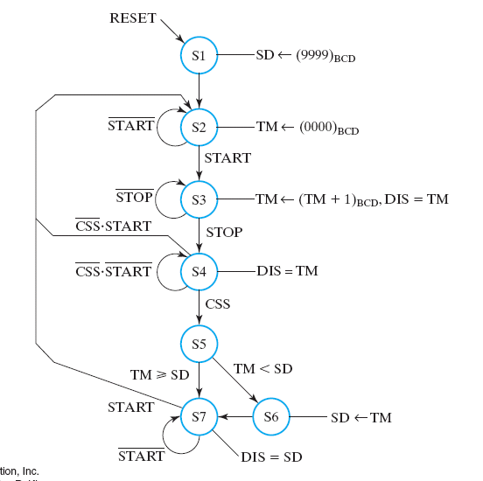
Step-by-step flow-chart
a hardware algorithm represented as state-diagram

Slide 20
Step-by-step flow-chart
a hardware algorithm represented as state-diagram
one step in one cycle

Slide 21
Step-by-step flow-chart
a hardware algorithm represented as state-diagram
one-step micro-operation in one cycle

Slide 22
Step-by-step flow-chart
Let’s trace the hardware algorithm

Slide 23
Step-by-step flow-chart
the initial status
SD: Stored Data
  the internal storage for the fastest value
set SD=99.99 at initial

Slide 24
Step-by-step flow-chart
Wait for start
TM: the Timing
  the register for the current value
set TM=00.00 until “START” pressed

Slide 25
Step-by-step flow-chart
do counting after “START” pressed
time
state
S3
control signals
do TM=TM+1
TM
00.10
00.11
00.12
00.13
do TM=TM+1

Slide 26
Step-by-step flow-chart
various decisions after “STOP” pressed

Slide 27
Step-by-step flow-chart
various decisions after “STOP” pressed
wait until some button pressed

Slide 28
Step-by-step flow-chart
various decisions after “STOP” pressed
restart counting if “START” pressed again

Slide 29
Step-by-step flow-chart
various decisions after “STOP” pressed
TM: current time value
SD: store data (fasted till now)
compare and store
SD = min {TM, SD}

Slide 30
Step-by-step flow-chart
various decisions after “STOP” pressed
TM: current time value
SD: store data (fasted till now)
if (TM<SD) SD=TM

Slide 31
Step-by-step flow-chart
various decisions after “STOP” pressed
TM: current time value
SD: store data (fasted till now)
do nothing and hold SD if (TM >= SD)

Slide 32
Step-by-step flow-chart
wait for the next “START”

Slide 33
Step-by-step flow-chart
re-start if “START” pressed again
wait for the next “START”

Slide 34
How to convert the “hardware algorithm” to real hardware?

Slide 35
Mapping to RTL design framework

Slide 36
Mapping to RTL design framework
micro-operations in data path side
we need registers TM and SD (16-bit for 4-digit time value)
TM
SD

Slide 37
Mapping to RTL design framework
state-diagram realized in the control-unit side
use the standard method in Chap. 5

Slide 38
Mapping to RTL design framework
control signals to inform which micro-operation to perform
TM
SD

Slide 39
Mapping to RTL design framework
status signals to guide the state transition
TM
SD

Slide 40
Mapping to RTL design framework
And, of course, lots of button inputs
TM
SD

Slide 41
Now we are back to this RTL design flow
Step 0: write-down the “step-by-step” flow-chart for the task
Step 1: starts from the general framework
Step 2: specify the behavior of each part
  control unit: state-diagram
  data path: micro-operation
Step 3: design circuits from behavior specification
  control unit: state-diagram to circuit (Chapter 5)
  data path: micro-operation to circuit (Sec. 7.3 – 7.6)

Slide 42
Behavior specification of the data path

Slide 43
Registers in the datapath side
TM (time value): 16-bit counters
  composed of 4 BCD counters
  00:00 -> 00:01 ->… ->99:99
SD: (stored data) fasted time till now
  16-bit register with load enable control
TM
SD

Slide 44
Registers in the datapath side
TM (time value): 16-bit counters
  composed of 4 BCD counters
  00:00 -> 00:01 ->… ->99:99
SD: (stored data) fasted time till now
  16-bit register with load enable control
TM
SD = (TM<SD)? TM: SD;
SD

Slide 45
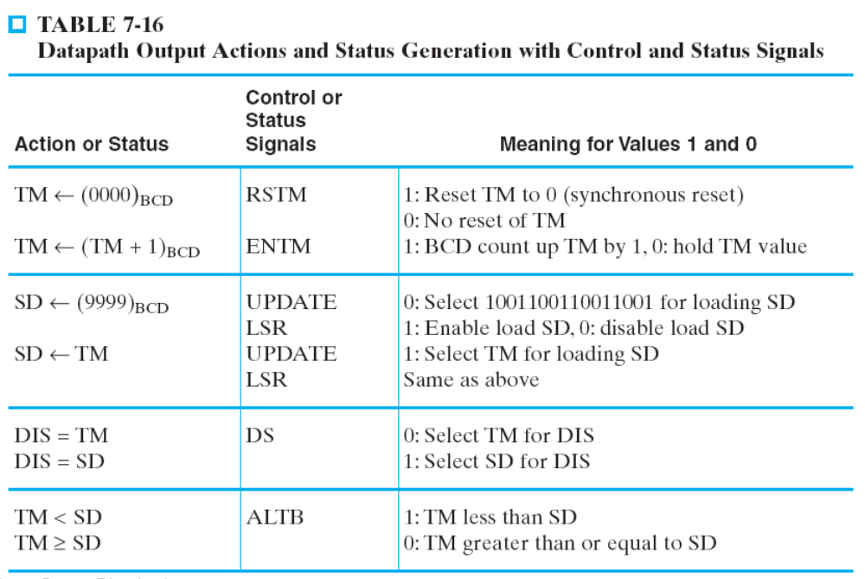
Micro-operations and control signals
RSTM, ENTM, UPDATE, LSR

Slide 46
Micro-operations and control signals
operations on TM

Slide 47
Micro-operations and control signals
operations on register SD

Slide 48

Status signal back to control unit
ALTB: A LessThan B
ALTB

Slide 49
Status signal back to control unit
SD = (TM<SD)? TM: SD;

Slide 50
Micro-operations and control signals
all operations required by the “hardware algorithm” are defined by the micro-operations (check by yourself!)

Slide 51
Behavior specification of the control unit
the state diagram

Slide 52
Steps of RTL Design
Step 0: write-down the “step-by-step” flow-chart for the task
Step 1: starts from the general framework
Step 2: specify the behavior of each part
  control unit: state-diagram
  data path: micro-operation
Step 3: design circuits from behavior specification
  control unit: state-diagram to circuit (Chapter 5)
  data path: micro-operation to circuit (Sec. 7.3 – 7.6)

Slide 53
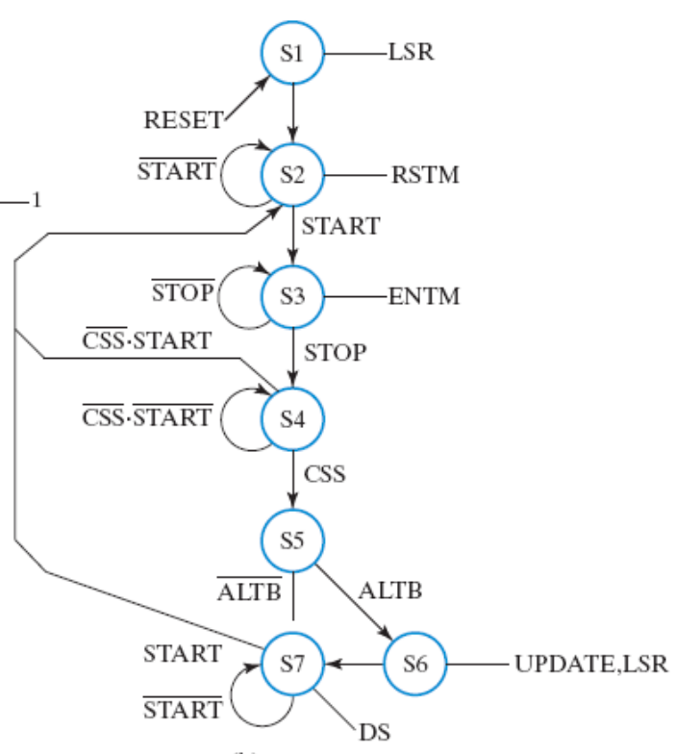
Behavior spec of the control unit
hardware algorithm
state diagram

Slide 54
Behavior spec of the control unit
check for the match on the hardware algorithm!

Slide 55
Behavior spec of the control unit
check for the match on the hardware algorithm!
LSR=1, UPDATE=0

Slide 56
Behavior spec of the control unit
check for the match on the hardware algorithm!
ENTM=1

Slide 57
Behavior spec of the control unit
check for remaining matches by yourself!

Slide 58
Now we finish the behavior spec of the dash watch

Slide 59
Circuit design from behavior spec

Slide 60
Steps of RTL design
Step 0: write-down the “step-by-step” flow-chart for the task
Step 1: starts from the general framework
Step 2: specify the behavior of each part
  control unit: state-diagram
  data path: micro-operation
Step 3: design circuits from behavior specification
  control unit: state-diagram to circuit (Chapter 5)
  data path: micro-operation to circuit (Sec. 7.3 – 7.6)

Slide 61
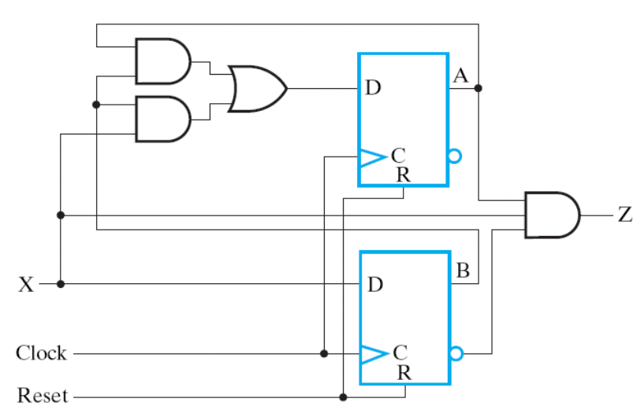
Control unit design
standard method from Chap. 5

Slide 62
Control unit design
standard method from Chap. 5
do it yourself! (notice the timing!)
combinational
circuit
D flip-flops
START, STOP, RESET
LSR, RSTM,
ENTM, UPDATE,…
ALTB

Slide 63
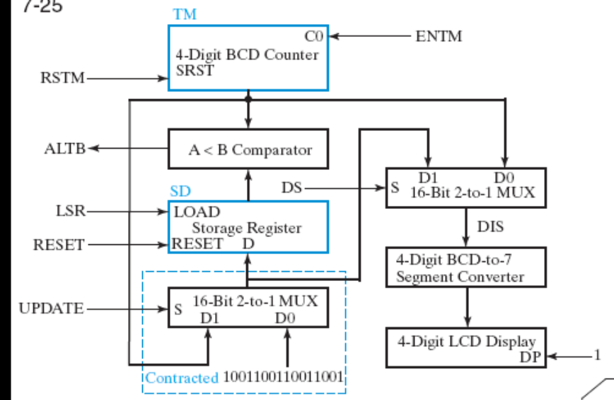
Data path design

Slide 64
Data path design
two core registers
  TM (time value): 4-digit BCD counter
    00:00 -> 00:01 -> 00:02 ->…
  SD (stored data): 16-bit register with load enable

Slide 65
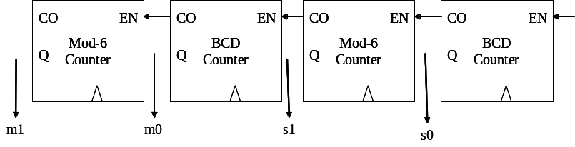
Data path design
two core registers
  TM (time value): 4-digit BCD counter
  SD (stored data): 16-bit register with load enable

Slide 66
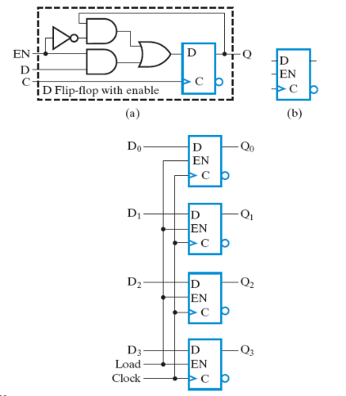
Data path design
two core registers
  TM (time value): 4-digit BCD counter
  SD (stored data): 16-bit register with load enable
(Figure 7-2)

Slide 67
Data path design
How to realize these micro-operations?

Slide 68
Data path design
How to realize these micro-operations?
Very similar to your digital clock design!

Slide 69

Data path design
How to realize these micro-operations?

Slide 70
Data path design
How to realize these micro-operations?
  use multiplexer (MUX) to select between multiple inputs

Slide 71
Data path design
How to realize these micro-operations?
  use multiplexer (MUX) to select between multiple inputs

Slide 72
Data path design
How to realize these micro-operations?
  use multiplexer (MUX) to select between multiple inputs

Slide 73
Data path design
realize by a combinational circuit to compare
  notice the timing!

Slide 74
Data path design
And the part to control 7-seg display
  skipped due to our FPGA board has different configuration

Slide 75
Put it all together

Slide 76
The Spec
start counting when “START” button pressed
  refresh every 0.01 second
  00.00 -> 00.01 -> 00.02 ->…00.99 -> 01.00 ->…
stop counting and holds current time when “STOP” button pressed
reset time to zero when “reset” button pressed
CSS: compare-and-store
  store the fastest value in internal storage
  e.g. 10.02 will replace 11.23
(Figure 7-23, Section 7-10)

Slide 77
(1) Step-by-step flow-chart
a hardware algorithm represented as state-diagram

Slide 78
(2) Behavior specification

Slide 79
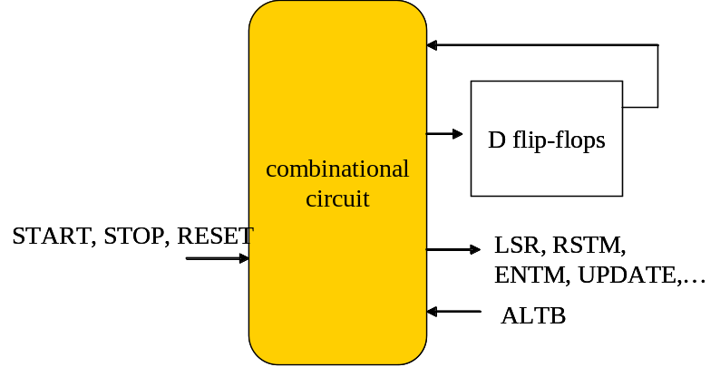
(3) Circuit design

Slide 80
Hard to imagine this circuit works, right?

Slide 81
Do these exercises with your midterm project
Draw a “software flow-chart” for the hardware algorithm (as you learned in 計概)
Draw the timing diagram of your control unit (alone)
Draw the timing diagram of your data path (alone)
Put these two timing diagram together
  and back-trace how the “hardware algorithm” works
Put these diagrams into your midterm project report!

