Slide 1
Arithmetic Logic Unit (ALU) Design
Lecture 08 (Part B)
Section 9-3

Slide 2
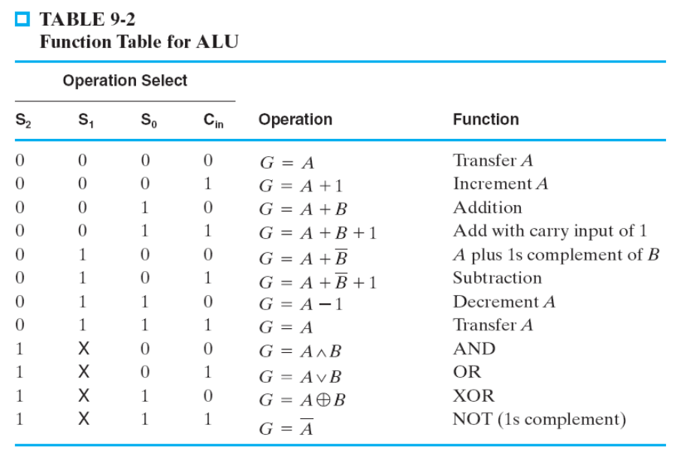
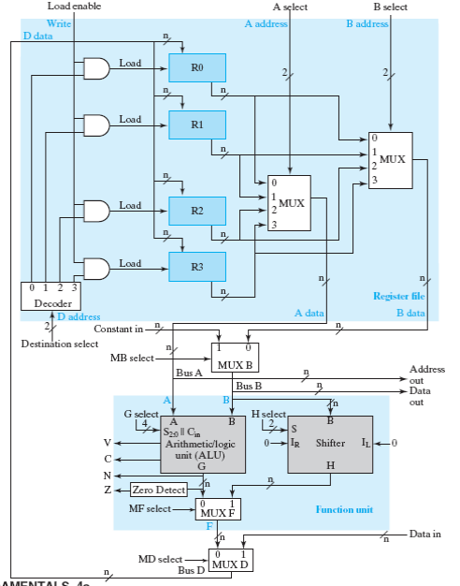
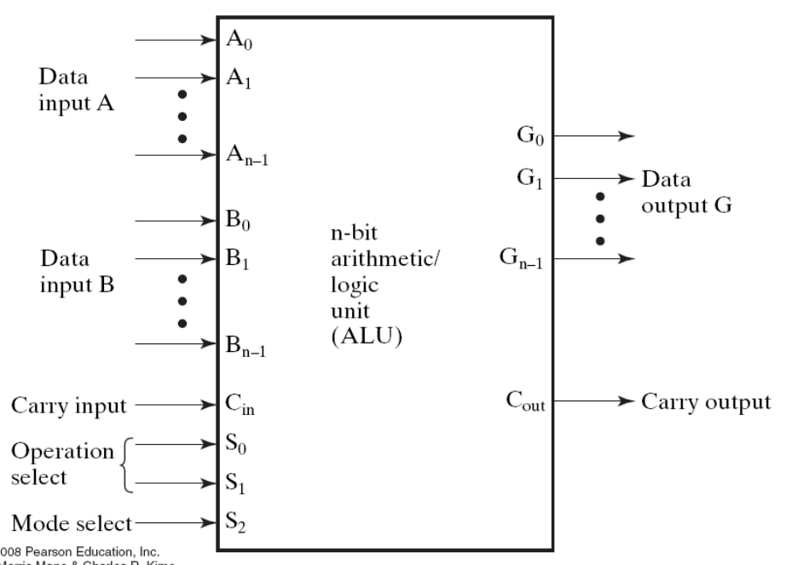
Today’s Goal
to design the ALU of a CPU
Figure 9-1: CPU data path

Slide 3
What’s the ALU for?
ALU: Arithmetic Logic Unit
Design philosophy from RTL design:
  CPU data path is a generic hardware for any mathematics operations
C/C++ operators:
  +, -, *, /,%,
  AND (&), OR (|), NOT (~), XOR (^)

Slide 4
Goal: Design the ALU of a CPU

Slide 5
Spec of the ALU

Slide 6
Spec of the ALU
two n-bit data inputs A and B

Slide 7
Spec of the ALU
one n-bit data output G

Slide 8
Spec of the ALU
4-bit control signal to select the function

Slide 9
Spec of the ALU
1-bit carry-out from the (internal) adder

Slide 10
Spec of the ALU
Operation Example
G=A+B
0
1
0
0

Slide 11
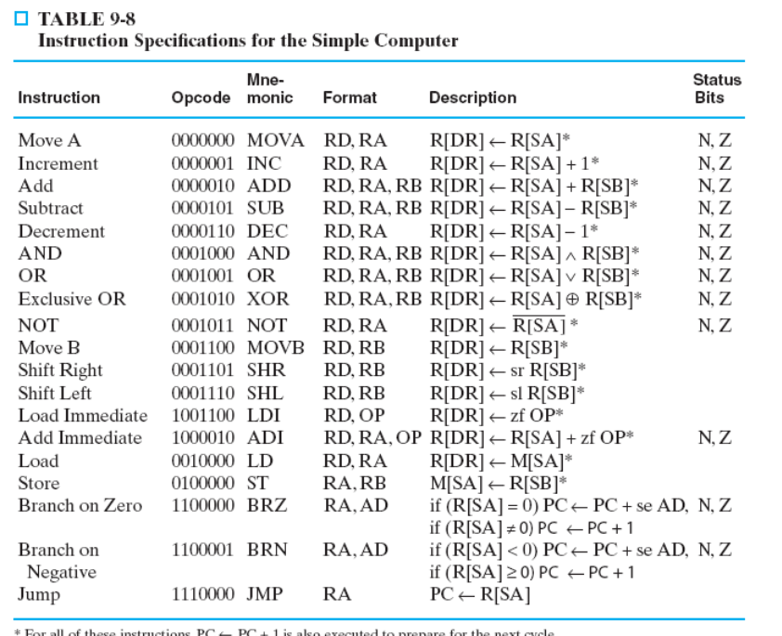
Why these operations?
to realize these assembly instructions

Slide 12
The design strategy and analysis

Slide 13
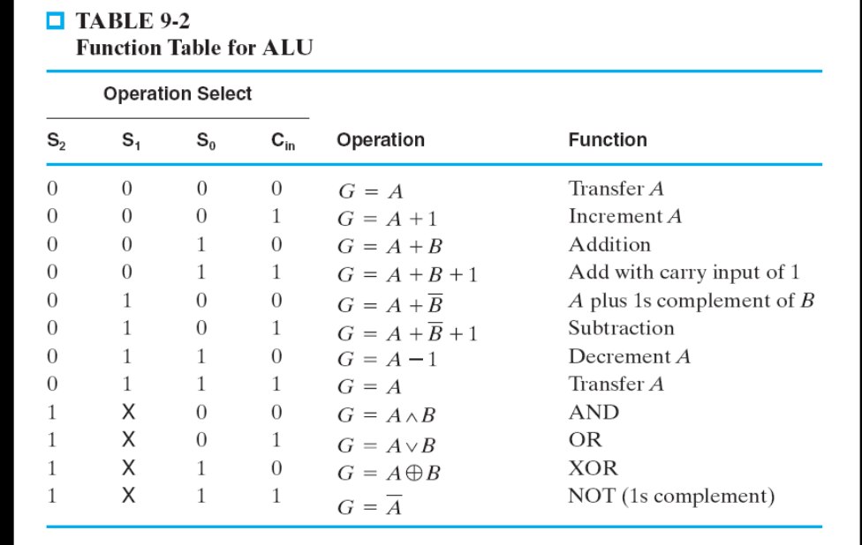
Implementation Strategy
the core is an adder
(Lecture 08A)
can be realized by an adder
arithmetic
unit
MUX
logic
unit

Slide 14
Implementation Strategy
arithmetic
unit
MUX
logic
unit
operations not realized by an adder
new!

Slide 15
Recall: arithmetic unit design
(Lecture 08A, Sec. 9-3)

Slide 16
Implementation Strategy
the core is an adder
(Lecture 08A)
can be realized by an adder
arithmetic
unit
MUX
logic
unit

Slide 17
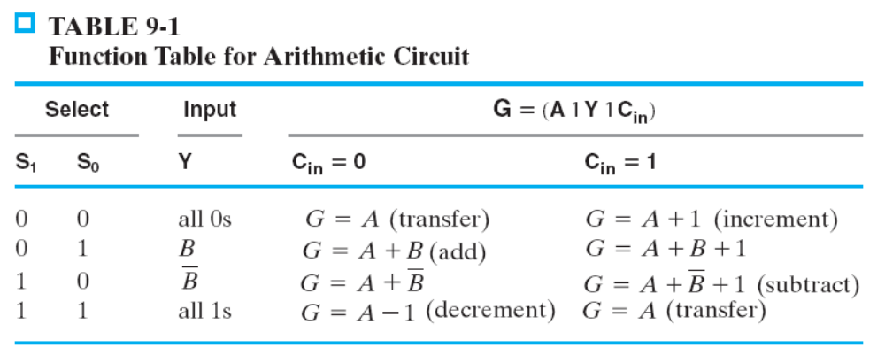
Recall The Goal: a generic arithmetic unit
Design a hardware with the following functions
B
A
n
n
arithmetic unit
S
Cin
2
n
G

Slide 18
Recall The Goal: a generic arithmetic unit
Design a hardware with the following functions
B
A
n
n
arithmetic unit
0
01
S
Cin
2
n
G
G=A+B

Slide 19
Recall The Goal: a generic arithmetic unit
Design a hardware with the following functions
B
A
n
n
arithmetic unit
1
10
S
Cin
2
n
G
G=A-B

Slide 20
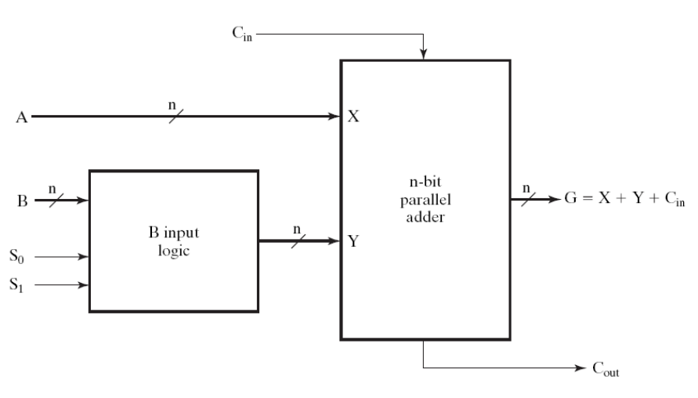
Overview of the circuit diagram
Figure 9-3

Slide 21
Overview of the circuit diagram
All are doing G=A+something
the adder we talked about before
Figure 9-3
A
G=A+something

Slide 22
Overview of the circuit diagram
All are doing G=A+something
Figure 9-3
“Something” controlled by the circuit

Slide 23
Control an input to the adder
Figure 9-3
B
0
(111…11)₂
~B
MUX
S
Y

Slide 24
Control an input to the adder
Figure 9-3
B
0
(111…11)₂
~B
MUX
S
Y
Y=B

Slide 25
Control an input to the adder
Figure 9-3
B
0
(111…11)₂
~B
MUX
S
Y
Y=~B

Slide 26
Realizing A+B
Figure 9-3
B
0
0
(111…11)₂
~B
G=A+B+0
MUX
01
S
01
Y=B
Y
Y=B

Slide 27
Realizing A-B
Figure 9-3
B
0
1
(111…11)₂
~B
G=A+(~B)+1
MUX
10
S
10
Y=~B
Y
Y=~B

Slide 28
The logic unit

Slide 29
Implementation Strategy
arithmetic
unit
MUX
logic
unit
operations not realized by an adder
new!

Slide 30
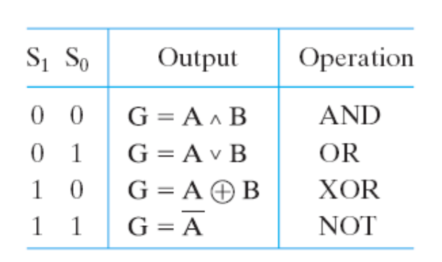
Spec of the logic unit
{S1,S0}
2
logic
unit
A
n
G
n
B
n

Slide 31
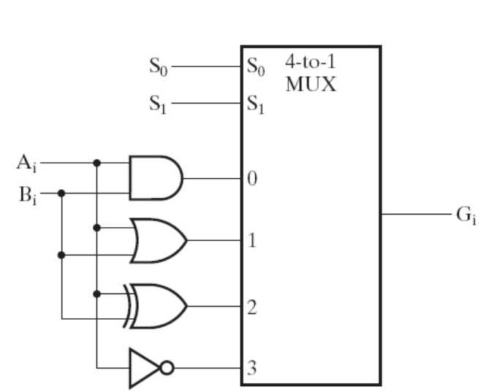












Design of the logic unit
{S1,S0}
2
…
logic
unit
A
n
G
n
…
B
n

Slide 32
Integrating the ALU

Slide 33
Recall Spec of the ALU

Slide 34
The complete design of ALU
Any one finds the bug in Table 9-2?
{S1,S0}
Cin
2
n
arithmetic
unit
S2
A
n
MUX
B
n
logic
unit
A
n
B
2
{S1,S0}

Slide 35
The complete design of ALU
{S1,S0}
Cin
2
n
arithmetic
unit
S2
A
n
MUX
B
n
logic
unit
A
0 0 X
0 1 X
0 X
1 1 X
n
B
2
{S1,S0}

Slide 36
The complete design of ALU
{S1,S0}
Cin
2
0
n
arithmetic
unit
S2
A
n
MUX
B
n
logic
unit
A
0 0 X
0 1 X
0 X
1 1 X
n
B
2
{S1,S0}

Slide 37
The complete design of ALU
01
0
{S1,S0}
Cin
2
0
n
arithmetic
unit
S2
A
A+B
n
MUX
B
n
logic
unit
A
0 0 X
0 1 X
0 X
1 1 X
n
B
2
{S1,S0}

Slide 38
The complete design of ALU
{S1,S0}
Cin
2
1
n
arithmetic
unit
S2
A
n
MUX
B
n
logic
unit
A
0 0 X
0 1 X
0 X
1 1 X
n
B
2
{S1,S0}

Slide 39
The complete design of ALU
{S1,S0}
Cin
2
1
n
arithmetic
unit
S2
A
n
MUX
B
n
logic
unit
A
0 0 X
0 1 X
0 X
1 1 X
n
A & B
B
2
{S1,S0}
00

Slide 40
In-Class Exercise

Slide 41
Problem
to compute Q: maximum even number not exceeding (A-B)+C
  using the ALU we taught today
n
Hardware to be
designed
A
n
B
n
Q
C
n
START

Slide 42
Problem
to compute Q: maximum even number not exceeding (A-B)+C
  using the ALU we taught today
Example 1: A=7, B=3, C=5
  (A-B)+C=9
  output Q=8
Example 2: A=7, B=3, C=4
  (A-B)+C=8
  output Q=8

Slide 43
Problem
to compute Q: maximum even number not exceeding (A-B)+C
  using the ALU we taught today
control
unit
???
No status signal
sent to control unit
S[2:0]
ALU
Cin
register Q
load

Slide 44
Requirements to your answers
data path with control signals specified
state diagram of the control unit, specifying
  operation of each state
  value of control signals for each state
the timing waveform to for A=7, B=3, C=5
  with states, content of register Q, and all control signals

